Slide 1

GIS Policy Board LiDAR Update
Tara Lanzrath, CFM
5-17-2018

Slide 2
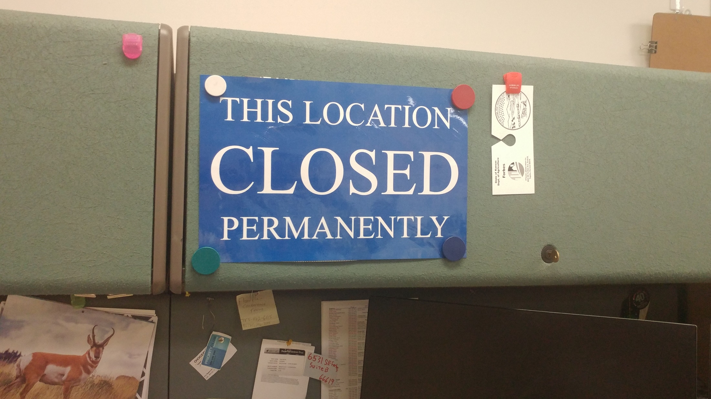
Tom Morey’s Former Cubicle
5-1-2018

Slide 3
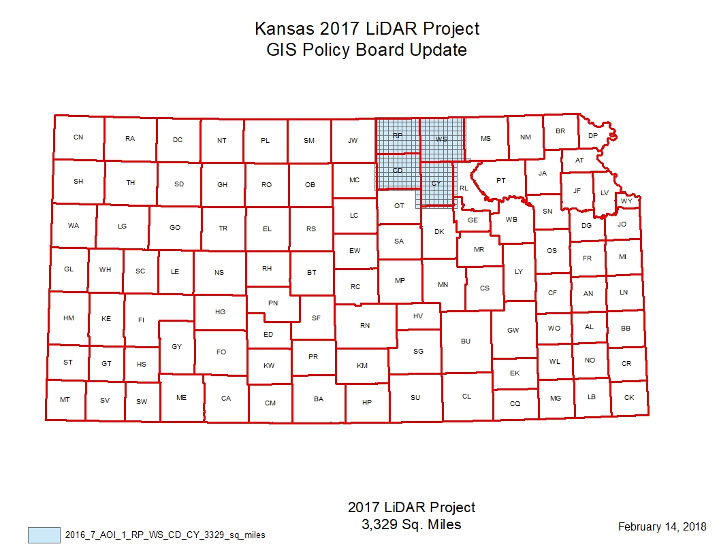
2017 Project update
We received corrections from the USGS on May 1, 2018. Atlantic is nearing completion on the corrections and we are expecting the delivery any day now.

Slide 4
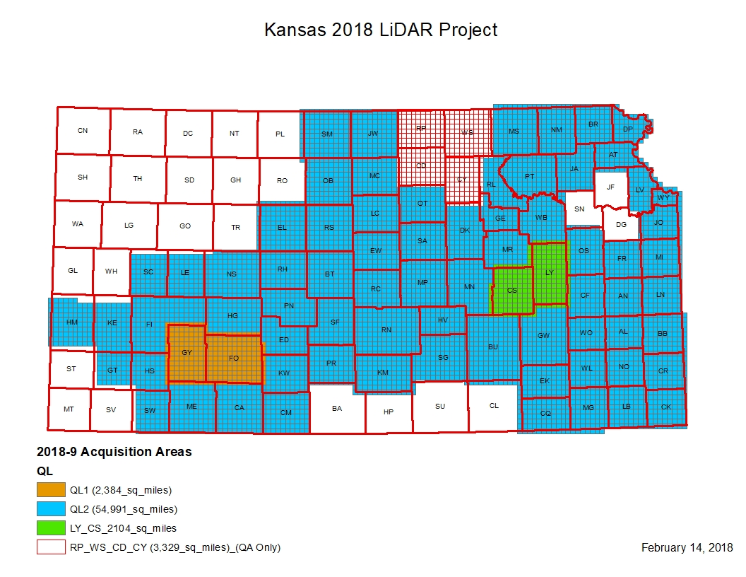

Slide 5
2018 Project Update
Acquisition stopped last week and will resume in the winter. Ground point densities were checked daily to meet requirements in vegetation areas.
Still in coordination with Atlantic/USGS on delivery schedule for 2018 acquisition QA/QC review – kickoff meeting will be sometime after June 4.
Review is expected to start in November and continue until May 2019.
47,442 square miles of hydro-enforced DEM.
We are also putting together an application to FEMA for hydro-enforcement of an additional roughly 35,400 square miles.

Slide 6
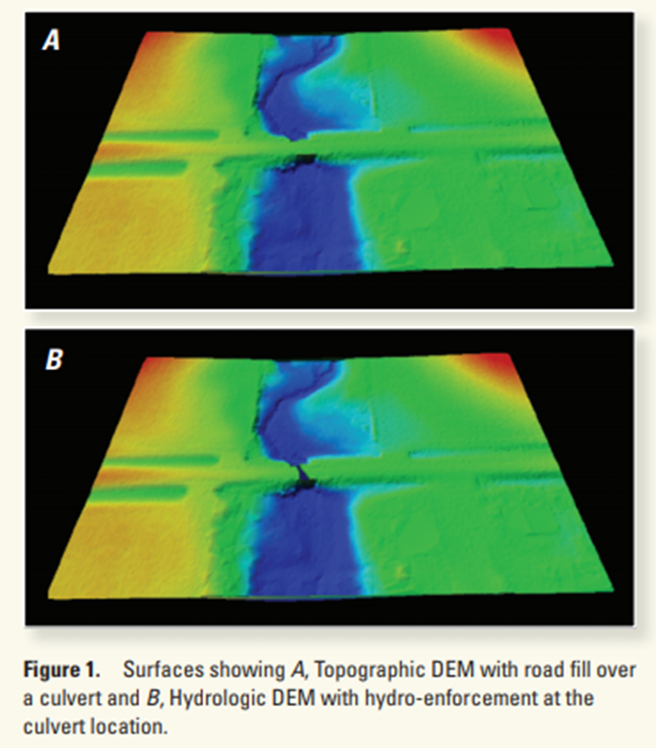
LiDAR Hydro-Enforcement
Hydrologic-enforcement (hydro-enforcement) of light detection and ranging (LiDAR)-derived digital elevation models (DEMs) modifies the elevations of artificial impediments (such as road fills or railroad grades) to simulate how human-made drainage structures such as culverts or bridges allow continuous downslope flow of water.
Figure on left from:
Poppenga, S.K., Worstell, B.B., Danielson, J.J., Brock, J.C., Evans, G.A., and Heidemann, H.K., 2014, Hydrologic enforcement of lidar DEMs: U.S. Geological Survey Fact Sheet 2014–3051, 4 p., https://dx.doi.org/10.3133/fs20143051.
ISSN 2327-6932 (online)

Slide 7
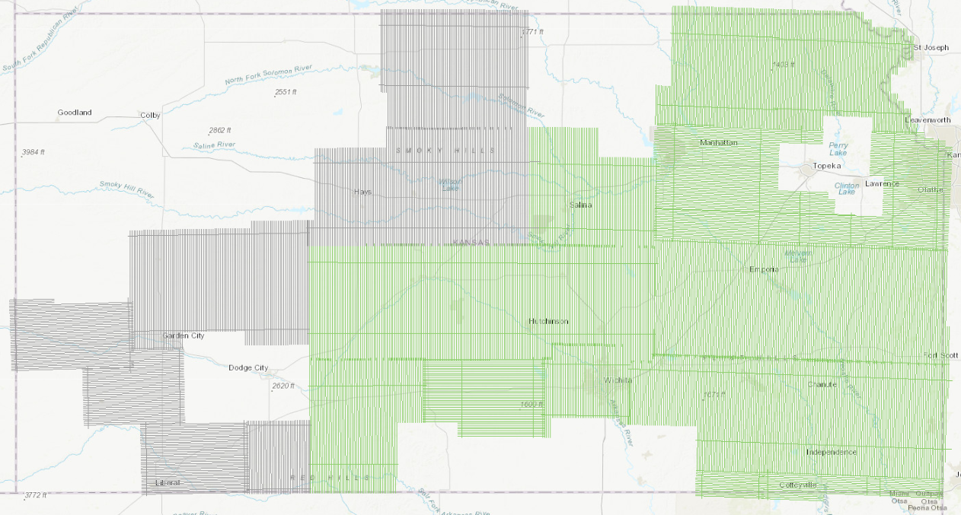
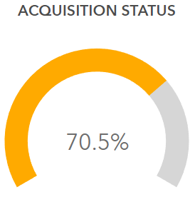

2018 Acquisition Status ArcGIS Online

Slide 8
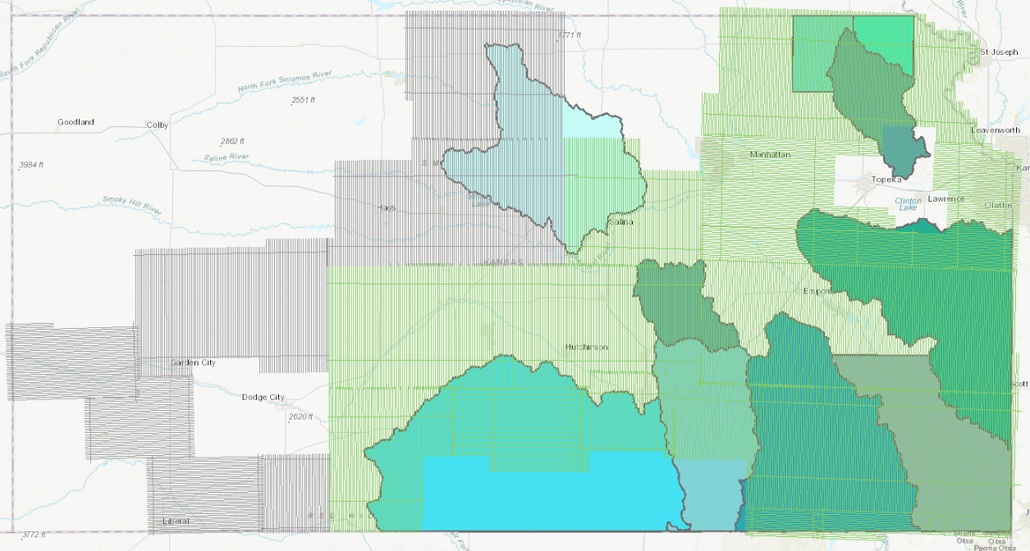
FY18 Floodplain Mapping Areas

Slide 9
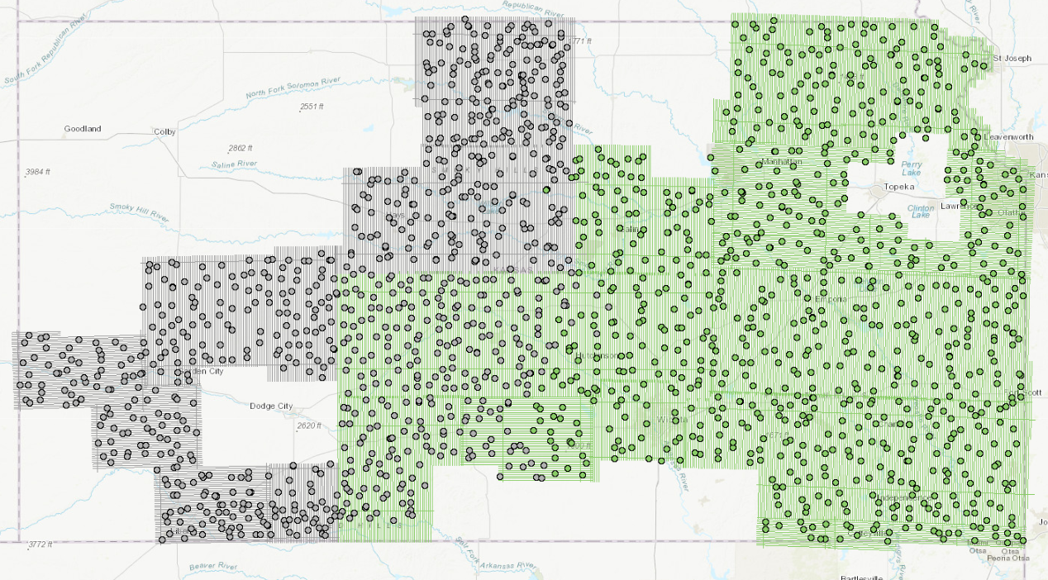
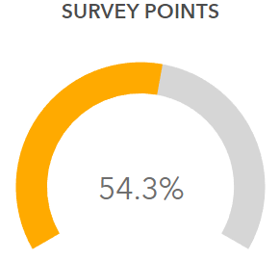

2018 Survey Point Status

