Slide 1
Kansas
GIS Policy Board
May 17, 2018

Slide 2
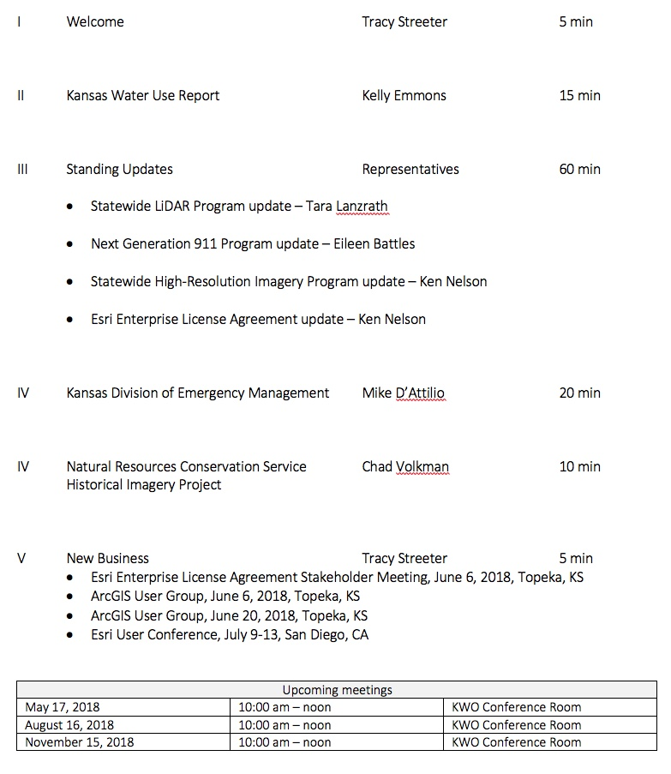
Meeting agenda
https://kansas.zoom.us/j/280140771
Conference Line: 646-558-8656
Participant Code: 280 140 771

Slide 3
Introductions & Announcements
DASC selected for Esri Special Achievement in GIS award (User Conference)
Kansas NG911 GIS Toolbox
MidAmerica GIS Consortium’s Outstanding Contribution in GIS Coordination
Kansas NG911 Program

Slide 4
Kansas Water Use Report
Kelly Emmons – Data Access & Support Center, Kansas Geological Survey

Slide 5
Kansas Base Flood Elevation Mapper
Tara Lanzrath – Kansas Department of Agriculture

Slide 6
Standing program updates
Statewide LiDAR Program - Tara Lanzrath
Kansas Next Generation 911 Program – Eileen Battles
Statewide Imagery Program – Ken Nelson
Esri Enterprise License Agreement – Ken Nelson

Slide 7
Kansas Division of Emergency Management
Mike D’Attilio

Slide 8

Kansas NG911 Imagery Program
Project 1:
Initial acquisition completed in 2013/14
Statewide, 1-foot, leaf-off, natural color, orthoimagery
Support NG911 GIS data remediation, PSAP operations, & other state and local GIS applications
Imagery available for download on DASC web site
Project 2:
Acquisition planned for 2018/19
Acquisition will begin in NW Kansas
Statewide, 1-foot, leaf-off, natural color & CIR, orthoimagery
Support NG911 GIS data maintenance, PSAP operations, & other state and local GIS applications
High-resolution ”buy-up” program

Slide 9
Kansas NG911 Imagery Program – Buy-ups
Executed agreements:
Osage County, cities within the county, 6” resolution
Rice County, cities within the county, 6” resolution
Barton County, cities within the county, 3” resolution
Lyon County, cities within the county, 3” resolution
Douglas/Shawnee/Jefferson counties partnership, 6” resolution

Slide 10
Esri Enterprise License Agreement Update
Enterprise License Agreement (ELA)
Negotiated flat-rate agreement that defines access to a specific set of Esri products & services
Unlimited access to Esri core technology
Limited access defined for other products such as ArcGIS Online
Kansas ELA available to state government only
ELA fully executed – February 1, 2018 – January 31, 2021
MOU’s signed & returned to Chris Mitchell @ OITS (99% complete)
Developed named user deployment plan (ArcGIS Online & Portal)
ELA Stakeholder Meeting scheduled for June 6, 2018
Kansas Bureau of Investigation, 1620 SW Tyler St, Topeka, KS 66612, USA

Slide 11
New business
Esri Enterprise License Agreement Stakeholder Meeting, June 6, 2018
10:00 am – noon, KBI Forensic Science Center Auditorium- 2001 SW Washburn Avenue, Topeka, KS
ArcGIS User Group, June 6, 2018
1:30 – 3:30 pm - KBI Forensic Science Center Auditorium- 2001 SW Washburn Avenue, Topeka, KS
ArcGIS User Group, June 20, 2018, Topeka, KS
1:30 – 3:30 pm, Shawnee County Annex, 1515 NW Saline St, Ste 100, Topeka, KS
Esri User Conference, July 9-13, San Diego, CA
Upcoming meetings
May 17, 2018 | 10:00 am – noon | KWO Conference Room
August 16, 2018 | 10:00 am – noon | KWO Conference Room
November 15, 2018 | 10:00 am – noon | KWO Conference Room

