Slide 1
Kansas
GIS Policy Board
February 15, 2018

Slide 2
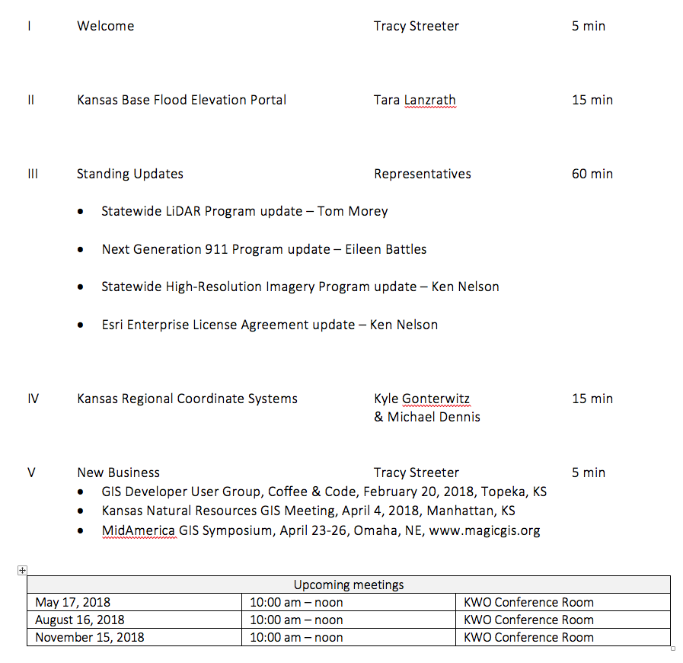
Meeting agenda
https://kansas.zoom.us/j/280140771
Conference Line: 646-558-8656
Participant Code: 280 140 771

Slide 3
Kansas Base Flood Elevation Mapper
Tara Lanzrath – Kansas Department of Agriculture

Slide 4
Statewide LiDAR Program Update
Tom Morey

Slide 5
Kansas Next Generation 911
Eileen Battles & Ken Nelson

Slide 6
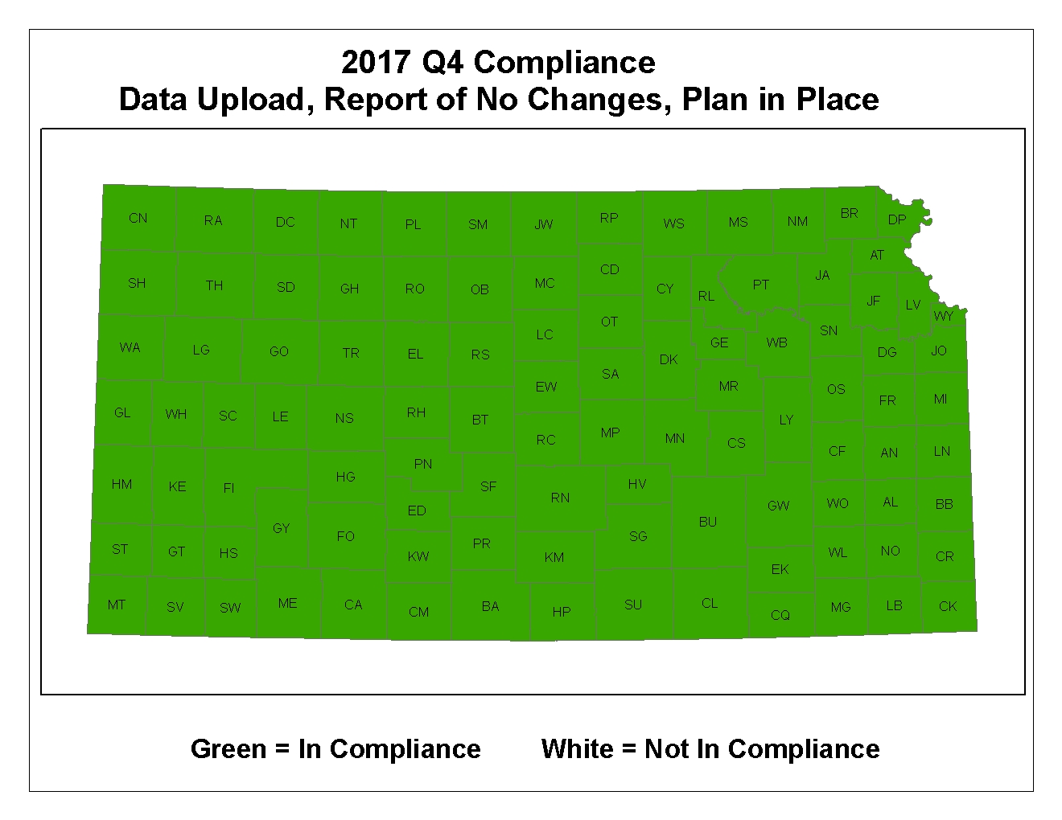
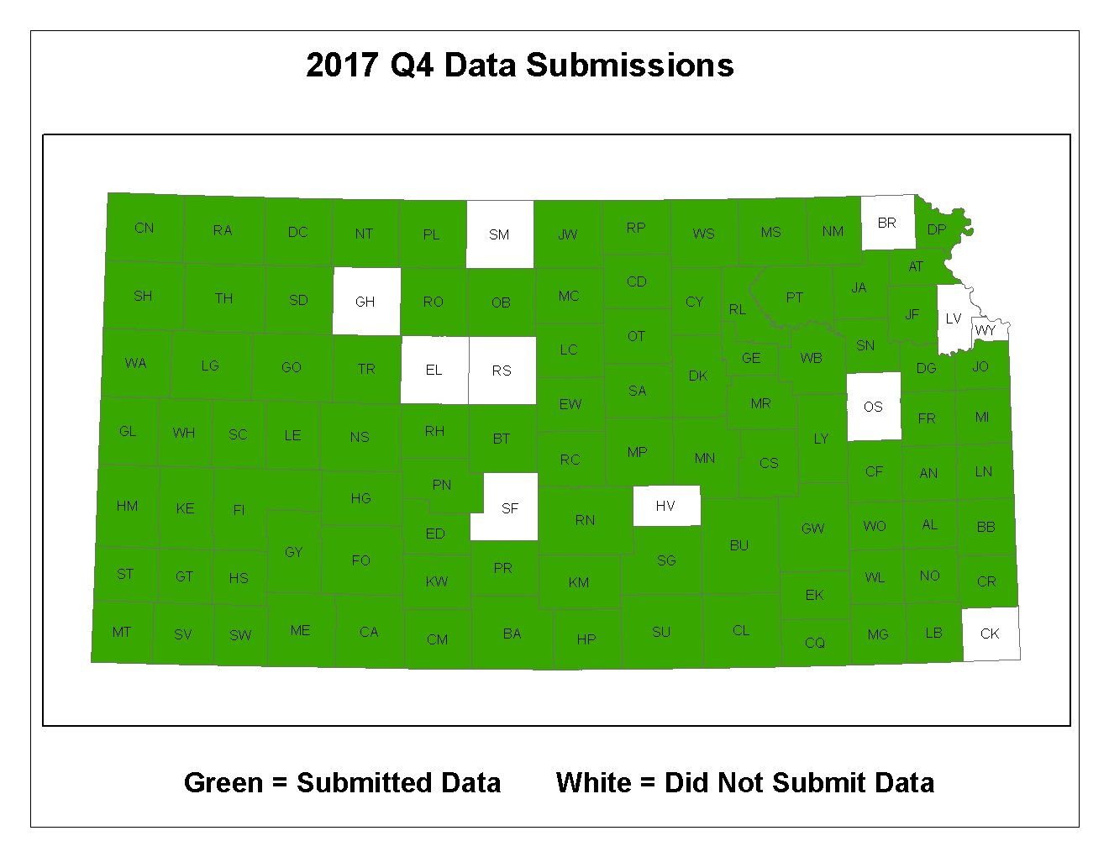
Next Generation 911
CY2017 Q4 GIS Data Submissions:
96 jurisdictions submitted updates that passed QA
7 jurisdictions verified no changes within the calendar quarter
2 jurisdictions are pending
100% compliance with Kansas NG911 GIS Data Governance Policy

Slide 7
Next Generation 911
Hosted System Deployment – 78 PSAPs now live on the system

Slide 8
Geospatial Call Routing
Geospatial Call Routing – the processes by which 911 calls are routed to the appropriate PSAP by referencing spatial data rather than tabular Master Street Address Guides (MSAG)
Alignment between the GIS data and the telco land line records
Over 60 counties are in alignment and ready for the transition
Awaiting access to West Safety System’s EGDMS portal. Kansas will be a beta test user of this system.
Transition to geoMSAGs will begin after system testing and verification of system processes.

Slide 9
911 Act – Legislative Update
Senate Bill 420, introduced February 12, 2018, referred to Committee on Utilities
http://kslegislature.org/li/b2017_18/measures/sb420/
The Council will develop a Management Reserve, which is a fund to cover the costs of new 911 functionality. Just like Text-to-911, the new features that will eventually come with NG911 like pictures and video, will have an implementation cost. This fund would assure that the Council will have enough money to cover those costs as the technology comes available.
Raise the 911 fee to 90 cents, 10 cents of which will be used to fund the Management Reserve until it reaches adequate levels. Any excess funds generated by that 10 cents will be returned to PSAPs in the form of competitive grants.
Raise the 911 fee cap to 95 cents, meaning the Council would have the authority to raise the fee up to 5 cents if needed in the future.
Raise the prepaid wireless fee from 1.06% per transaction to 1.8% per transaction.
Raise the minimum distribution from $50,000 to $60,000
Add to allowable expenses the salary of PSAP employees while they are engaged in training, up to 24 hours per year per employee.
Establish a pre-approval process for expenditures.
Limit the penalty for unauthorized expenditures to repayment of the expense plus $500 or 10%, whichever is smaller
Limit the civil penalties the Council can impose to $500
Define the Councils authority on training as recommending standards for general operations and establishing required standards on the operations of the NG911 hosted solution
Add GIS data standards and policies to the legislation and the authority for the Council to engage a firm to maintain a PSAP’s GIS data if the PSAP fails to do so for a year with, the cost of which being billed to the PSAP.
Several minor language corrections and updates throughout the documents.
(Source: Sherry Massey)

Slide 10

Kansas NG911 Imagery Program
Project 1:
Initial acquisition completed in 2013/14
Statewide, 1-foot, leaf-off, natural color, orthoimagery
Support NG911 GIS data remediation, PSAP operations, & other state and local GIS applications
Imagery available for download on DASC web site
Project 2:
Acquisition planned for 2018/19
Acquisition will begin in NW Kansas
Statewide, 1-foot, leaf-off, natural color & CIR, orthoimagery
Support NG911 GIS data maintenance, PSAP operations, & other state and local GIS applications
High-resolution ”buy-up” program

Slide 11
Kansas NG911 Imagery Program – Buy-ups
Executed agreements:
Osage County, cities within the county, 6” resolution
Rice County, cities within the county, 6” resolution
Barton County, cities within the county, 3” resolution
Lyon County, cities within the county, 3” resolution
Douglas/Shawnee/Jefferson counties partnership, 6” resolution
Indicated interest:
Ellis County, areas within the county, 6” inch resolution
Finney County, cities within the county, 6” or 3” resolution
Grey County, cities within the county, 6” or 3” resolution
Linn County, countywide coverage, 6” resolution
Crawford County, countywide coverage, 6” resolution
Greenwood County, cities within the county, 6” or 3” resolution
Atchison County, cities within the county, 6” or 3” resolution
City of Ottawa - 6” or 3” resolution

Slide 12
Esri Enterprise License Agreement Update
Two types of agreements…
Master Purchase Agreement (MPA)
Defines price schedule for all Esri products and services
Software, consulting services, 3rd party royalty products, etc
Available to state and local jurisdictions
Enterprise License Agreement (ELA)
Negotiated flat-rate agreement that defines access to a specific set of Esri products & services
Unlimited access to Esri core technology
Limited access defined for other products such as ArcGIS Online
Kansas ELA available to state government only
ELA renewal at procurement office for review and signature

Slide 13
Esri Enterprise License Agreement Update
ELA History
Original 3-year agreement:
February 1, 2011 – January 31, 2014
1-year extension February 1, 2014:
January 31, 2015
Current 3-year agreement:
Year 5 – February 1, 2015 – January 31, 2016
Year 6 – February 1, 2016 – January 31, 2017
Year 7 – February 1, 2017 – January 31, 2018
Why?
Unlimited access to core technology
Substantially reduced procurement costs
Flexibility to deploy the necessary software products when and where needed
Allows agencies to experiment with different software packages and configurations before purchasing
Standardized budget over the term of the agreement
Improved coordination across enterprise

Slide 14
Kansas Regional Coordinate Systems
Michael Dennis – Geodetic Analysis
Kyle Gonterwitz – Kansas Department of Transportation

Slide 15
New business
GIS Developer User Group, Coffee & Code, February 20, 2018, Topeka, KS
Kansas Natural Resources GIS Meeting, April 4, 2018, Manhattan, KS
MidAmerica GIS Symposium, April 23-26, Omaha, NE, www.magicgis.org
Upcoming meetings
May 17, 2018 | 10:00 am – noon | KWO Conference Room
August 16, 2018 | 10:00 am – noon | KWO Conference Room
November 15, 2018 | 10:00 am – noon | KWO Conference Room

