Slide 1

GIS Policy Board
LiDAR Update
5-13-2016

Slide 3
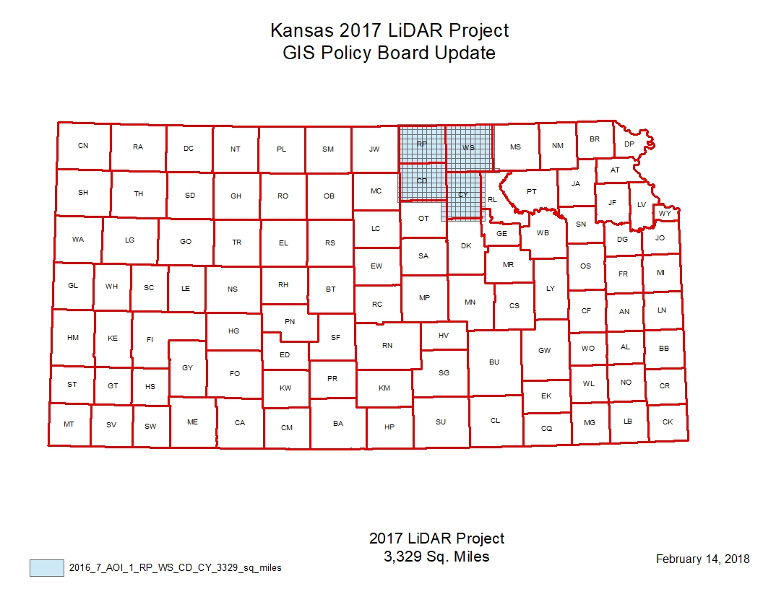
2017 Project update
Is being packaged for delivery to USGS Feb. 19

Slide 4
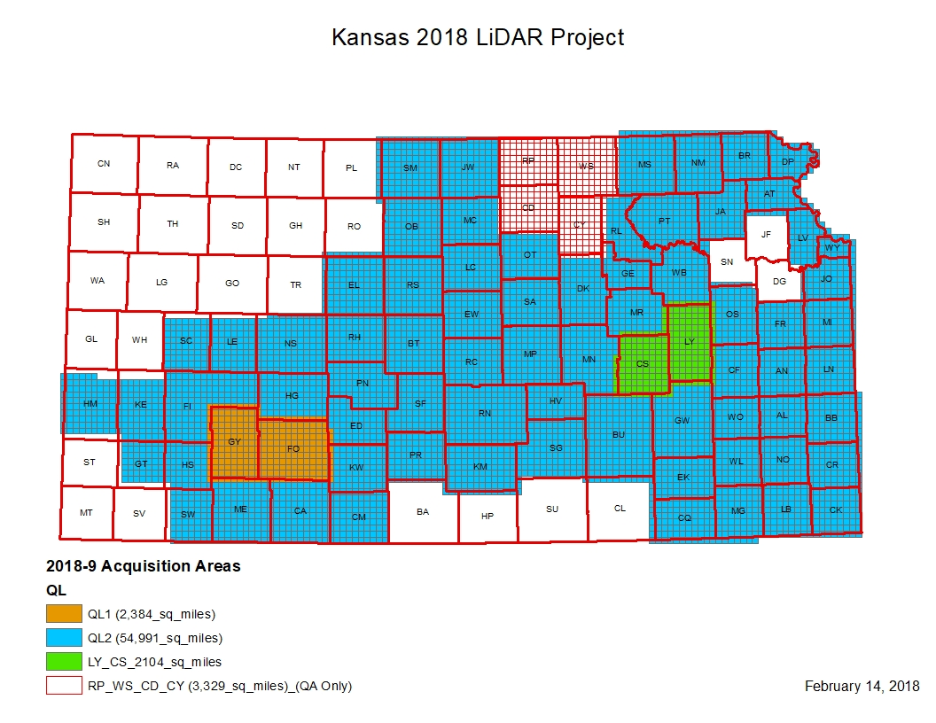
2018 Project Update

Slide 5
2018 Project Update
Acquisition is underway
Still in coordination with USGS on delivery schedule for QA/QC review
We were notified that our application under the 3DEP program has been accepted.
Will fund a portion of data development and acquisition for Lyon and Chase Counties
47,442 Square Miles of hydro-enforced DEM

Slide 6
2018 Acquisition Status

Slide 7
2018 Survey Status

Slide 8
2019 Proposed Project

