Slide 1
Kansas Base Flood Elevation (BFE) Portal
KDA-DWR and DASC Project
GIS Policy Board Meeting
Tara Lanzrath, CFM
February 15, 2018

Slide 2
Outline
  Background
    What is a Base Flood Elevation?
    Why this data is important
  Base Flood Elevation Portal
    Development & Testing
    How it Works
    Future Enhancements
  Questions/Contacts

Slide 3
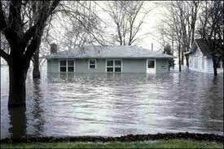
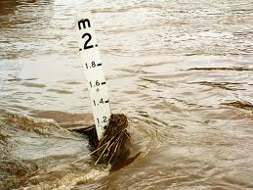
What is a Base Flood Elevation?
Base Flood
  The flood having a 1% chance of being equaled or exceeded in any given year, more commonly referred to as the “100-year flood.”
  This is the flood FEMA regulates to.
Base Flood Elevation (BFE)
  Expected water surface elevation during the base flood.
Uses of BFE Information
  Letter of Map Amendments (LOMAs), Elevation Certificates, New Construction.

Slide 4
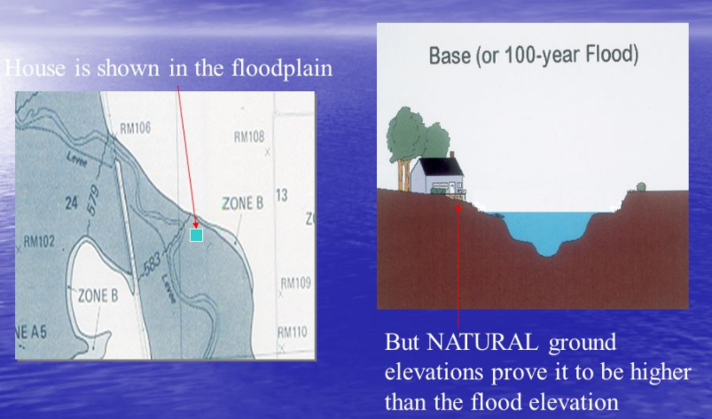
LOMAs Explained
The LOMA is a legal document that will officially remove a structure that was inadvertently mapped within the floodplain
To prove this, the Lowest Adjacent Grade (LAG) must be at or above the BFE for the structure to qualify for removal from the floodplain
Only a surveyed elevation can be used in the LOMA application, but in the portal we estimate the LAG using LiDAR to provide to the user

Slide 5
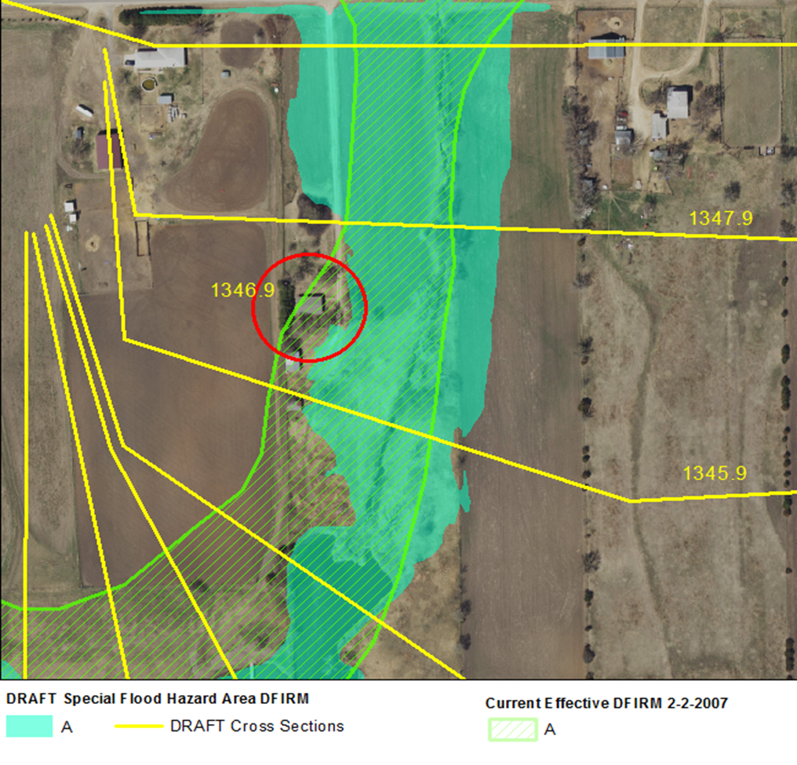
Why Did We Build a BFE Portal?
While FEMA provides base flood elevation information for detailed study areas, Zone A BFE information is not provided but allows for use of “best available data”
At KDA-DWR, we have provided this information historically from the HEC-RAS modeling used for the studies

Slide 6
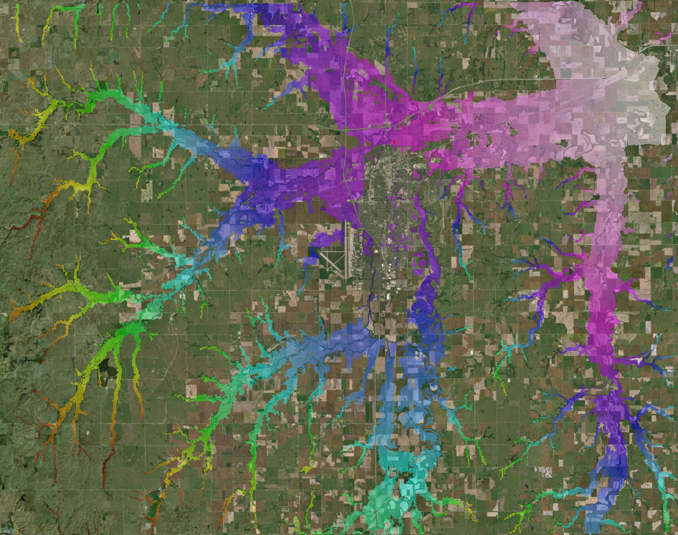
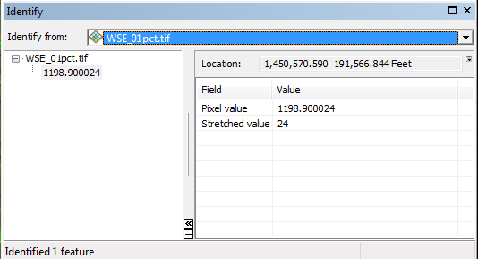
New Initiative in BFE Determinations
We are switching to a 2D modeling base and our more recent products for Zone As are water surface elevation grids. This is more of a “point and click” determination approach.
Some early grids have some quality issues, so for now we are checking each determination before approval.

Slide 7
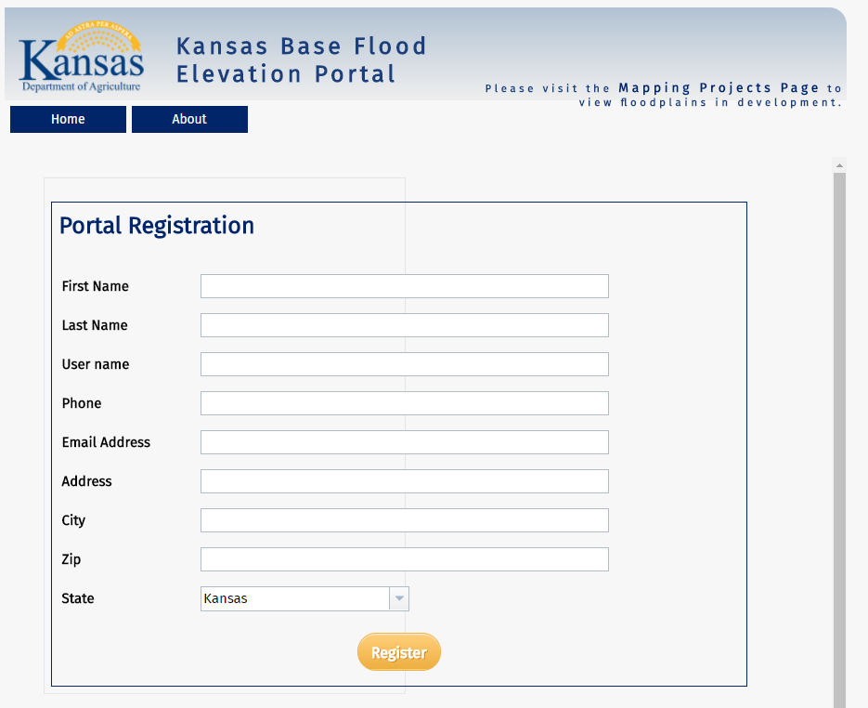
Kansas BFE Portal
http://maps.kgs.ku.edu/fpm_bfe/login.cfm
KDA-DWR collaboration with DASC begin in Sept 2016 to construct the Portal
Launched October 1, 2017 and is used for requesting Zone A BFEs where data is available

Slide 8
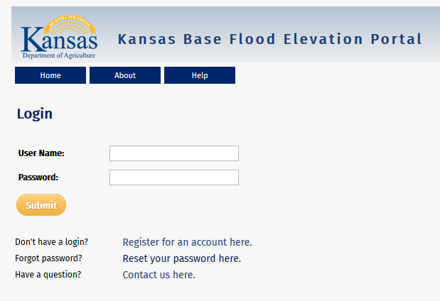
BFE Portal
Goal: To improve workflows by utilizing a user drawn polygon to automatically extract the maximum elevation from the water surface elevation grid (BFE Determination) and the minimum elevation from the LiDAR service for the approximate Lowest Adjacent Grade (LAG) value.
Statistics
104 registrants since the October 1 launch. These are primarily surveyors or engineering firms, but we do have some citizens registered.
70 “partial” users – these are from previous requests and may become regular users.
85 BFE requests since Oct 1, 2017.

Slide 9
Behind the Scenes
The Portal draws upon the following Services:
  KDA-DWR service on the BFE Status and Detailed Study areas vs Zone A Floodplain information
  DASCs NG911 & LiDAR Service- for address points and road names and to return LiDAR values from the user click and an approximate Lowest Adjacent Grade (LAG) from the user polygon
  DASC is hosting KDA-DWR water surface elevation grids as a service where the BFE is extracted from the user polygon

Slide 10

Testing the Portal
KDA-DWR tested the Portal several times within KDA hosted classes and within DWR before releasing to the public
During the first test the system crashed, and we did not have any successful BFE submissions
Since then, DASC moved the geoprocessing task outside of the map, and it runs smoothly

Slide 11
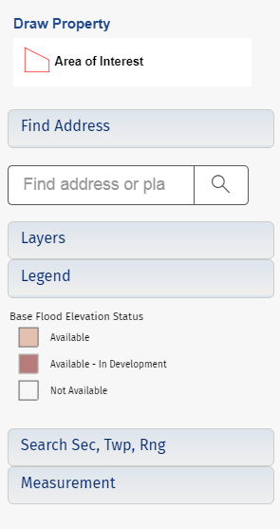
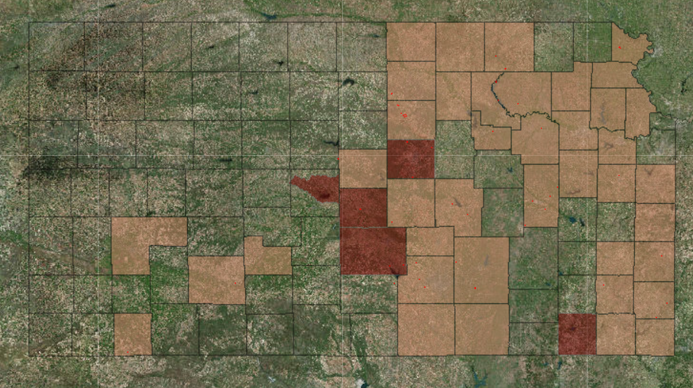
BFE Request Page
Use this page to verify the status of BFE data. You can also click on the map to obtain a LiDAR elevation at a specific point, which will display in the upper left corner of the screen. Once zoomed into the map, the floodplain data will appear and requests can be made.

Slide 12
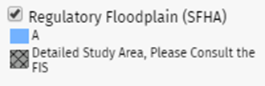
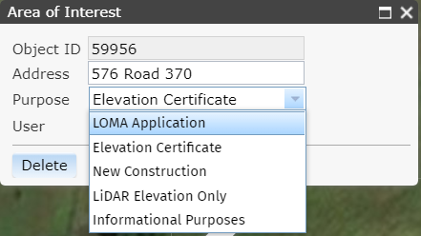
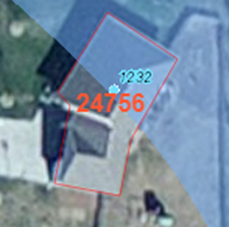
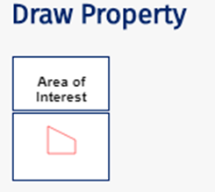

Drawing the Property
1) Use the Address or Sec, Twp, Rng Search to locate your property*
*Note: Please verify your location is in a Zone A; otherwise use the FIS to find your BFE
4) You will need to fill out the box with the address and purpose and then click ‘Save’
3) Important: Please trace the boundary of the structure using the aerial imagery as your guide as shown below
2) Click on the Area of Interest Polygon to start drawing

Slide 13

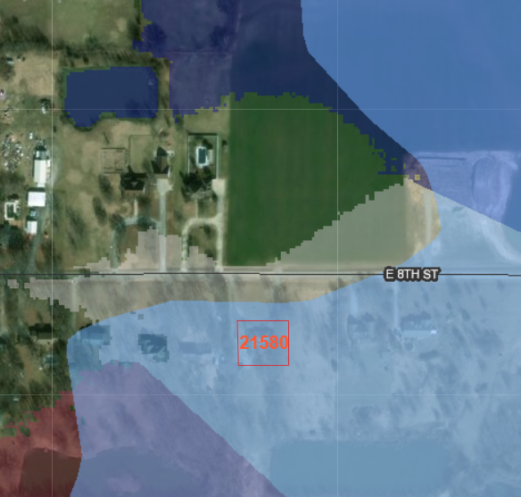
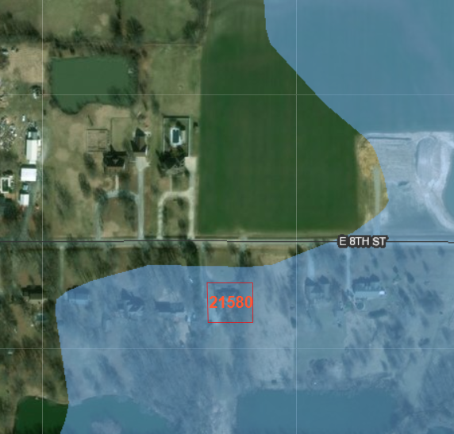
Map Views Depend on User Level
Admin View
Access to all – LiDAR & BFE
values, supplemental data
User View
Can obtain LiDAR point data, but must submit request to obtain official BFE

Slide 14
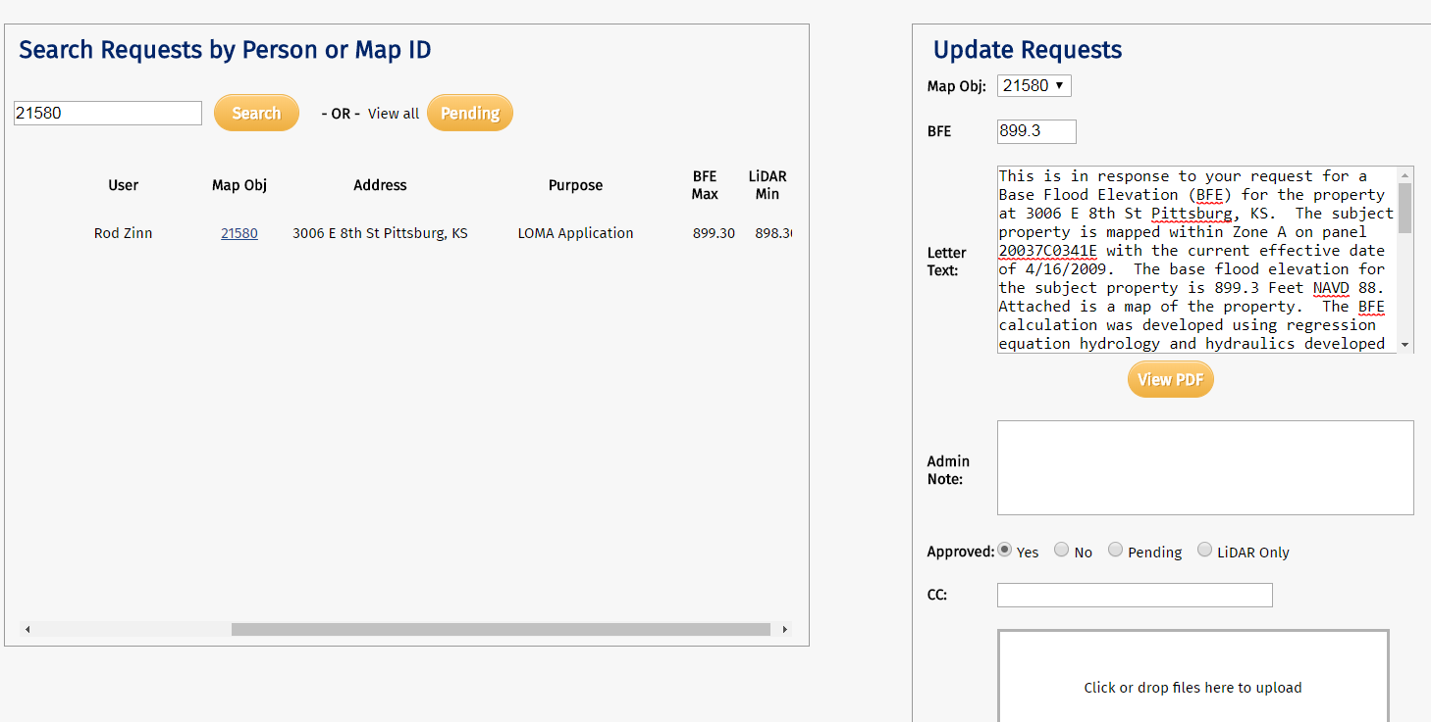
Admin View

Slide 15
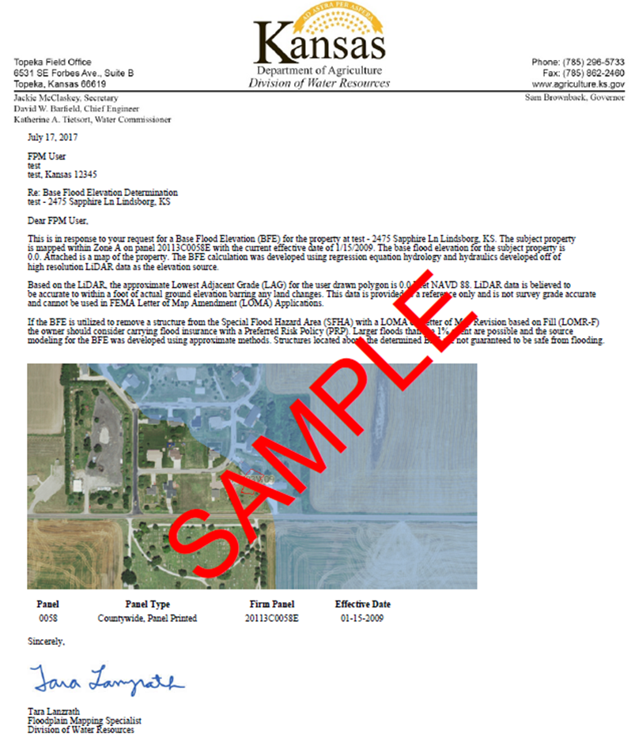
Sample KDA-DWR BFE Letter

Slide 16





Other Portal Resources
For Admins | For Users
– shows all pending requests with the date received. This is where BFE requests are approved or denied and the letter is generated | shows a record of user requests and LiDAR values
Tab where all PDF documents are kept with an option to export all requests | Information about the Portal as well as Frequently Asked Questions and more information
Approve all users – check user names, etc. For users there are general use instructions/info. | PDF Quick Guide to walk the user through the Portal
 | Allows the user to update contact information

Slide 17
Benefits of the BFE Portal
As Admins
  BFE requests sit within the Portal and aren’t lost within emails
  The user tells us specifically the location, so we aren’t searching for it
  We have spatial records of previous requests
  DASC is hosting our grid data and provides maintenance
As Users
  Central location for all requests
  Gives an idea on the chances of obtaining a LOMA before money is spent on a surveyor
  An official letter stating the user BFE and approximate LAG will be emailed

Slide 18
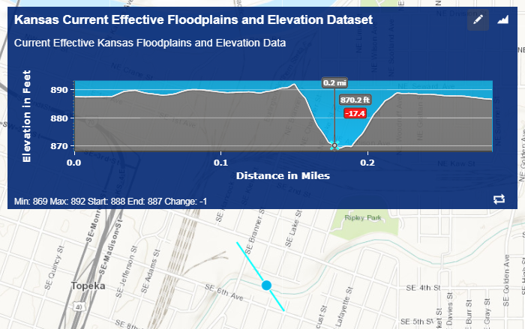
Future Enhancements
Once we are more confident with our newer grid data, we plan to have this process be more automated and possibly bypass our review process. Ideally, the letter template would be automatically populated based on the source information.
We are working with DASC on implementing a LiDAR elevation profile tool similar to ESRI’s elevation service tool.

Slide 19
Questions?
Tara Lanzrath, CFM, KDA-DWR
Floodplain Mapping Specialist
Tara.Lanzrath@ks.gov
Ken Nelson, DASC, nelson@kgs.ku.edu
Kelly Emmons, DASC, emmons@kgs.ku.edu
Asif Iqbal, DASC, aiqbal@kgs.ku.edu
Brent Miller, DASC, bmiller@kgs.ku.edu

