Slide 1
Historical Imagery Agreement Update
December 2018 | Chad Volkman – NRCS GIS Specialist

Slide 2
USDA Background
Agriculture Adjustment Act of 1933
Kansas acquired from 1937 - 1941
First aerial record of the entire state
Base for some of the first soil surveys

Slide 3
Kansas NRCS Background
35mm slide scanning
33 field offices with hardcopy 1937-1941 imagery
Imagery used for conservation planning, environmental compliance, and financial assistance programs
Pilot project with Jewell and Doniphan counties
DOJ litigation hold on pre-2000 imagery

Slide 4
Historical Imagery Agreement
Cooperative Ecosystems Studies Unit
NRCS and Emporia State University
9/25/2018 through 12/31/2020
$105,000 of NRCS funds
ESU provides technical and administrative functions to achieve the purpose

Slide 5
Agreement Objectives
Develop specifications for scanning and georeferencing
Scan and georeference at least 33 counties of 1930s or 1940s imagery

Slide 6
Agreement Deliverables
Best practices for scanning
  100% - December 2018
Best practices for mosaic and georeferencing
  100% - March 2019
33 counties scanned
  50% - June 2019
  75% - December 2019
33 counties georeferenced
  25% - June 2019
  50% - December 2019
All deliverables complete December 2020

Slide 7
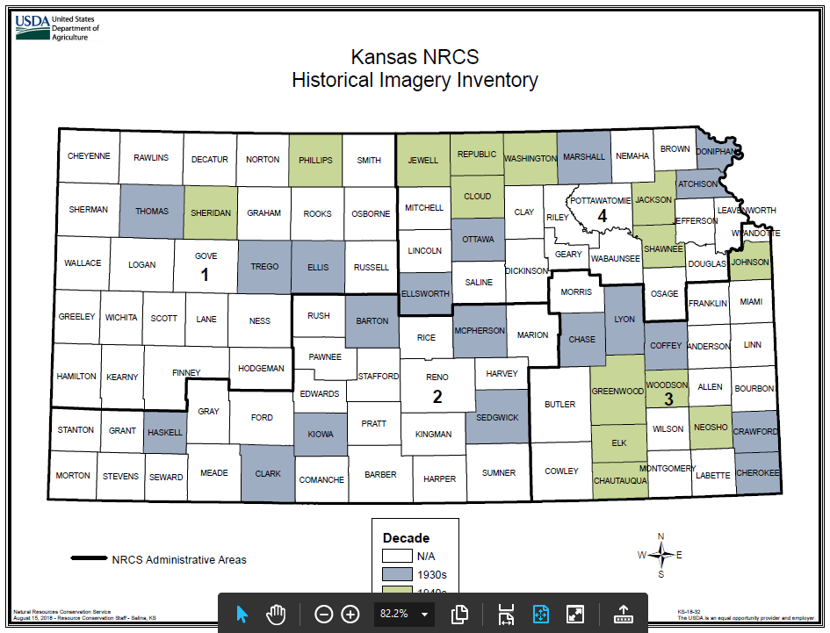

Slide 8
Agreement Status
Finalizing scanning and georeferencing methods
  600 dpi minimum
  Mosaic process
Lyon County complete (1937)
  With minor gaps
Continued testing of additional methods and software

Slide 9
Additional Items
Connect with other organizations
Share scanning and georeference processes
Identify other sources of imagery
Web portal for organizations to document their holdings
Prioritize counties
Public domain data storage

Slide 10
Non-Discrimination Statement
In accordance with Federal civil rights law and U.S. Department of Agriculture (USDA) civil rights regulations and policies, the USDA, its Agencies, offices, and employees, and institutions participating in or administering USDA programs are prohibited from discriminating based on race, color, national origin, religion, sex, gender identity (including gender expression), sexual orientation, disability, age, marital status, family/parental status, income derived from a public assistance program, political beliefs, or reprisal or retaliation for prior civil rights activity, in any program or activity conducted or funded by USDA (not all bases apply to all programs). Remedies and complaint filing deadlines vary by program or incident.
Persons with disabilities who require alternative means of communication for program information (e.g., Braille, large print, audiotape, American Sign Language, etc.) should contact the responsible Agency or USDA’s TARGET Center at (202) 720-2600 (voice and TTY) or contact USDA through the Federal Relay Service at (800) 877-8339. Additionally, program information may be made available in languages other than English.
To file a program discrimination complaint, complete the USDA Program Discrimination Complaint Form, AD-3027, found online at How to File a Program Discrimination Complaint and at any USDA office or write a letter addressed to USDA and provide in the letter all of the information requested in the form. To request a copy of the complaint form, call
(866) 632-9992. Submit your completed form or letter to USDA by:
(1) mail: U.S. Department of Agriculture
Office of the Assistant Secretary for Civil Rights
1400 Independence Avenue, SW
Washington, D.C. 20250-9410;
(2) fax: (202) 690-7442; or
(3) email: program.intake@usda.gov.
USDA is an equal opportunity provider, employer, and lender.

