Slide 1
Kansas
GIS Policy Board
December 6, 2018

Slide 2
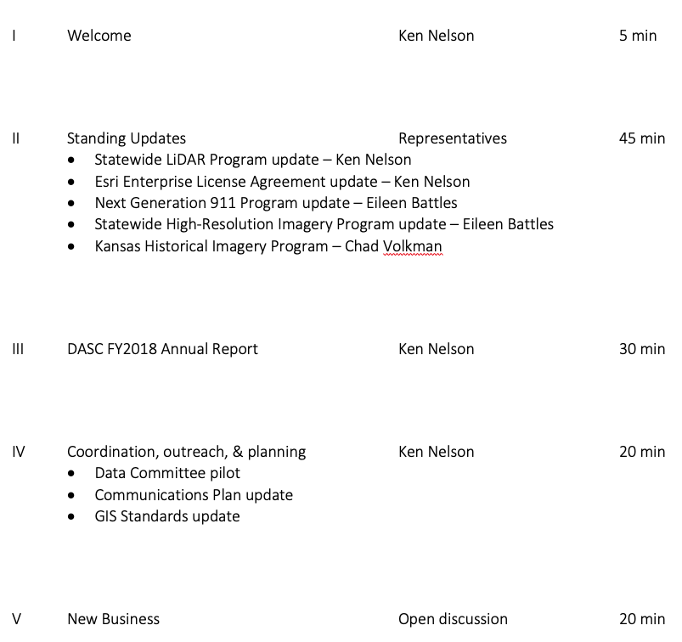
Meeting agenda
https://kansas.zoom.us/j/280140771
Conference Line: 646-558-8656
Participant Code: 280 140 771

Slide 3
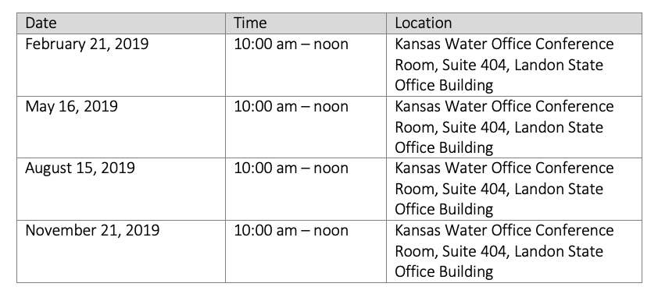
Introductions & Announcements

Slide 4
Standing program updates
Statewide LiDAR Program – Ken Nelson (for Tara Lanzrath)
Esri Enterprise License Agreement – Ken Nelson
Kansas Next Generation 911 Program – Eileen Battles
Statewide High Resolution Imagery Program – Eileen Battles
Kansas Historical Imagery Program – Chad Volkman

Slide 5
Esri Enterprise License Agreement Update
ELA anniversary – February 1, 2019 – January 31, 2020
Expect to see invoices from Chris Mitchell (or someone at OITS) soon
Annual ELA Survey
License deployment survey
ArcGIS Online & Portal deployment
Level 2 named user allocation plan
Reminder - quarterly ELA tech transfer webinars

Slide 6
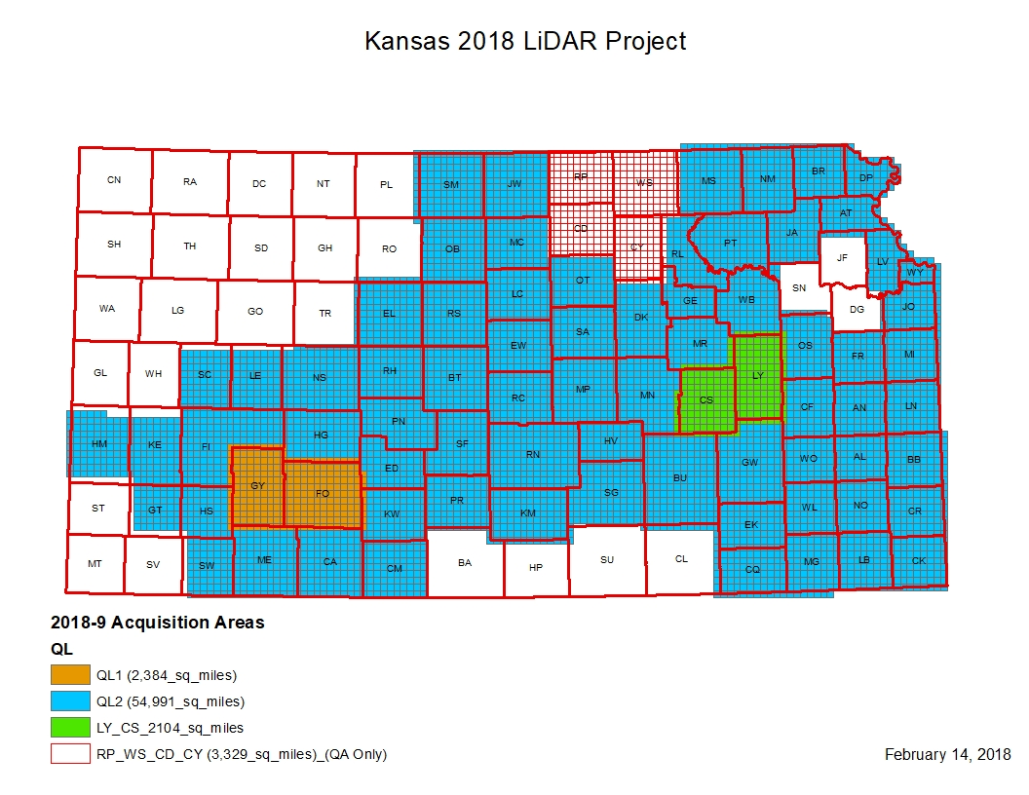
Statewide LiDAR Program update

Slide 7
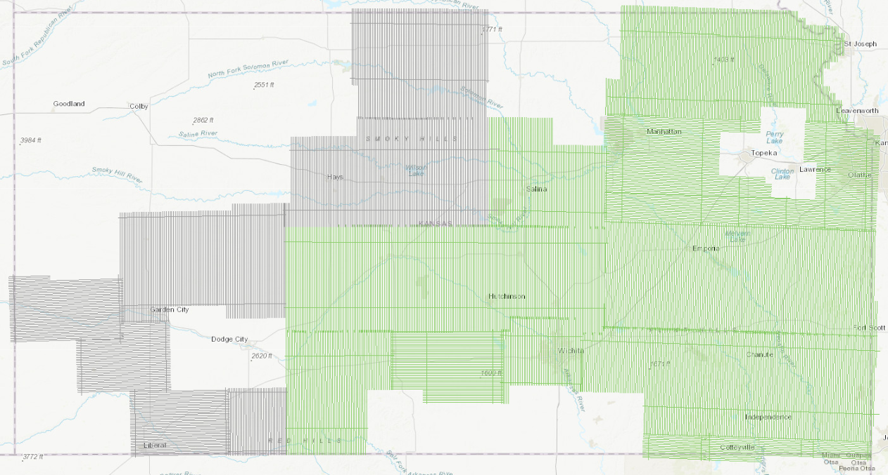
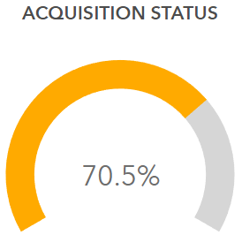

Statewide LiDAR Program update
Survey acquisition is 100% complete

Slide 8
Statewide LiDAR Program update

Slide 9
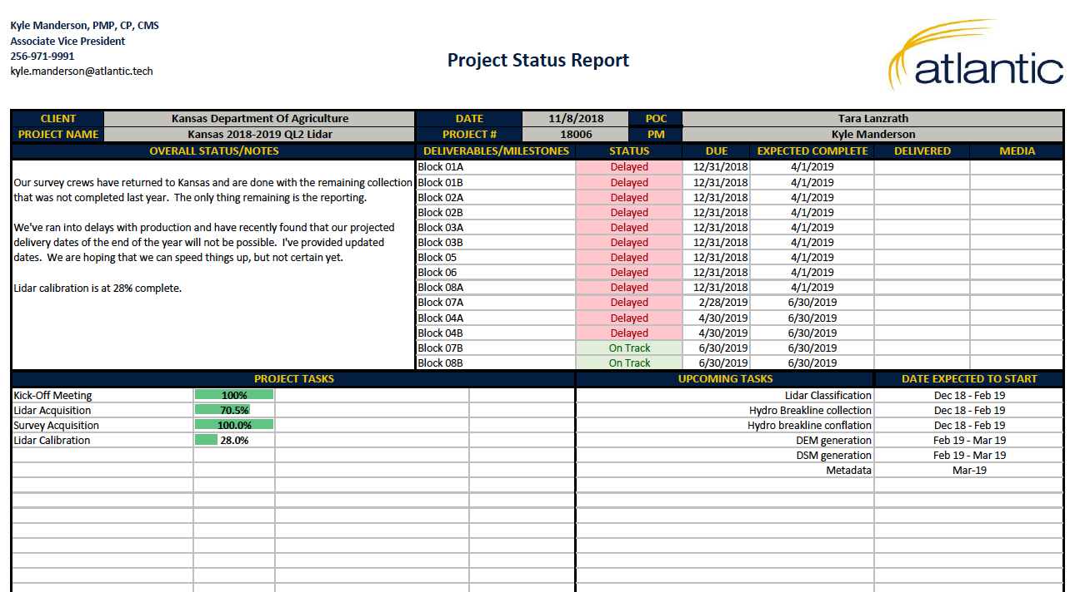
LiDAR update

Slide 10
Kansas NG911 Update
Eileen Battles

Slide 11
Statewide High Resolution Imagery Program
Eileen Battles

Slide 12
Kansas Historical Aerial Imagery Program
Chad Volkman

Slide 13
GIS Initiative Communication Plan
Versions 1.1, 1.2 (incorporated comments from Deb Divine)
Defines..
Who we are contacting?
Why we are contacting them?
Who should we be contacting?
Who is contacting us?
Defines…
Stakeholders
Communication channels
Timelines
Responsibilities
Communication products:
Reports
Briefings
Strategic & Business Plans
Project & Initiative FAQ series
Kansas GIS Welcome Kit
Kansas Video Series

Slide 14
GIS Data Committee Pilot
Theme: Elevation & Imagery
Members:
Tara Lanzrath – Chair
Eileen Battles
Jude Kastens
Brent Miller
Ken Nelson
Joanna Rohlf
Kick-off meeting held November 1, 2018
Initial focusing on the thematic data assessment

Slide 15
GIS Standards Update
Information Technology Executive Council (ITEC)
The 17 member Information Technology Executive Council is responsible for approval and maintenance of all information technology policies, IT project management procedures, the statewide technical architecture, and the state's strategic information management plan. (source - https://oits.ks.gov/kito/itec)
Information Technology Advisory Board (ITAB)
The Information Technology Advisory Board, or ITAB as it is more commonly known, functions as a technical resource to the Chief Information Technology Officer, or CITO for the Executive Branch of state government. (source - https://oits.ks.gov/kito/itab-home)
ITEC Policies & Guidelines
1000 Series – Applications/Software
2000 Series – Project Management
3000 Series – Governance
4000 Series – Architecture
5000 Series – Business Contingency
6000 Series – Data/Records/Content
7000 Series – Security
8000 Series – Shared Solutions
9000 Series - Infrastructure
GIS falls under the GIS series
6100 – GIS Metadata Policy
6120 – GIS Cadastral Policy
6120A – GIS Cadastral Standard
6180 - Water Utility Data Policy
6180A - Water Utility Data Standard

Slide 16
GIS Standards Update – plan of attack
6100 – GIS Metadata Policy
DASC is taking the lead, and work has already begun
Conduct state-level peer review to determine which states have already made this transition, how they accomplished this task, and any lessons learned along the way (in-progress)
Conduct review of ISO metadata conversion and maintenance tools (in-progress)
Determine LOE & methodology to implement ISO metadata standard
Socialize information and suggested timeline with GIS community
6120/6120A – GIS Cadastral Policy & Standard
Establish Administrative Boundaries Data Committee
Chaired by David Harper, Director of Property Valuation and Division of Vehicles, Department of Revenue
Initial focus on reviewing and updating cadastral policy & standard
6180/6180A – Water Utility Data Standard
Kansas Water Office is taking the lead and conducting an internal review of the standard
Katie Goff is leading this effort
Will pursue updates on all policies & standards. Will communicate recommended changes and seek approval from the GIS Policy Board, ITAB, and ultimately adoption by ITEC.

Slide 17
New business

