Slide 1

GIS Policy Board LiDAR Update
Tara Lanzrath, CFM
8-16-2018

Slide 2
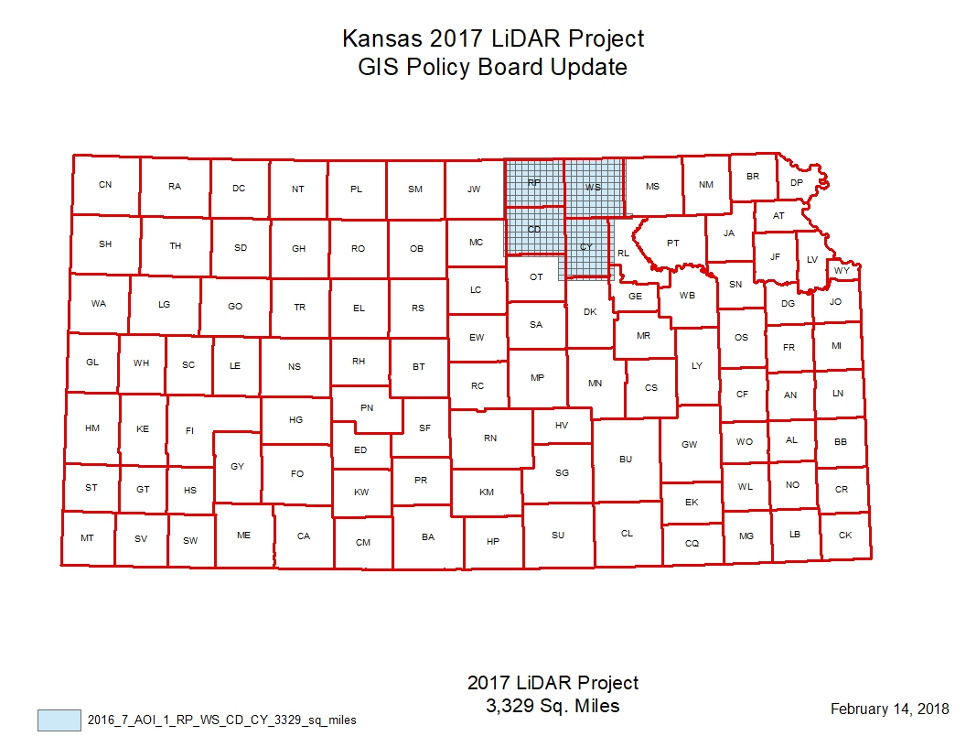
2017 Project update
The final data was delivered to DASC and received on July 2, 2018.

Slide 3
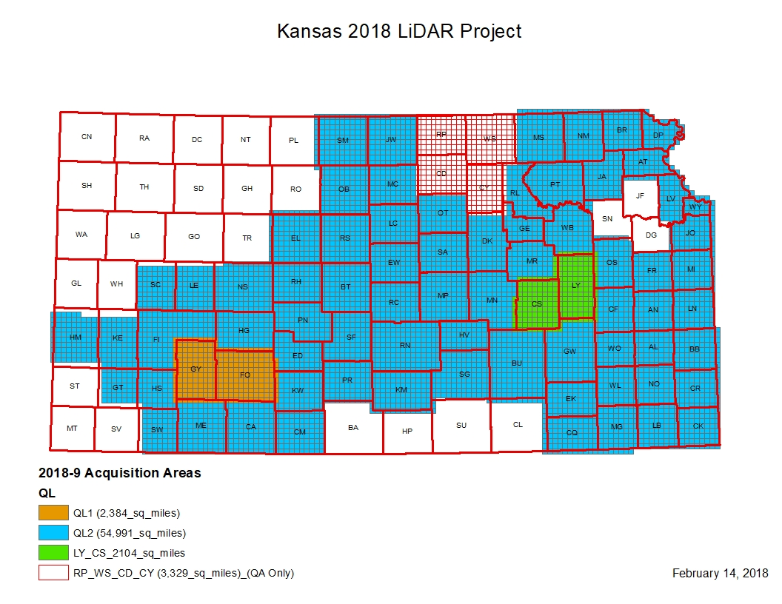

Slide 4
2018 Project Update
Acquisition stopped in May and will resume in the winter.
Kickoff meeting was held July 20, 2018 with the USGS. Still in coordination with Atlantic/USGS on delivery schedule for 2018 acquisition QA/QC review –
Review is expected to start in December 2018.
Atlantic has sent a delivery block schedule for review.
47,442 square miles of hydro-enforced DEM within this agreement.
We submitted the FEMA grant application Friday, August 10. This included funding for hydro-enforcement of an additional roughly 35,400 square miles.

Slide 5
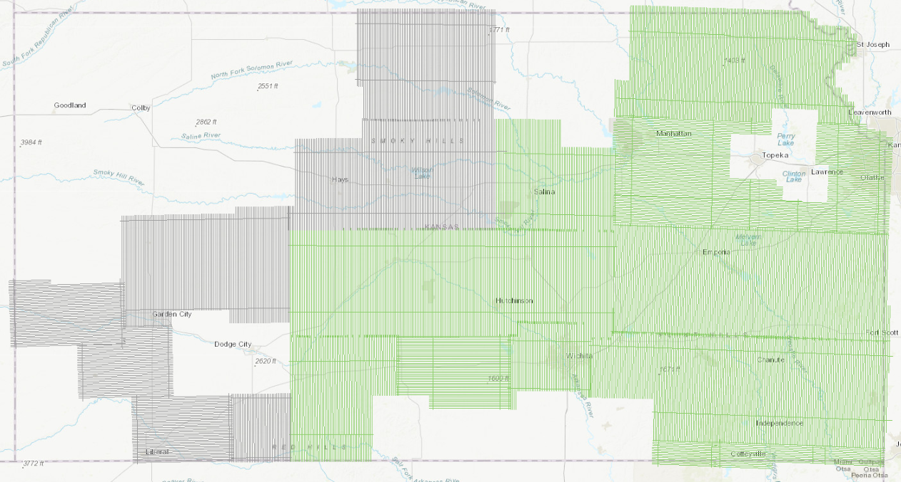
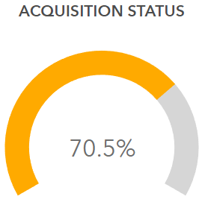

2018 Acquisition Status ArcGIS Online
Survey acquisition is 100% complete

Slide 6
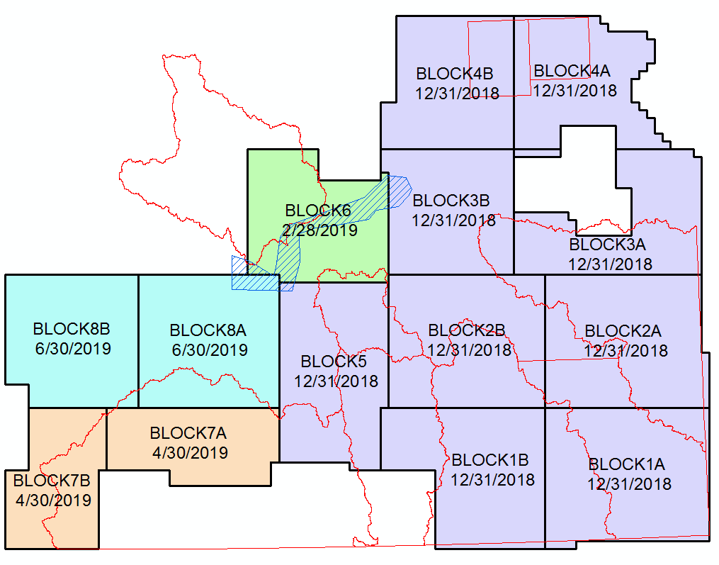
FY18 Draft Delivery Blocks and Priority Areas

