Slide 1
Kansas
GIS Policy Board
August 16, 2018

Slide 2
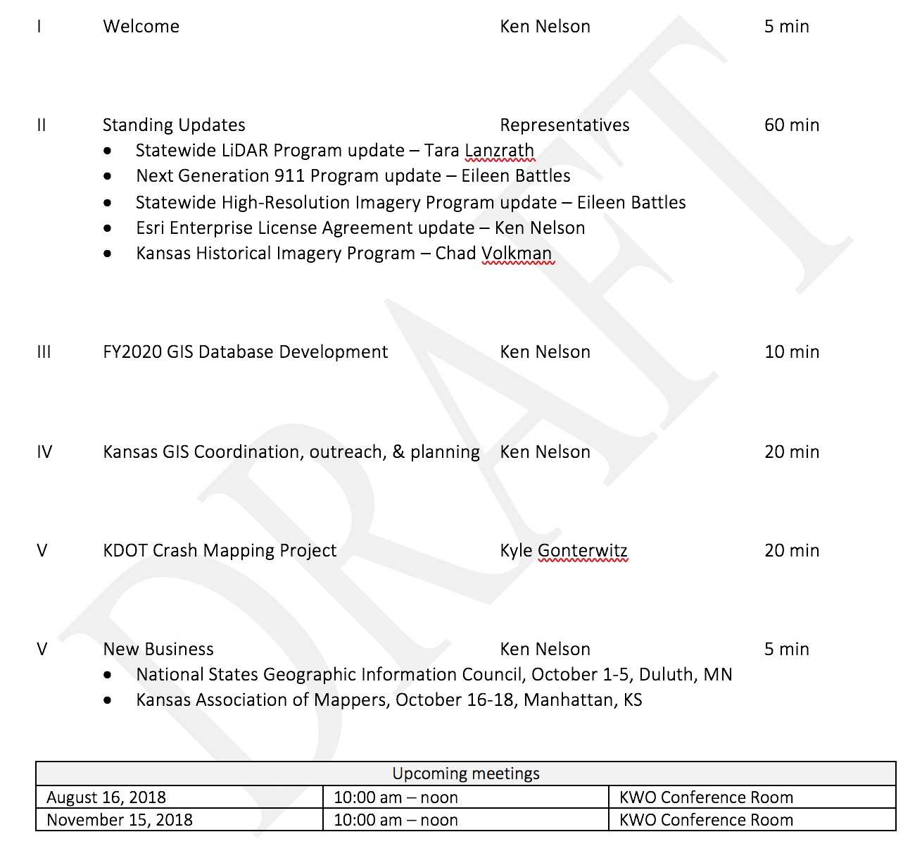
Meeting agenda
https://kansas.zoom.us/j/280140771
Conference Line: 646-558-8656
Participant Code: 280 140 771

Slide 3
Introductions & Announcements
New Executive Branch Chief Information Technology Officer, Lee Allen

Slide 4
Standing program updates
Statewide LiDAR Program - Tara Lanzrath
Kansas Next Generation 911 Program – Eileen Battles
Statewide High Resolution Imagery Program – Eileen Battles
Esri Enterprise License Agreement – Ken Nelson
Kansas Historical Imagery Program – Chad Volkman

Slide 5
Esri Enterprise License Agreement Update
Enterprise License Agreement (ELA)
Negotiated flat-rate agreement that defines access to a specific set of Esri products & services
Unlimited access to Esri core technology
Limited access defined for other products such as ArcGIS Online
Kansas ELA available to state government only
ELA fully executed – February 1, 2018 – January 31, 2021
MOU’s signed & returned to Chris Mitchell @ OITS (100% complete)
Developed named user deployment plan (ArcGIS Online & Portal)
KDEM (ArcGIS Online)
KDOL (ArcGIS Online)
KDHE (Portal)
KDA (Portal)
Quarterly ELA tech transfer webinars (date TBD)

Slide 6
FY2020-21 GIS Database Development
Three proposals were submitted to KWO for budget planning consideration. The KWA budget committee meets August 17, 2018.
Proposals:
Kansas Historical Aerial Photography Preservation (NRCS/Emporia State University), 2 year project, $150,000 request
Kansas Segmented Library of Inundation Extents (KBS/KARS), 2 year project, $200,000 request
Data Portal for the Kansas Master Well Inventory (KGS), $67,674
Will send update to the Board based on the outcome of the KWA budget meeting
GIS PB develops RFP process for FY2022-23 budget period

Slide 7
Coordination, Outreach, & planning
Kansas GIS Initiative Communication Plan – draft v1.1
GIS Data Committees, data assessment

Slide 8
GIS Initiative Communication Plan
Initial draft
Defines who we are (or should be) contacting, and why
Define communication channels, timelines, and responsibilities

Slide 9
Data Asset Review
What we have:
- What data assets/resources are available?
- What is the condition of these resources?
- Why do we need it? Does the data meet our needs?
- Are there applicable standards? Does the data adhere to the applicable standards? Should it?
What we need:
- What data do we need?
- How much would it cost to build and most importantly maintain?
- Who can/should build it?
- What are the likely funding sources?

Slide 10
Data asset review workflow
Kansas One Map
Data Assessment
Long-term
Plan
Data Layer
Condition/fitness for use
Metadata
Authoritative
Adheres to applicable standards
Use case/purpose
Data maintenance strategy
Funding strategy
Future enhancements
Cost & gap
Tell the story
Build the story

Slide 11
Data asset review workflow
Kansas One Map
Data Assessment
Long-term
Plan
Land Cover
Last update = 2015
Metadata = Y
Authoritative = Y
Adheres to applicable standards = Y
Data maintenance strategy = data should be updated every 10 years
Cost = $250,000
Funding strategy = Previous projects have been funded by the KWP/GISPB and KDWPT, with in-kind support from the Kansas Biological Survey. With steep cuts to the GIS PB data development funds, alternate funding sources need to be identified.
Future enhancements = unknown at this time
Kansas NG911 Road Centerline Database
Kansas NG911 Address Points
Kansas Land Cover Patterns – 2015
KGS Surficial Geology
LiDAR
…
Build the story
Tell the story

Slide 12
Proposed Data Committees
Administrative Boundaries, Cadastral/Real Estate
Critical Infrastructure and Structures
Cultural and Recreational
Elevation & Imagery (pilot)
Environmental Resources & Water Resources
Land Surface/Geology/Soils
Transportation
Utilities and Energy Resources
Water Resources

Slide 13
Proposed Data Committees
Elevation & Imagery Data Assets
- Statewide LiDAR (QL2/QL3, w/QL2 under development)
- Planned hydro-enforcement of all QL2 data
- SLIE database
- BFE data & portal
- 2014 statewide 1-foot, leaf-off imagery
- 2018 statewide 1-foot, leaf-off imagery (under development)
- NAIP (multiple years)
- Historical imagery (various years & vintages, plans for expanding initiative through NRCS funding, request for KWP funding)

Slide 14
Better answer important questions
Information discovery…build a more exhaustive data catalog
Document use cases that support development and maintenance of individual data layers
Develop gap analysis for specific layers, themes, or programs
Supports long-range strategic & business planning
How much does $X cost?

Slide 15
KDOT Crash Mapping
Kyle Gonterwitz – Kansas Department of Transportation
Ken Nelson – KGS/DASC

Slide 16
New business
National States Geographic Information Council, October 1-5, Duluth, MN
Kansas Association of Mappers, October 16-18, Manhattan, KS
Upcoming meetings
May 17, 2018 | 10:00 am – noon | KWO Conference Room
August 16, 2018 | 10:00 am – noon | KWO Conference Room
November 15, 2018 | 10:00 am – noon | KWO Conference Room
February, 2019 – date tbd | 10:00 am – noon
May, 2019 – date tbd | 10:00 am – noon
August, 2019 – date tbd | 10:00 am – noon
November, 2019 – date tbd | 10:00 am – noon

