Slide 1
Centerline Repurpose
A KDOT/DASC Project

Slide 2
What we did
NG911 GIS
KDOT GIS
Conflation
Road centerlines and LRS
Roads and highways LRS Source network 1,2,2.5
Road centerlines
Roads and highways LRS Target network 2.5
Roads and highways LRS events

Slide 3
What we should do next
NG911 GIS
KDOT GIS
Conflation
Road centerlines and LRS
Roads and highways LRS Source network 3a, 3b
Road centerlines
Roads and highways LRS Target network 3
Roads and highways LRS events

Slide 4

What we should keep doing - testing & iterating, developing the final data migration plan “?”
NG911 GIS
KDOT GIS
Conflation
Road centerlines and LRS
Roads and highways LRS Source network 3a, 3b
Road centerlines
Roads and highways LRS Target network 3
Roads and highways LRS events

Slide 5
Why? Roads. Crashes. Safety.
23 USC 148
Highway Safety Improvement Program (HSIP, 23 USC 148 b 2)
Achieve significant reduction in fatalities and serious injuries on all public roads

Slide 6
Why? Traffic Records & Safety Data
23 USC 148
Safety Data Improvement (23 USC 148 a 9)
Crash, roadway, traffic data on a public road, characteristics of highway and train traffic, licensing, and vehicle data.

Slide 7
MIRE 2.0, July 2018 Roadway Data Guidelines
Model Inventory Roadway Elements – 202 data elements:
Segments
Intersections
Intersection Leg
Interchange/Ramp
Horizontal Curve
Vertical Grade

Slide 8
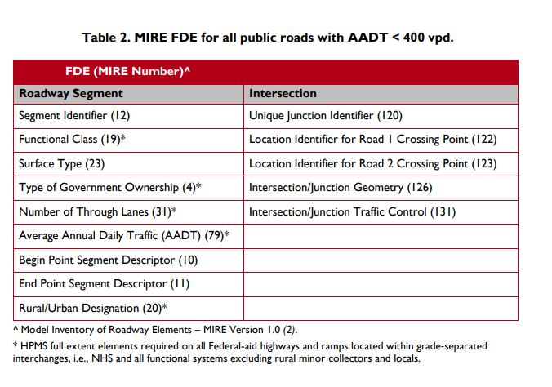
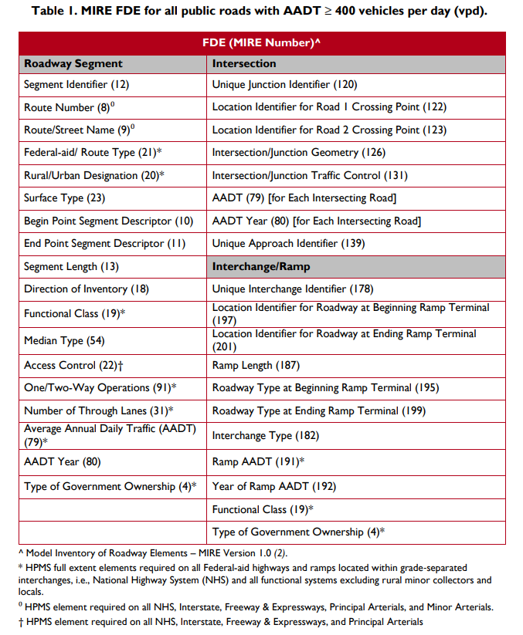
MIRE 2.0, July 2018
Fundamental Data Elements (MIRE FDE)
https://safety.fhwa.dot.gov/fde/illustrations.html
Non-local paved, local paved, unpaved

Slide 9
MMUCC (5th edition, 2017) – Crash Data Guidelines
Model Minimum Uniform Crash Criteria
Uniform crash data based on collaborations between agencies including:
NHTSA
Federal Highway Administration (FHWA)
Federal Motor Carrier Safety Administration (FMCSA)
National Transportation Safety Board (NTSB)
GHSA
State Departments of Transportation (DOTs)
local law enforcement
emergency medical services
safety organizations
industry partners
academia.

Slide 10
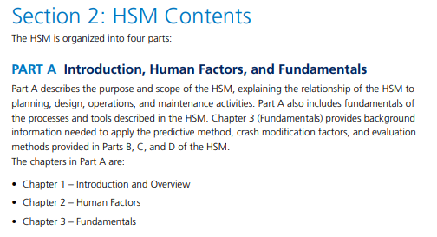
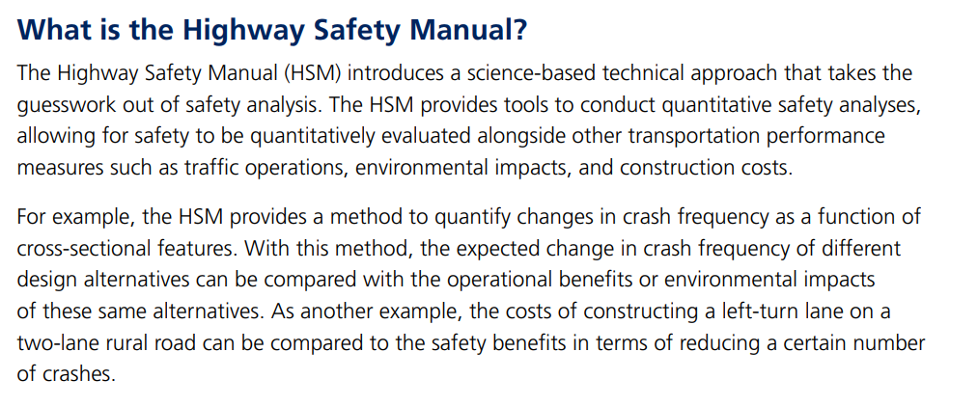
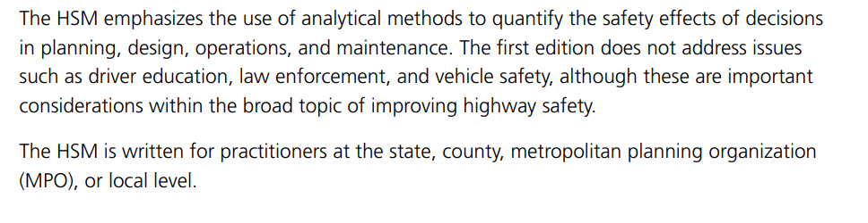
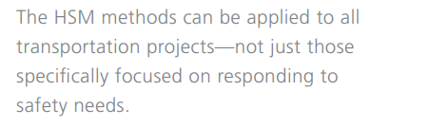
Highway Safety Manual

Slide 11
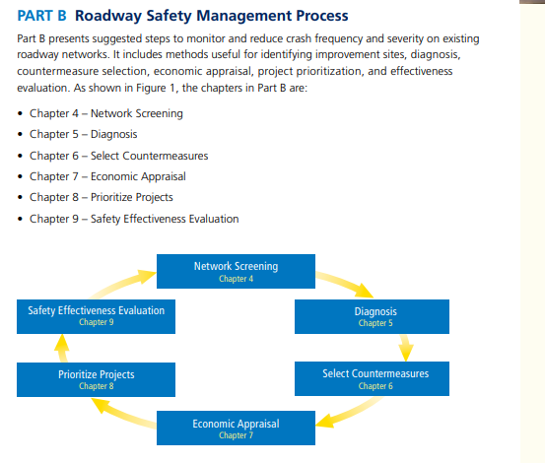
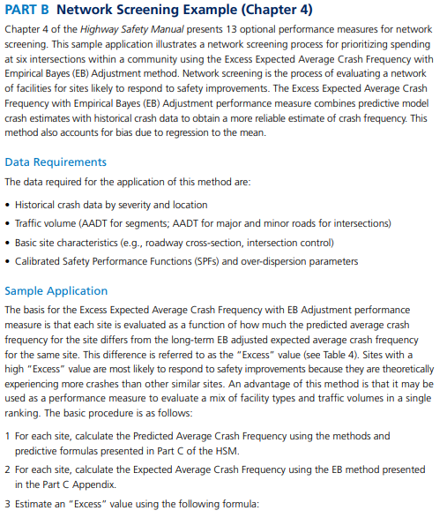
Highway Safety Manual, part B:

Slide 12
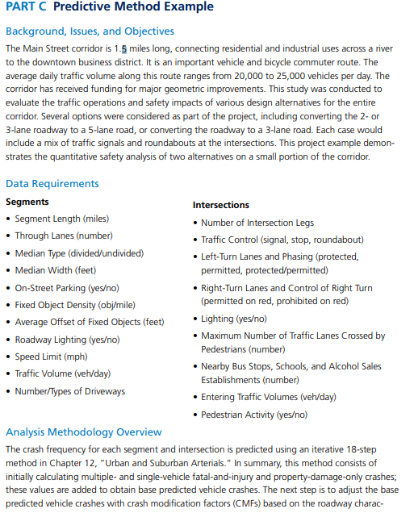
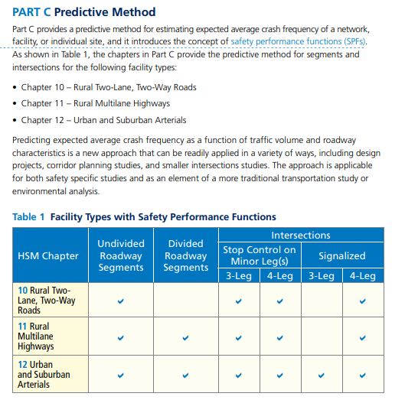
Highway Safety Manual, part C:

Slide 13
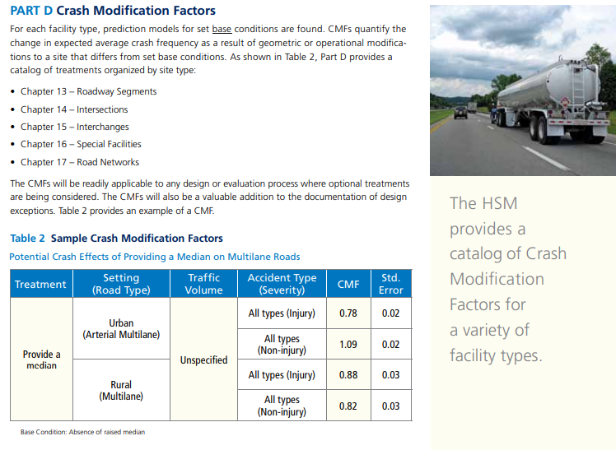
Highway Safety Manual, part D:

Slide 14
Goals
Roadway – implement statewide linear referencing
Complete MIRE minimums by 2027
All public roads, segmentation, Safety Analysis screening
Crash – automate crash locating
Intersection geocode, RefPost reference, offset from intersection
Locate-able mapped crashes by 2019
Crash modification factors, circumstances

Slide 15
DASC’s role
Scrubbing and standardizing address components of crash records
Geocode backlog of crash records (approximately 360,000 records)
Develop automated processes to geocode daily load of new crash records
Pass intersection locations back to KDOT for “offsetting”
DASC will be assuming this task in the near future
Develop interactive mapping application
Develop REST API to support simple report and data extract functions

Slide 16
Current statistics
Minimum match score accepted into database 95%
85% of all records matched with 95% score or better
Original match rate was in the mid-60’s, with a lower confidence interval
X number of records matched out of a total of Y

Slide 17
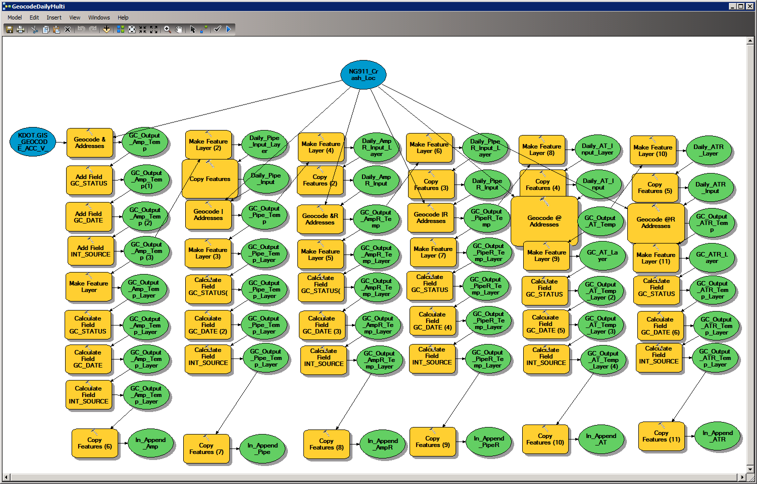
Crash map geocoding process
12 Cascading Geocoding Processes
2 inputs options (Multi vs Single) X 3 Delimiters (|, &, @) X 2 street orders (original vs reverse)
+ 2 More
County-only zone with |
County-only zone with &
County of crash is usually accurate. City is less reliable.
Multi Field vs Single Line Input
Results may vary, but they shouldn’t
Multi Field is much faster (less parsing)
Cascade Zones
Often confidence in one Zone is high (e.g., City or County)
while other Zone is low (e.g., ZIP)
Consider standard length codes for each zone

Slide 18
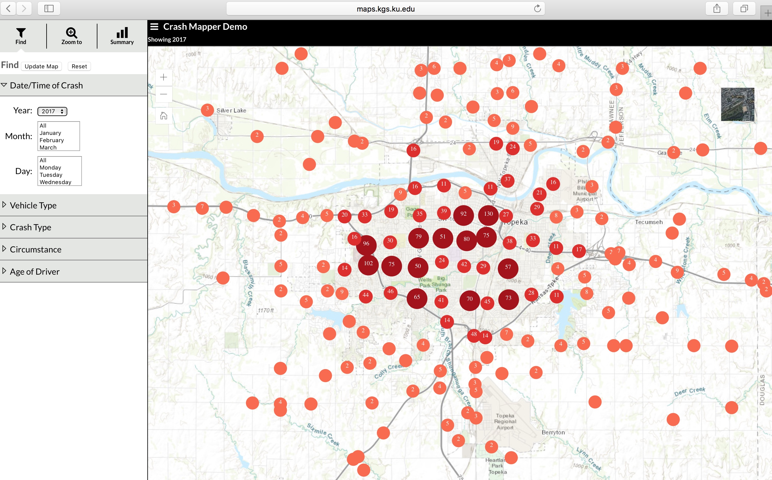
Crash Mapper

