Slide 1
Kansas
GIS Policy Board
September 8, 2017

Slide 2
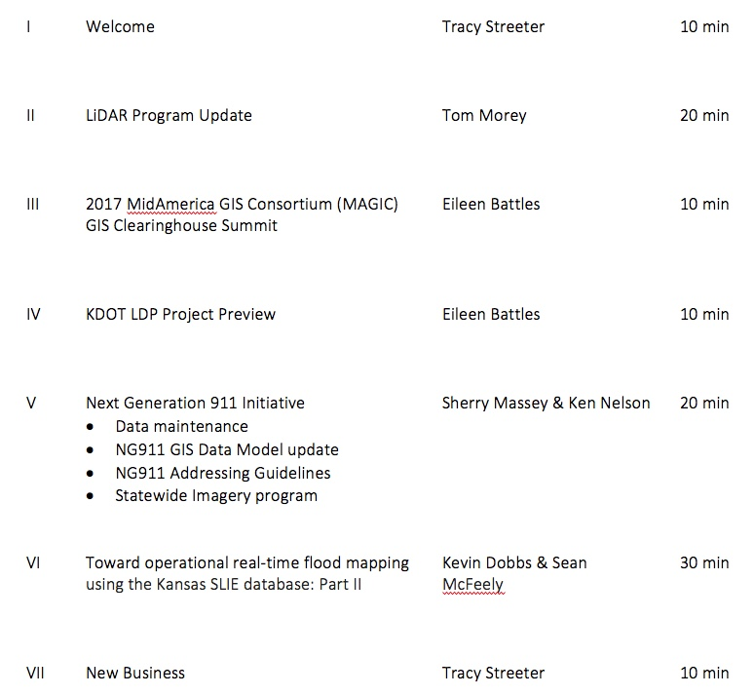
Meeting agenda
https://kansas.zoom.us/j/280140771
Conference Line: 646-558-8656
Participant Code: 280 140 771

Slide 3
LiDAR Program Update
Tom Morey

Slide 4
MAGIC GIS Clearinghouse Summit
Eileen Battles

Slide 5
KDOT Regional Coordinate System – initiative website
Eileen Battles

Slide 6
Next Generation 911
Data Maintenance
100% compliance 2nd Quarter w/95 counties submitting new data and 10 reporting no changes
Version 2.1 of the GIS Data Model went out for public review this morning with comments due back by Sept 22.
GIS Committee working on address assignment guidelines, per public request

Slide 7
NG911 Imagery Update
Status update:
Currently processing agreement extension through procurement office
Project highlights:
Statewide, leaf-off, 1-foot, natural color & CIR, acquired 2018/19
Access to 1’ version of NAIP imagery in file-based and web service formats:
2015
2017
1 – meter, leaf-on, available via APFO/DASC
Public domain release of 2014/15 1-foot, leaf-off, imagery
Buy-up options for local jurisdictions

Slide 8
Real-time Flood Mapping
Sean McFeely
Riverside Technology
www.riverside.com

Slide 9
New business
National States Geographic Information Council – September 25-29, 2017, Providence, RI
Kansas Association of Mappers – October 17-20, 2017, Lawrence, KS
Next GIS Policy Board Meeting: November 3, 2017, 10:00 am – noon, 509 Landon State Office Building

