Slide 1

GIS Policy Board LiDAR Update
Sep. 8 2017

Slide 2
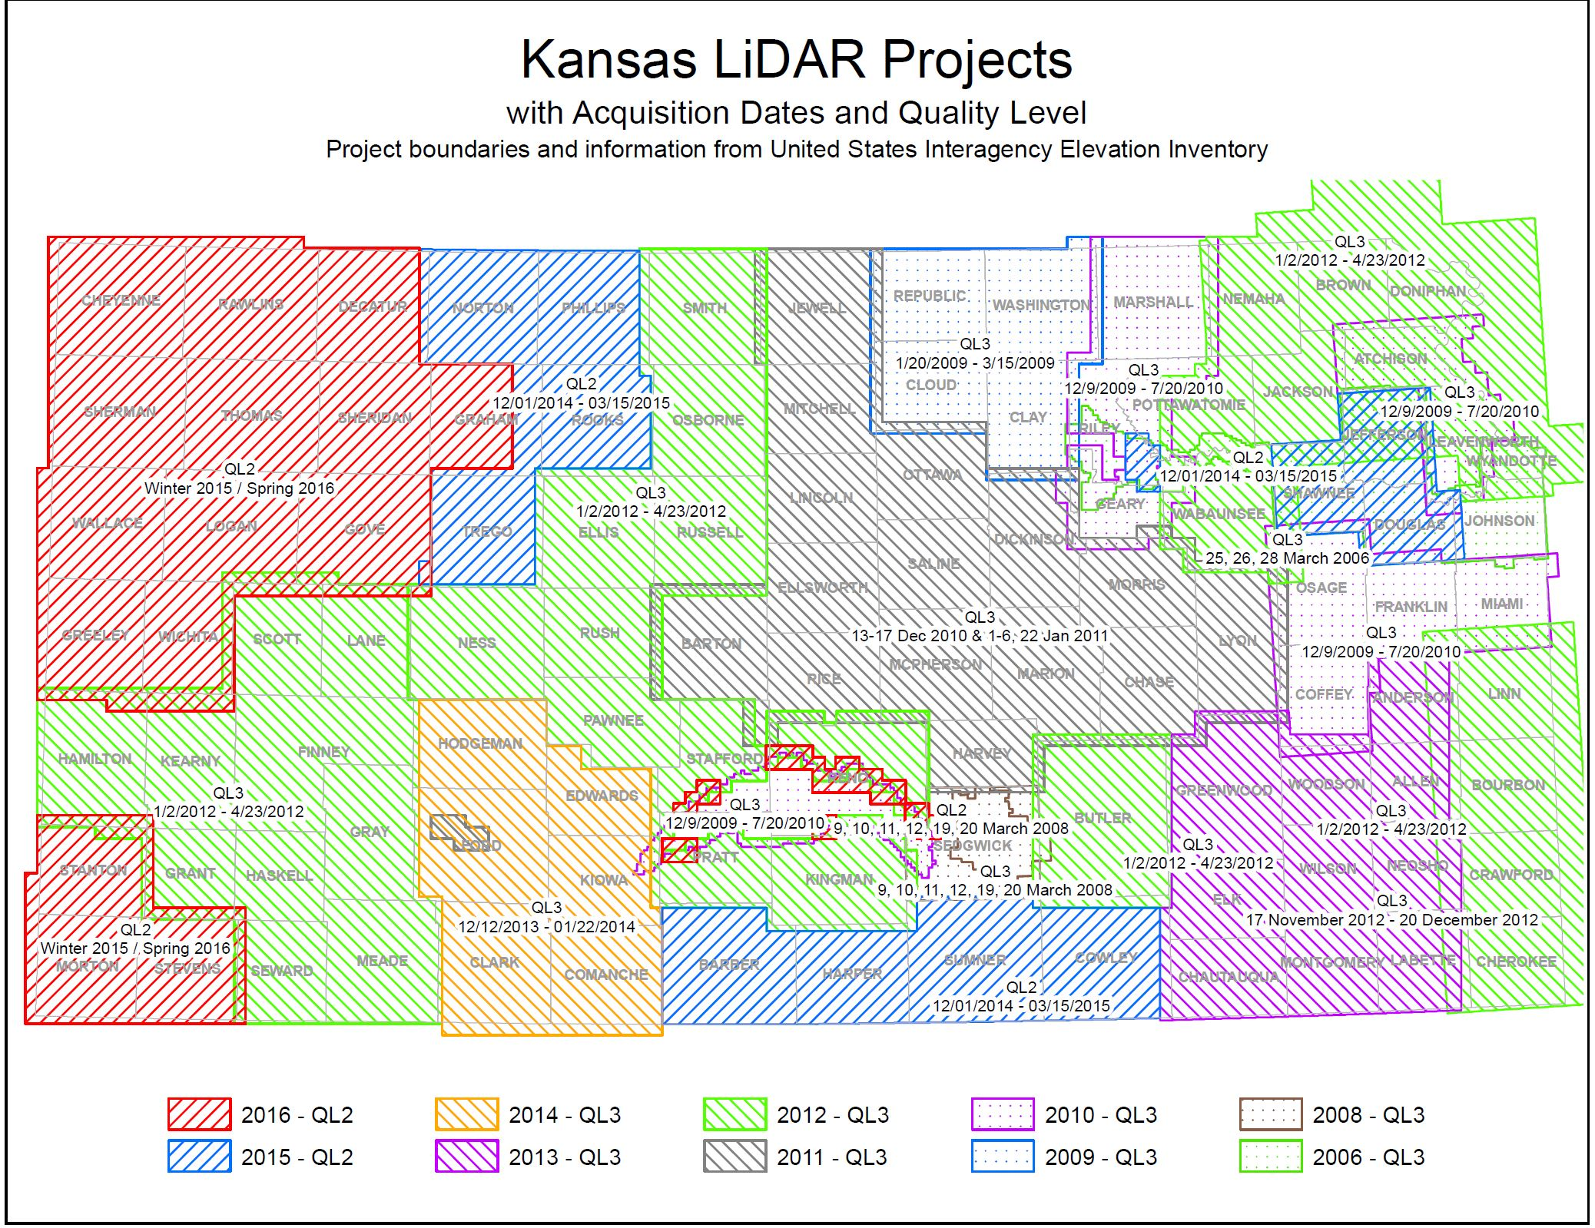

Slide 3
2017 Project Update
Republic, Cloud, Washington, Clay
All four counties captured and data development underway
Should be completed within the next month
Will submit 3DEP application and submit for QA/QC when approved by USGS

Slide 4
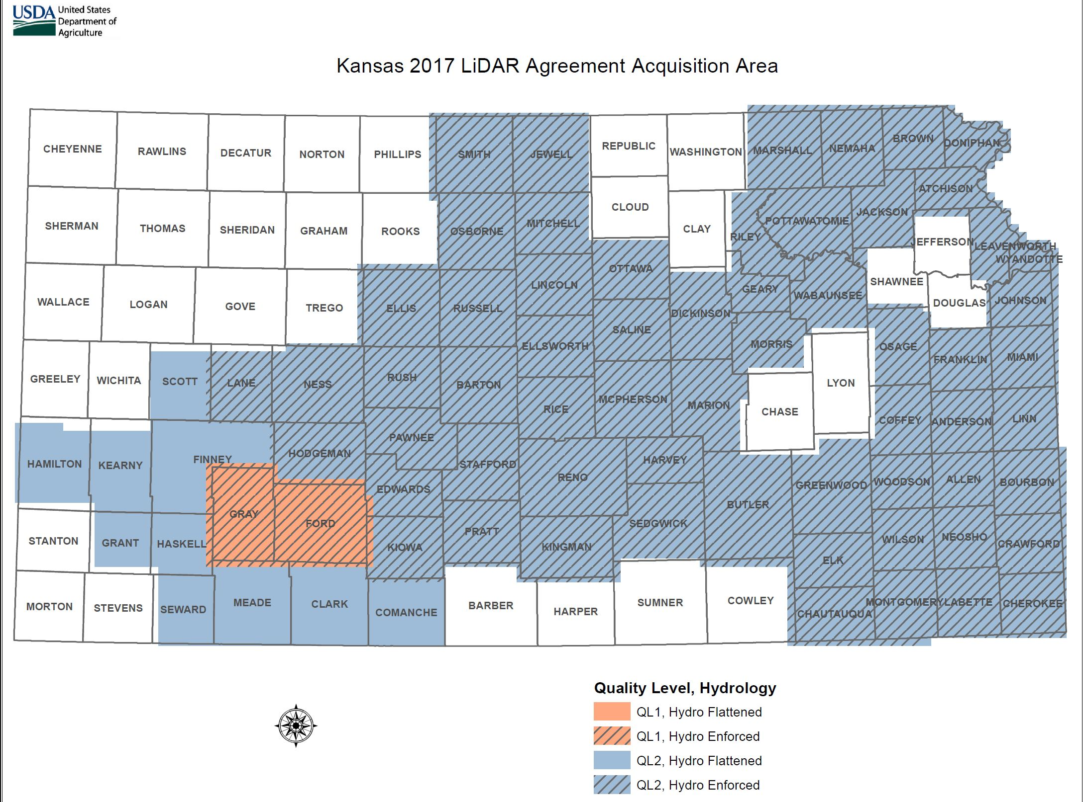
2018 NRCS Project Submittal

Slide 5
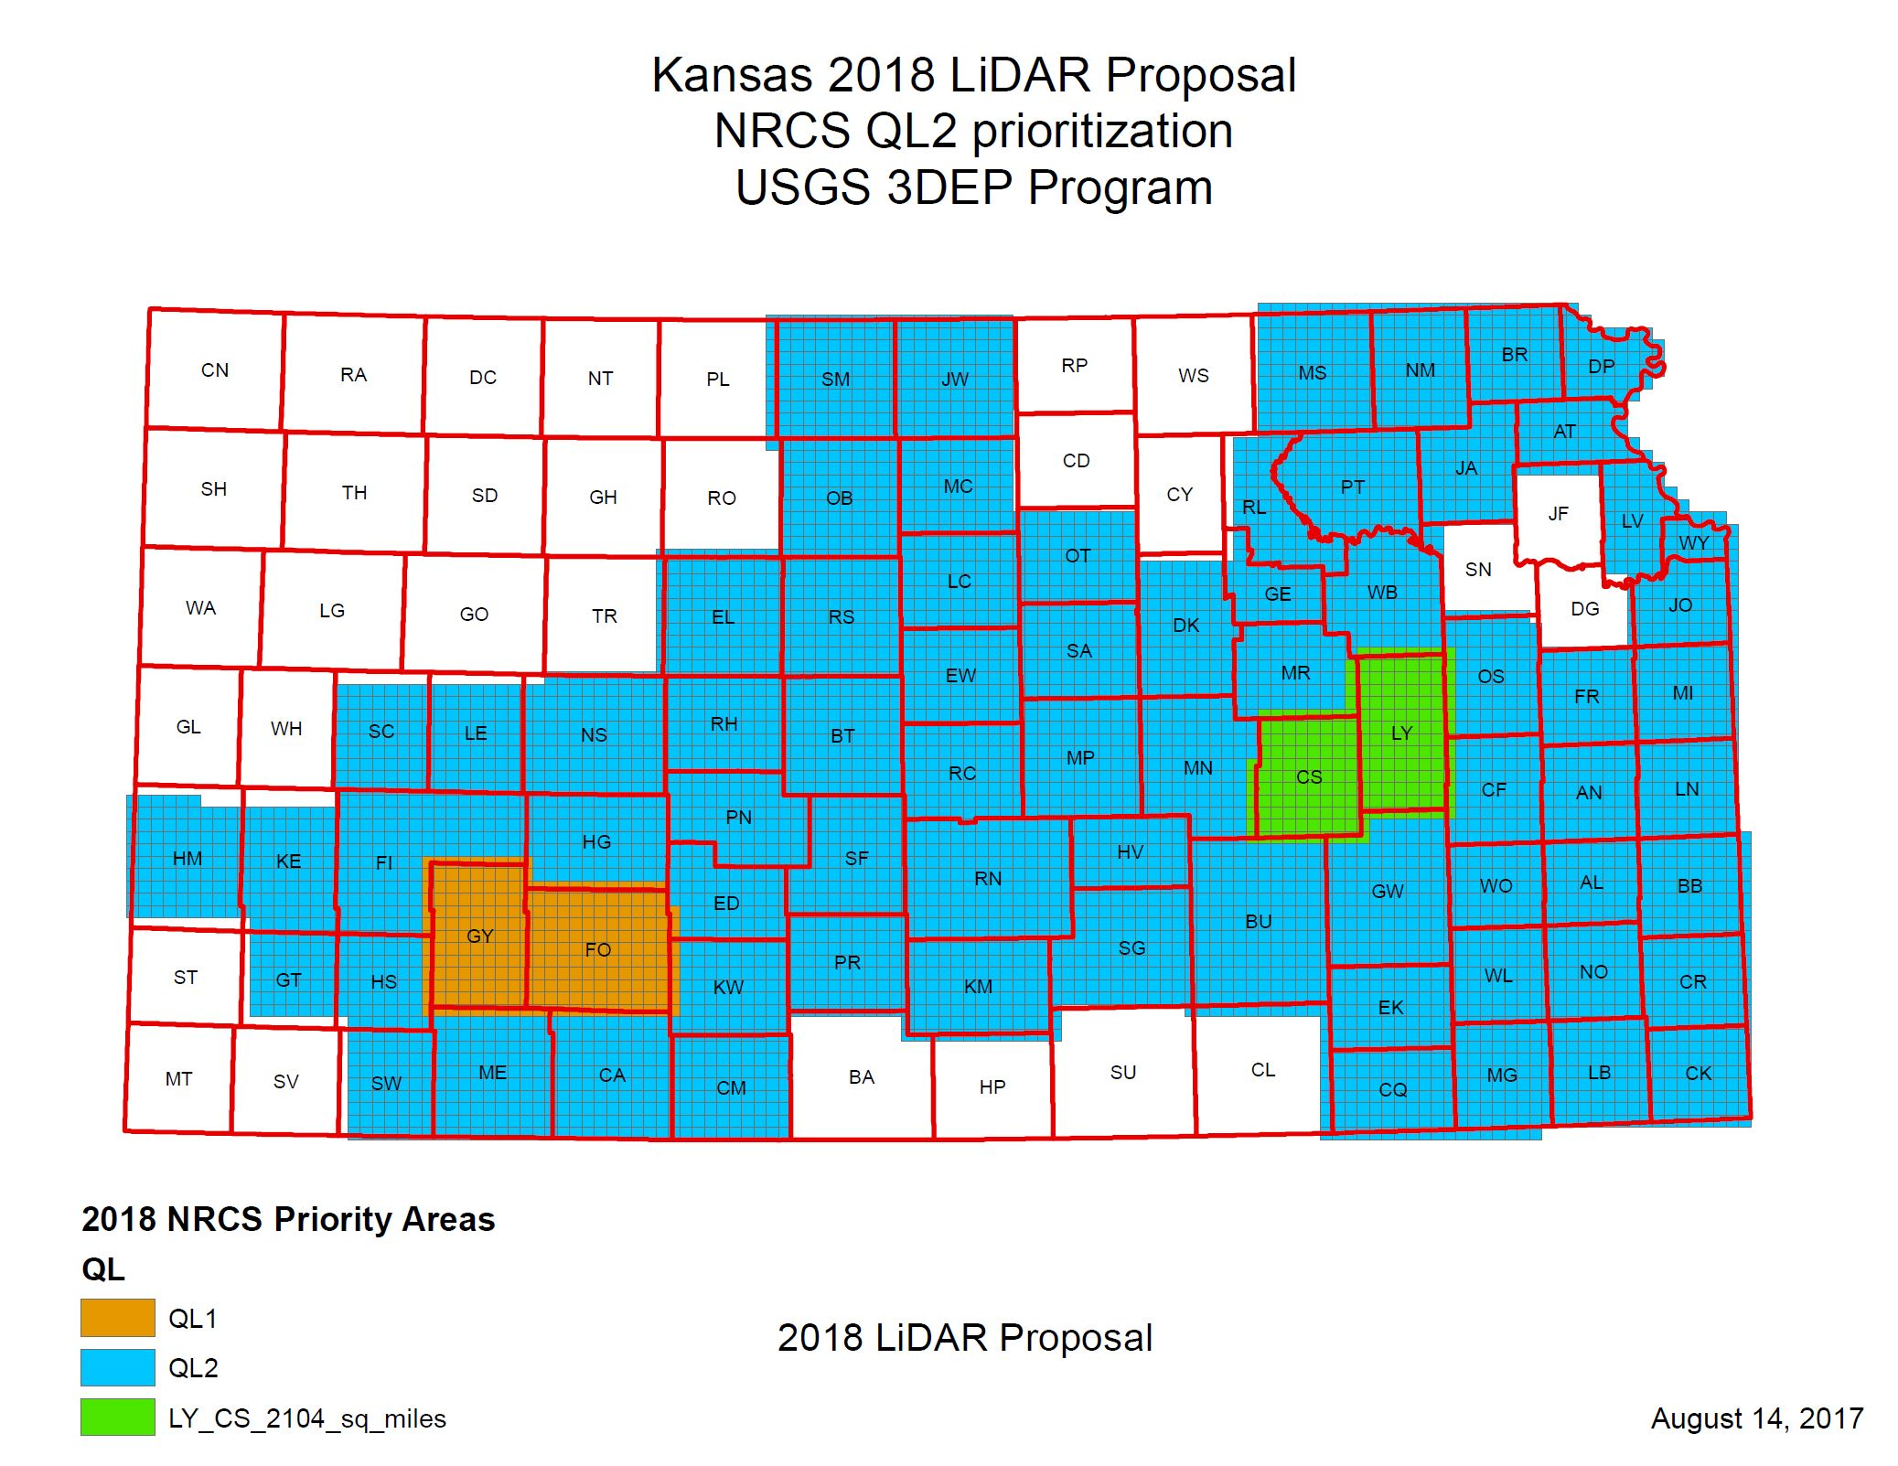
2018 USGS 3DEP Proposal

Slide 6
2018 USGS 3DEP Proposal
Acquisition of LY-CS
2104 sq. miles
Will be flown this fall/winter
QA/QC of 2017 Project (RP, WS, CD, CY) and LY-CS
5423 SQ. Miles
$239,129
NRCS Project Commitment: $5,930,000
Total Project: $6,169,129
51,930 sq. miles.

