Slide 1
Kansas
GIS Policy Board
May 12, 2017

Slide 2
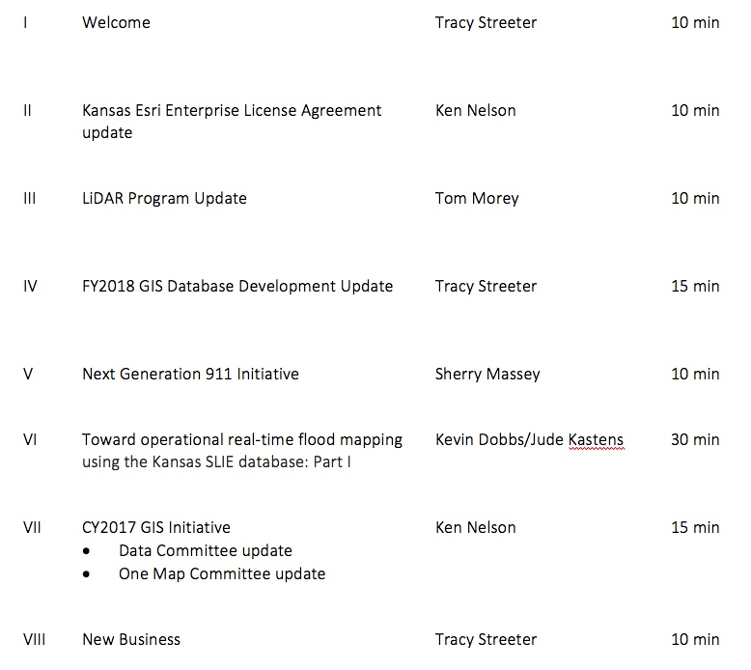
Meeting agenda
https://global.gotomeeting.com/join/300171301
Conference Line: 641-715-3395
Participant Code: 1054194

Slide 3
Esri Enterprise License Agreement
Two types of agreements…
Master Purchase Agreement (MPA)
Defines price schedule for all Esri products and services
Software, consulting services, 3rd party royalty products, etc
Available to state and local jurisdictions
Enterprise License Agreement (ELA)
Negotiated flat-rate agreement that defines access to a specific set of Esri products & services
Unlimited access to Esri core technology
Limited access defined for other products such as ArcGIS Online
Kansas ELA available to state government only

Slide 4
Esri Enterprise License Agreement
ELA History
Original 3-year agreement:
  February 1, 2011 – January 31, 2014
1-year extension February 1, 2014:
  January 31, 2015
Current 3-year agreement:
  Year 5 – February 1, 2015 – January 31, 2016
  Year 6 – February 1, 2016 – January 31, 2017
  Year 7 – February 1, 2017 – January 31, 2018

Slide 5
Esri Enterprise License Agreement
Why?
Unlimited access to core technology
Substantially reduced procurement costs
Flexibility to deploy the necessary software products when and where needed
Allows agencies to experiment with different software packages and configurations before purchasing
Standardized budget over the term of the agreement
Improved coordination across enterprise

Slide 6
Esri Enterprise License Agreement
Renewal process:
ELA Stakeholder Meeting #1 – April 17, 2017
ELA Stakeholder Meeting #2 – May 16, 2017
Organize information collected from meetings, discussions with Esri to help right-size/tune the ELA to the Kansas application – May/June, 2017
Presentation to OITS leadership – June/July, 2017
Initial Esri offering & negotiation process – July, 2017
Finalize new three agreement – August, 2017

Slide 7
LiDAR Update
2016 North AOI
  15,000 sq miles
  Sent to NGTOC for review on April 22, 2017
  Will be provided to DASC upon acceptance
  Will complete statewide coverage

Slide 8
LiDAR Update
Quality Level (QL) 2 & 3 coverage

Slide 9
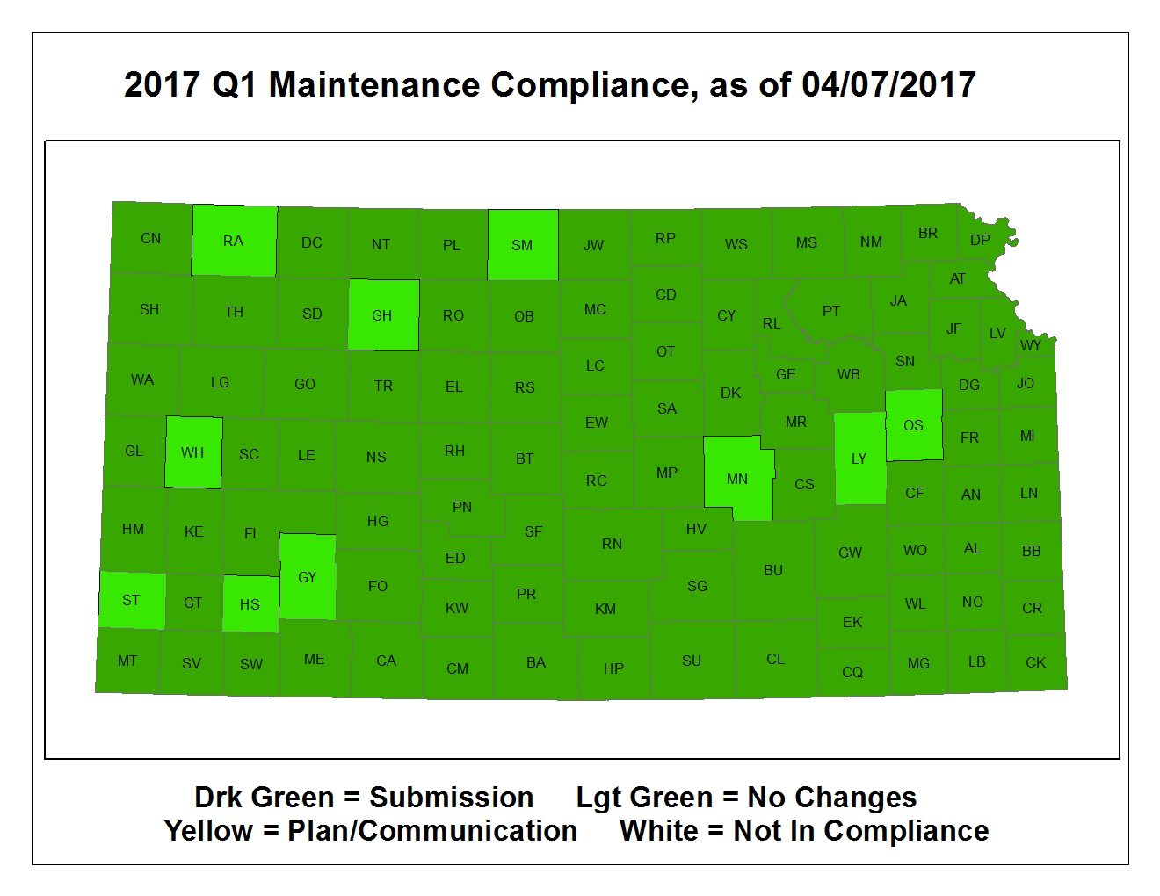
Next Generation 911
CY2017 – Q1 Data Maintenance

Slide 10
Next Generation 911
Hosted System Deployment – 56 PSAPs now live on the system

Slide 11
Next Generation 911
Other project highlights:
Kansas first state to sign onto AT&T Nationwide Emergency Services IP Network (ESInet)
Statewide high-res imagery refresh planning
Spring/Summer 2017 GIS Data Maintainer & Data Steward training schedule
  Sedgwick County Emergency Operations Center
  Wichita, KS - May 9, 2017
  Finnup Center at Lee Richardson Zoo
  Garden City, KS - June 20, 2017
  Fort Hays State University
  Hays, KS - July 19, 2017
  Allen County Community College
  Iola, KS - July 25, 2016
  Lawrence Public Works
  Lawrence, KS - August 16, 2017
NG911 GIS Committee meeting this summer to discuss data model updates - v2.1
NG911 Summit meetings:
  Nebraska summit held in January, 2017
  Working on scheduling Oklahoma – tentatively planned for August

Slide 12
Real-time flood mapping
Toward operational real-time flood mapping using the Kansas SLIE database: Part I – Kevin Dobbs, Jude Kastens

Slide 13
2017 GIS Initiative Planning
Data Committees
One Map Committee

Slide 14
New business
Next GIS Policy Board Meeting: July 7, 2017, 10:00 am – noon, web conference

