Slide 1
NG911 Update
March 10, 2017

Slide 2
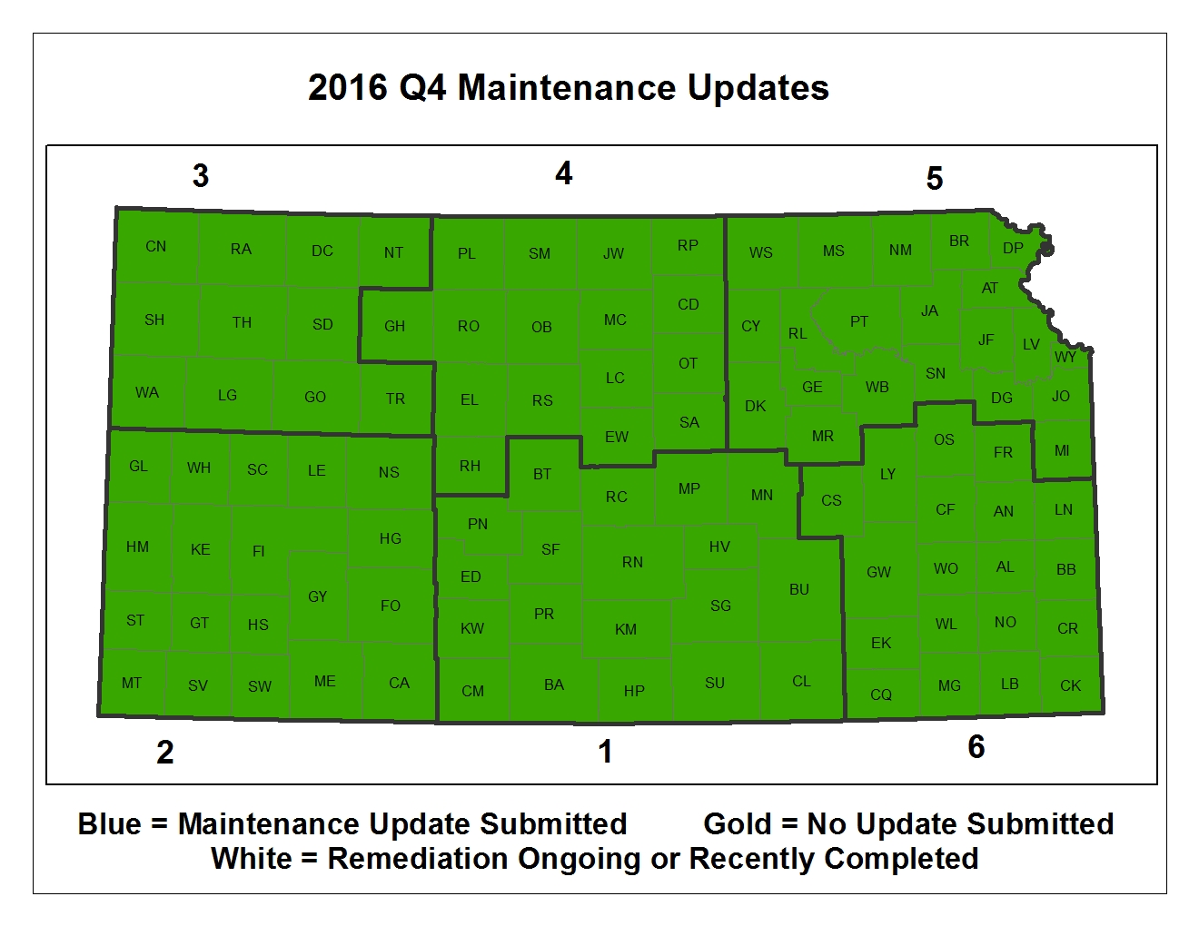

Slide 3
2016 Quarter 4: 100% Participation
2017 Quarter 1: Deadline March 31
26 Counties have submitted updates
First time successive “No Change” reports will be evaluated for compliance. Two counties are on that bubble.

Slide 4
Update Items
Call Handling implementation: 48 PSAPs
Next Maintenance deadline: March 31st
Operating on Version 2.0 of the Data Model
Authoritative Boundary aggregation
GIS/MSAG Alignment

