Slide 1
LiDAR Update
Tom Morey
Kansas Department of Agriculture
March 10, 2017

Slide 2
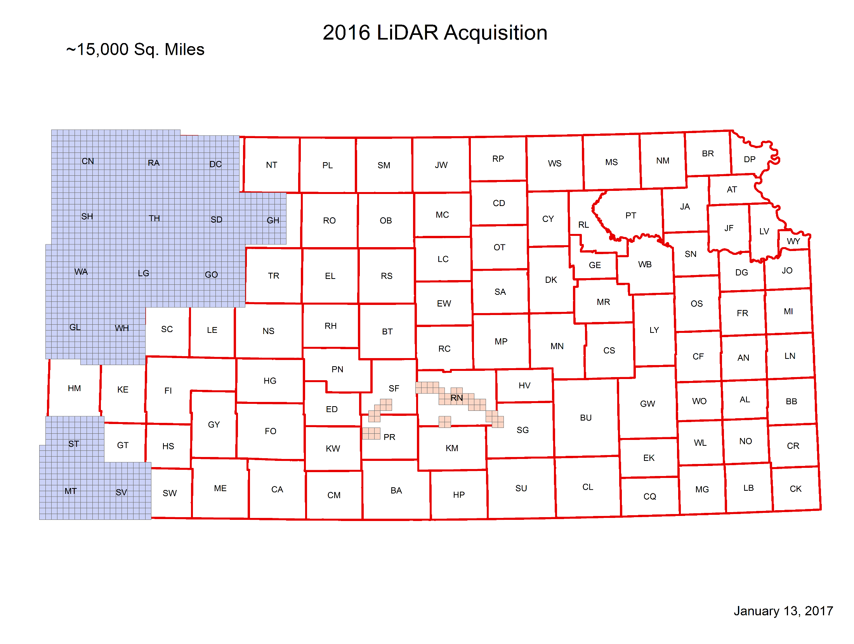

Slide 3
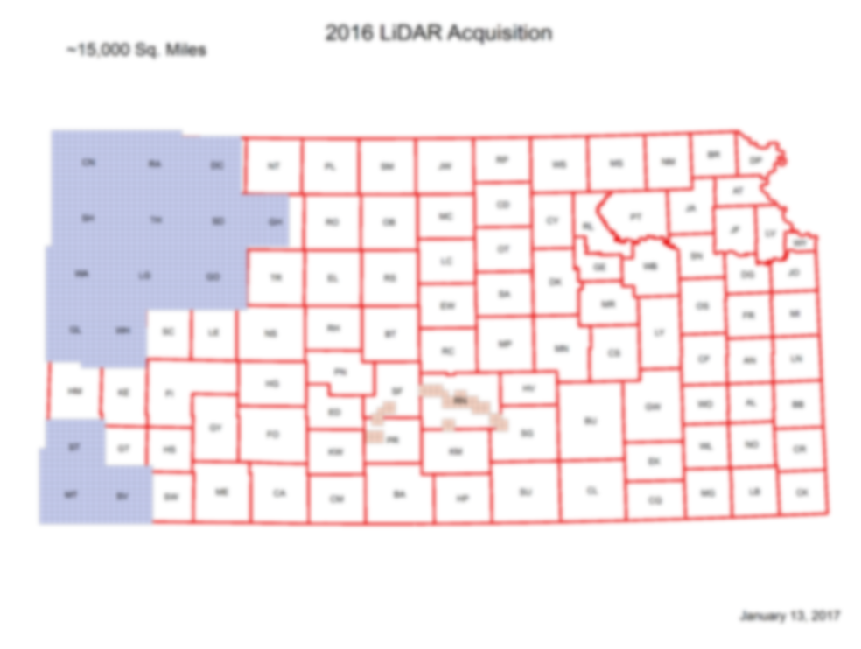
Cheney and SW KS
Approved by NGTOC
Delivered to DASC
Discussion of tile specific metadata
NW KS Delivered to Dewberry
Delivered to Dewberry
Expect comments and corrections in March followed by delivery to NGTOC

Slide 4
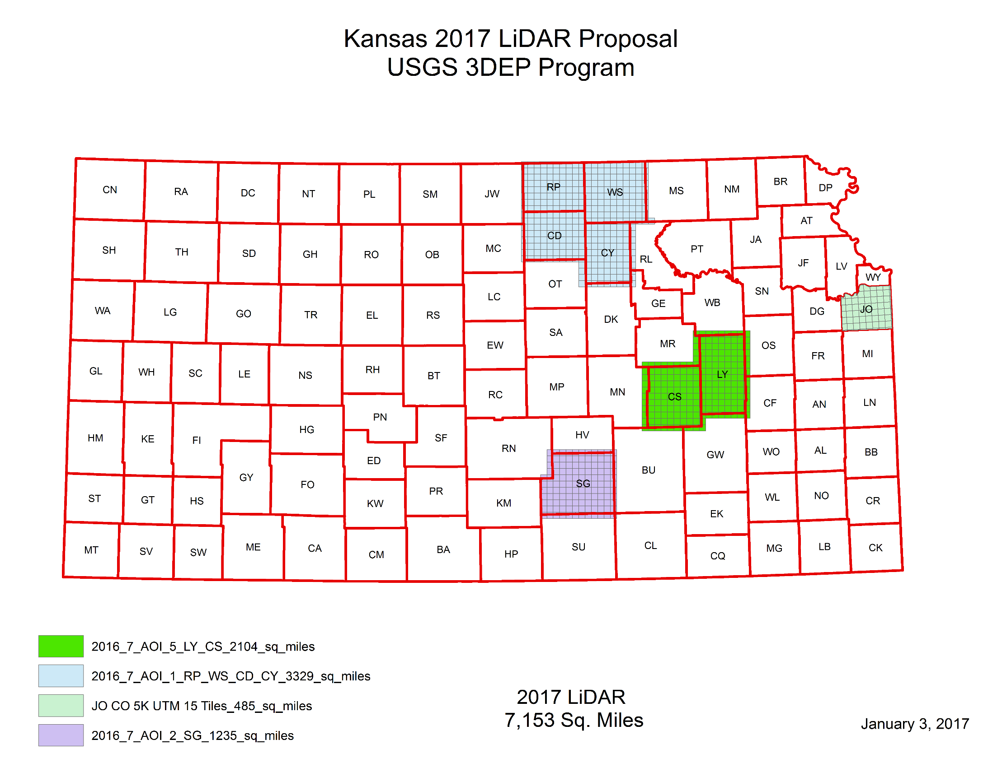
2017 Project

Slide 5
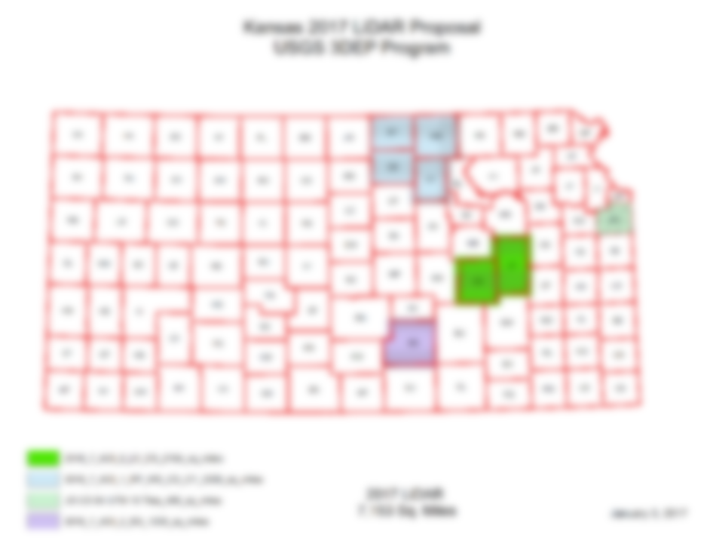
2017 Project
2017 Project Update
RP, WS, CD, CY
Acquisition 80% Complete
Finalizing in the next few weeks
Problem Report for Remaining Areas
Johnson County and Sedgwick County/Wichita
Lyon/Chase
USGS Application

Slide 6
Corrective Measures
Finalize USGS application
Develop acquisition plan for fall 2017—Lyon an Chase
Potential NRCS funding
Priorities include non-QL2 areas
Osage, Coffey, Franklin, Miami
Johnson County ???
Sedgwick County/Wichita???

Slide 7
Status Map

Slide 8
QUESTIONS?

