Slide 1


Kansas GIS Initiative
Data Committees

Slide 2
Data Committee Responsibilities
5-7 member committees
Meet regularly
  Frequency determined by committee…monthly, quarterly
Data asset review
  What do we have?
  Assess current condition
  Determine ideal condition?
  Gap analysis
  Kansas One Map certification
Be aware of local, state, and national programs and standards that impact the data theme
Report on progress and findings to GIS Policy Board
Attend and present at annual meeting, potentially held in conjunction with the KAM conference

Slide 3
Proposed Data Committees
Administrative Boundaries, Cadastral/Real Estate
Critical Infrastructure and Structures
Cultural and Recreational
Elevation & Imagery
Environmental Resources & Water Resources
Land Surface/Geology/Soils
Transportation
Utilities and Energy Resources
Water Resources

Slide 4
Data asset review workflow
Kansas One Map
Data Assessment
Long-term
Plan
Data Layer
Condition/fitness for use
Metadata
Authoritative
Adheres to applicable standards
Use case/purpose
Data maintenance strategy
Funding strategy
Future enhancements
Cost & gap
Tell the story
Build the story

Slide 5
Data asset review workflow
Kansas One Map
Data Assessment
Long-term
Plan
Land Cover
Last update = 2015
Metadata = Y
Authoritative = Y
Adheres to applicable standards = Y
Data maintenance strategy = data should be updated every 10 years
Cost = $250,000
Funding strategy = Previous projects have been funded by the KWP/GISPB and KDWPT, with in-kind support from the Kansas Biological Survey. With steep cuts to the GIS PB data development funds, alternate funding sources need to be identified.
Future enhancements = unknown at this time
Kansas NG911 Road Centerline Database
Kansas NG911 Address Points
Kansas Land Cover Patterns – 2015
KGS Surficial Geology
LiDAR
…
Build the story
Tell the story

Slide 6
Better answer important questions
Information discovery…build a more exhaustive data catalog
Document use cases that support development and maintenance of individual data layers
Develop gap analysis for specific layers, themes, or programs
Supports long-range strategic & business planning
How much does $X cost?

Slide 7
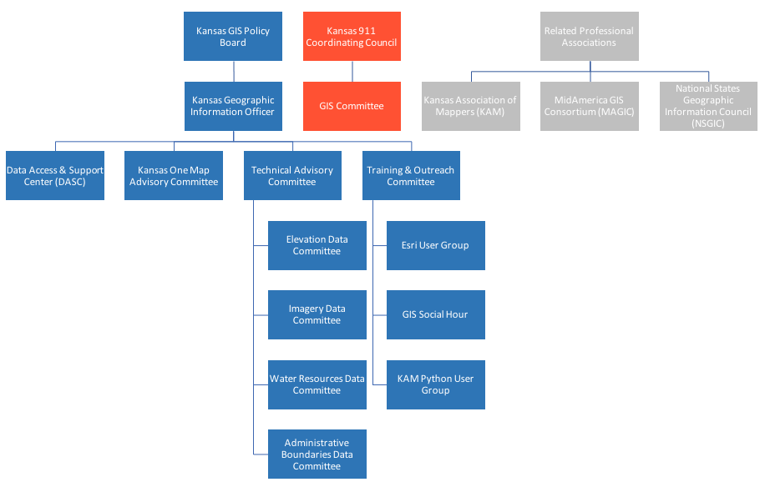
GIS Initiative Components – draft example

Slide 8
Start today
How do we get started?
  DASC will facilitate effort
  Reports will follow standard format
  Start simple, be flexible
  Just get started!
Still looking for volunteers
  Email battles@kgs.ku.edu
  Chairs and SME

