Slide 1
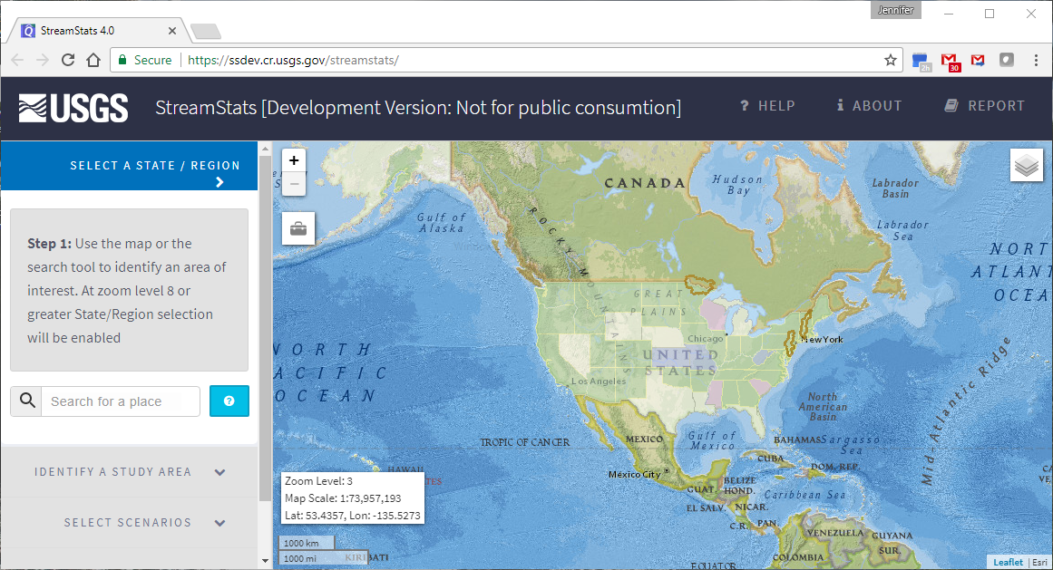
USGS StreamStats is a Map-based Web Application
StreamStats uses geographic information system (GIS) software and programming techniques to extract watershed parameters with minimal time and resources.
One nation-wide interface

Slide 2
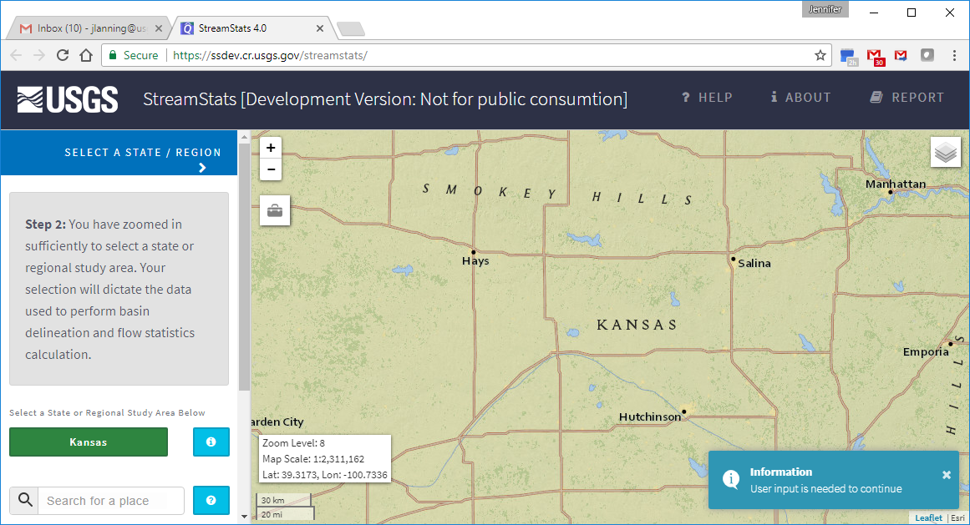
Step-based

Slide 3
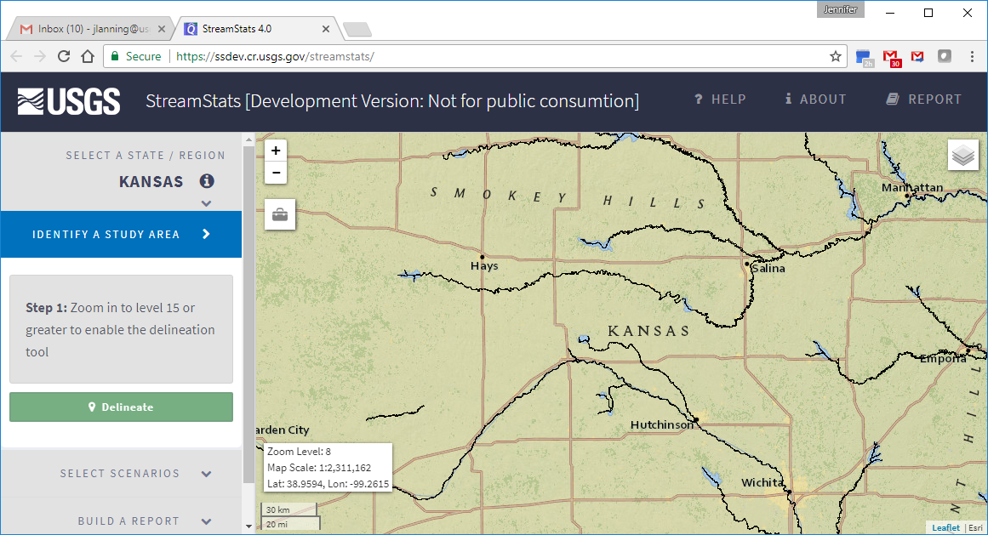
Zoom-in to select a point

Slide 4
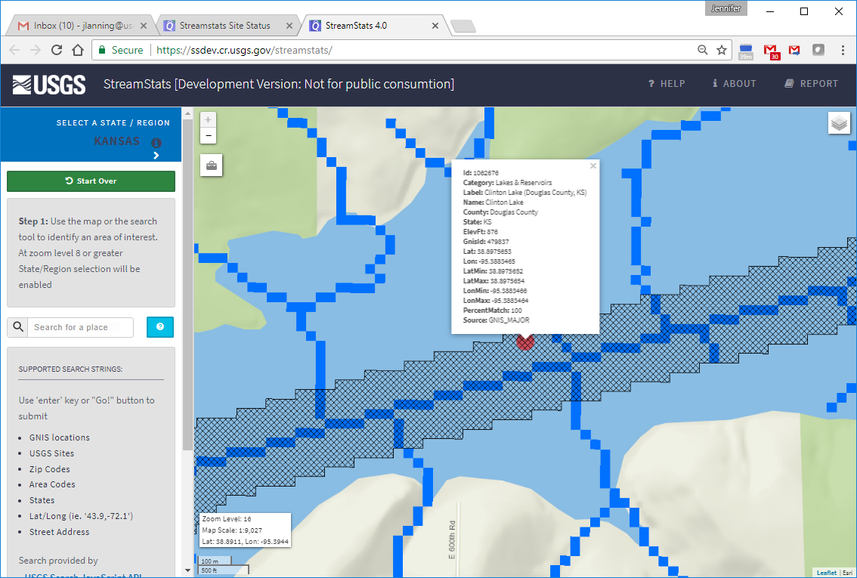
Pan or Search
Notes:
SUPPORTED SEARCH STRINGS:
Use 'enter' key or "Go!" button to submit
GNIS locations
USGS Sites
Zip Codes
Area Codes
States
Lat/Long (ie. '43.9,-72.1')
Street Address
Search provided byUSGS Search JavaScript API

Slide 5
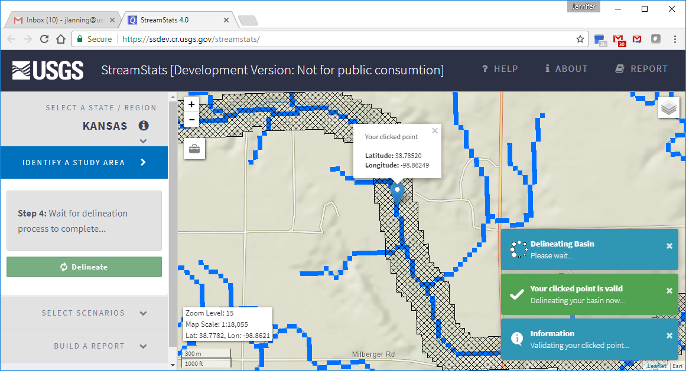
Watershed Delineation from a Point

Slide 6
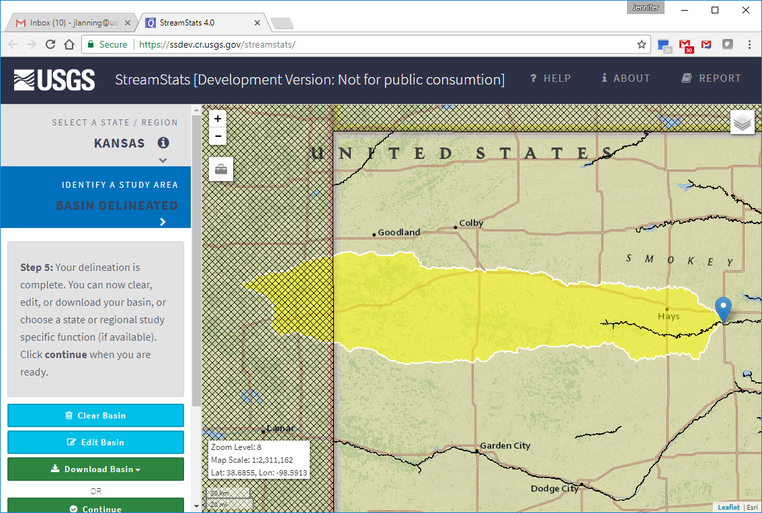

Slide 7
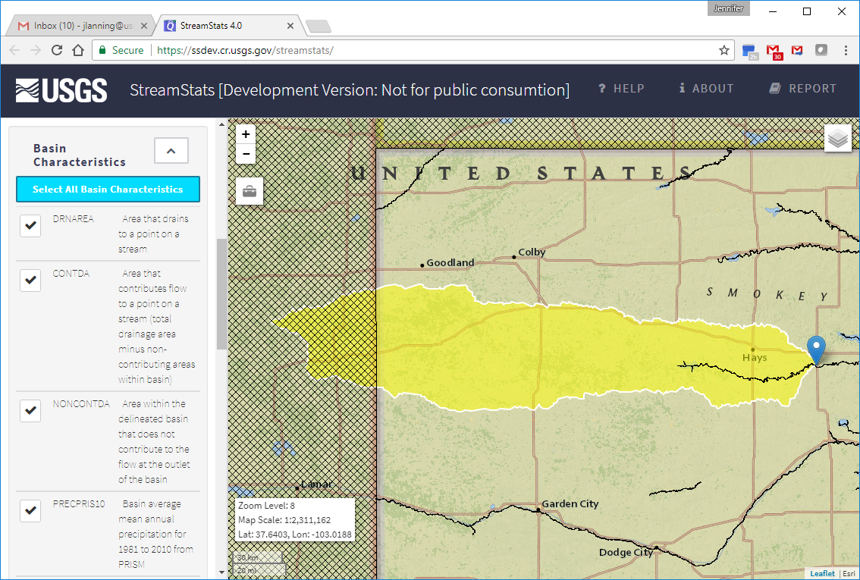

Slide 8
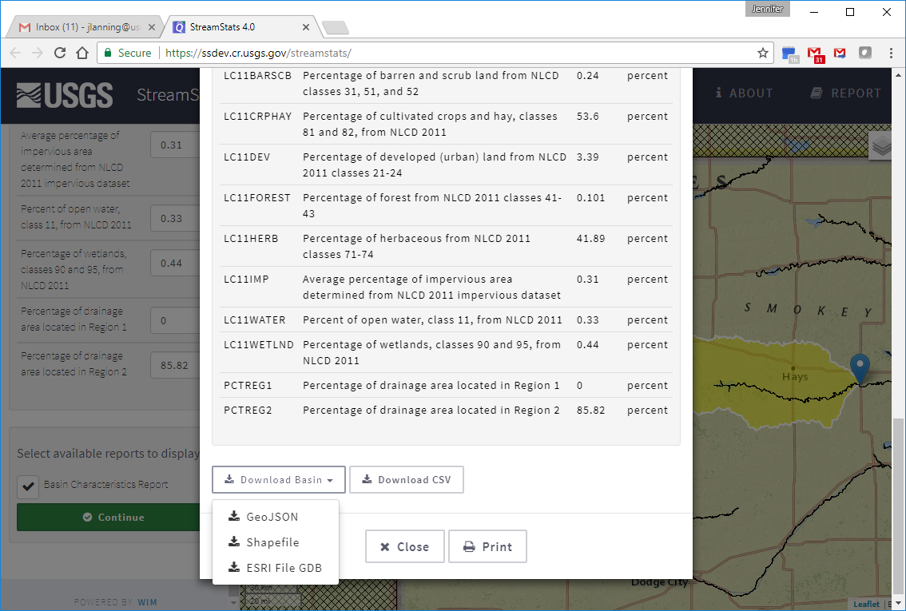
Basin Characteristics Report

Slide 9
StreamStats Introductory WebEx for Kansas Cooperators
Date: Wednesday, August 23, 2017
Time: 10:00 am
https://usgs.webex.com
Meeting number: 715 380 698
Meeting password: Kansas
Teleconference: Call-in number 1-703-648-4848 code 88468107#

Slide 10
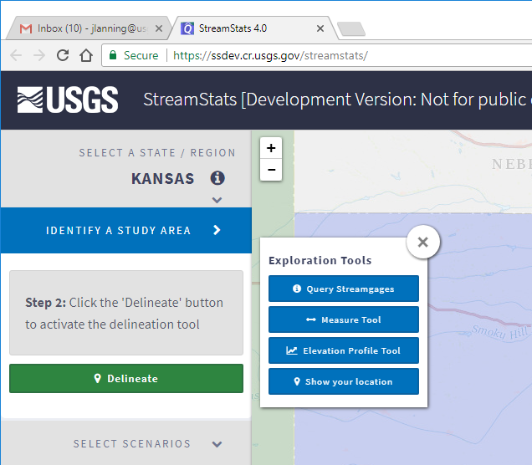
Tools

Slide 11
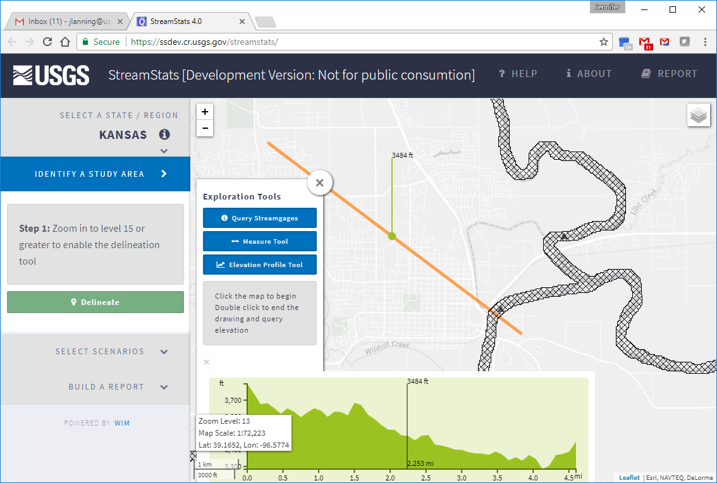

Slide 12
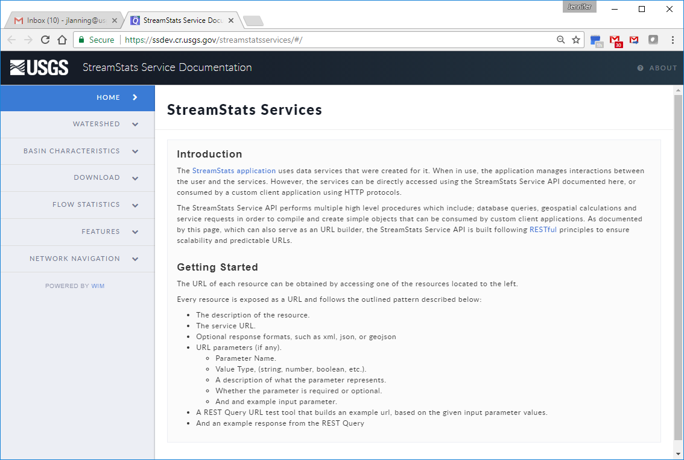
Web services

