Slide 1

GIS Policy Board LiDAR Update
5-13-2016

Slide 2
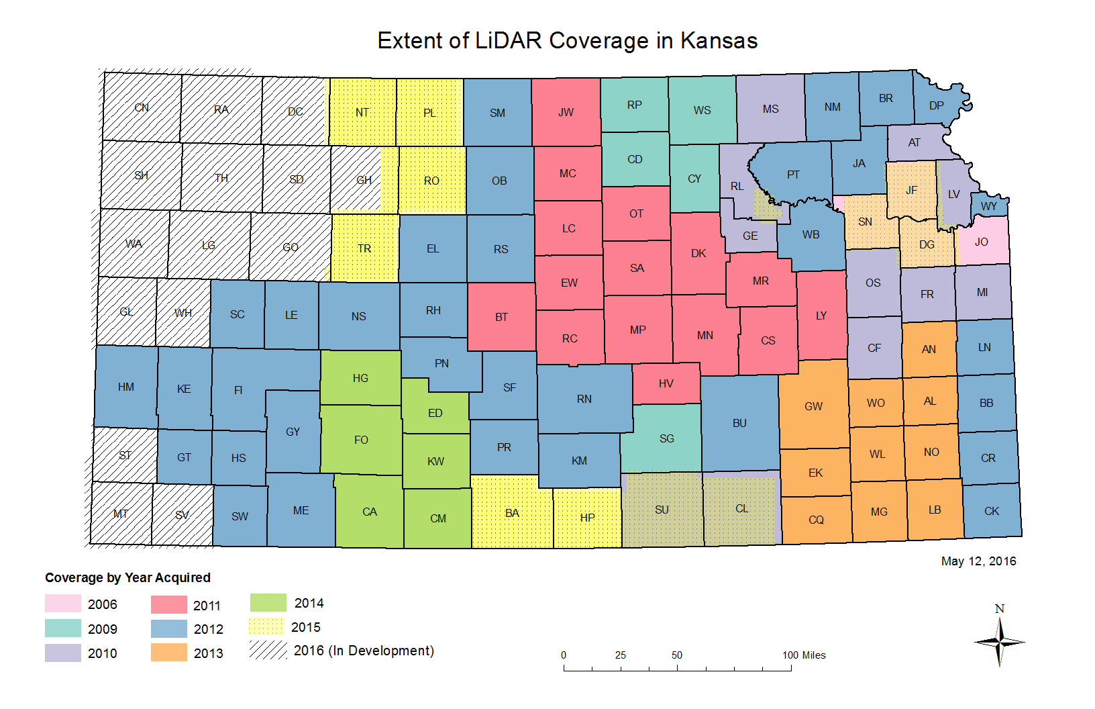

Slide 3
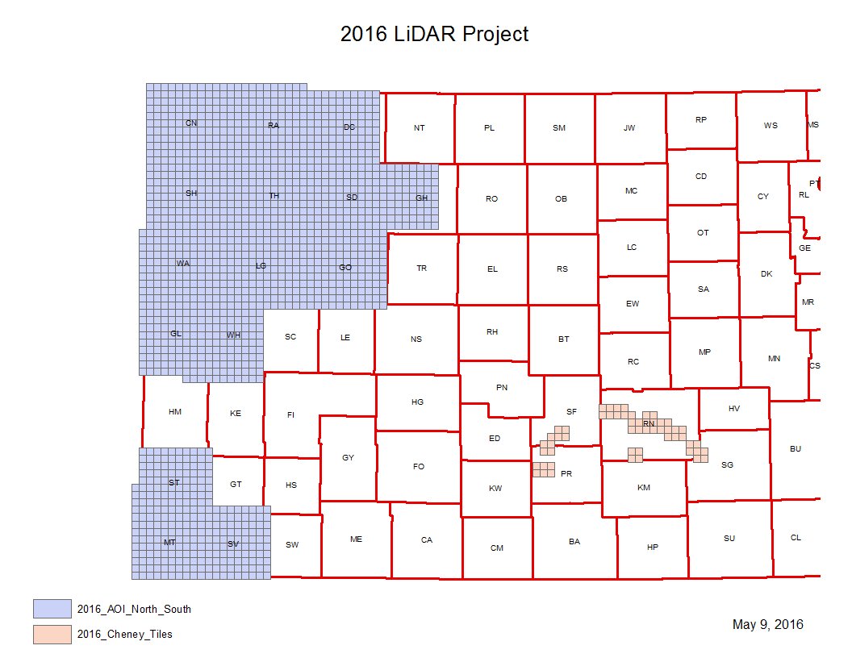
2016 Project update

Slide 4
2016 Project Update
South AOI and Cheney Tiles have passed independent QA/QC and also NGTOC Review
Are available now on DASC and National Map
North AOI has passed independent review
Submitted to NGTOC for their review

Slide 5
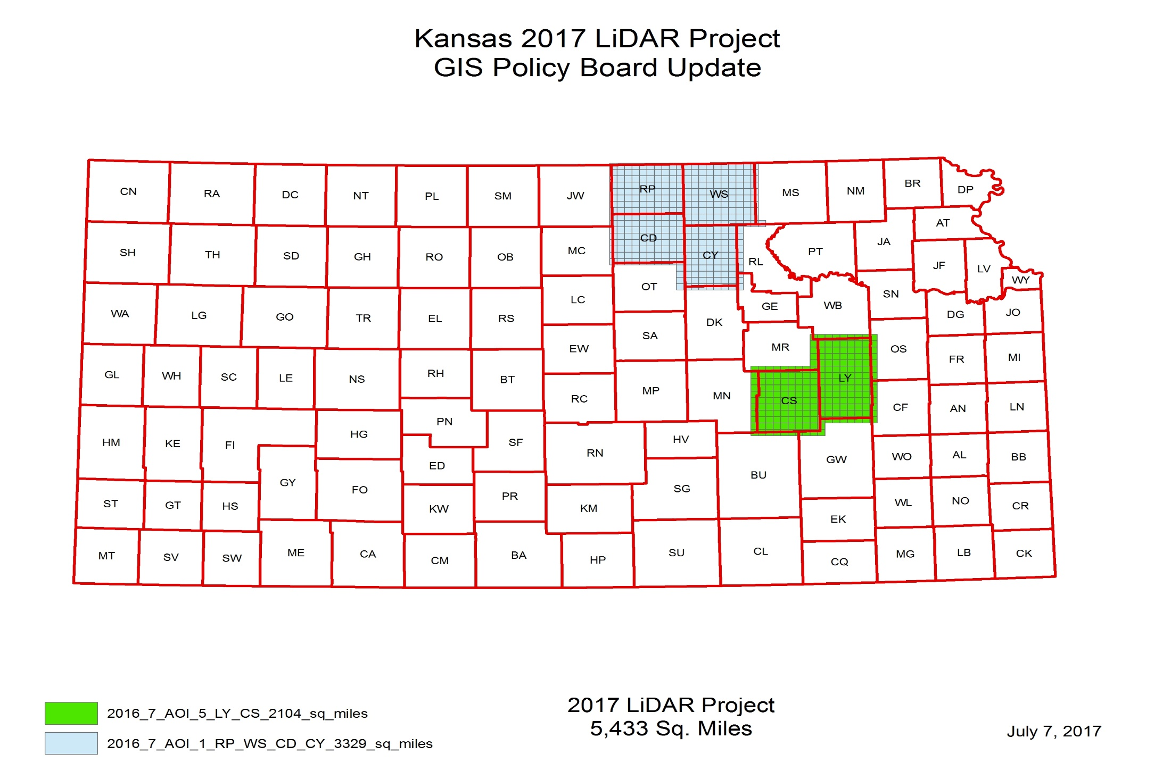
2017 Project Update

Slide 6
2017 Project Update
Republic, Cloud, Washington and Clay have all been captured
Working on data development
Lyon and Chase will be part of 2018 3DEP application

Slide 7
2018 Proposed Project

Slide 8
2018 Proposed Project
Lyon and Chase will be a part of this project
2017 GIS Policy Board funds
2018 USGS 3DEP application
Ongoing discussions with Johnson and Sedgwick Counties
Attempted to get agreements last year
Johnson County is likely, unsure about Sedgwick
NRCS

