Slide 1
Kansas
GIS Policy Board
July7, 2017

Slide 2
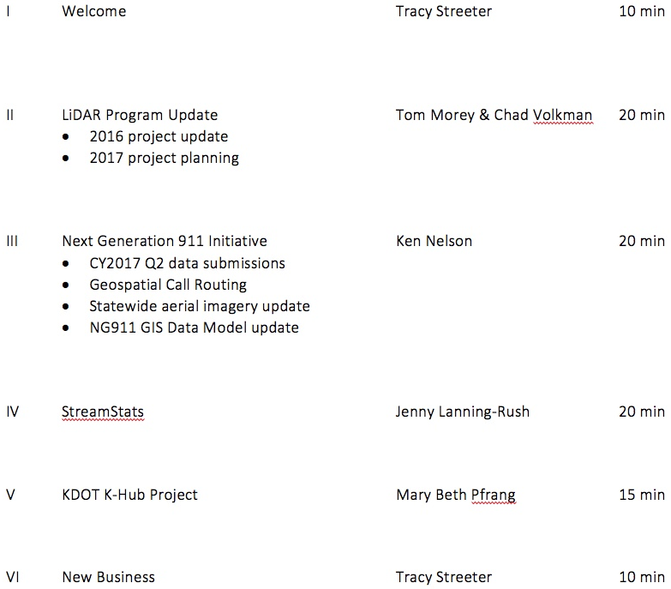
Meeting agenda
https://kansas.zoom.us/j/280140771
Conference Line: 646-558-8656
Participant Code: 280 140 771

Slide 3
LiDAR Update
Tom Morey & Chad Volkman

Slide 4
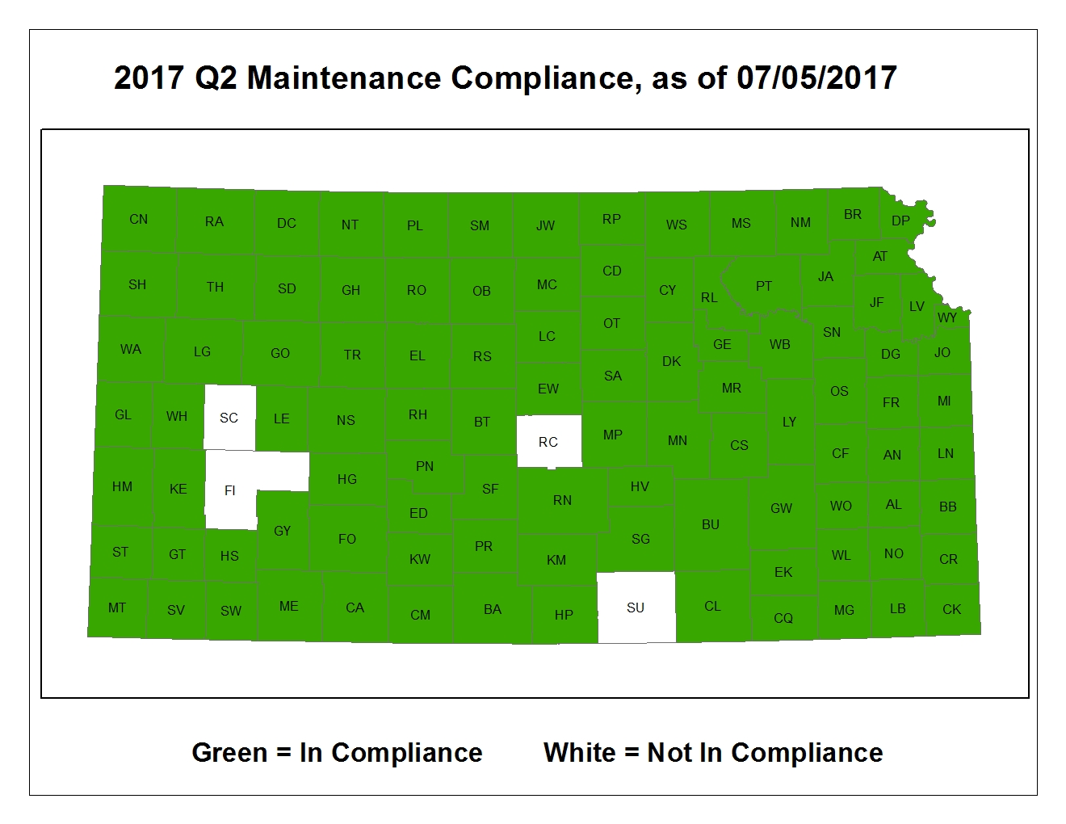
Next Generation 911
CY2017 – Q2 Data Maintenance

Slide 5
Next Generation 911
Hosted System Deployment – 62 PSAPs now live on the system

Slide 6
Geospatial Call Routing
Geospatial Call Routing – the processes by which 911 calls are routed to the appropriate PSAP by referencing spatial data rather than tabular Master Street Address Guides (MSAG)
In the NG911 realm, standards-based Geospatial Call Routing, is one of many i3-components running on an Emergency Services IP Network (ESINet)
The Kansas 911 Coordinating Council was the first state in the nation to sign an agreement with AT&T for their nationwide ESINet services
Kansas will begin migrating PSAP’s to the ESINet in January, 2018. This migration will include geospatial call routing.
To ensure a smooth migration process, the Council and GIS Committee are:
Working with local jurisdictions to ensure continual data maintenance
Provide training and technology transfer
Coordinate with business partners AT&T & West Safety Solutions to determine requirements, test workflows, and evaluate data validation results
All of the work over the past 3+ years has been to prepare for this transition

Slide 7
NG911 Imagery Update
Project highlights:
Statewide, leaf-off, 1-foot, natural color & CIR, acquired 2018/19
Access to 1’ version of NAIP imagery in file-based and web service formats:
2015
2017 (planned)
1 – meter, leaf-on, available via APFO/DASC
Public domain release of 2014/15 1-foot, leaf-off, imagery

Slide 8
Other items of note
NG911 training events continue this summer:
Fort Hays State University Hays, KS - July 19, 2017 Allen County Community College Iola, KS - July 25, 2016 Lawrence Public Works Lawrence, KS - August 16, 2017
NG911 GIS Committee will meet later this month to review changes to the data standard
Kansas/Oklahoma NG911 Summit scheduled for August 9 in Oklahoma City, OK

Slide 9
StreamStats
Jenny Lanning-Rush, USGS

Slide 10
K-Hub Project Update
Mary Beth Pfrang, KDOT

Slide 11
New business
Agency GIS Updates
Next GIS Policy Board Meeting: September 8, 2017, 10:00 am – noon, 509 Landon State Office Building

