Slide 1
NG911 Update
January 13, 2017

Slide 2
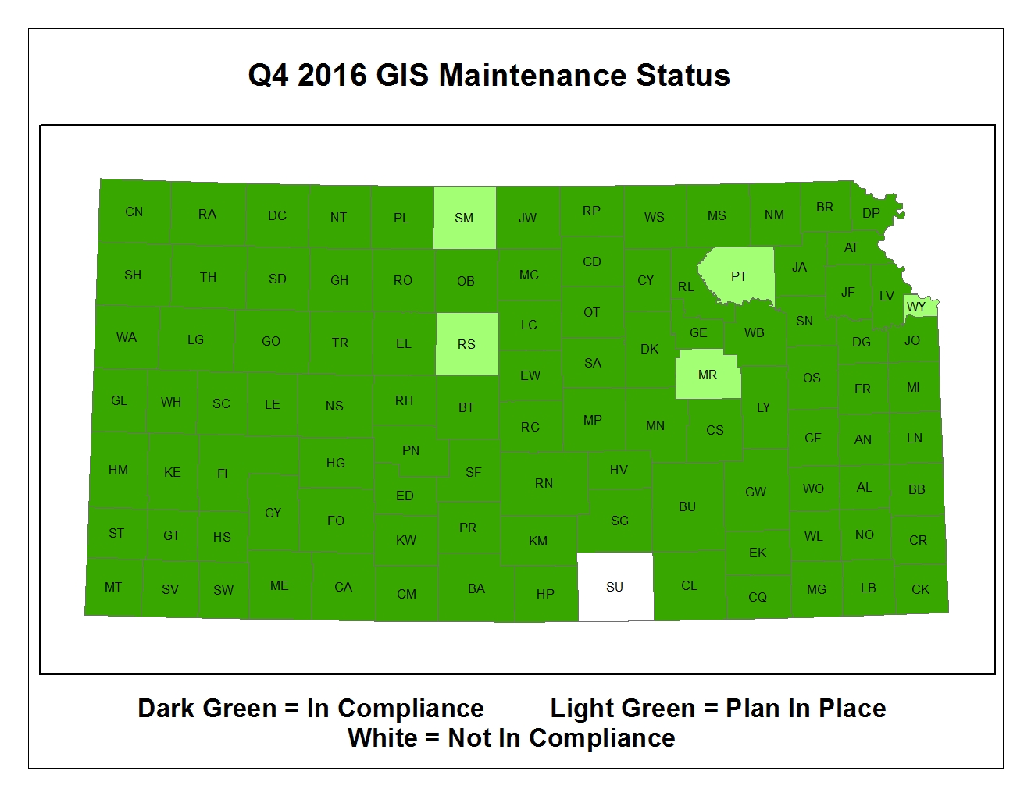

Slide 3
Quarter Four
136 successful submissions
13 reports of No Changes
Most counties submitted once in the quarter
The most prolific submits every 2-3 weeks

Slide 4
Update Items
Call Handling implementation: 48 PSAPs
Next Maintenance deadline: March 31st
Operating on Version 2.0 of the Data Model
Authoritative Boundary aggregation
GIS/MSAG Alignment

