Slide 1
LiDAR Update
Tom Morey
Kansas Department of Agriculture
January 13, 2017

Slide 2
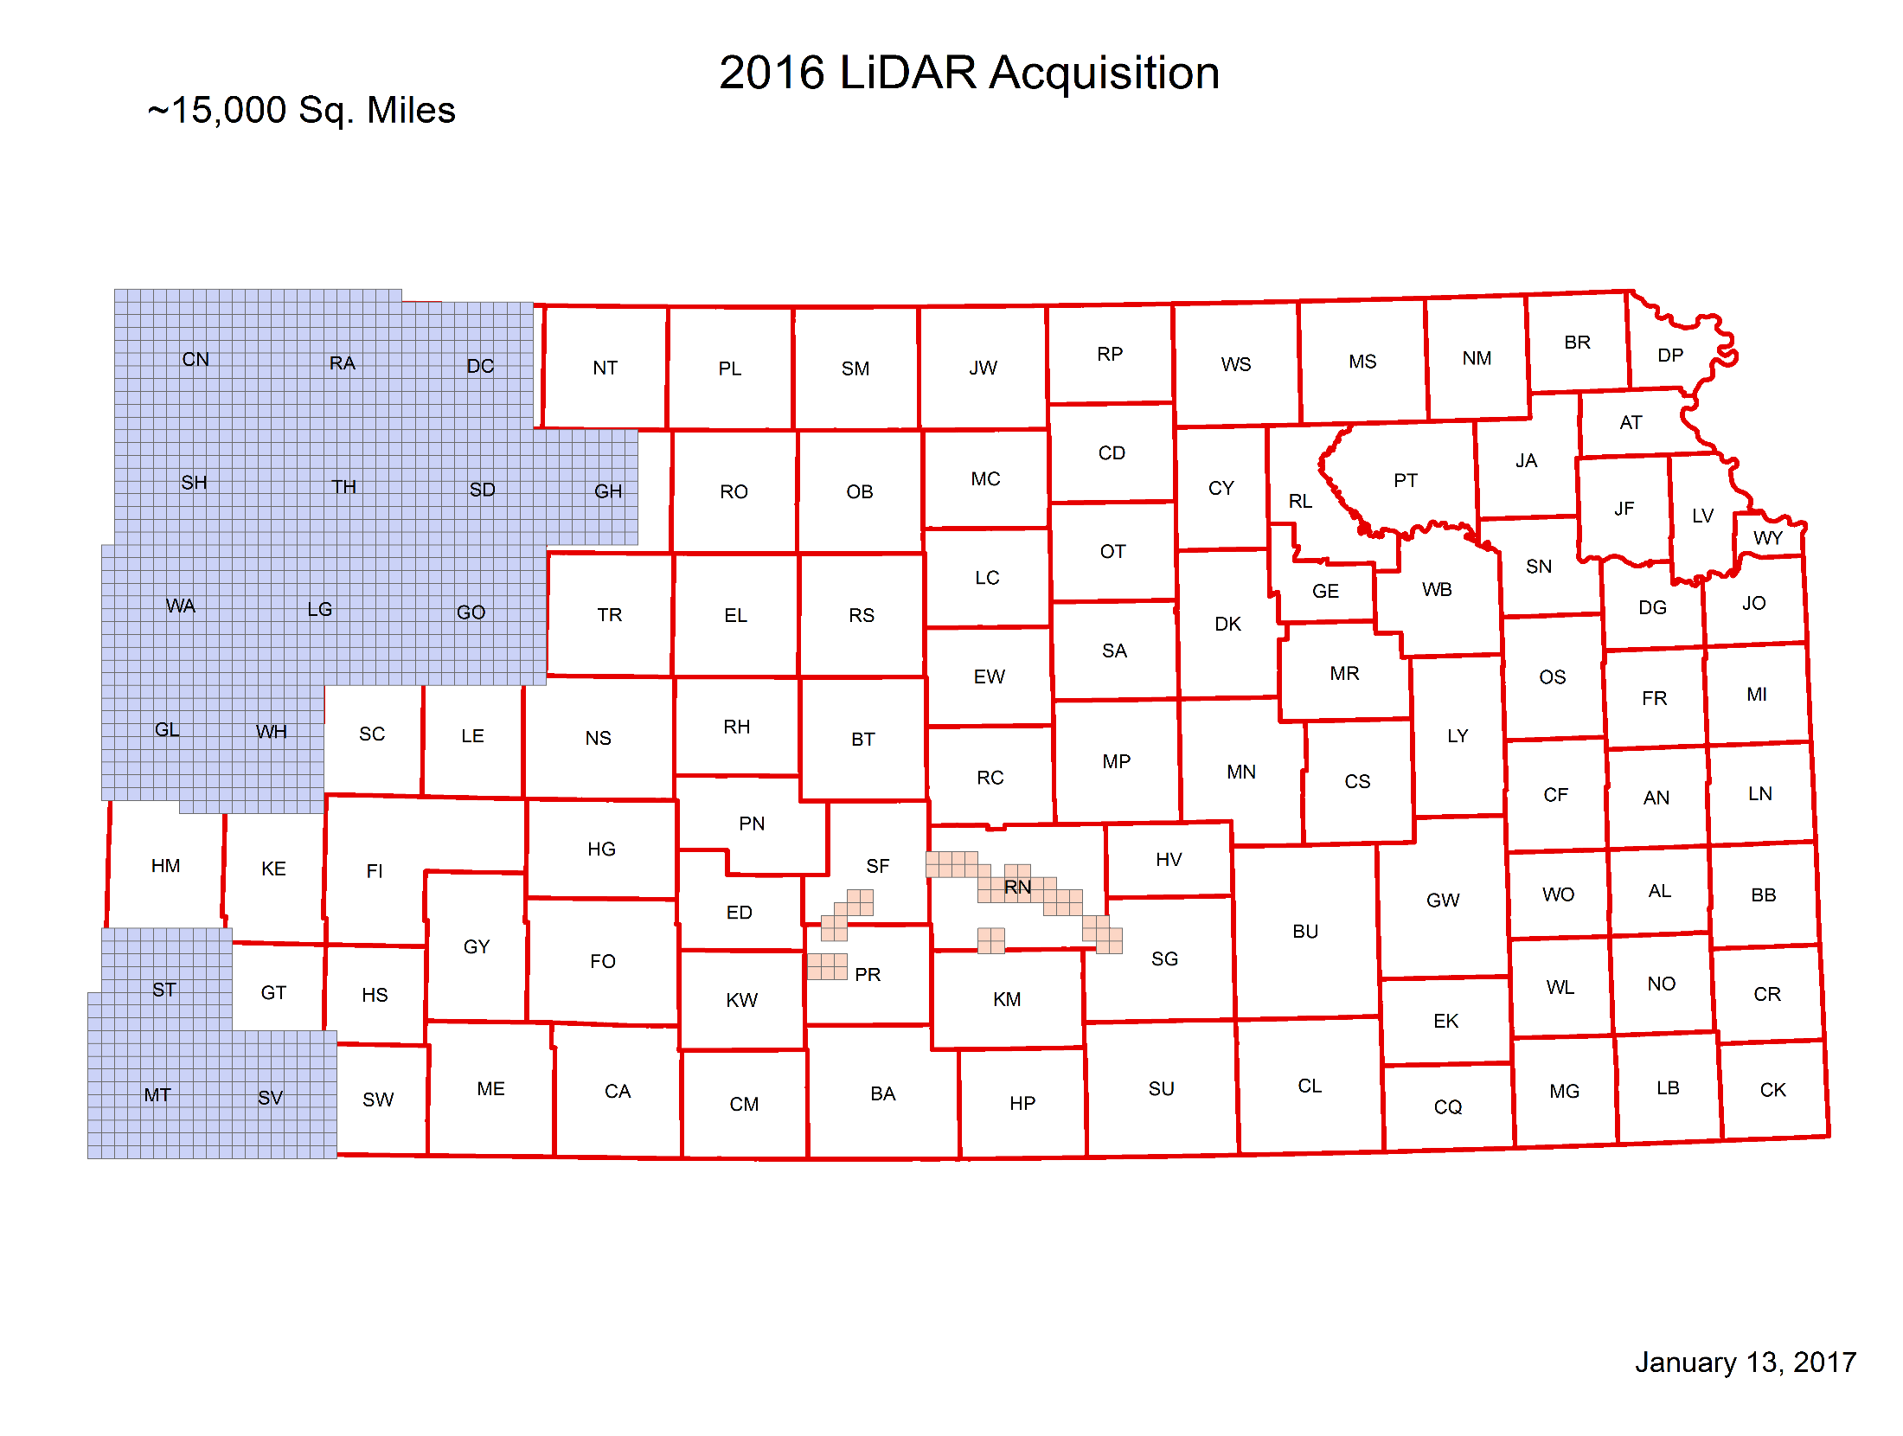

Slide 3
Project Update
Cheney and SW KS
Delivered to QA Vendor
Hydroflattening issues identified
Will be addressed and resent after delivery of NW data
NW KS data being delivered next week
Problems with size of this data in DEM and DSM creation
~12,000 miles.
Ran over the holiday week and only 50% complete

Slide 4
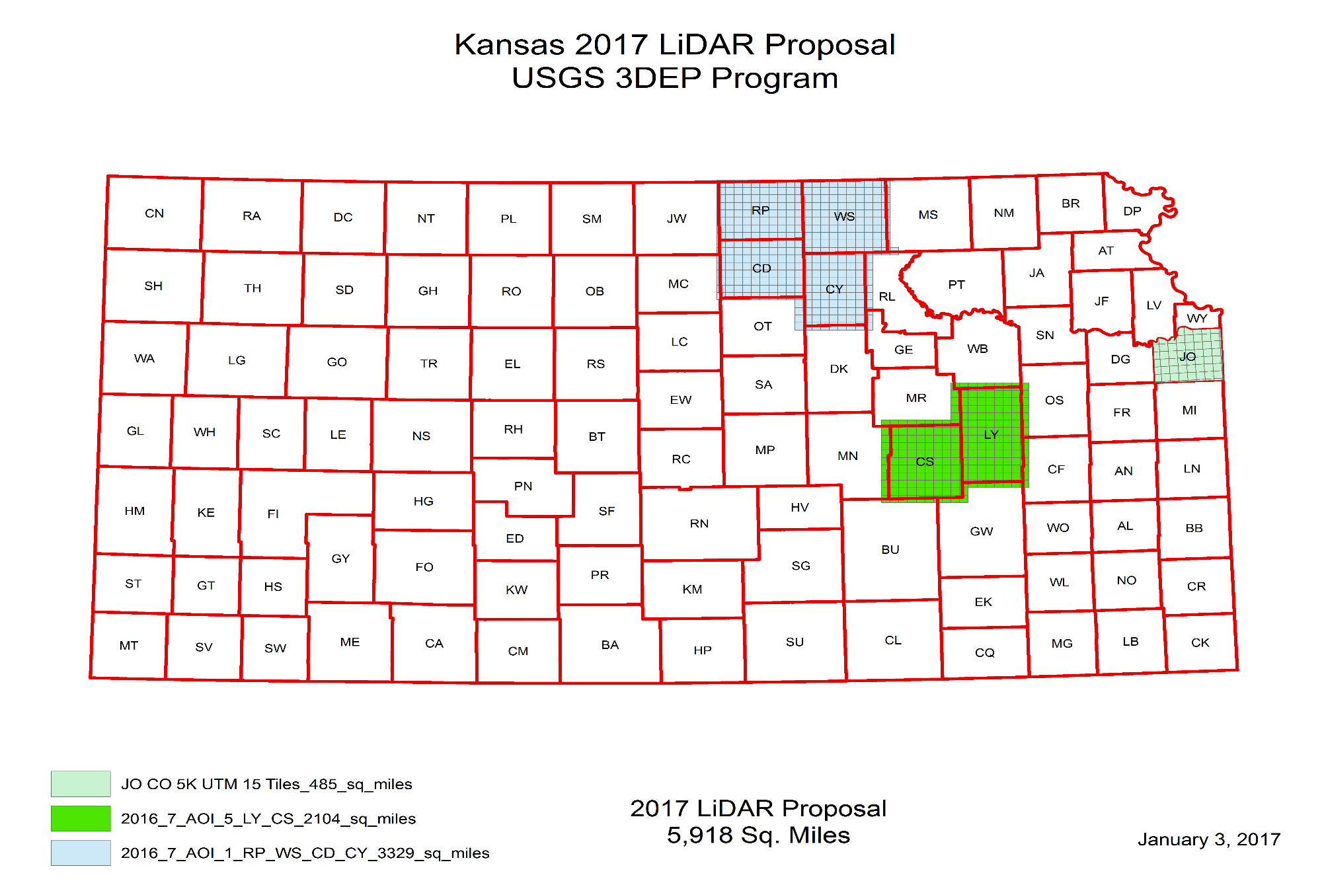
2017 Project

Slide 5
2017 Project
Three Project areas
RP, WS, CD, CY
Lyon Chase
Johnson
Sedgwick , Andover ???
Funding
NRCS, GIS Policy Board, Johnson County
Application to USGS

Slide 6
Status Map

Slide 7
QUESTIONS?

