Slide 1
NG911 Update
December 7, 2017

Slide 2
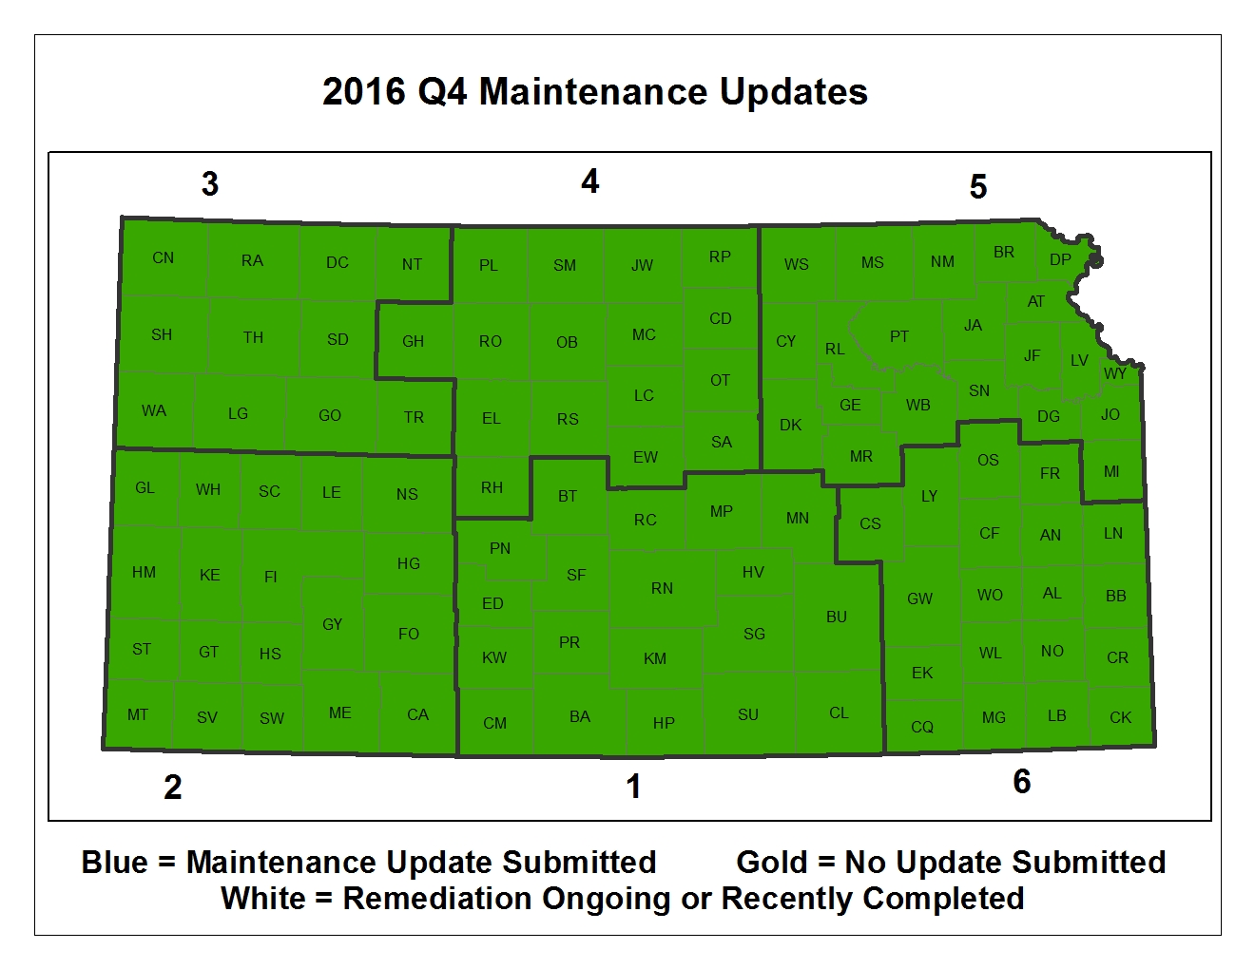
2017 Q3 Maintenance Updates
Green = In compliance White = Out of compliance

Slide 3
2017 Quarter 3: 100% Participation
2017 Quarter 4: Deadline December 31
In Q3 99 counties submitted updated data. Only 6 reported No Changes
44 Counties have submitted updates for Q4

Slide 4
KS NG911 GIS Data Model
Version 2.1
Put out for vendor review and two public reviews and finalized in October
Changes from 2.0 center on attributes needed for transition to geospatial call routing
Addition feature classes were added to support Vesta Locate maps at the request of PSAPs
  Utility service areas
  Bridges
  Cell Sites

Slide 5
Geospatial Call Routing
Alignment between the GIS data and the telco land line records
Two counties have been tested through the transition
Training next week on the use of the web interface for data submission to West
Transition to geoMSAGs should begin shortly after training
Approx 50 counties are ready for the transition as of today

