Slide 1

Kansas NG911 Imagery Program
Kansas Statewide Imagery Acquisition and
Local Buy Up Opportunity
December 7, 2017

Slide 2

Kansas NG911 Imagery Program
Project 1:
  Initial acquisition completed in 2013/14
  Statewide, 1-foot, leaf-off, natural color, orthoimagery
  Support NG911 GIS data remediation, PSAP operations, & other state and local GIS applications
Project 2:
  Acquisition planned for 2018/19
  Acquisition will begin in NW Kansas
  Statewide, 1-foot, leaf-off, natural color & CIR, orthoimagery
  Support NG911 GIS data maintenance, PSAP operations, & other state and local GIS applications
  High-resolution ”buy-up” program

Slide 3
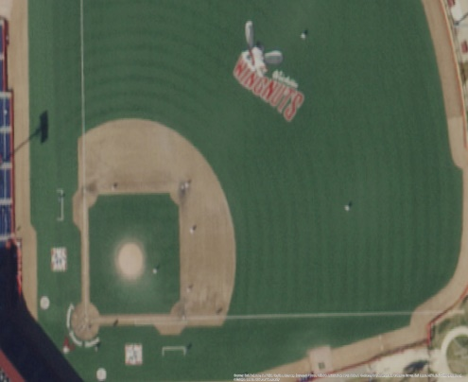
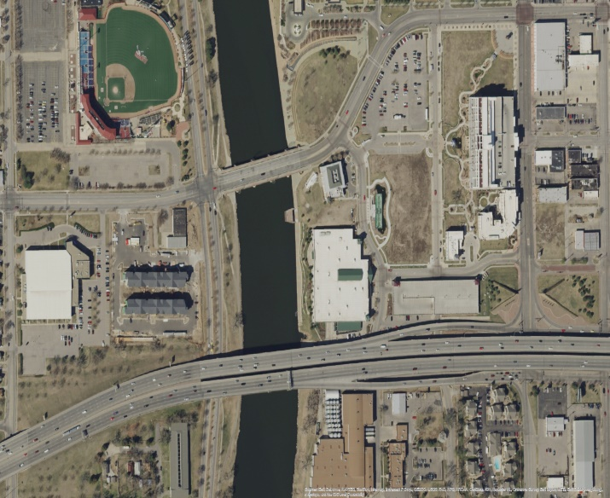
Program update
Renewed 3-year agreement with Surdex to update statewide imagery
License allows access to the following:
  State, county, and municipal (city) government agencies/department
  Regents institutions
  All Public School Districts
  Any firm doing work on behalf of one of these entities
  No public domain distribution
Public domain release of 2013/14 1-foot, leaf-off, imagery
Primarily funded by Kansas 911 Coordinating Council, with cost-share provided by the Traffic Records Coordinating Council (TRCC), and the Kansas Department of Revenue (KDOR)

Slide 4
2018 Acquisition Details: Introducing Tim Donze
Tim is the Business Development Rep supporting the Kansas Imagery Program
Tim Donze
VP Business Development
Surdex Corporation
520 Spirit of St. Louis Blvd.
Chesterfield, MO 63005
314-422-7616 (direct)
636-368-4424 (office)
636-368-4400 (main)
TimD@surdex.com

Slide 5
Surdex Overview
Headquartered in Chesterfield (greater St. Louis), Missouri
  17,000 square foot production facility
  30,000 square foot hangar facility
~95 employees
  8 ASPRS Certified Photogrammetrists
  3 Professional Land Surveyors
  1 Registered Engineer
  1 Project Management Professional (PMP) certification

Slide 6
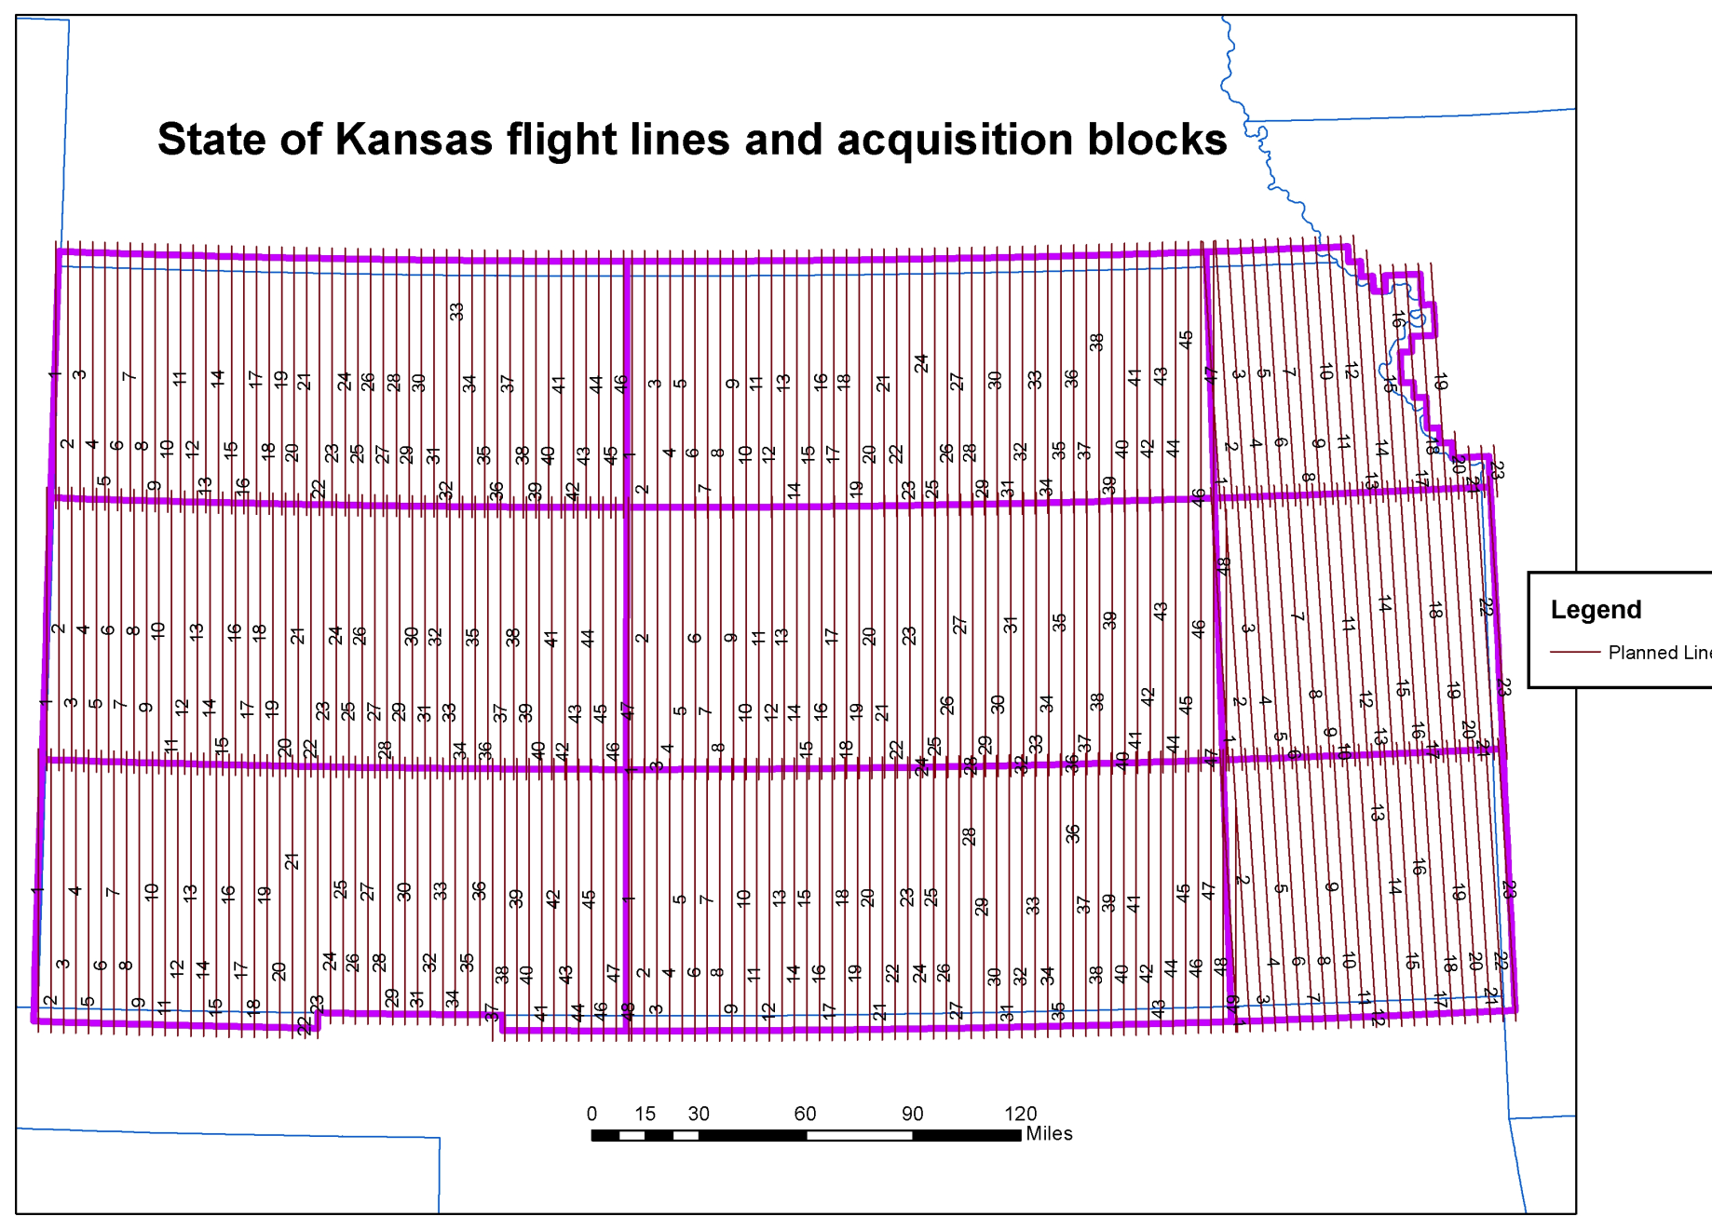
Flight plan for 1’ resolution

Slide 7
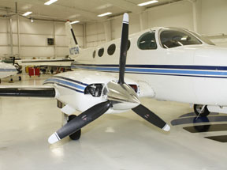
Equipment
Aircraft
Cameras / Sensors
4 Twin-turbine Cessna 441 (Conquest)
2 Twin-piston engine Cessna 414 - Cessna 335
4 Single-piston engine Cessna 206
4 Leica ADS100 digital pushbroom cameras
3 Leica / Intergraph DMC digital cameras
1 Leica RCD30 medium format digital camera system
2 OpTech Galaxy LiDAR sensors

Slide 8
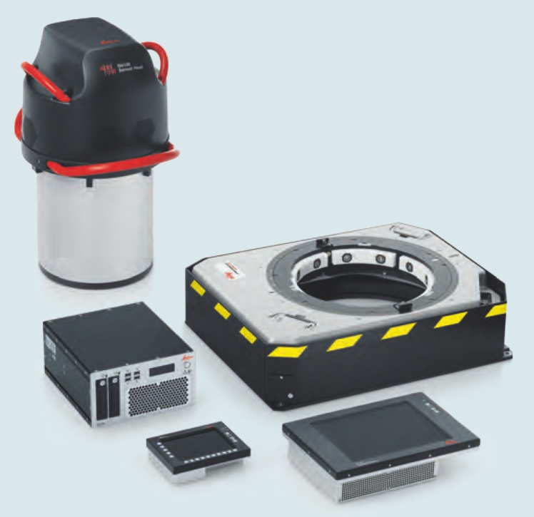
Digital Camera
Largest swath width –efficient acquisition
5um pixel – fly higher
Time Delayed Integration (TDI) – sensitivity & speed
Exceptional radiometric sensitivity
Optically-aligned nadir, forward, back RGBN arrays means full stereoscopic viewing
No pan-sharpening: no blooming or blurring

Slide 9
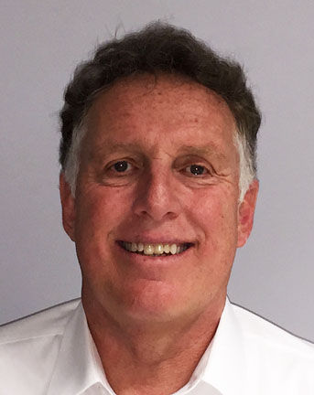
Project manager: Jim Gottgetreu
Over 36 years of experience
ASPRS Certified Photogrammetrist
Specializing in resource allocation, logistics planning and production management

Slide 10
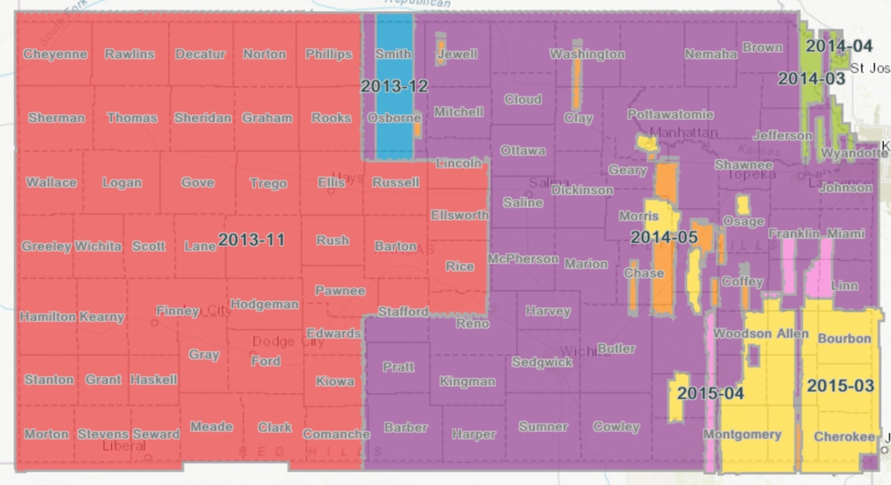
NG911 Imagery
2013 – 2015 acquisition, statewide 1-foot imagery distribution
  This imagery is now public domain!
  DASC catalog
    Esri REST service
    Link to flight dates
  Formats available
    MrSID – available for download
    GeoTIFF – by request
  Eventually imagery will be available in county mosaic MrSID format

Slide 11
NG911 Imagery
2017+ acquisition, statewide 1-foot imagery distribution
  Licensed product
  Formats available by request
    GeoTIFF
    MrSID compressed
    WMS
    Esri REST service
  PSAP imagery refresh
Access provided by DASC
  No need to request new credentials for services or tokens
  Existing credentials for services and tokens will continue to allow access

Slide 12
Why offer a Kansas Buy Up Program?
In 2013/2014, the 1’ imagery collection was performed on a very short schedule to facilitate the remediation process
Local government shared their desire to potentially “buy-up” the imagery to higher quality than 1’
Local government shared their desire to leverage the NG911 Imagery Program for these buy-ups.

Slide 13
What is the Kansas Buy Up Program?
Local government is offered the opportunity to leverage the NG911 Imagery Program to purchase higher resolution imagery
This is not mandatory, but an option that has been requested
Purchase higher resolution imagery for your cities or county-wide
Pick your own resolution 6”, 4”, 3”, etc
Buy-up imagery does not fall under the license agreement

Slide 14
Leveraging the NG911 Imagery Program Will:
Save you time and effort in procuring orthoimagery*
Make available to you a qualified service provider already working in the State
Provide flexible payment terms offered to assist with fiscal planning
*Check to see if your jurisdiction allows the use of the state contract.

Slide 15
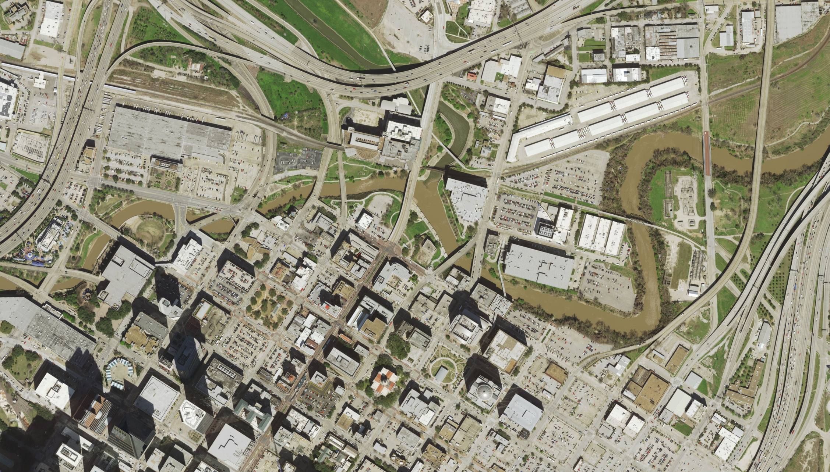
Sample Imagery: 6” Resolution

Slide 16
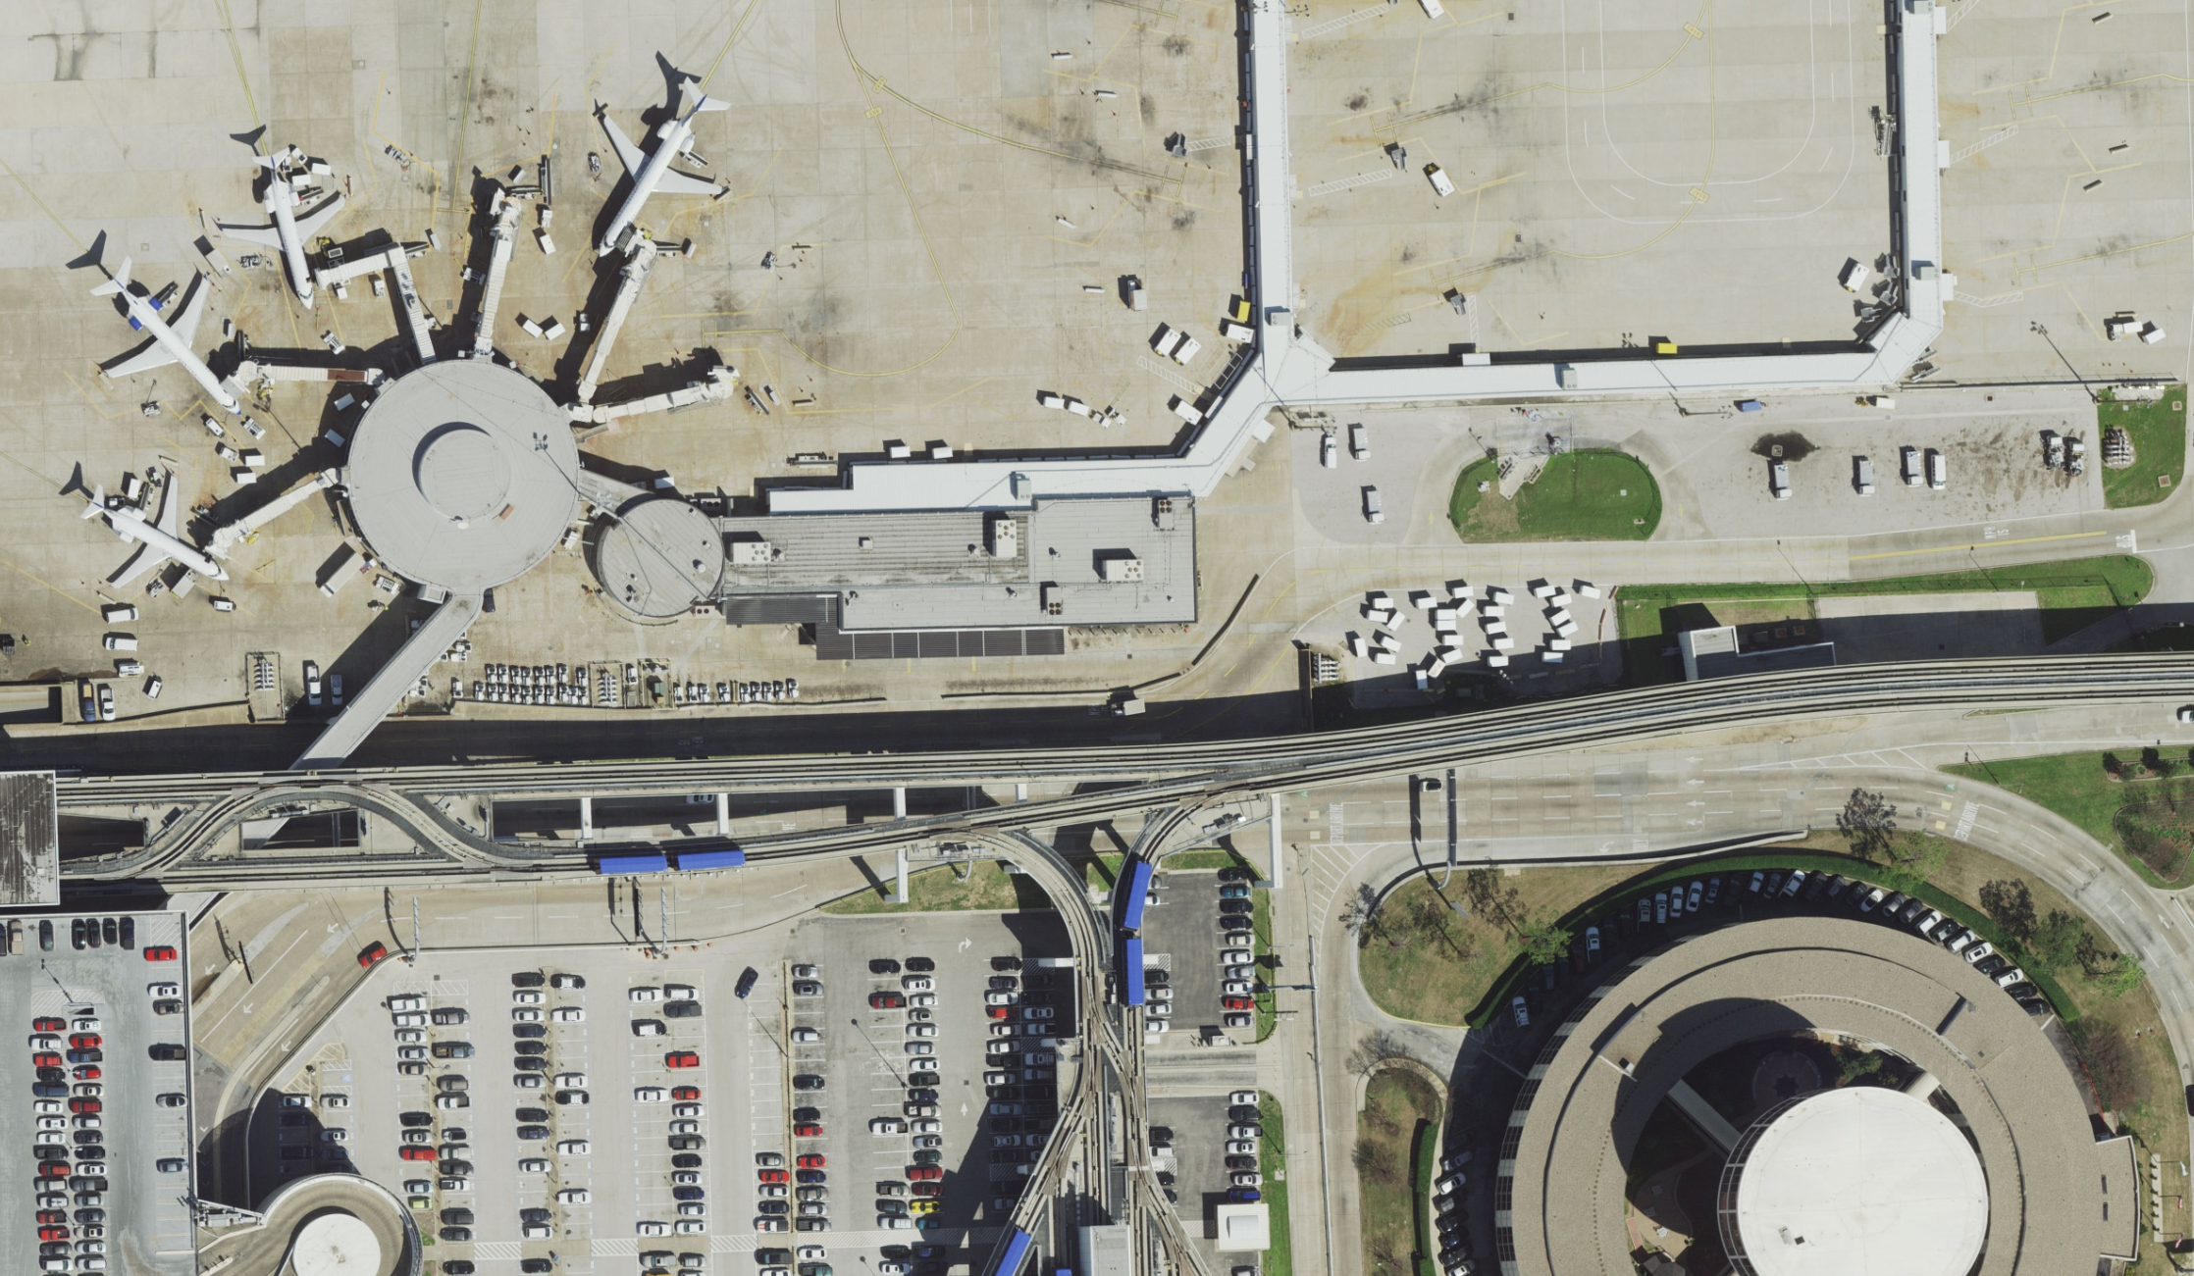
Sample Imagery: 3” Resolution

Slide 17
Ballpark Pricing
6-inch Options
Contiguous Square Miles | Price Per Square Miles
1 - 25 | Please call
26 - 100 | $300 - 150
101 - 500 | $150 - 95
501 - 1000 | $140 - 75
1001 - 3000 | $130 - 66
3000 + | $ 110 - 65
3-inch Options
Contiguous Square Miles | Price Per Square Miles
1 - 25 | Please call
26 - 100 | $600 - 400
101 - 500 | $350 - 175
501 - 1000 | $300 - 150
1001 + | $200 - 130

Slide 18
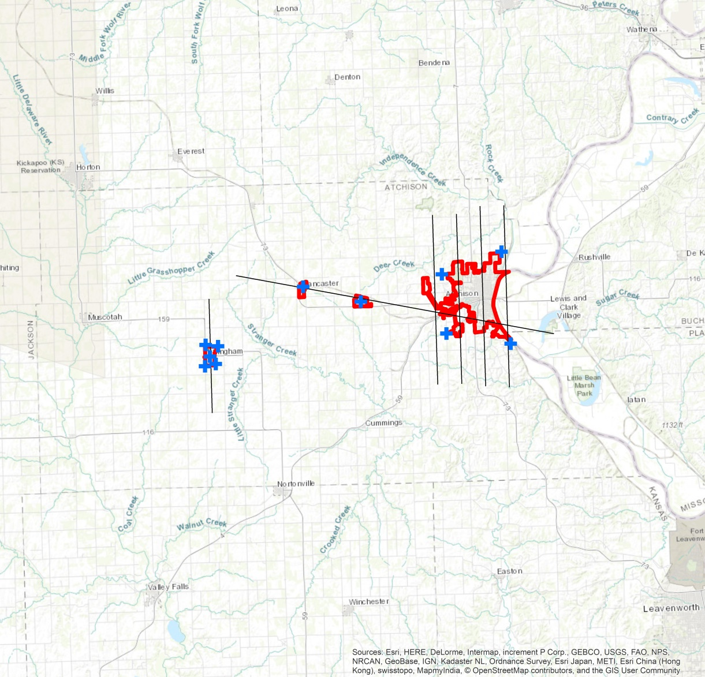
Examples of buy-up interest
Atchison
$12,100

Slide 19
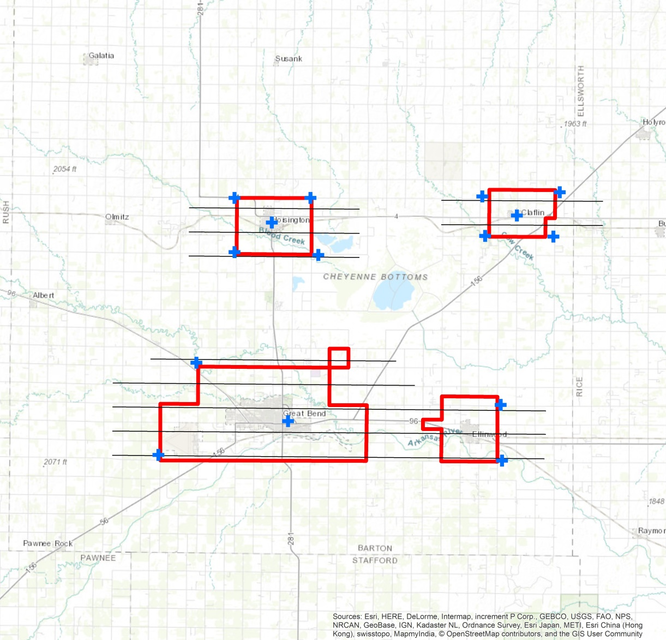
Examples of buy-up interest
Barton
$19,300

Slide 20
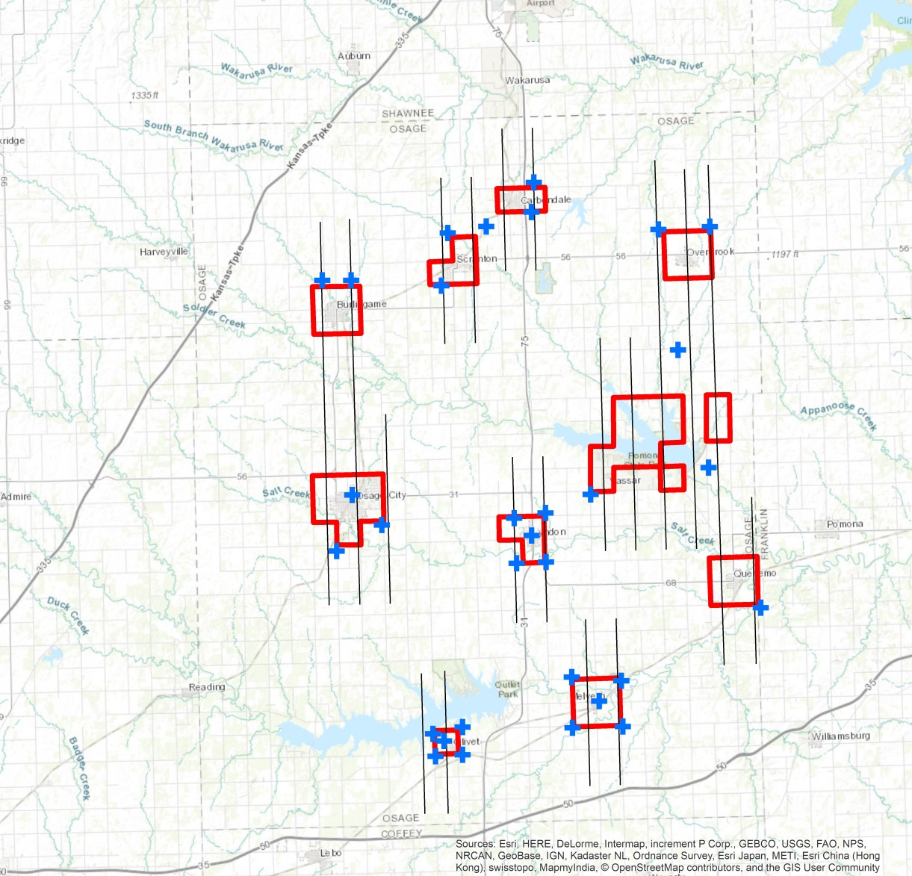
Examples of buy-up interest
Osage
$25,950

Slide 21
County-wide 6”
An average (square/rectangular) Kansas county will be $95 per square mile
When 2 or 3 contiguous counties fly at the same time, typically the price will drop to $70 per square mile
Beyond that the price can drop to $65 per square mile

Slide 22
Thank you & questions
Tim Donze
VP Business Development
Surdex Corporation
520 Spirit of St. Louis Blvd.
Chesterfield, MO 63005
314-422-7616 (direct)
636-368-4424 (office)
636-368-4400 (main)
TimD@surdex.com
Ken Nelson
Kansas Geographic Information Officer
Kansas 911 Coordinating Council, GIS Committee Chair
Kansas Geological Survey
The University of Kansas
nelson@kgs.ku.edu
785-864-2164 (voice)

