Slide 1
LiDAR Update
Tom Morey
Kansas Department of Agriculture
Dec 7, 2017
A day that will live in infamy

Slide 2
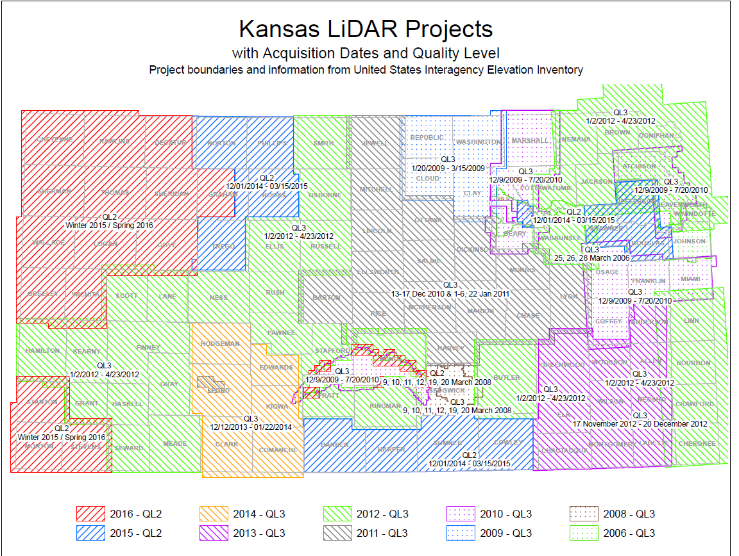

Slide 3
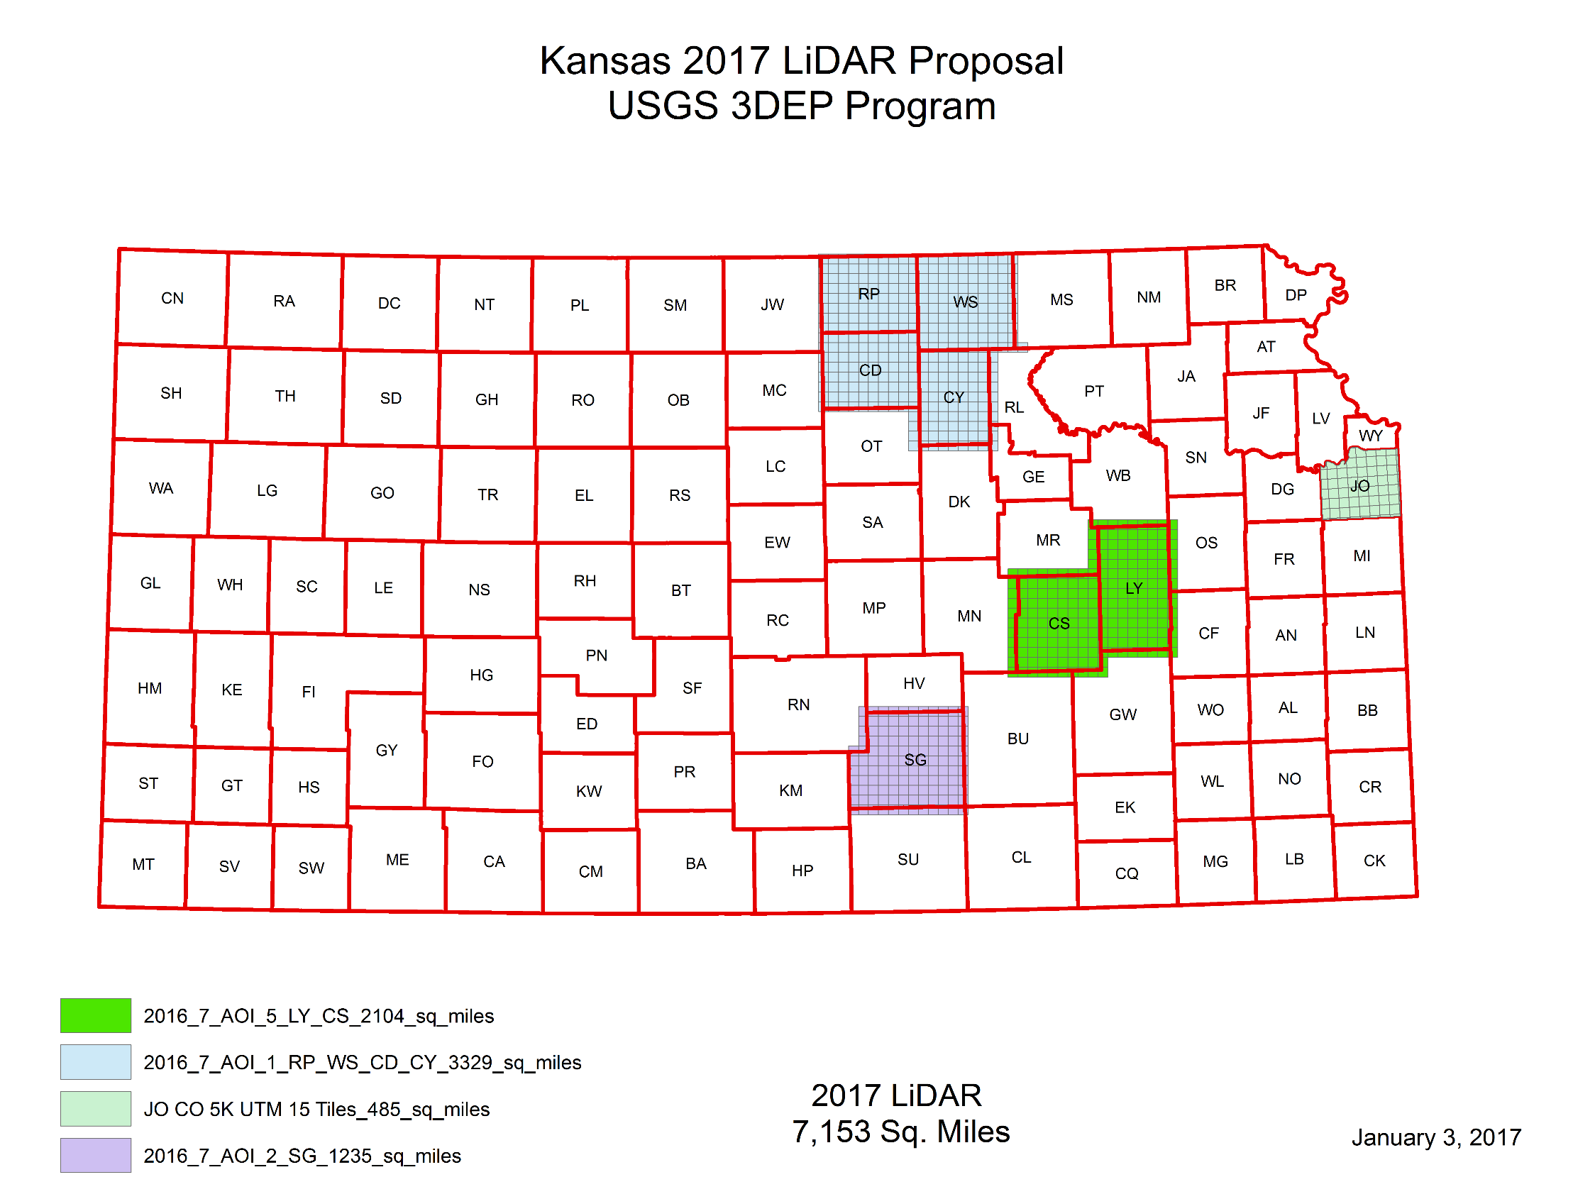
2017 Project

Slide 4
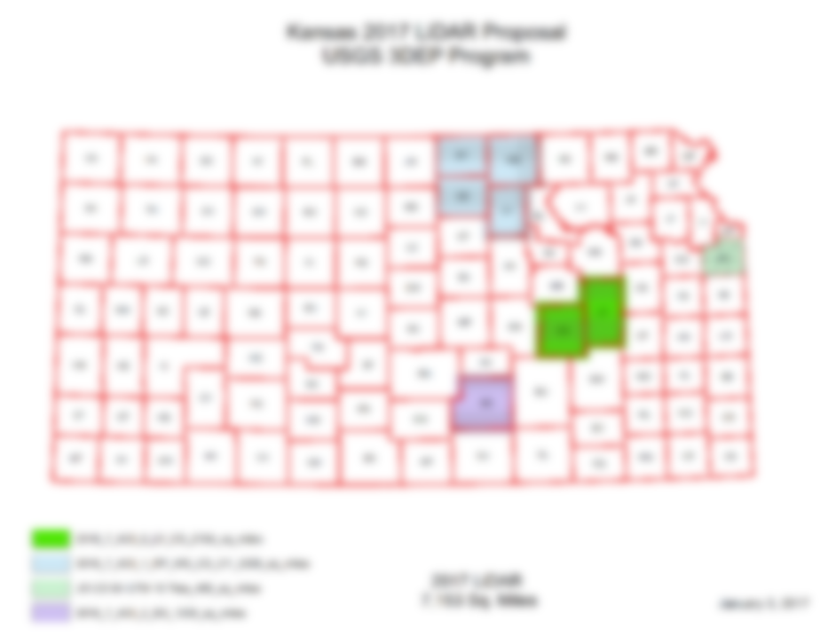
2017 Project
2017 Project Update
RP, WS, CD, CY
Acquisition 100% Complete
Data Development 100%
Internal QC 95% Complete
Preparing for Delivery to USGS for QA/QC
Johnson County and Sedgwick County/Wichita
Lyon/Chase

Slide 5
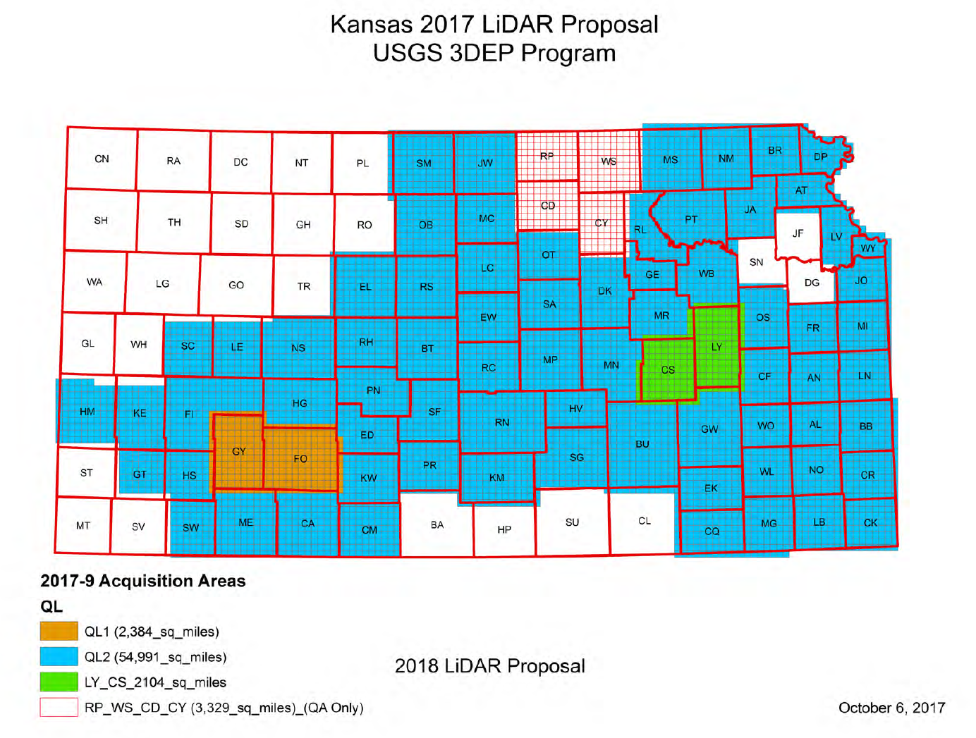
2018 Project Update

Slide 6
2018 Project Update
Kickoff Meeting this afternoon
Multiple Partners
NRCS
USGS
Policy Board
Additional Products in Johnson, Wyandotte and Sedgwick
Splitting up into two acquisition years
Should begin acquisition early Jan.
Entire project complete by Spring 2020

Slide 7
QUESTIONS?

