Slide 1
Kansas
GIS Policy Board
December 7, 2017

Slide 2
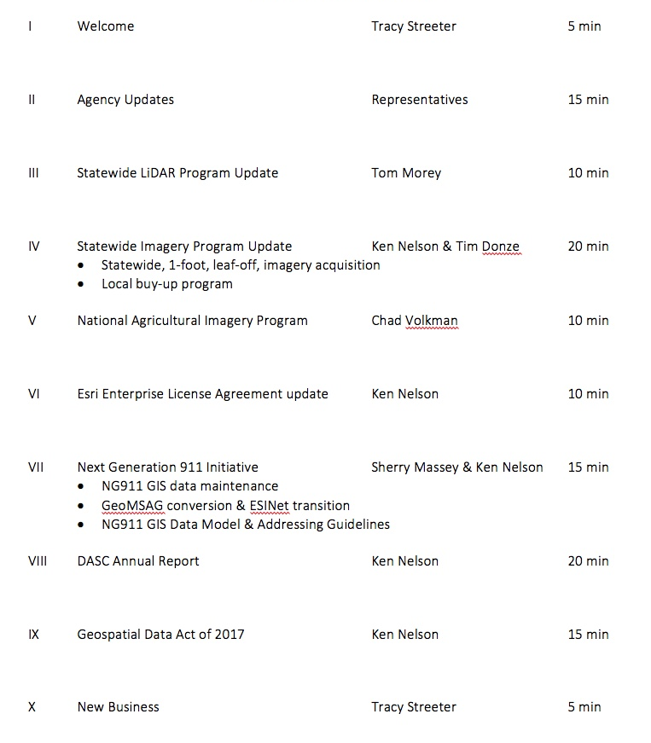
Meeting agenda
https://kansas.zoom.us/j/280140771
Conference Line: 646-558-8656
Participant Code: 280 140 771

Slide 3
Agency Updates

Slide 4
Statewide LiDAR Program Update
Tom Morey

Slide 5
Statewide Imagery Program Update
Ken Nelson & Tim Donze (Surdex)

Slide 6
NAIP Discussion
Board discussion

Slide 7
Esri Enterprise License Agreement Update
Two types of agreements…
Master Purchase Agreement (MPA)
Defines price schedule for all Esri products and services
Software, consulting services, 3rd party royalty products, etc
Available to state and local jurisdictions
Enterprise License Agreement (ELA)
Negotiated flat-rate agreement that defines access to a specific set of Esri products & services
Unlimited access to Esri core technology
Limited access defined for other products such as ArcGIS Online
Kansas ELA available to state government only

Slide 8
Esri Enterprise License Agreement Update
ELA History
Original 3-year agreement:
  February 1, 2011 – January 31, 2014
1-year extension February 1, 2014:
  January 31, 2015
Current 3-year agreement:
  Year 5 – February 1, 2015 – January 31, 2016
  Year 6 – February 1, 2016 – January 31, 2017
  Year 7 – February 1, 2017 – January 31, 2018
Why?
Unlimited access to core technology
Substantially reduced procurement costs
Flexibility to deploy the necessary software products when and where needed
Allows agencies to experiment with different software packages and configurations before purchasing
Standardized budget over the term of the agreement
Improved coordination across enterprise

Slide 9
Kansas Next Generation 911
Sherry Massey

Slide 10
DASC Annual Report
Ken Nelson

Slide 11
Geospatial Data Act of 2017
Board discussion

Slide 12
New business
United States Census Bureau LUCA workshop, January 11, 2017,
Next GIS Policy Board Meeting: January 12, 2017?
MidAmerica GIS Symposium, April 23-26, Omaha, NE, www.magicgis.org

