Slide 1

Kansas Geologic Sample Repository
Geologic Sample Repositories Webinar
Presented By
Mike Dealy P.G.#71, Kansas Geological Survey - Wichita
May 12, 2020

Slide 2
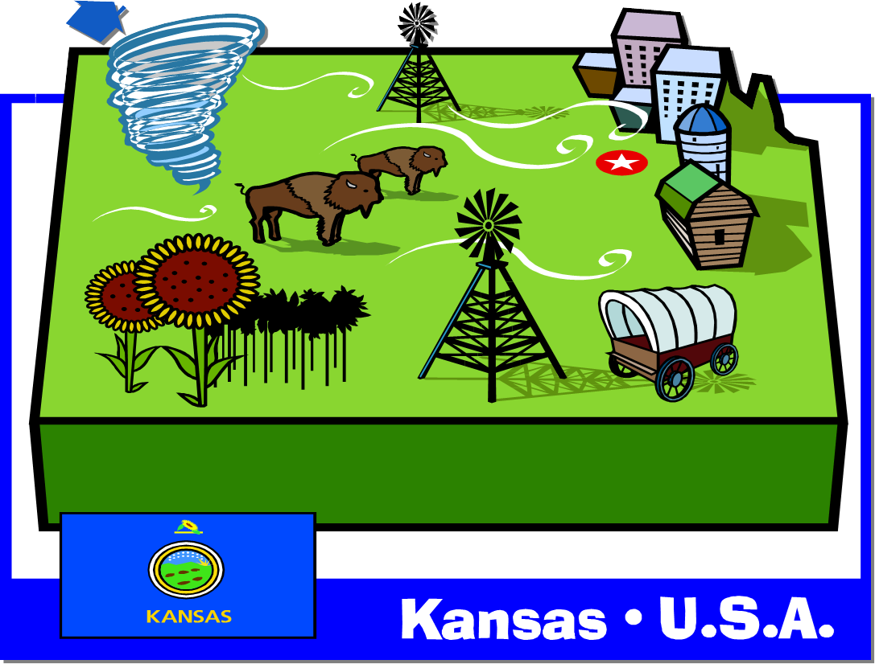
Geologic Samples located in Lawrence and Wichita
Lawrence Core
Wichita Cuttings
Notes:
1) About 150 miles from each other as the crow flies.

Slide 3
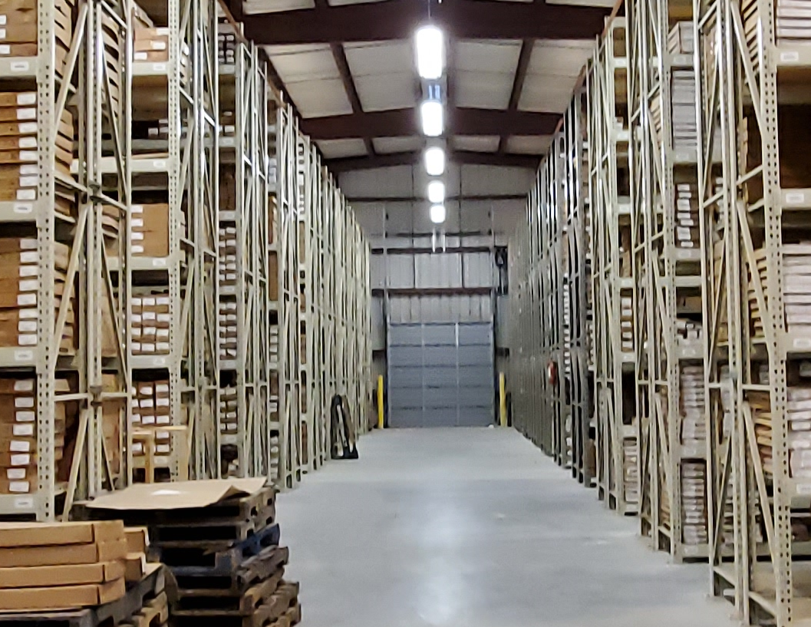
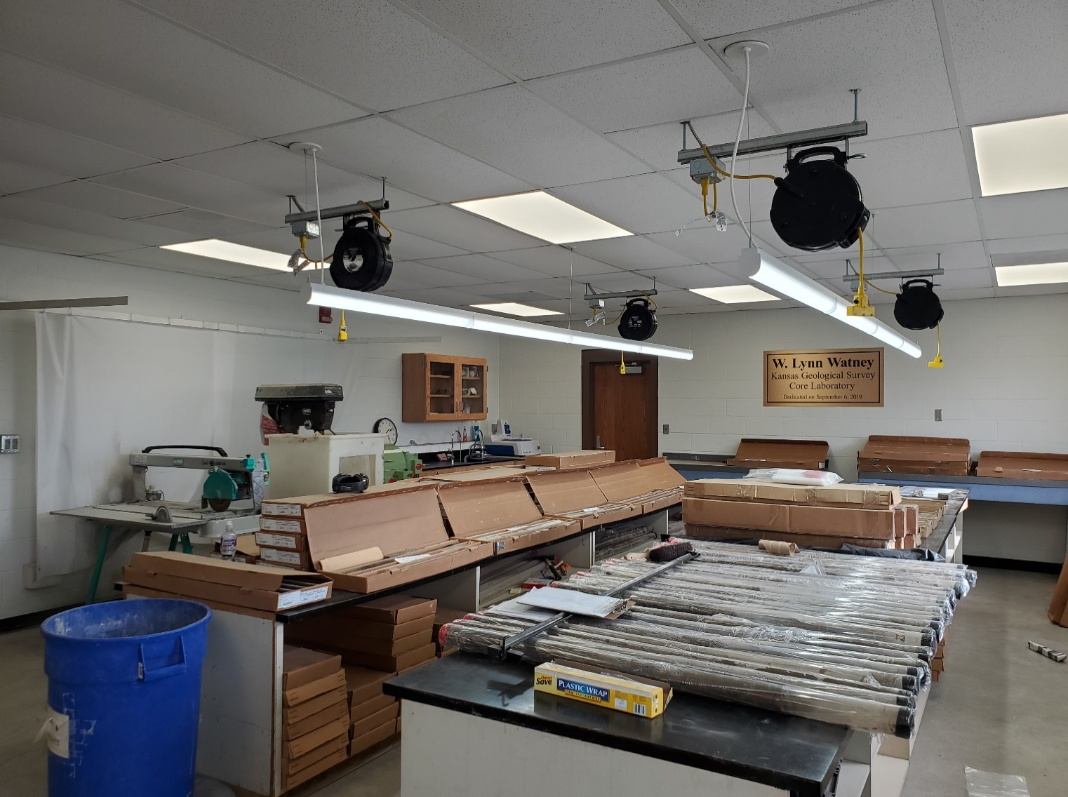
Lawrence Core Facility (Barn)
Repository for over 67,000 boxes
Representing more than 5,000 drill holes
Nikki Potter, Manager Core Facility
Phone: 785 864-2098
eMail: npotter@kgs.ku.edu

Slide 4
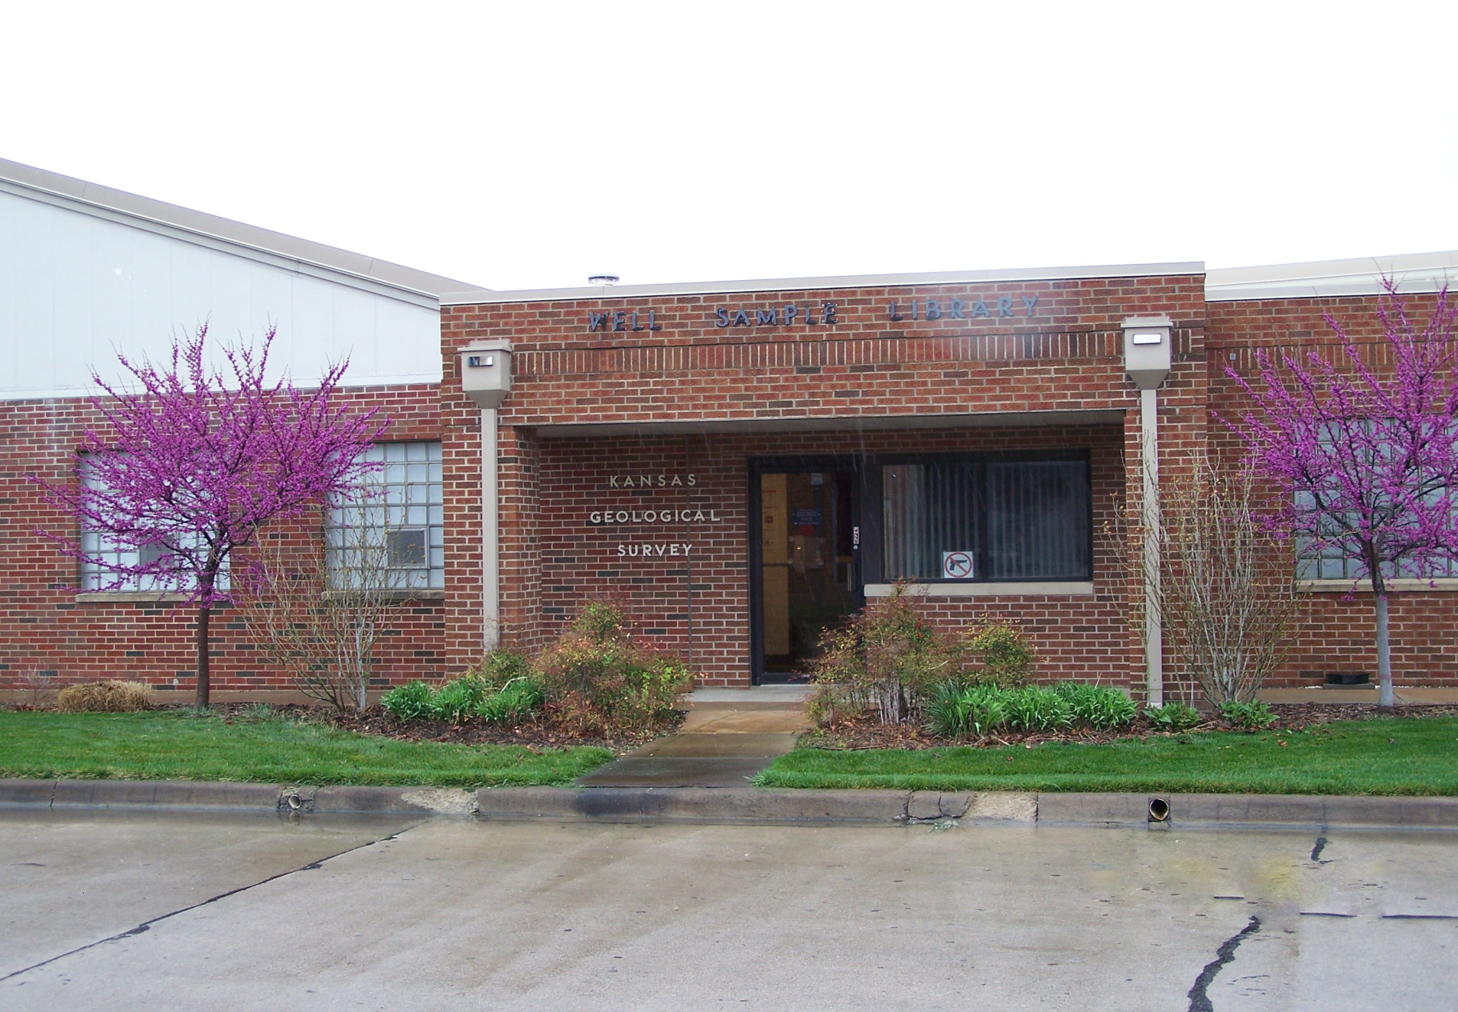
Mission
The mission of the University of Kansas, Kansas Geological Survey - Wichita, is to:
collect and preserve samples of the Kansas rock record for research and energy exploration,
maintain retail sales of publications, maps, and software published by the Survey,
make available to the public geologic, hydrologic, and other natural resource information about Kansas, and
promote and participate in research and technology transfers, and foster the overall Survey mission.

Slide 5
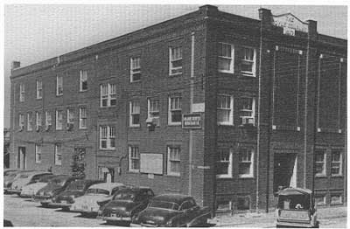
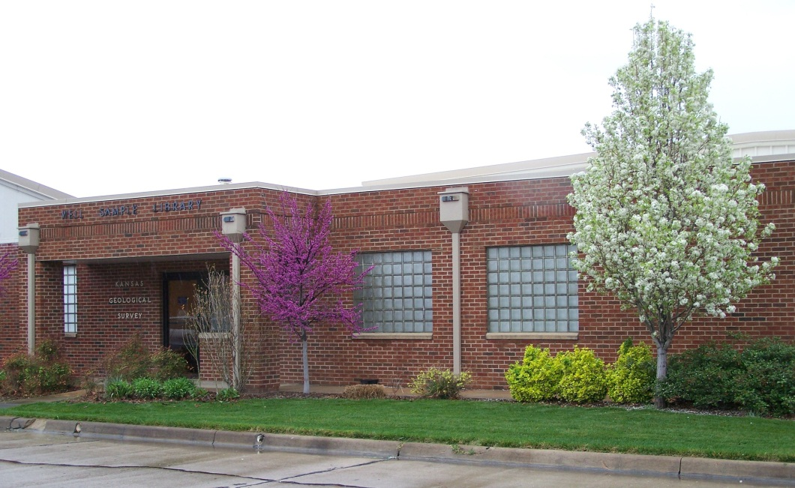
Sample Preservation: Past & Present
Prior to 1938 - no central repository for well cuttings.
1938 - establishment of the first well sample repository in downtown Wichita.
Late 1950’s - series of fund drives provided for construction of a larger facility in west Wichita.
Early 1980’s – The facility, operations, and administration was transferred from a private oil & gas organization to the Kansas Geological Survey, University of Kansas

Slide 6
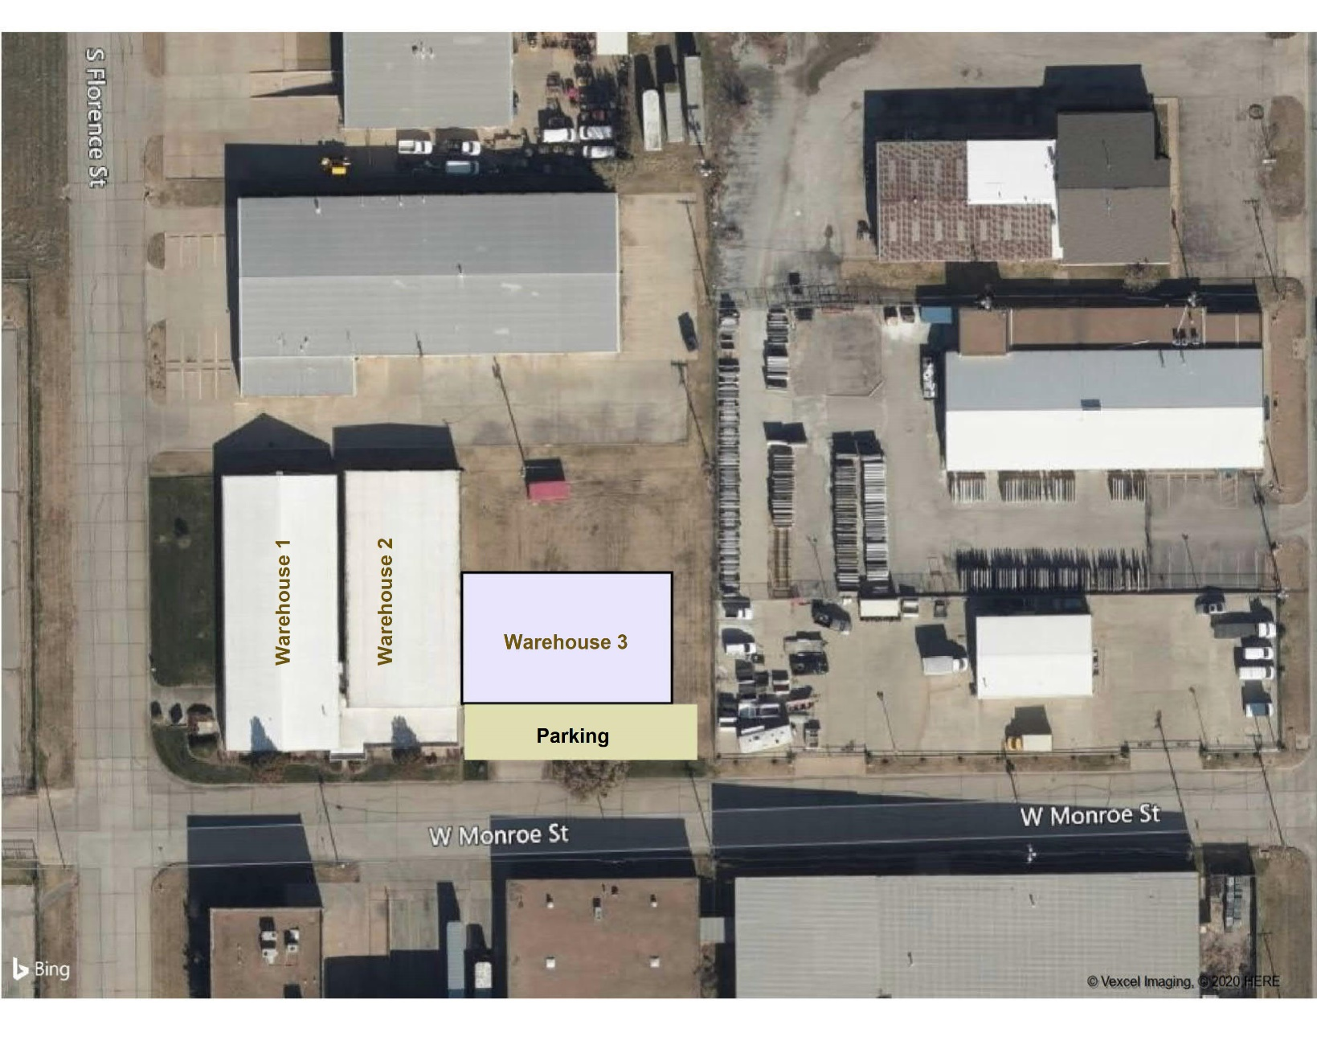
Sample Preservation: Past & Present
Kansas Geologic Sample Repository
23,500 ft² facility
1,500 ft² admin area
22,000 ft² repository
30% remaining storage
KGS owns & operates

Slide 7
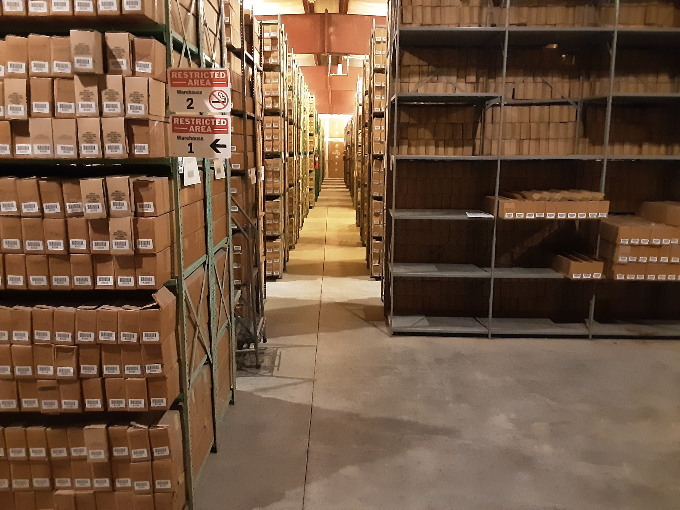
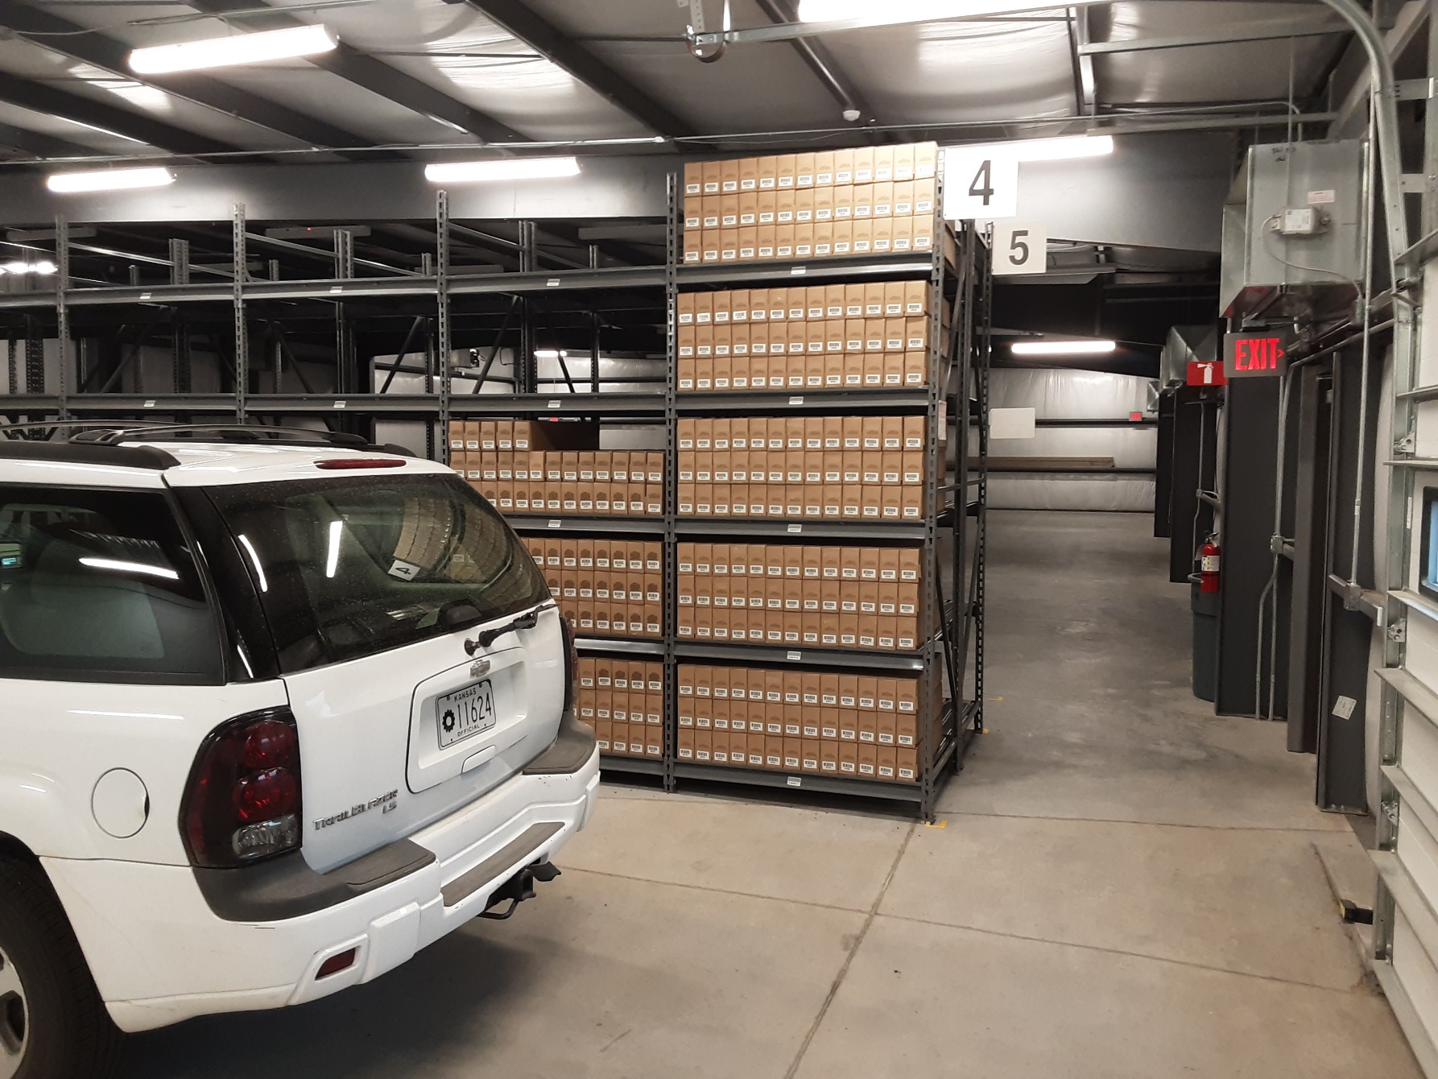
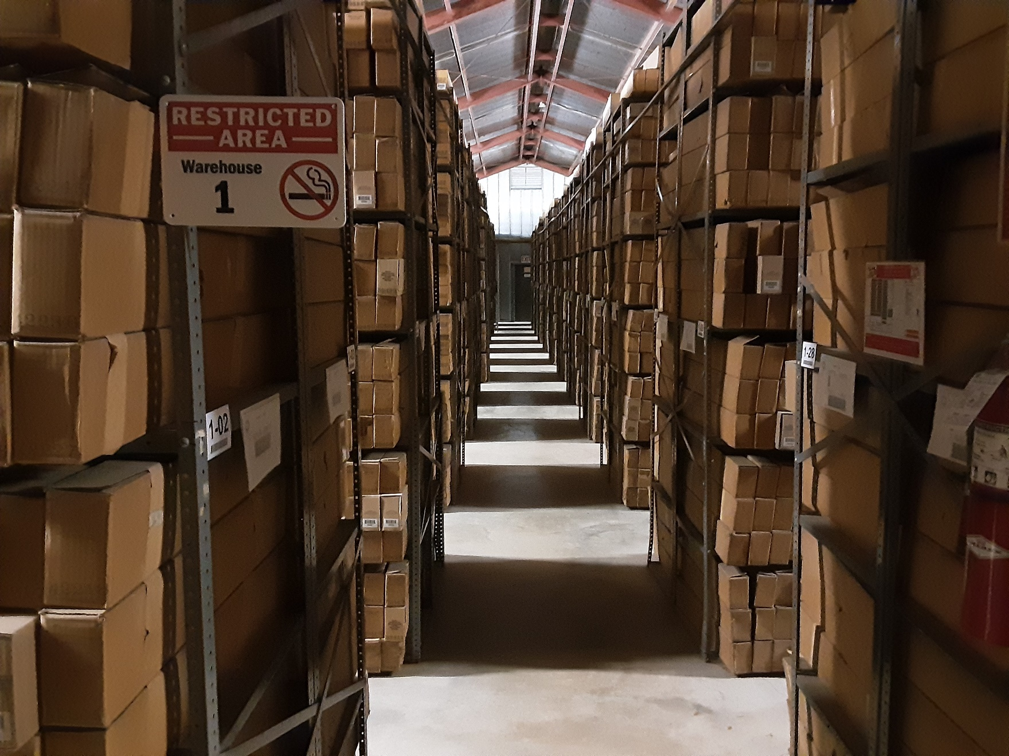
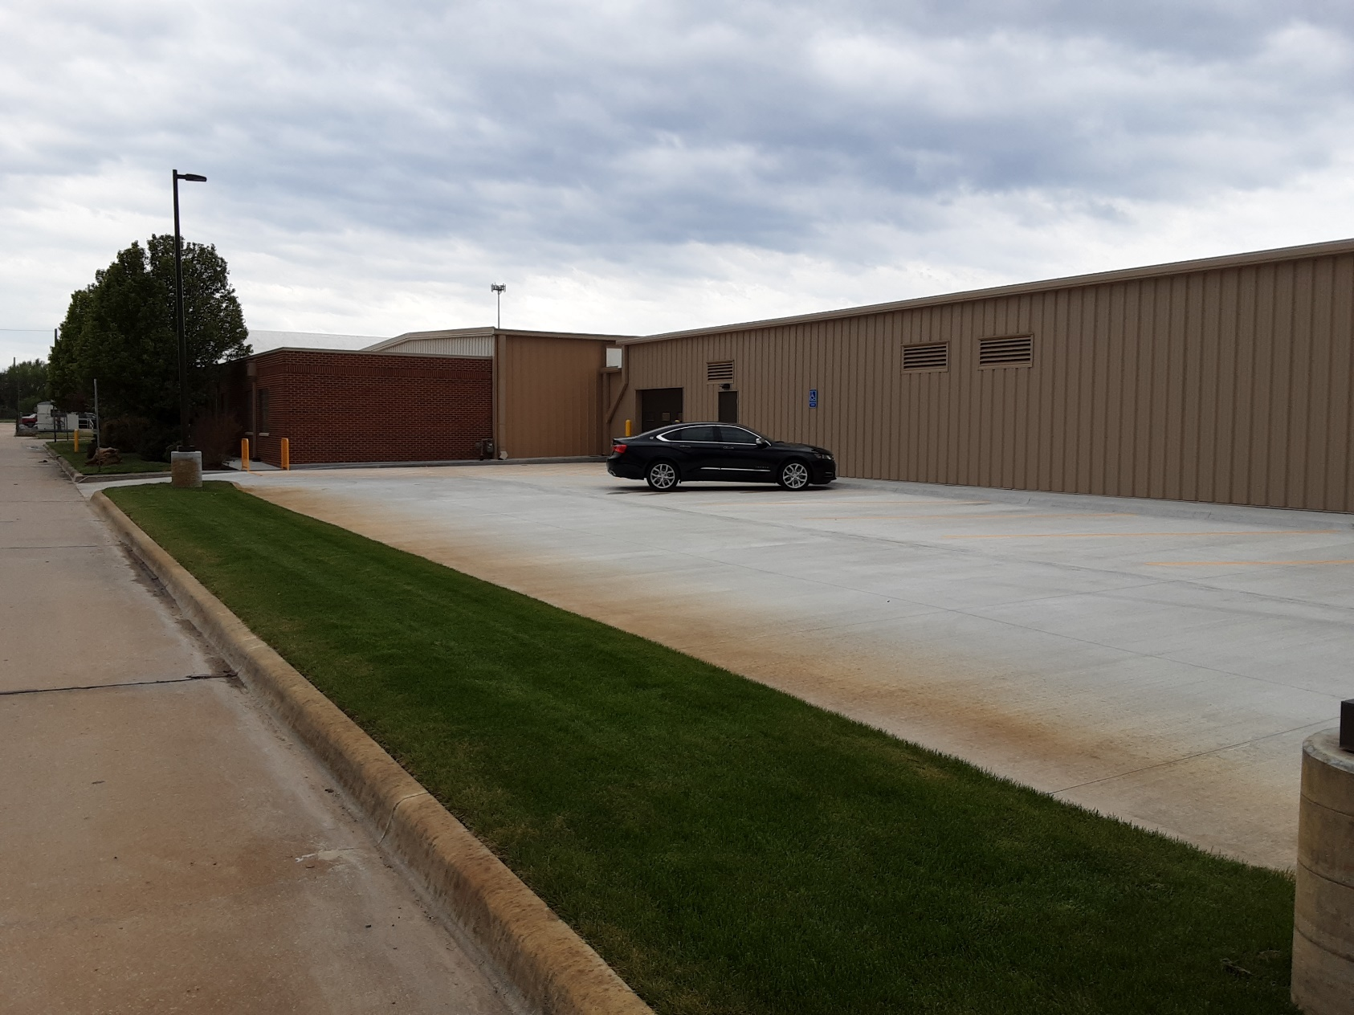
Sample Preservation: Past & Present

Slide 8
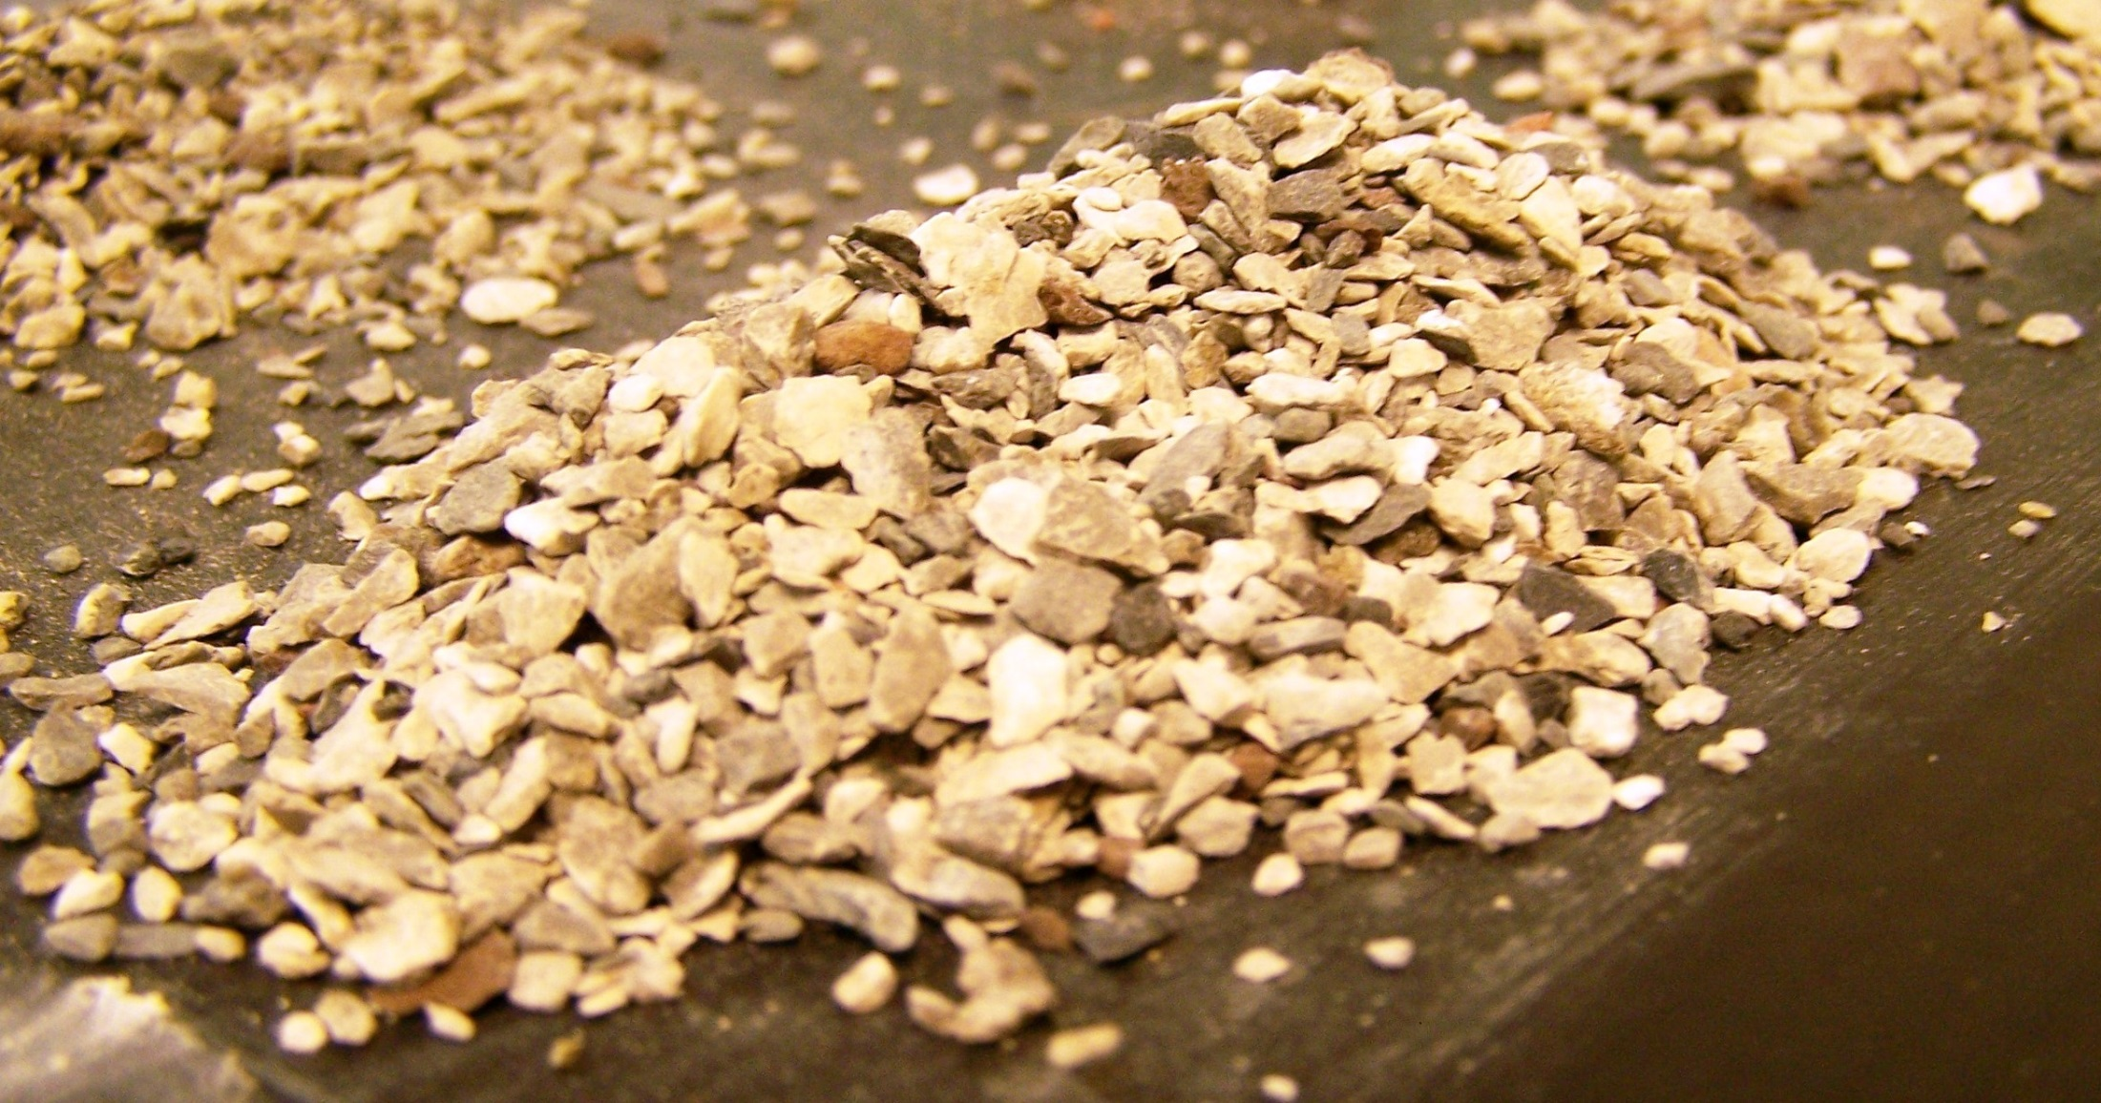
Sample Preservation: Past & Present
Sample cuttings--small pieces of the rock created by drilling, flushed up to the surface, and captured during the drilling process--a valuable source of geologic information.
Examination of drill cuttings collected from oil and gas wells began in the 1880’s.
A skillful geologist, petroleum engineer, or researcher is able to determine rock type, the specific formation encountered, formation depths, porosity, and hydrocarbon content.

Slide 9
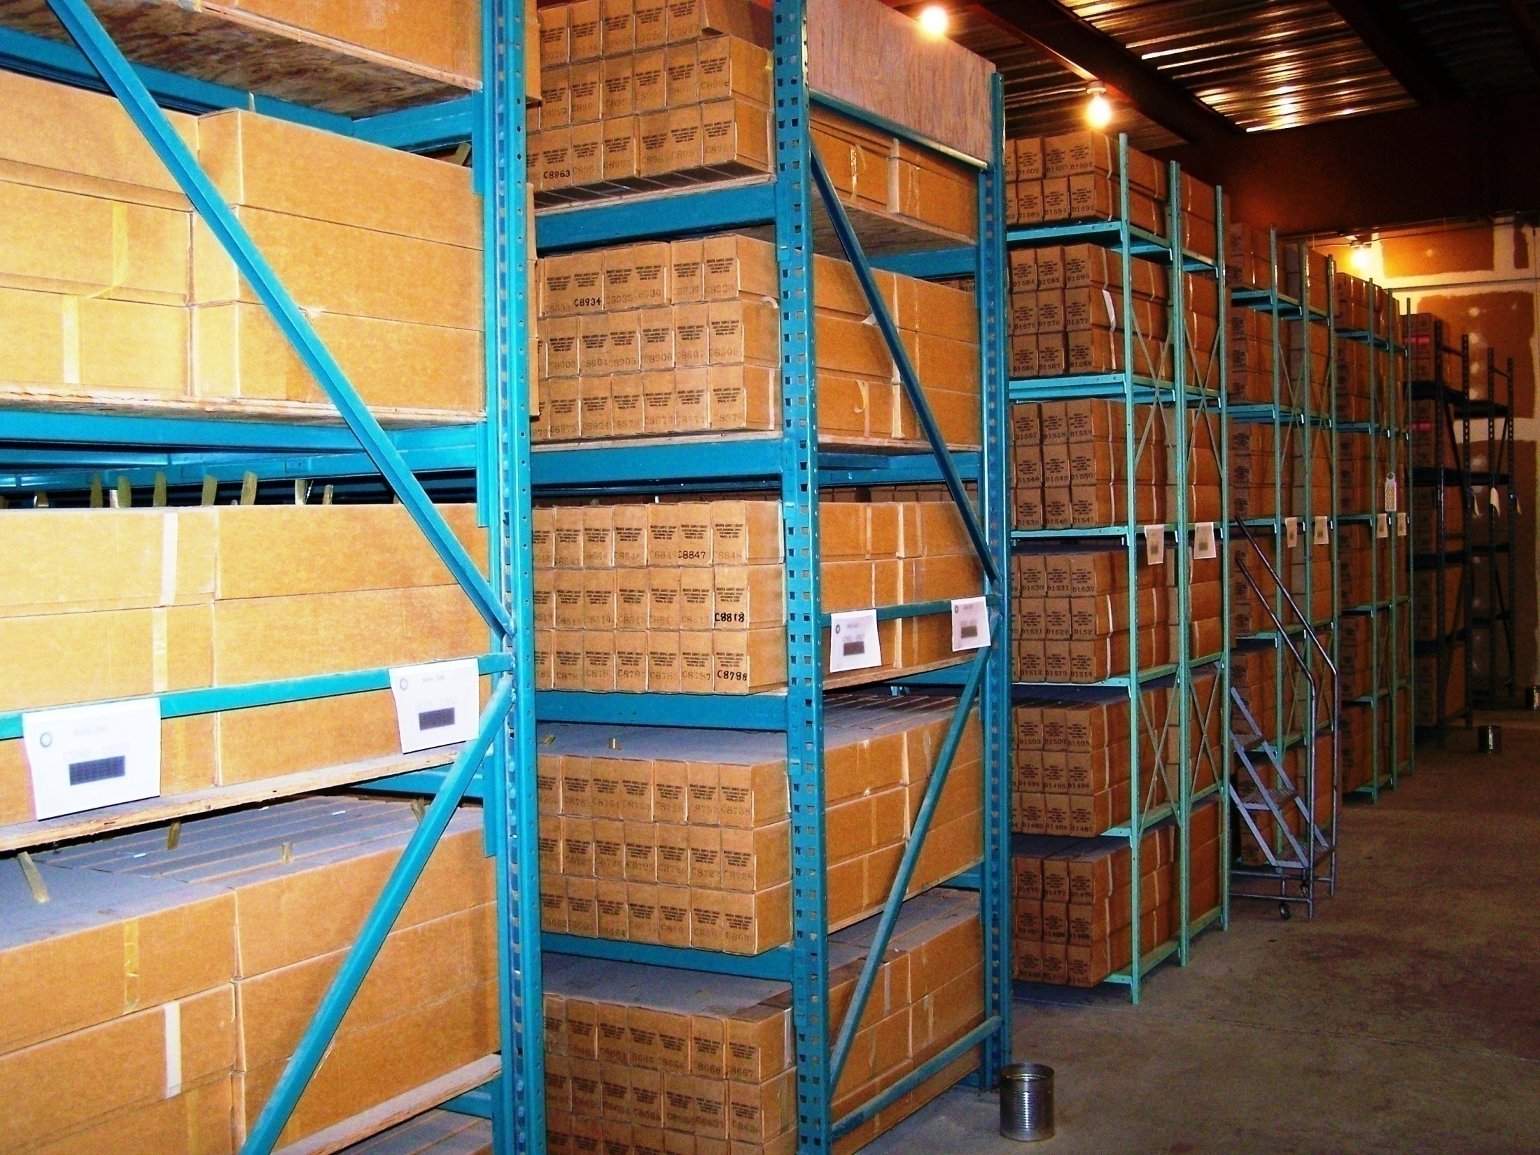
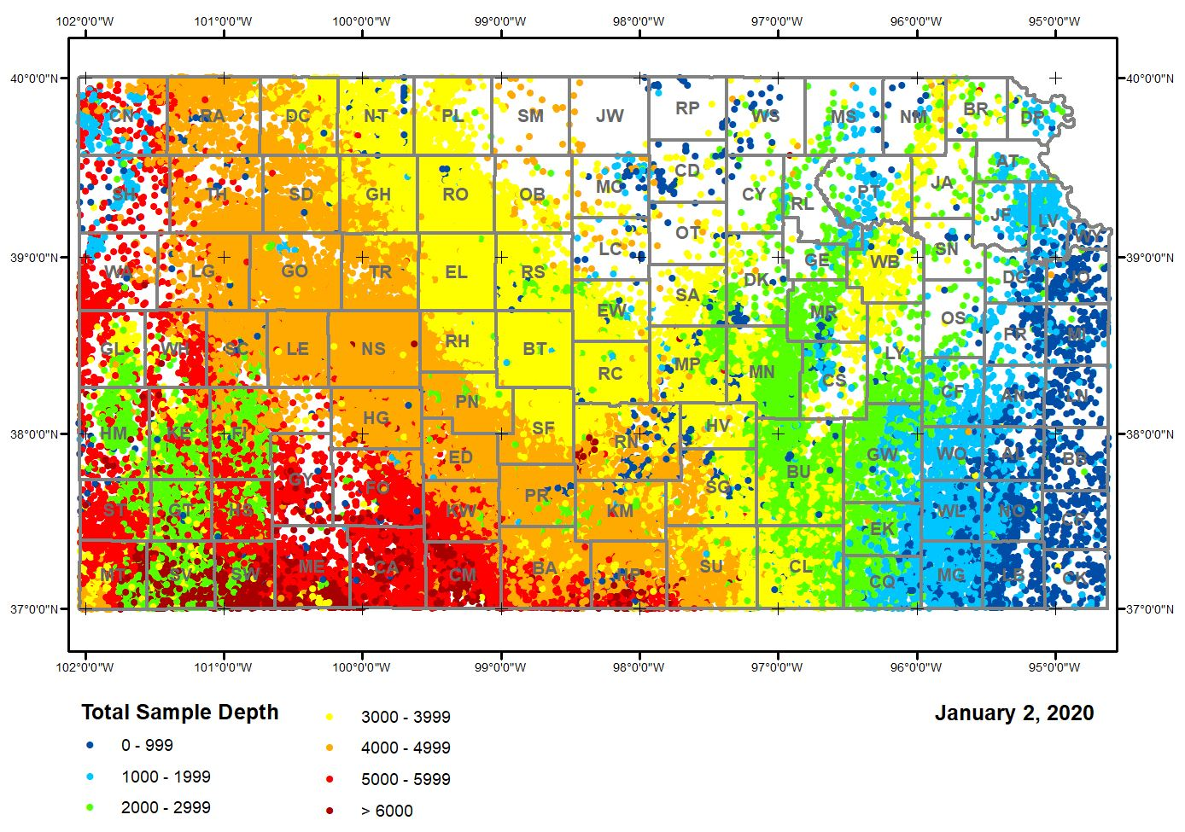
Sample Preservation: Present
In cooperation with oil and gas operators, KGS has preserved samples from nearly 146,000 wells
Well samples are checked out to examine for energy exploration, research, and educational purposes.
Salina Basin
Central Kansas Uplift
Forest City Basin
Mississippian Limestone Play
The age of well samples preserved ranges from 1913 to present.
Hugoton – Panoma Gas Fields
Cherokee Basin
The geologic age ranges from the Quaternary Period (1 million years ago) to the Precambrian (nearly 600 million years ago).

Slide 10
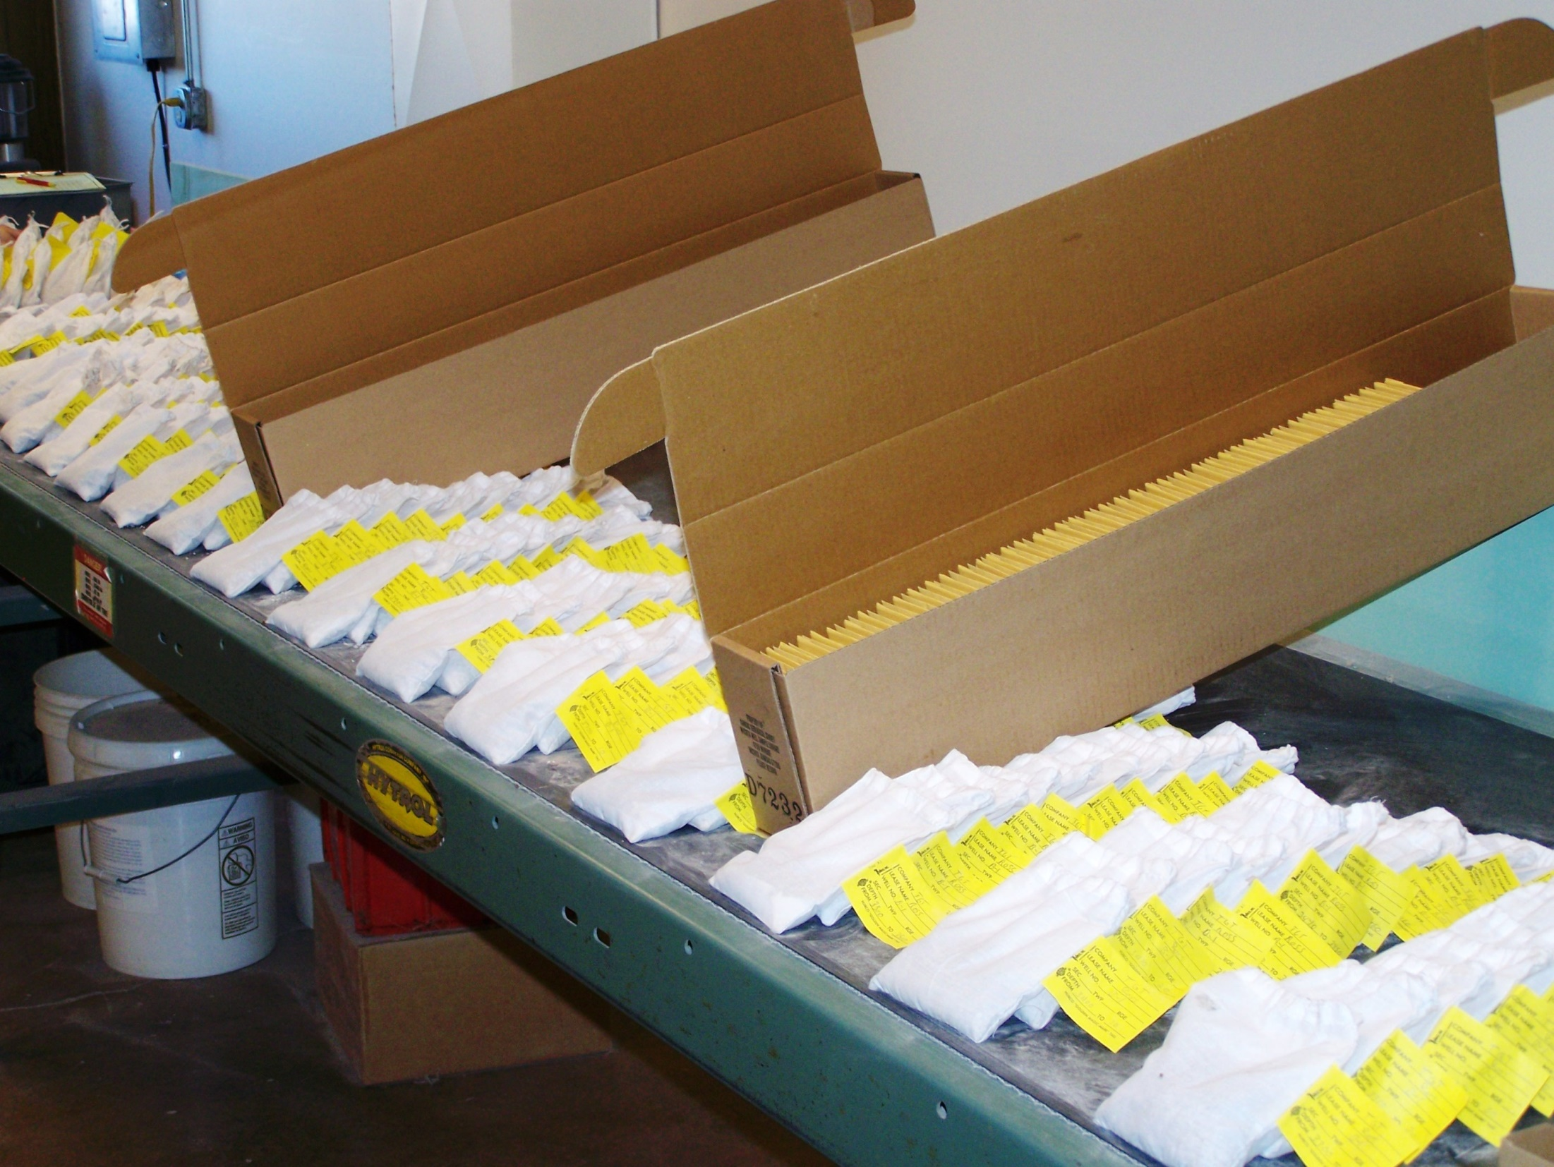
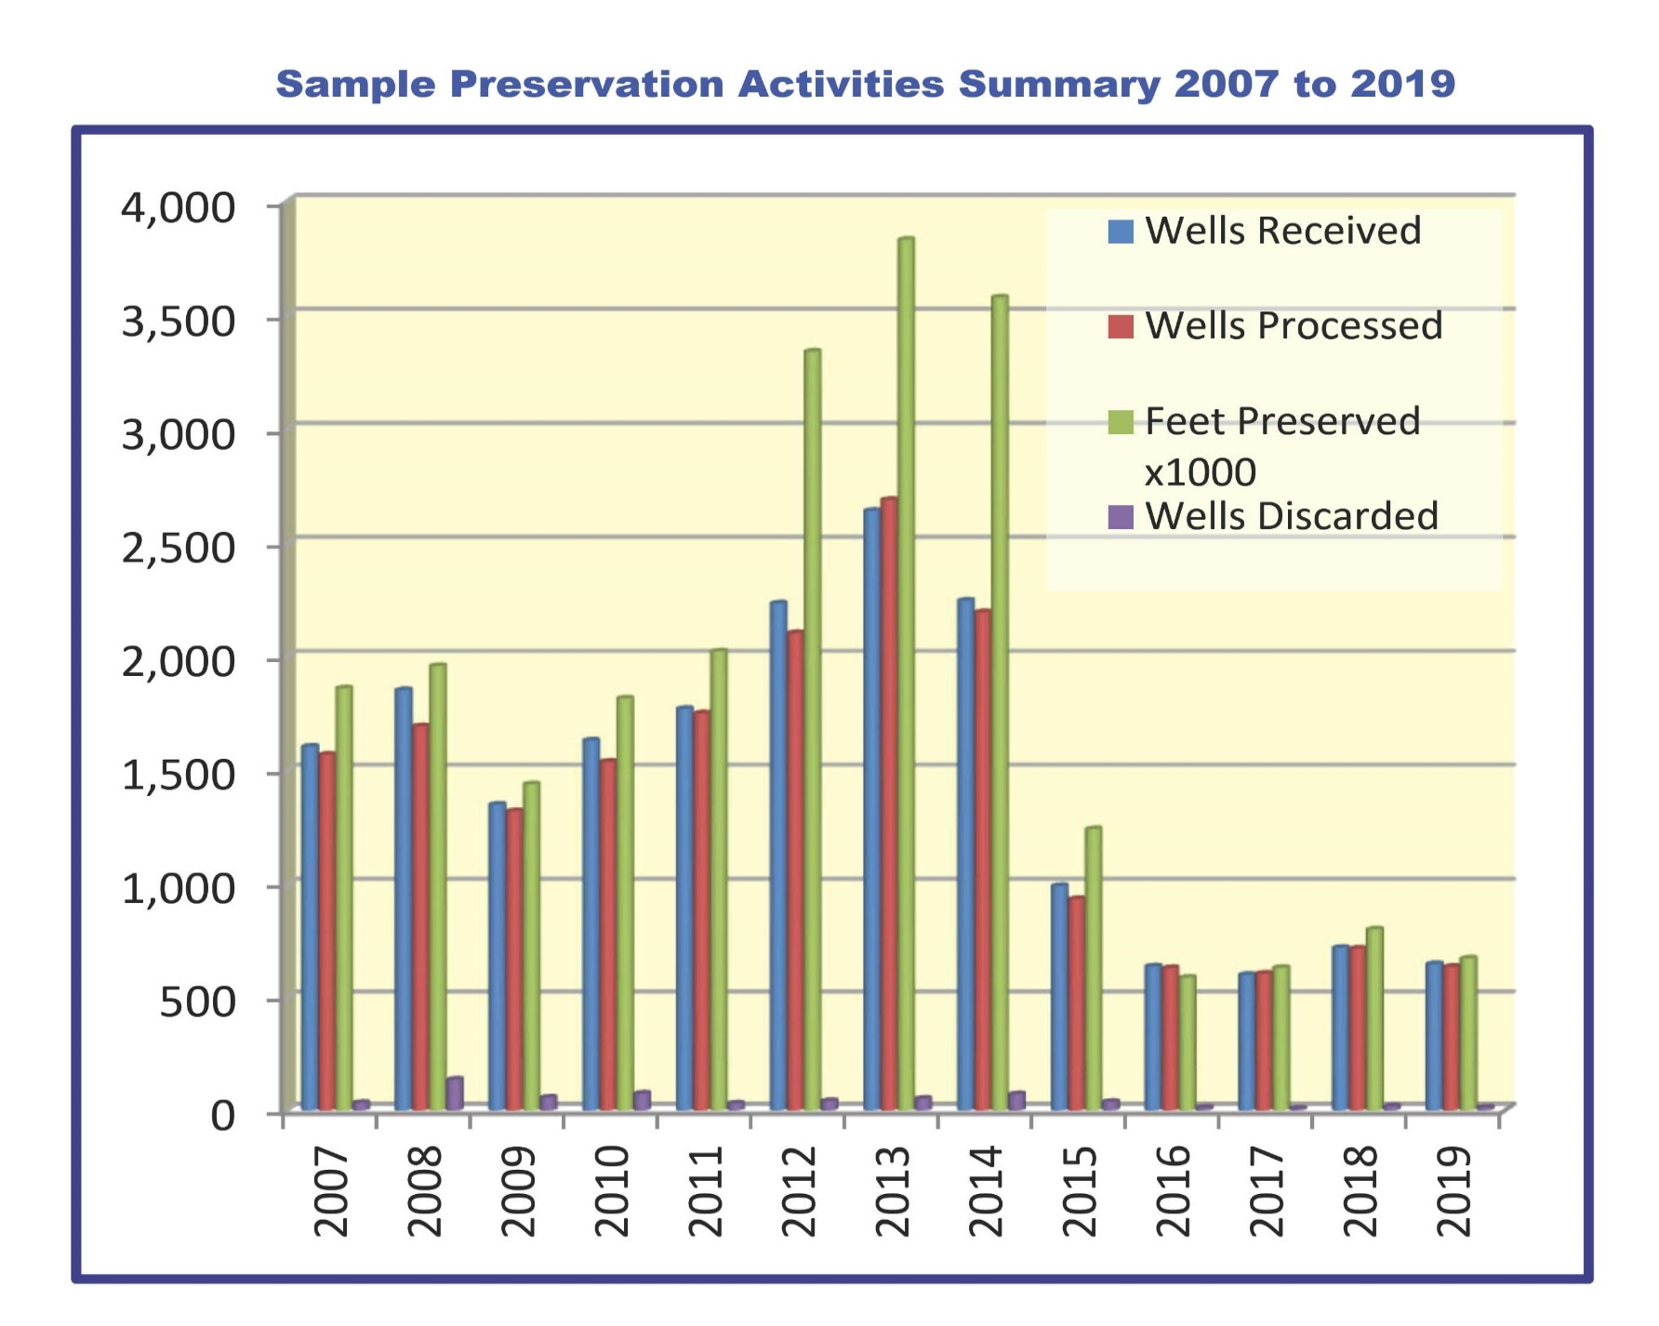
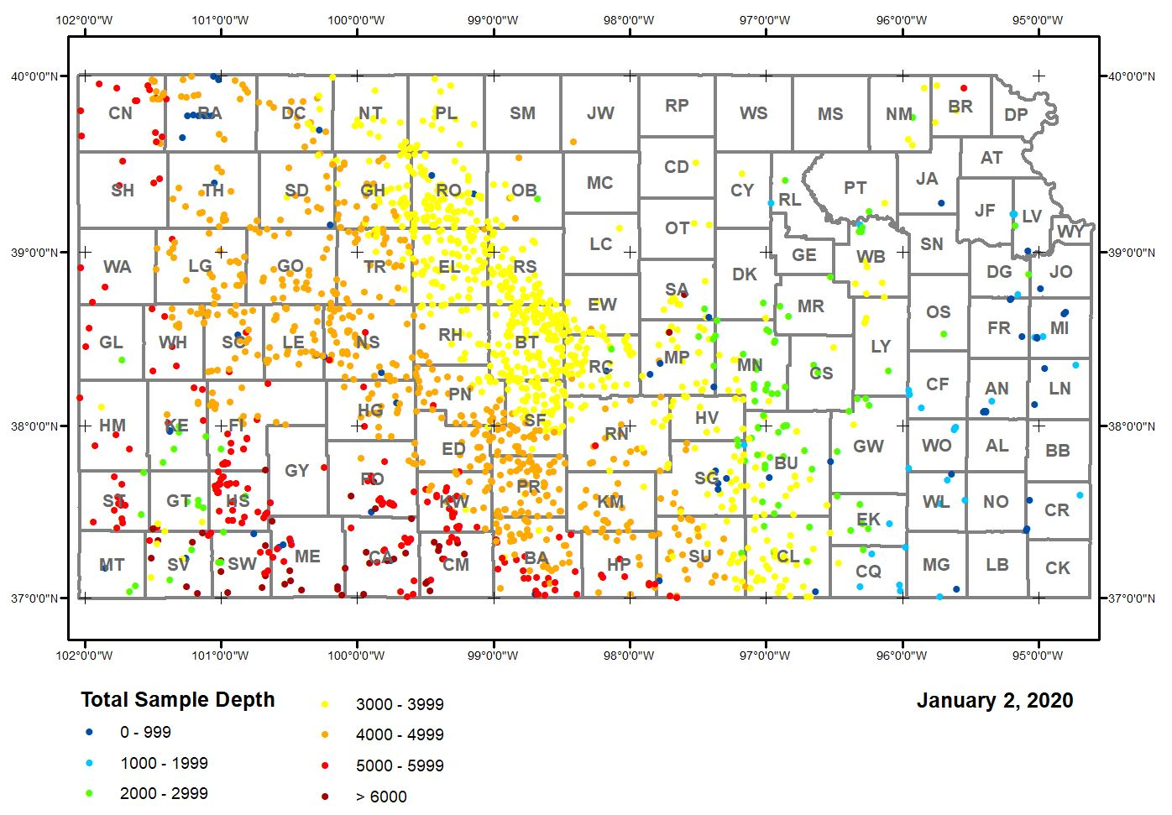
Sample Preservation: Present
Sample Preservation Activities 2019
Petroleum companies provided the Survey with geologic samples from 652 oil and gas wells.
Samples from 640 wells were preserved at an average rate of nearly 1,067 sample feet per hour for a total of 699 processing hours.
104,000 sample envelopes and 2,871 sample boxes were used to preserve and restore well samples.
Samples from 14 wells were discarded as not being geologically significant to the oil or gas operator and the sample collection.
Staff preserved about 0.68 million sample feet, the equivalent to the flight distance from Wichita to Topeka, Kansas.
USGS grant funded 2,445 hours to restore samples for 4,750 wells and resolved 26,292 sample preservation issues, including the recovery of missing samples for 725 wells.
Sample Processing Supplies
Supplies needed to preserve 1,000,000 sample feet.
Approximately 190 miles of samples preserved
Equivalent to distance from Wichita to Kansas City
625 sample boxes
87,500 sample envelopes
87,500 printed envelope labels
1,250 staff hours
Distribution of Well Sample Preserved, 2019

Slide 11
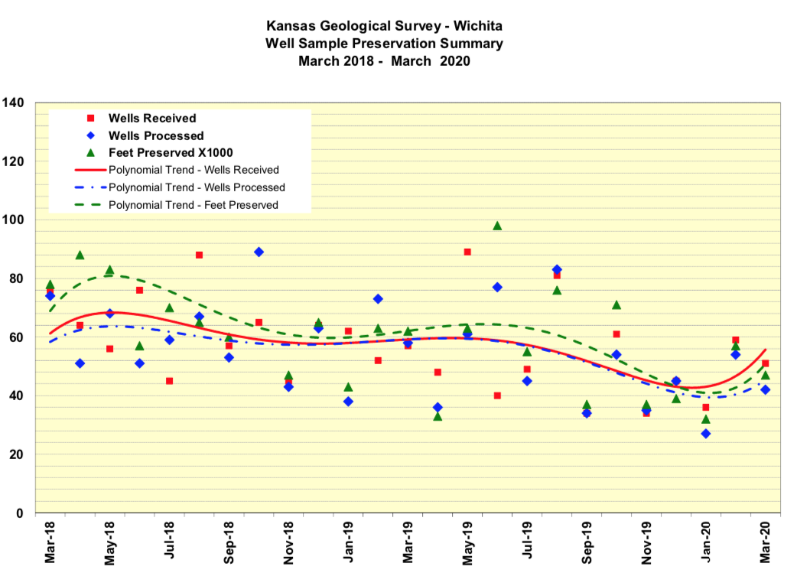
Preservation Summary of Samples from Oil or Gas Wells
March 2018 – March 2020

Slide 12

Sample Preservation Requirements
The Kansas Corporation Commission governs the preservation of well samples, cores and logs. In accordance with K.A.R. 82-3-107, The Kansas Geological Survey may request formation samples or drill cuttings for inclusion to the Kansas Geologic Sample Respository.
Upon request from the Kansas Geological Survey, the samples shall be washed and cut into splits or sets. A set shall be placed in labeled sample envelopes and delivered, at the prepaid expense of the operator, to the Kansas Geological Survey, sample repository, Wichita, Kansas.

Slide 13
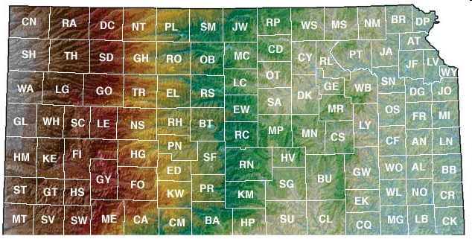
Sample Preservation Requirements
Sample density
Total well depth- >100 feet deeper
Sample age- >40 years old
Drill method- vertical and horizontal
Operator requests preservation
Sample per ¼ section
Sample per section

Slide 14
Sample Preservation Requirements
KGS notice to operator to provide samples
Notice is sent either mail, email,
or fax depending on operator’s preference.

Slide 15
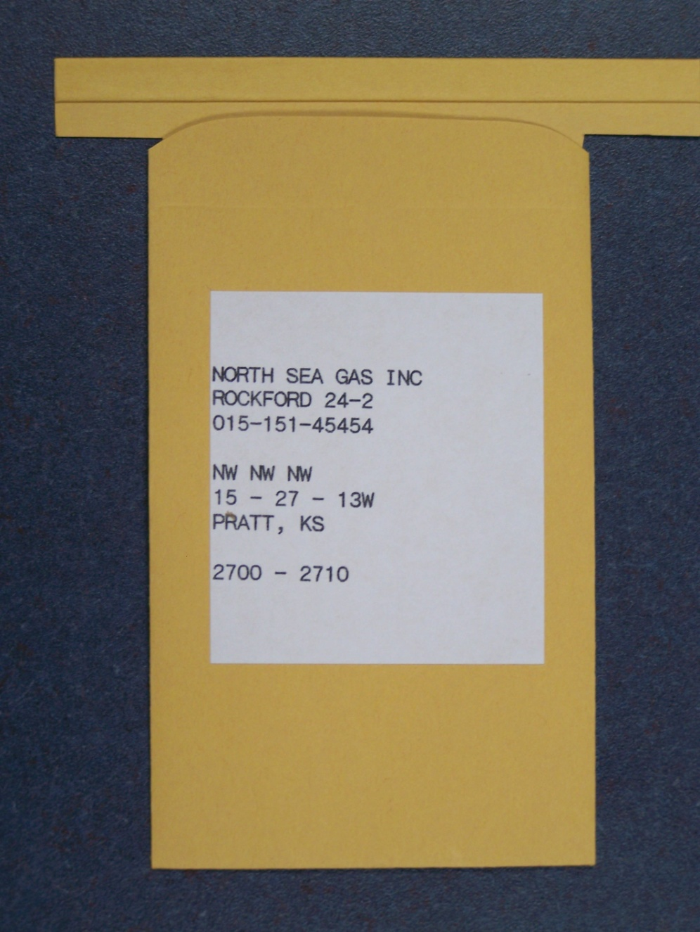
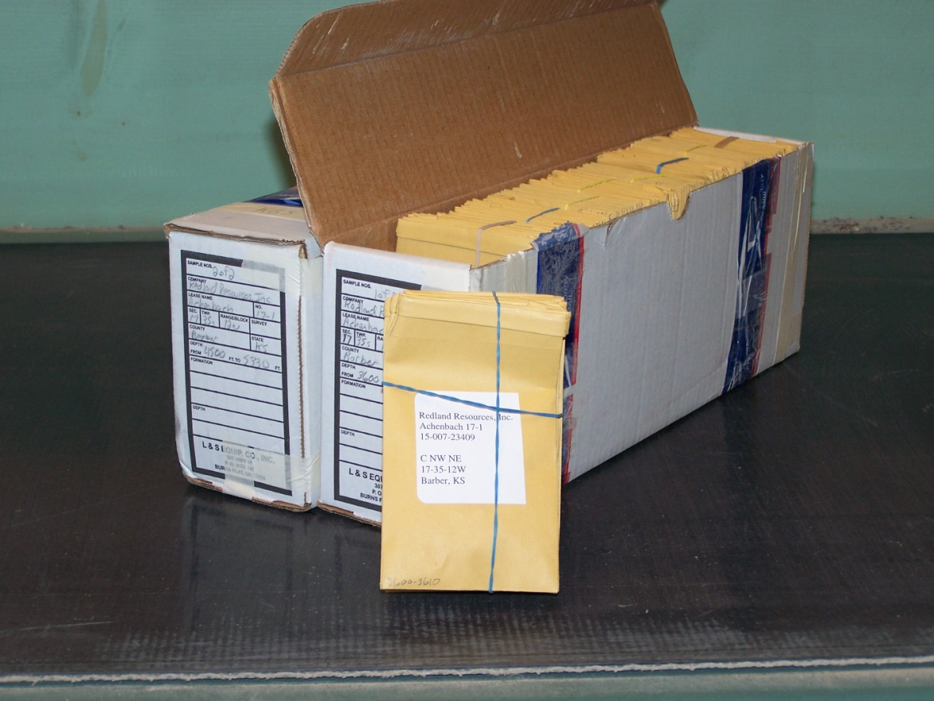
Submitting Samples
Prepared Samples
Sample submission form
Clean and dry
Three by five inch manila envelopes with a metal fold top
Sorted/grouped by interval
Properly labeled:

Slide 16
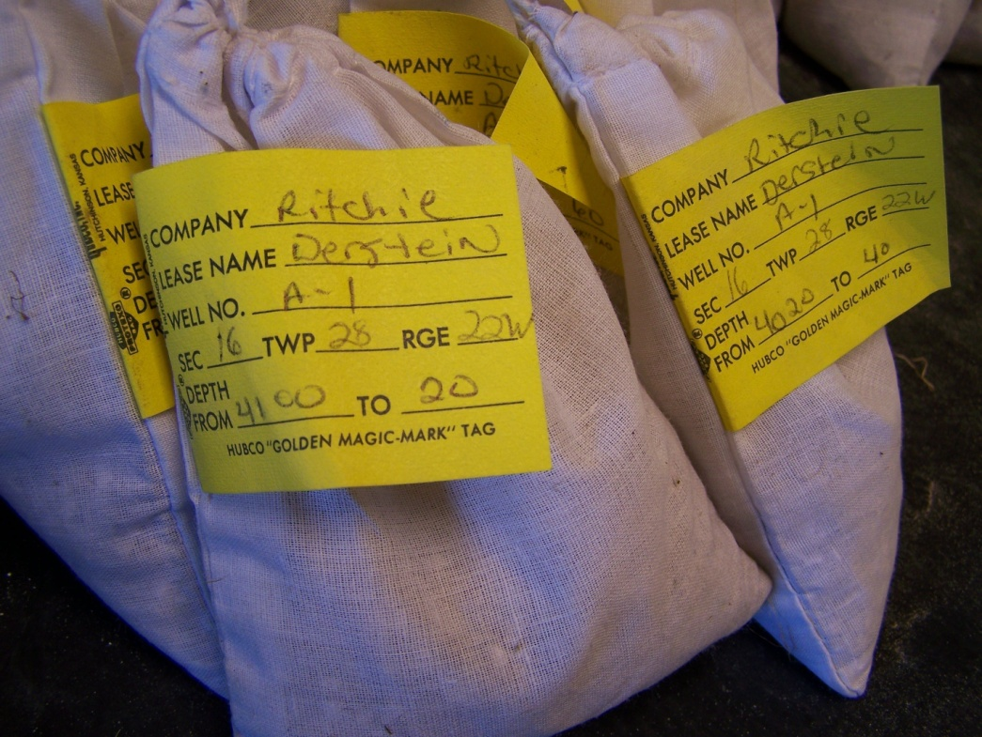
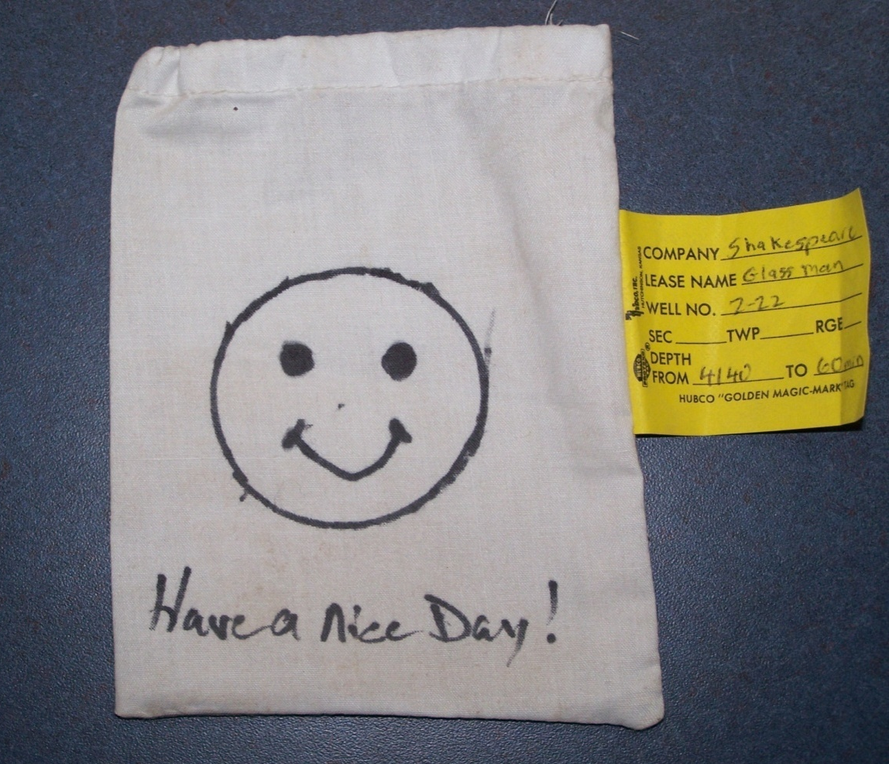
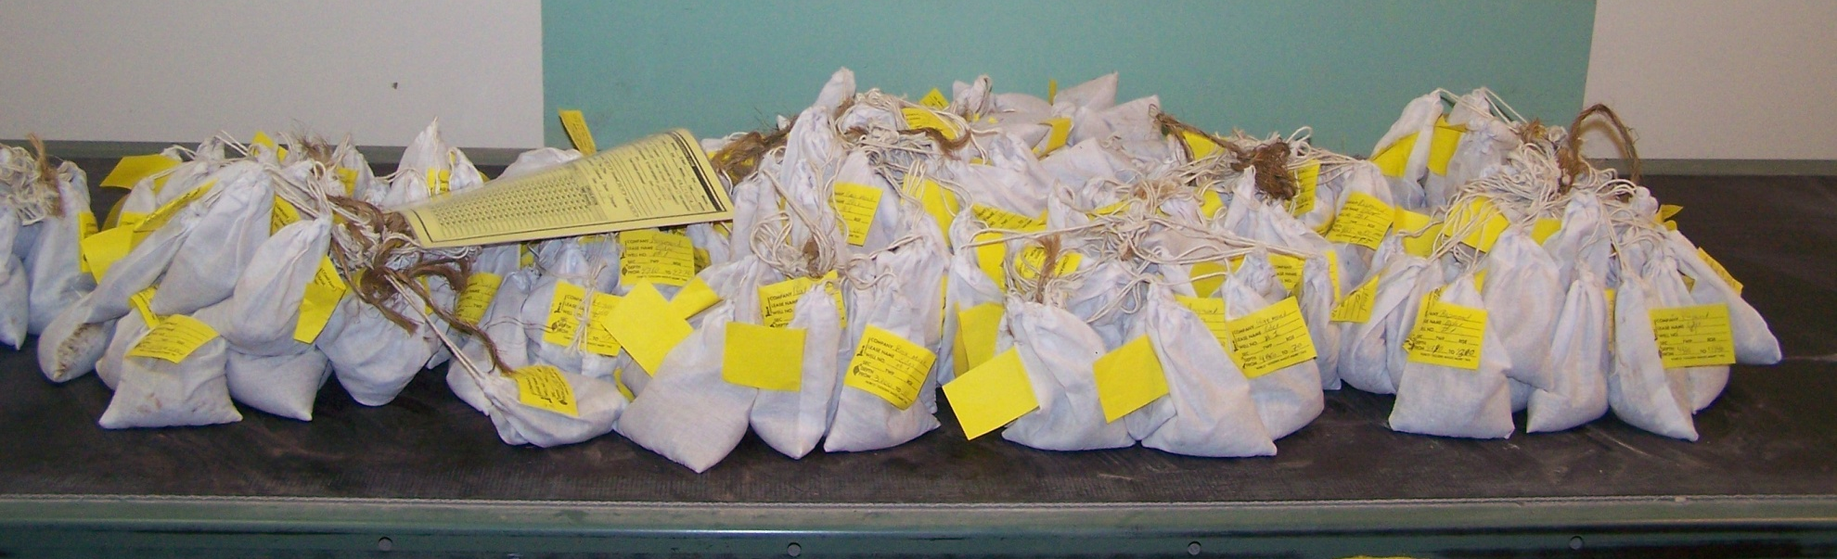
Submitting Samples
Regular Samples
Sample submission form
Clean and dry
Legibly labeled
Sorted/grouped by interval

Slide 17
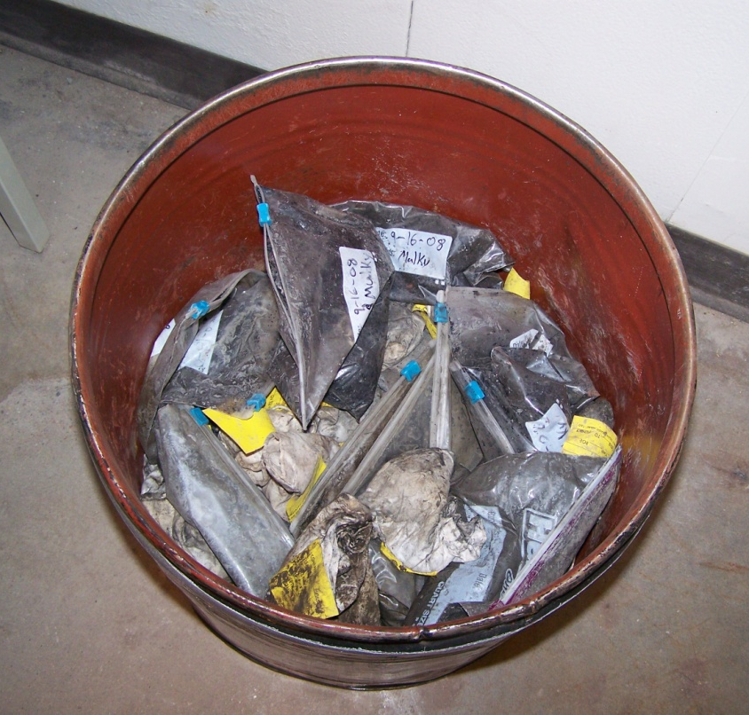
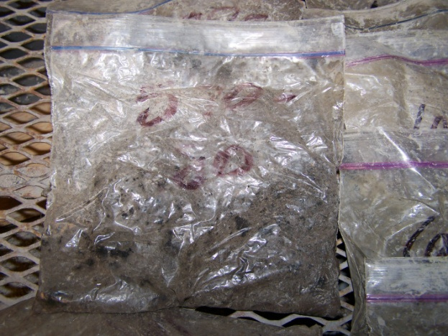
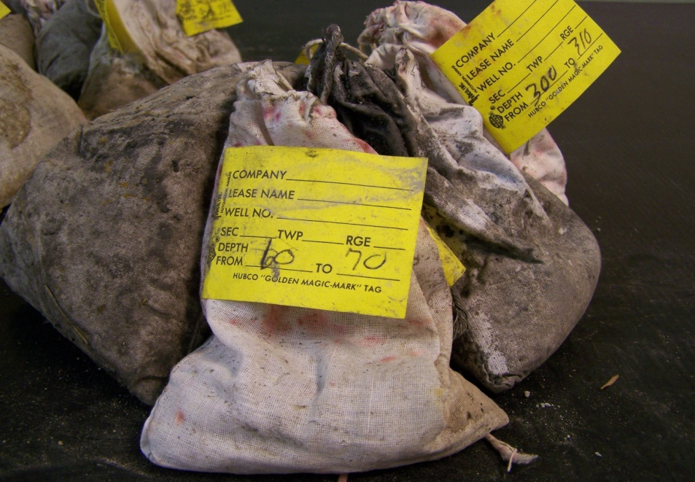
Submitting Samples
Irregular Samples
Sample submission form is missing, incomplete, illegible
Wet, dirty, unwashed
Loose, disorganized
Sample bags incorrectly or illegibly labeled

Slide 18
Submitting Samples
Types of Rotary Samples Processed | Cost Per Foot
Prepared Sample Set | $0.00
Regular Sample Set | $0.06
Irregular Sample Set | $0.12
Confidential Sample Set | $0.10
Duplicate Sample Set | $0.06
$0
$60
$120
$100
$60
Based on 1,000 sample feet preserved

Slide 19
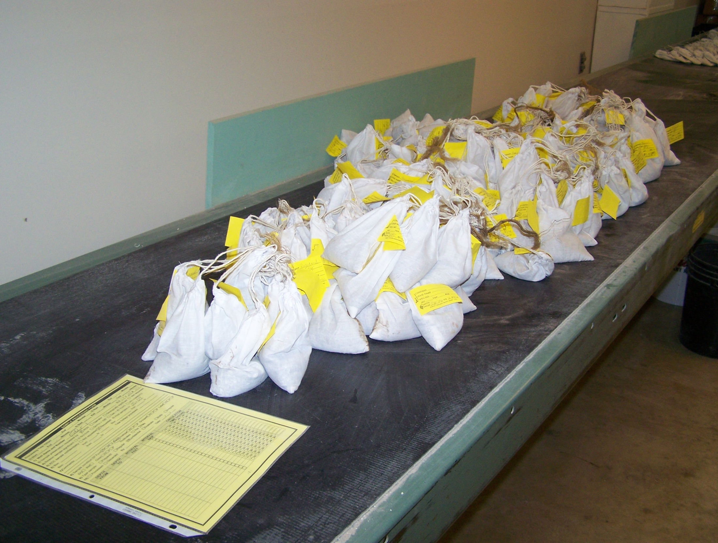
Preserving Samples
Sample intake:
  check well name on form vs. sample labels
  reason samples submitted
  confidentiality
  duplicates
Processing packet records
  sample intervals
  circulations
  skips

Slide 20
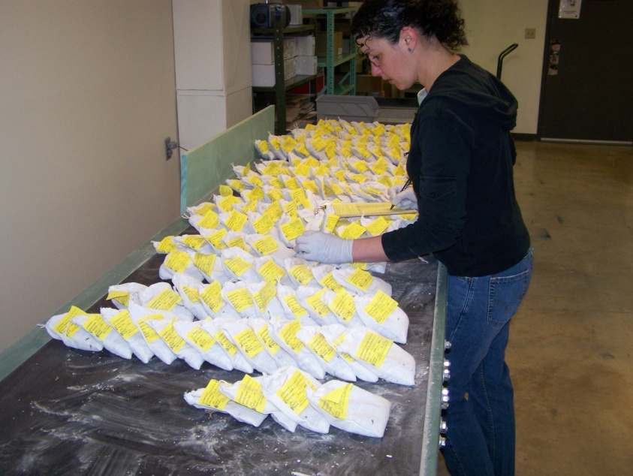
Processor records start and end times
Samples laid out according to depth, shallow to deepest
Processor records depths, circulations, skips

Slide 21
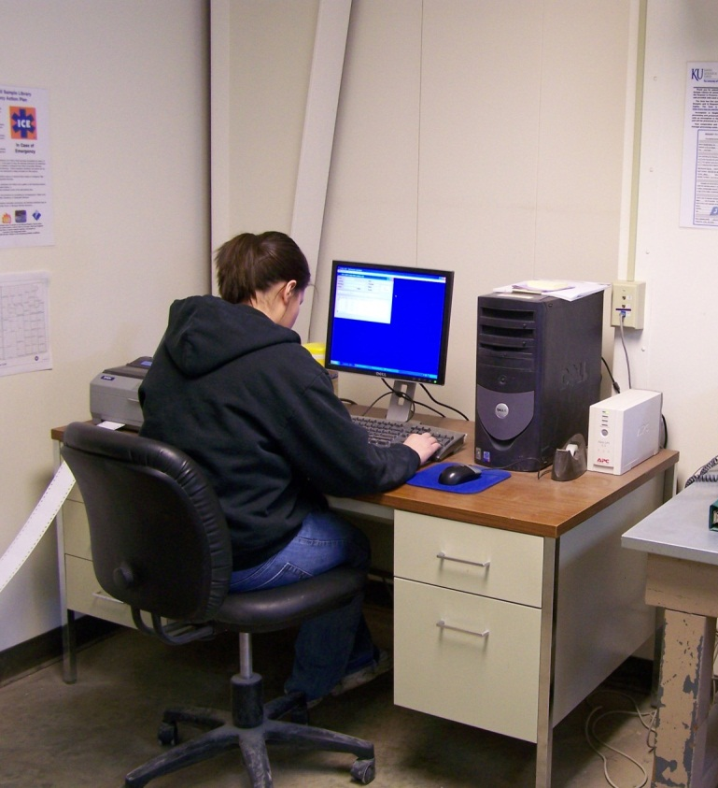
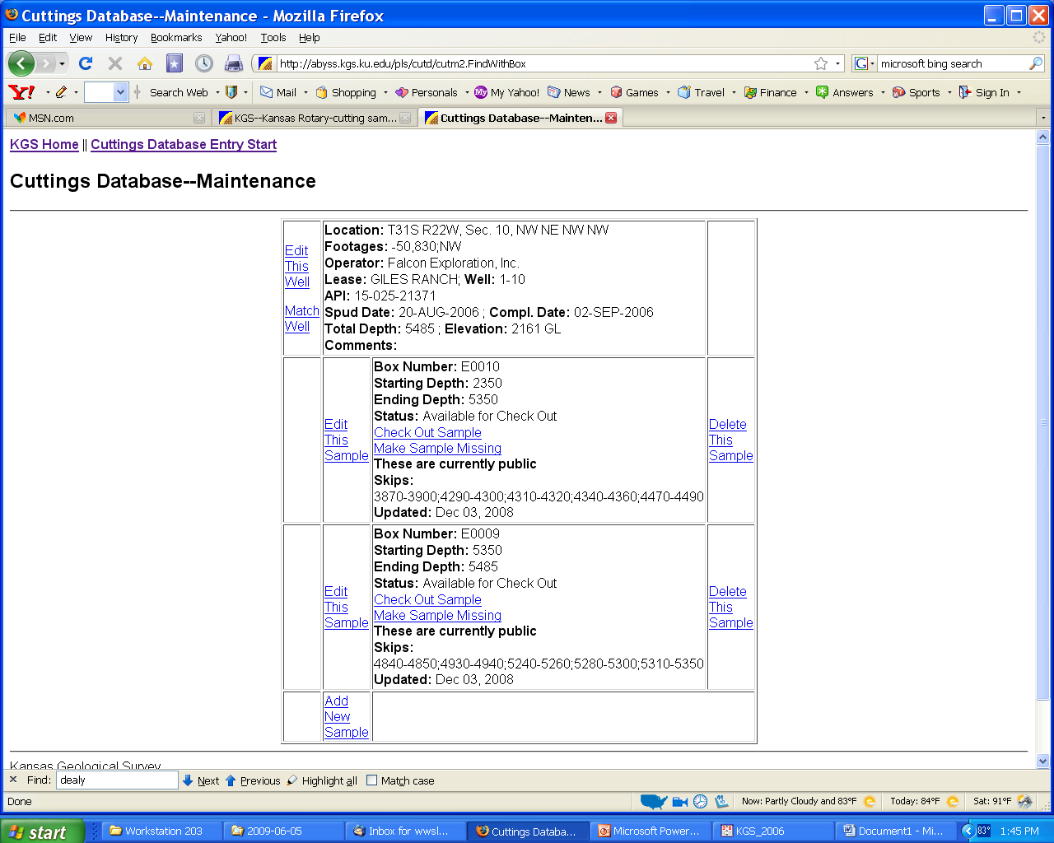
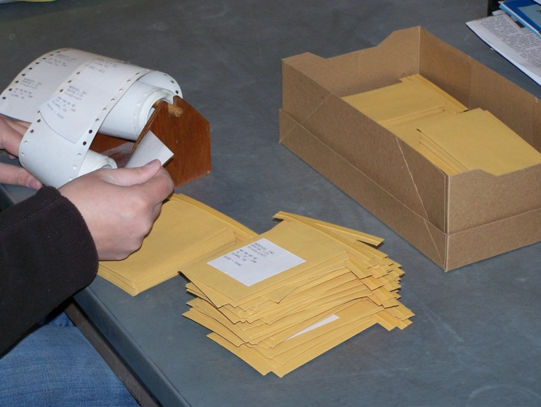
Preserving Samples
Labels printed
Attached to sample envelopes
Information entered into sample database

Slide 22
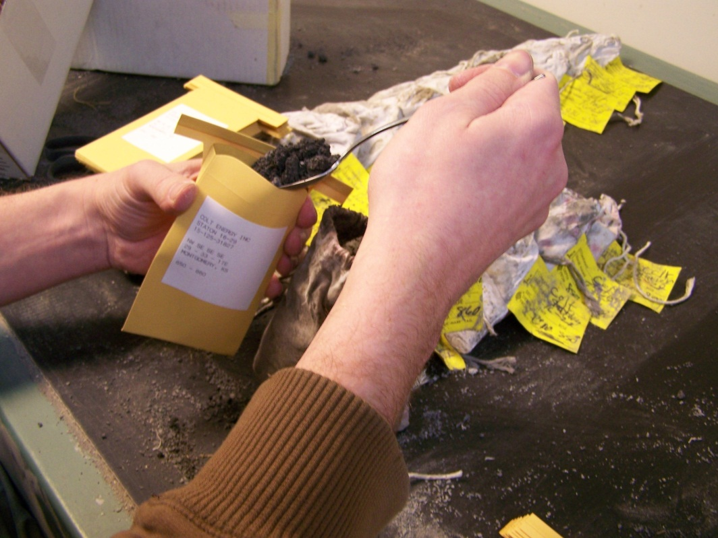

Sample box may contain multiple wells
Confidential well samples are placed in restricted boxes
28 to 42 grams of sample placed into sample envelopes

Slide 23
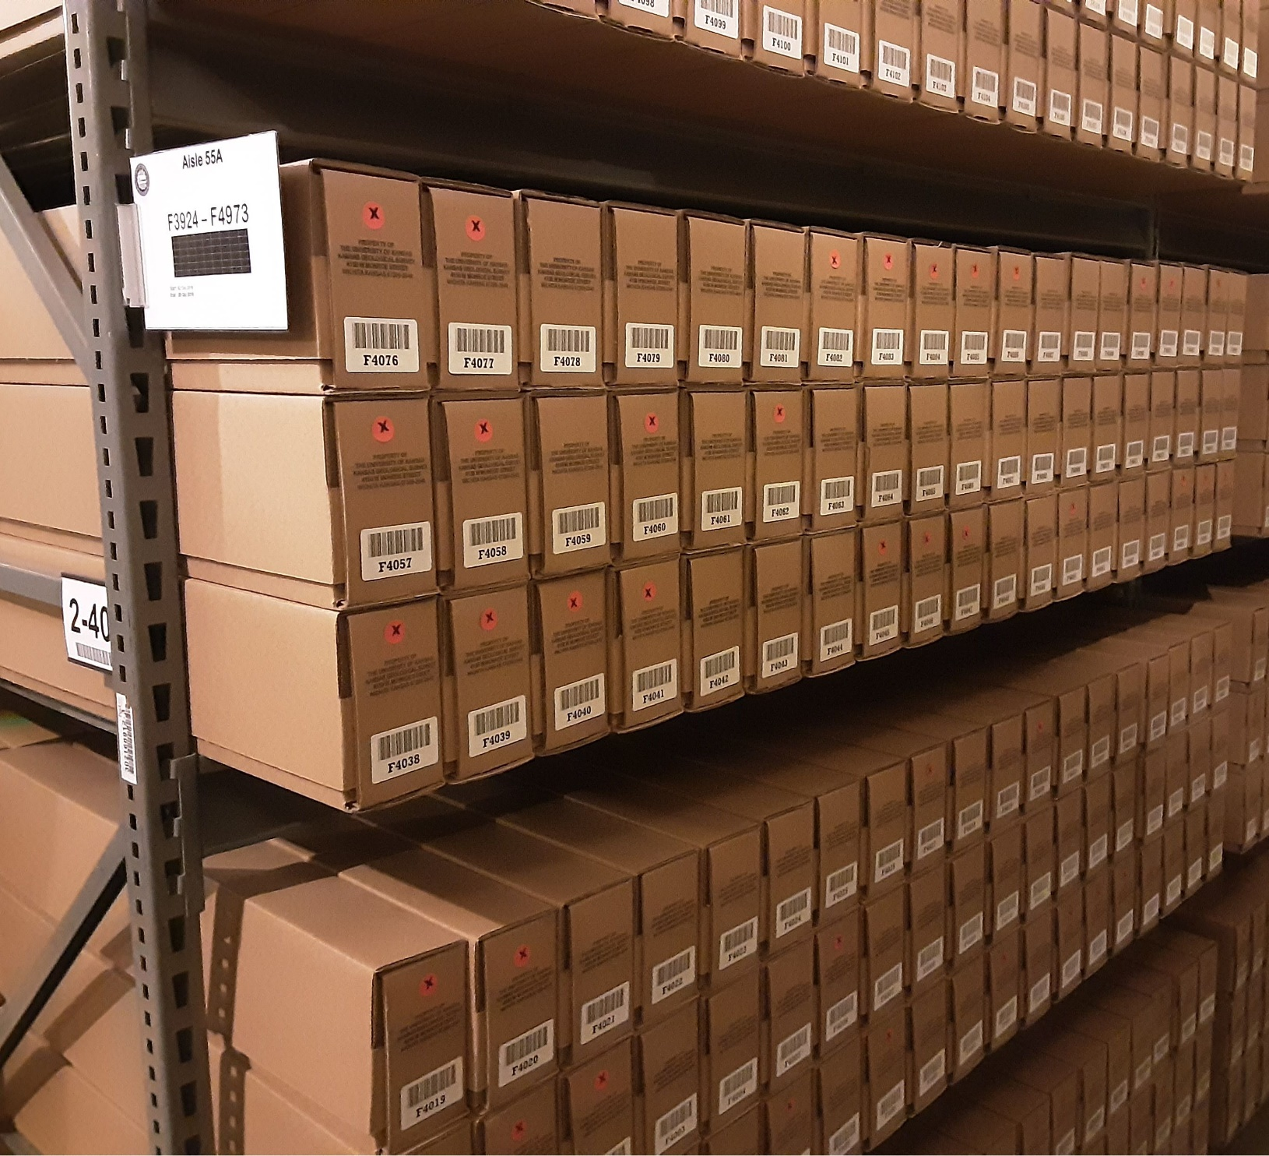
Confidential Samples
Public Samples
Box Over Hang (Avoid)

Slide 24
Usage
Sample Check Out Request per box | $3.00
Sample Examination Loan In-house per box | $0.00
Sample Examination Loan--Mini 30 day limit per box | $8.00
Sample Examination Loan--Regular 60 day limit per box | $15.00
Sample Examination Loan--Max 90 day limit per box | $22.00
Overdue Loan per box per day | $1.00

Slide 25
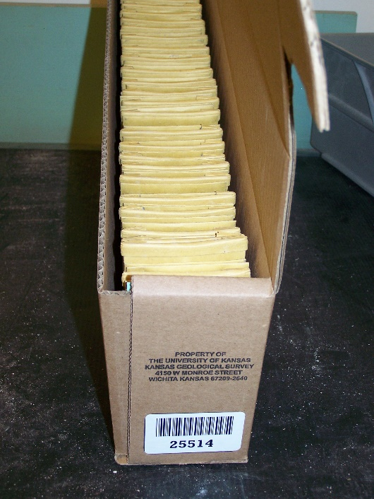
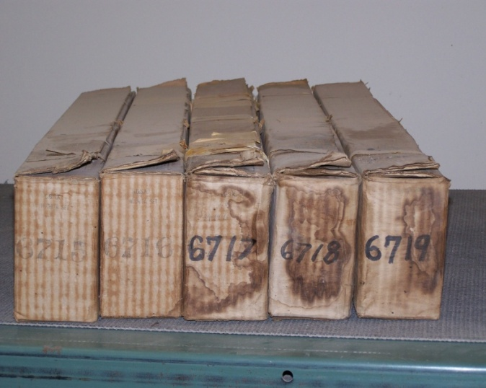
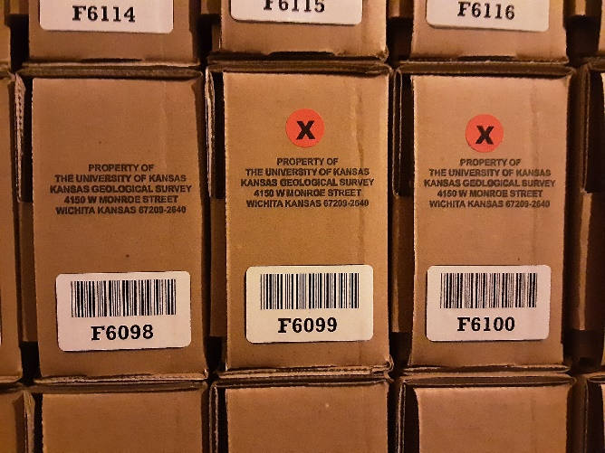
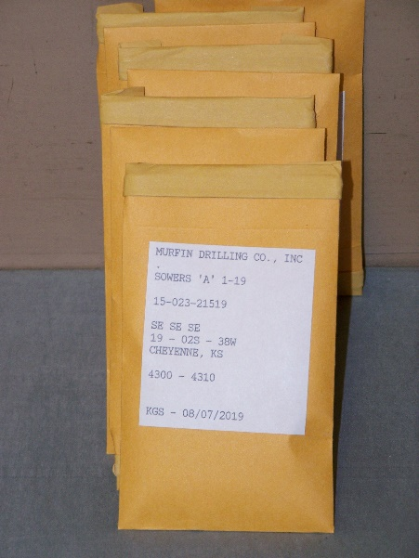
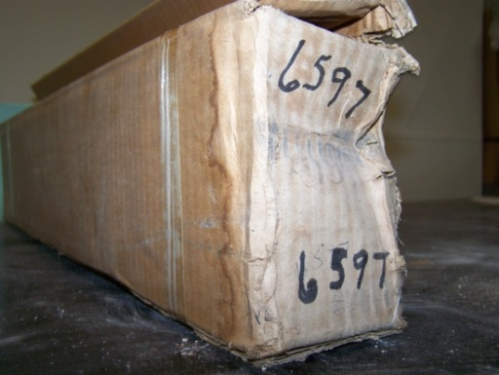
Preserving Samples
Sample Restoration Program:
identify samples at risk due to physical or water damage
re-box samples
re-envelope/re-label samples
update the rotary cuttings database
bar coding

Slide 26
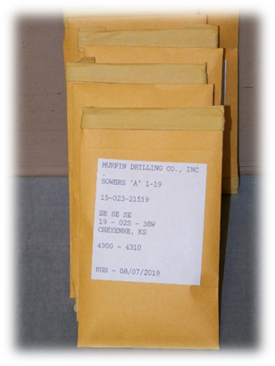
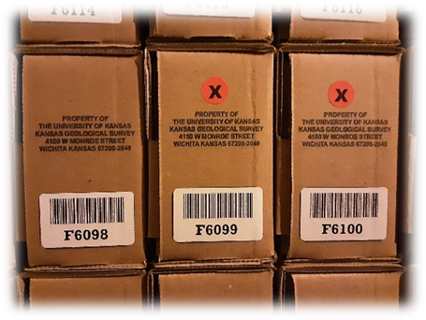
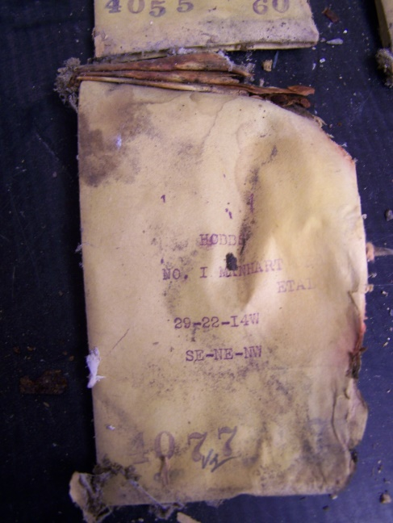
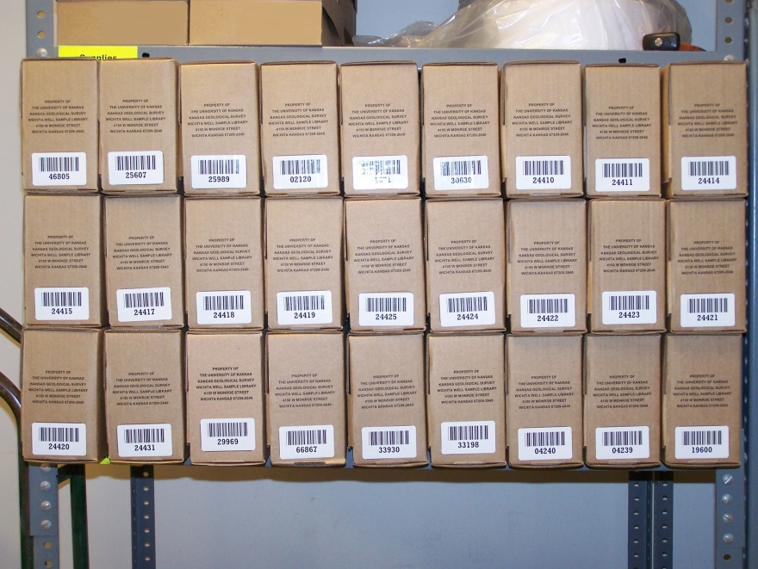
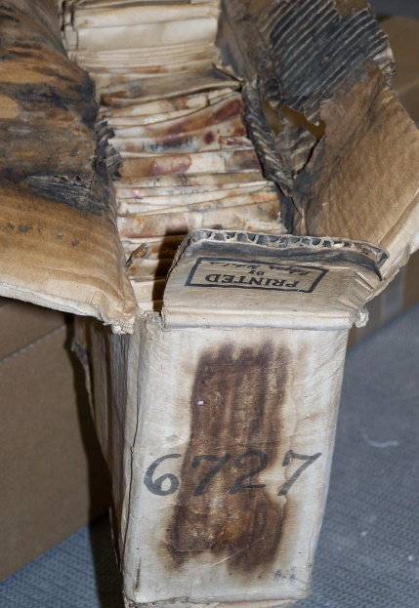
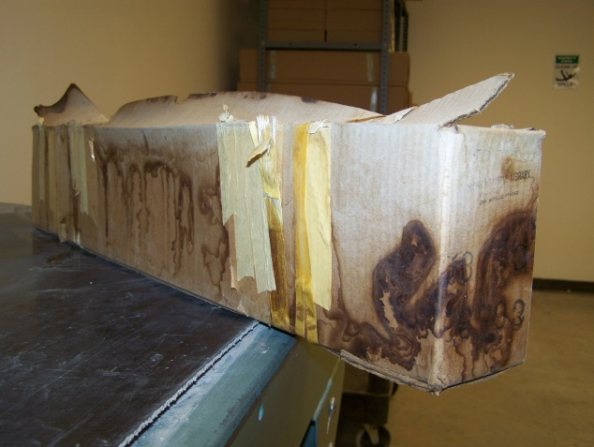
Preserving Well Samples
Sample Restoration Program Initiated Spring 2008:
identify samples at risk due to physical or water damage
re-box samples
re-envelope/re-label samples
update the rotary cuttings database
bar coding

Slide 27
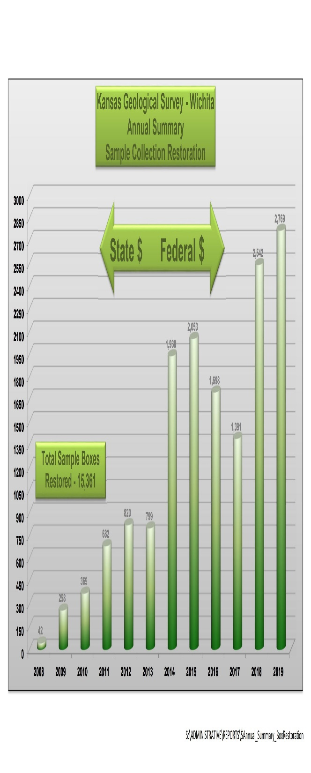
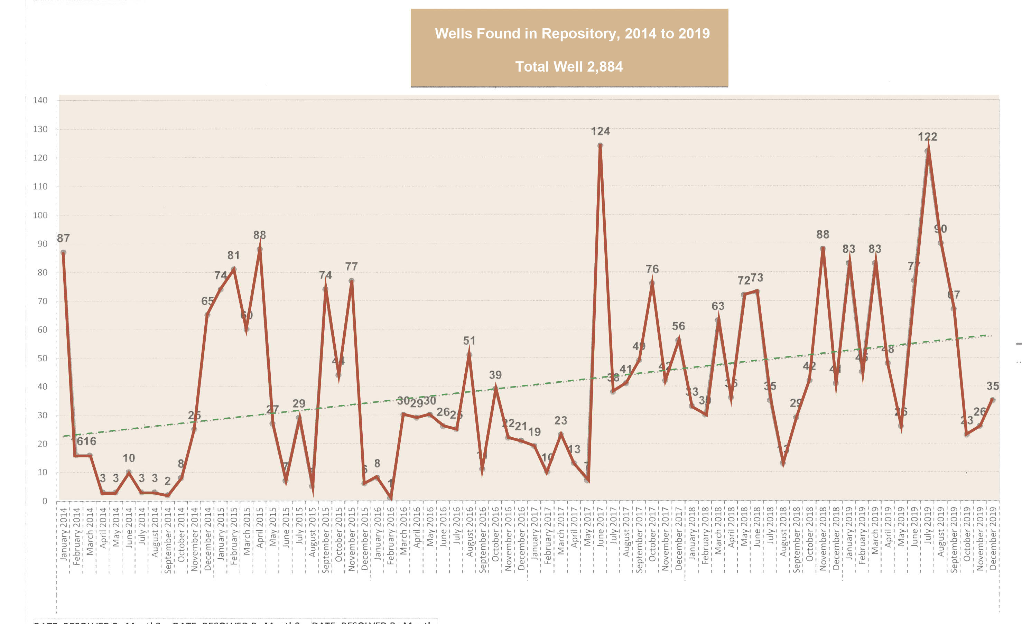
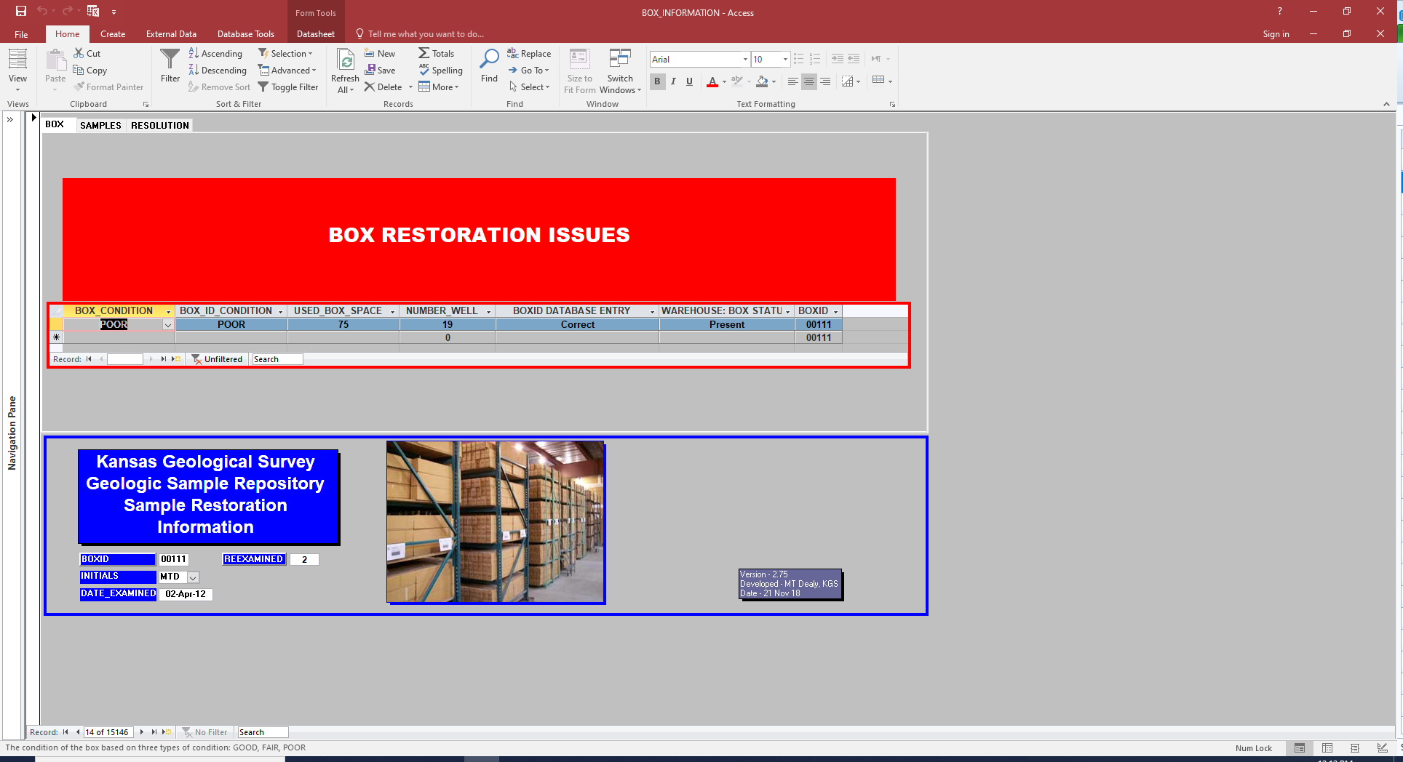
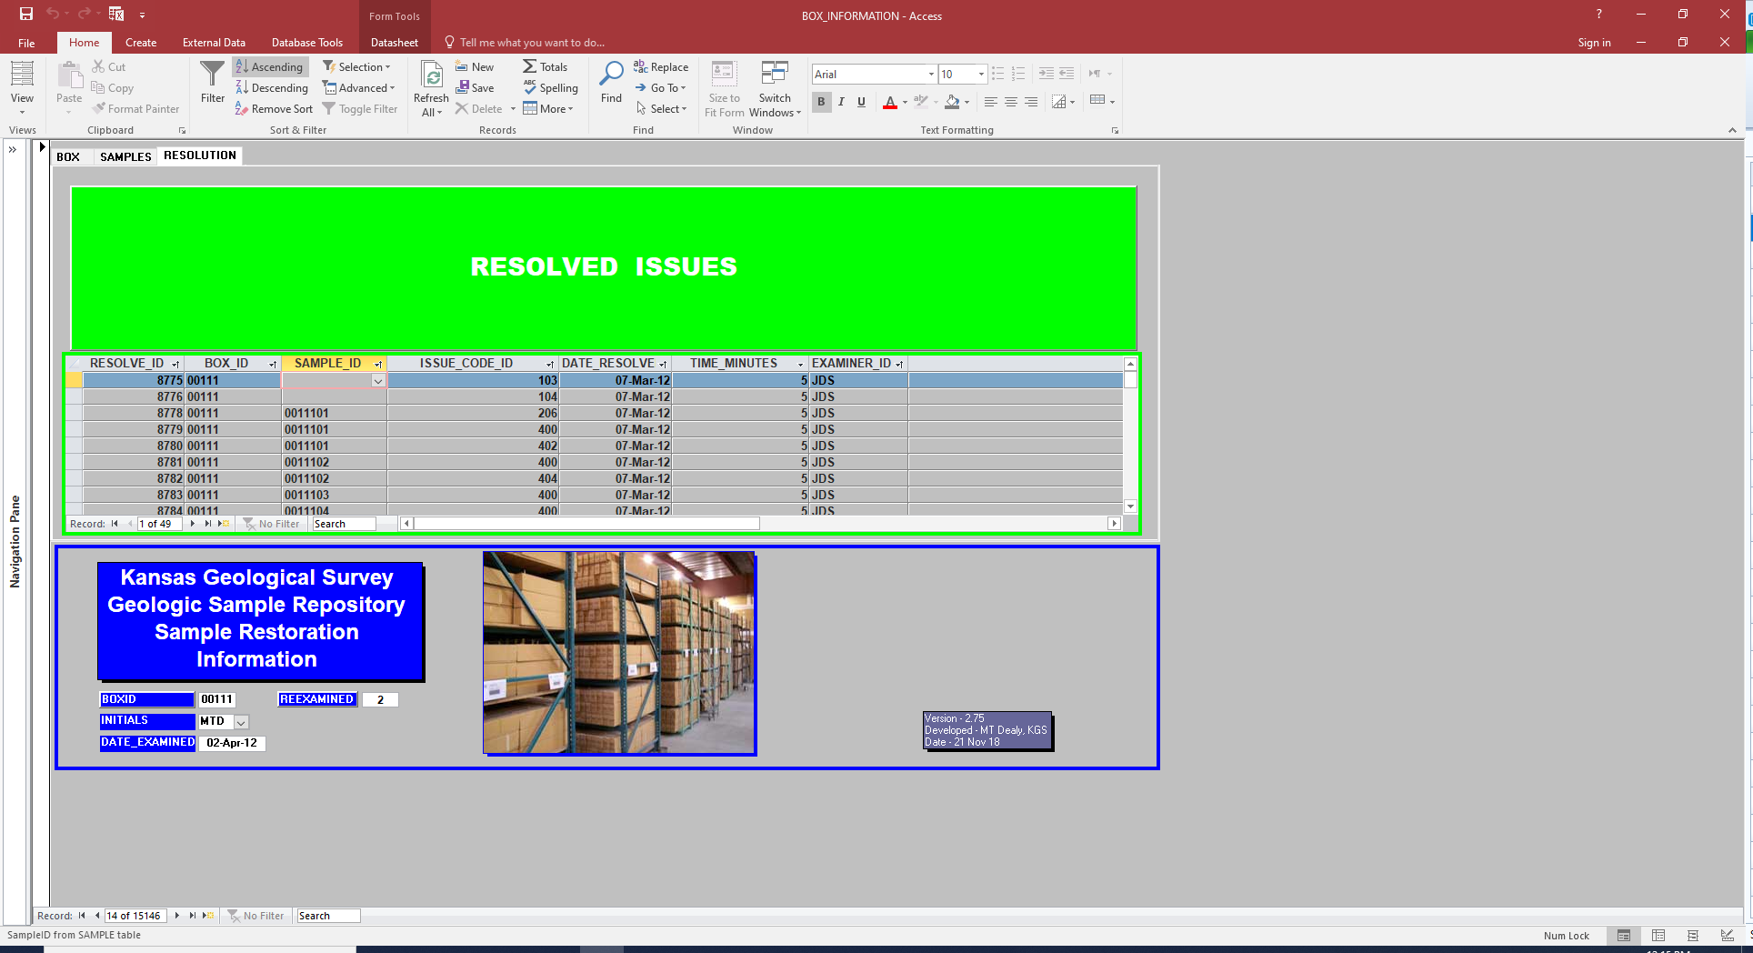
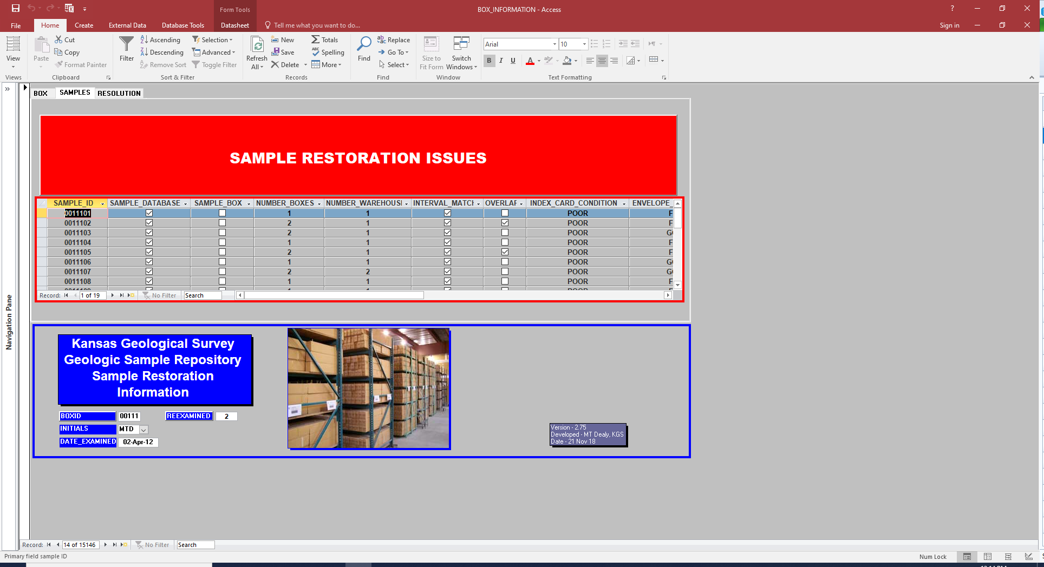
Box Restoration Database
ISSUE
ISSUE_CODE_ID | ISSUE_TYPE
100 | Box missing in database
101 | Box missing from warehouse
102 | Box lost
103 | Box physical condition
104 | Box physical condition of ID
105 | Box space used greater than 100 percent
106 | Box space used less than 100 percent
107 | Box ID format
108 | Box ID wrong
110 | Box empty recycle BoxID
111 | Box needing maintenance
115 | Box moved to WH3
199 | Box ID vacated not in service
202 | Sample not in database
203 | Sample interval does not match box & database
204 | Sample located in two warehouses
205 | Sample missing from box
206 | Sample skips incorrect or missing
207 | Sample moved - list new Box ID in comments
209 | Well samples have duplicate BoxID
210 | Core samples
301 | Well header information sparse
302 | Incorrect or missing well header
303 | Multiple well headers in database
400 | Index card condition
401 | Envelope condition
402 | Envelope label condition
403 | Sample data insufficient unable to preserve
404 | Overlapping or duplicate sample interval
405 | Sample envelopes out of order
410 | Envelope Adhesive
411 | Envelope Biological
412 | Envelope Size
413 | Envelope Rust
414 | Envelope Atrophy
415 | Envelope Design
416 | Envelope Leaking
900 | Box evaluation
999 | No issue

Slide 28




Preserving Well Samples
Lesson Learned
  Insulate, insulate and insulate repository
  Funds well spent
  Warehouse 1 & 2 insulated new roofs
  Stopped condensation in WH 1 & 2
  Warehouse 3 completely insulated

Slide 29



Future Considerations
Construction is underway concerning the future of sample storage:
Space:
Approximately 80% of the warehouse storage is filled with samples, with three to five years left before maximum storage capacity is reached.
Proposed
Storage
Building
2012
2009

Slide 30
Mission
Kansas Geologic Sample Repository,
Kansas Geological Survey-Wichita,
University of Kansas
316 943-2343
mdealy@kgs.ku.edu
http://www.kgs.ku.edu/General/wichita.html
Questions?

