Slide 1


Kansas Department of Revenue
Data Access & Support Center
Kansas Statewide Tax Units Initiative

Slide 2
Data Access & Support Center
Established by the Kansas GIS Policy Board in 1991
Central archive and distribution center for Kansas GIS databases
Located at the Kansas Geological Survey at the University of Kansas
Web site – http://www.kansasgis.org

Slide 3
Kansas GIS Data
The DASC Data Catalog

Slide 4
Kansas GIS Data
The DASC Data Catalog
Over 200,000 files distributed annually
Approximately 30TB* delivered annually
DASC stores over 11TB of geospatial data
Host over 250 map services that receive around 60 million hits annually
* compressed

Slide 5
Imagery
Statewide, 1 foot resolution, leaf off, natural color imagery - acquired ~2015 & 2018

Slide 6
Elevation data
LiDAR

Slide 7
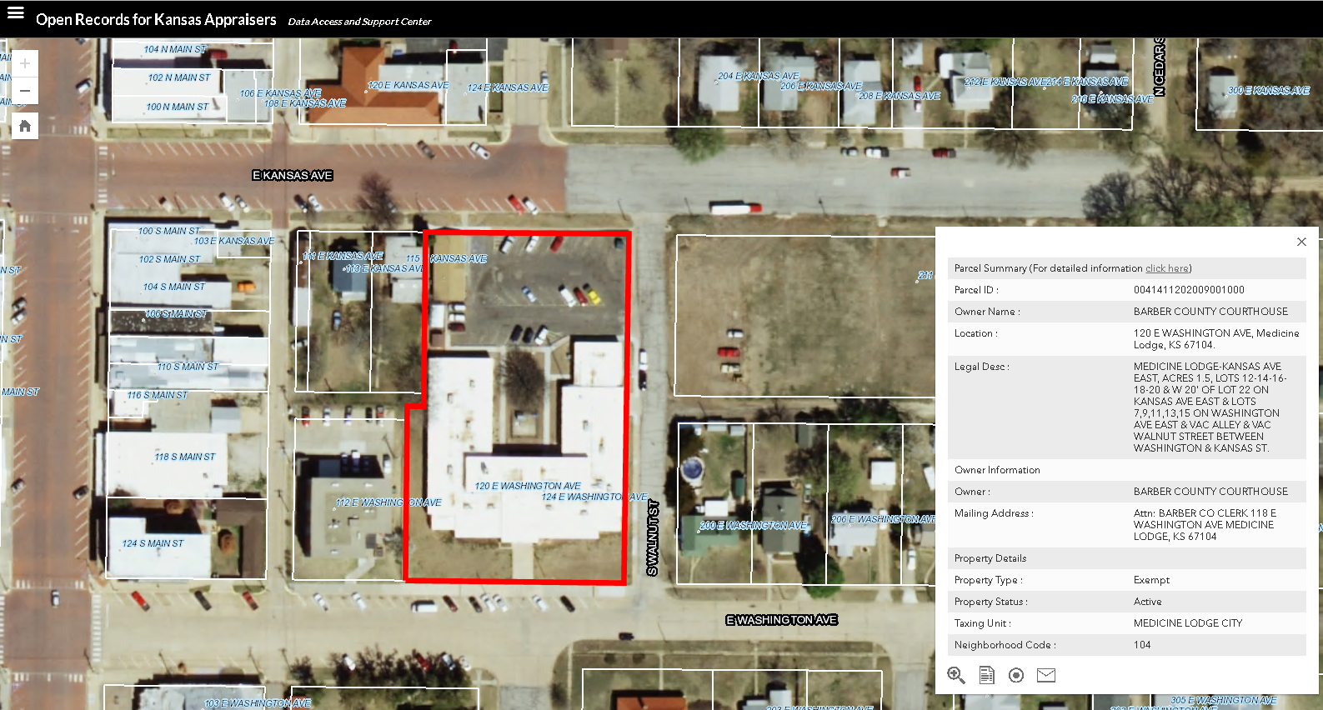
DASC Initiatives
A few of our projects -
Kansas Next Generation 911
Open Records for Kansas Appraisers
Dept of AG - Base Flood Elevation
Kansas Water Office - Rural Water District boundaries
KDOT Crash Reports
Statewide Tax Unit Boundaries

Slide 8
Kansas Statewide Tax Unit Boundaries
Background
2009 – Proof of concept
  Work with PVD to develop workflow
  Clerks training
  Gather available data
  Data clean up - correct data gap errors, standardize attribute information (State codes, as well as tax unit codes)
2010 – Establish statewide baseline GIS file
  DASC & PVD worked to together gathering tax unit information from Clerks separate from Certification
  Data collected via GIS files or paper maps and verified for accuracy by Clerks
  Clerks also submit database summary of tax units to KDOR/PVD Tax Unit database

Slide 9
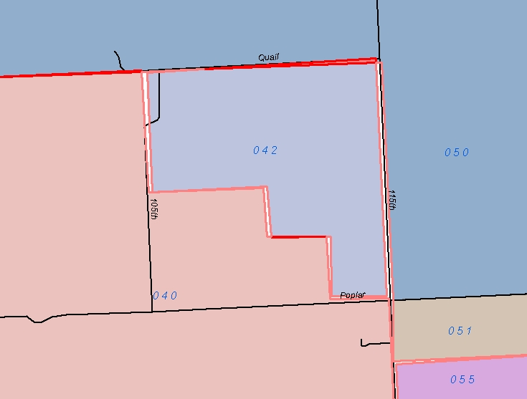
Kansas Statewide Tax Unit Boundaries
Topology Errors
Gaps
Overlaps
Errors internally and along county boundaries

Slide 10
Kansas Statewide Tax Unit Boundaries
Data Attributions issues:
Inconsistent – not all units had the required 3 digit state tax unit code
Standardization – maintaining FIPS Codes (state & county)
Before standardization
Tax Unit
068
161
20
7
32
4A
9999

Slide 11
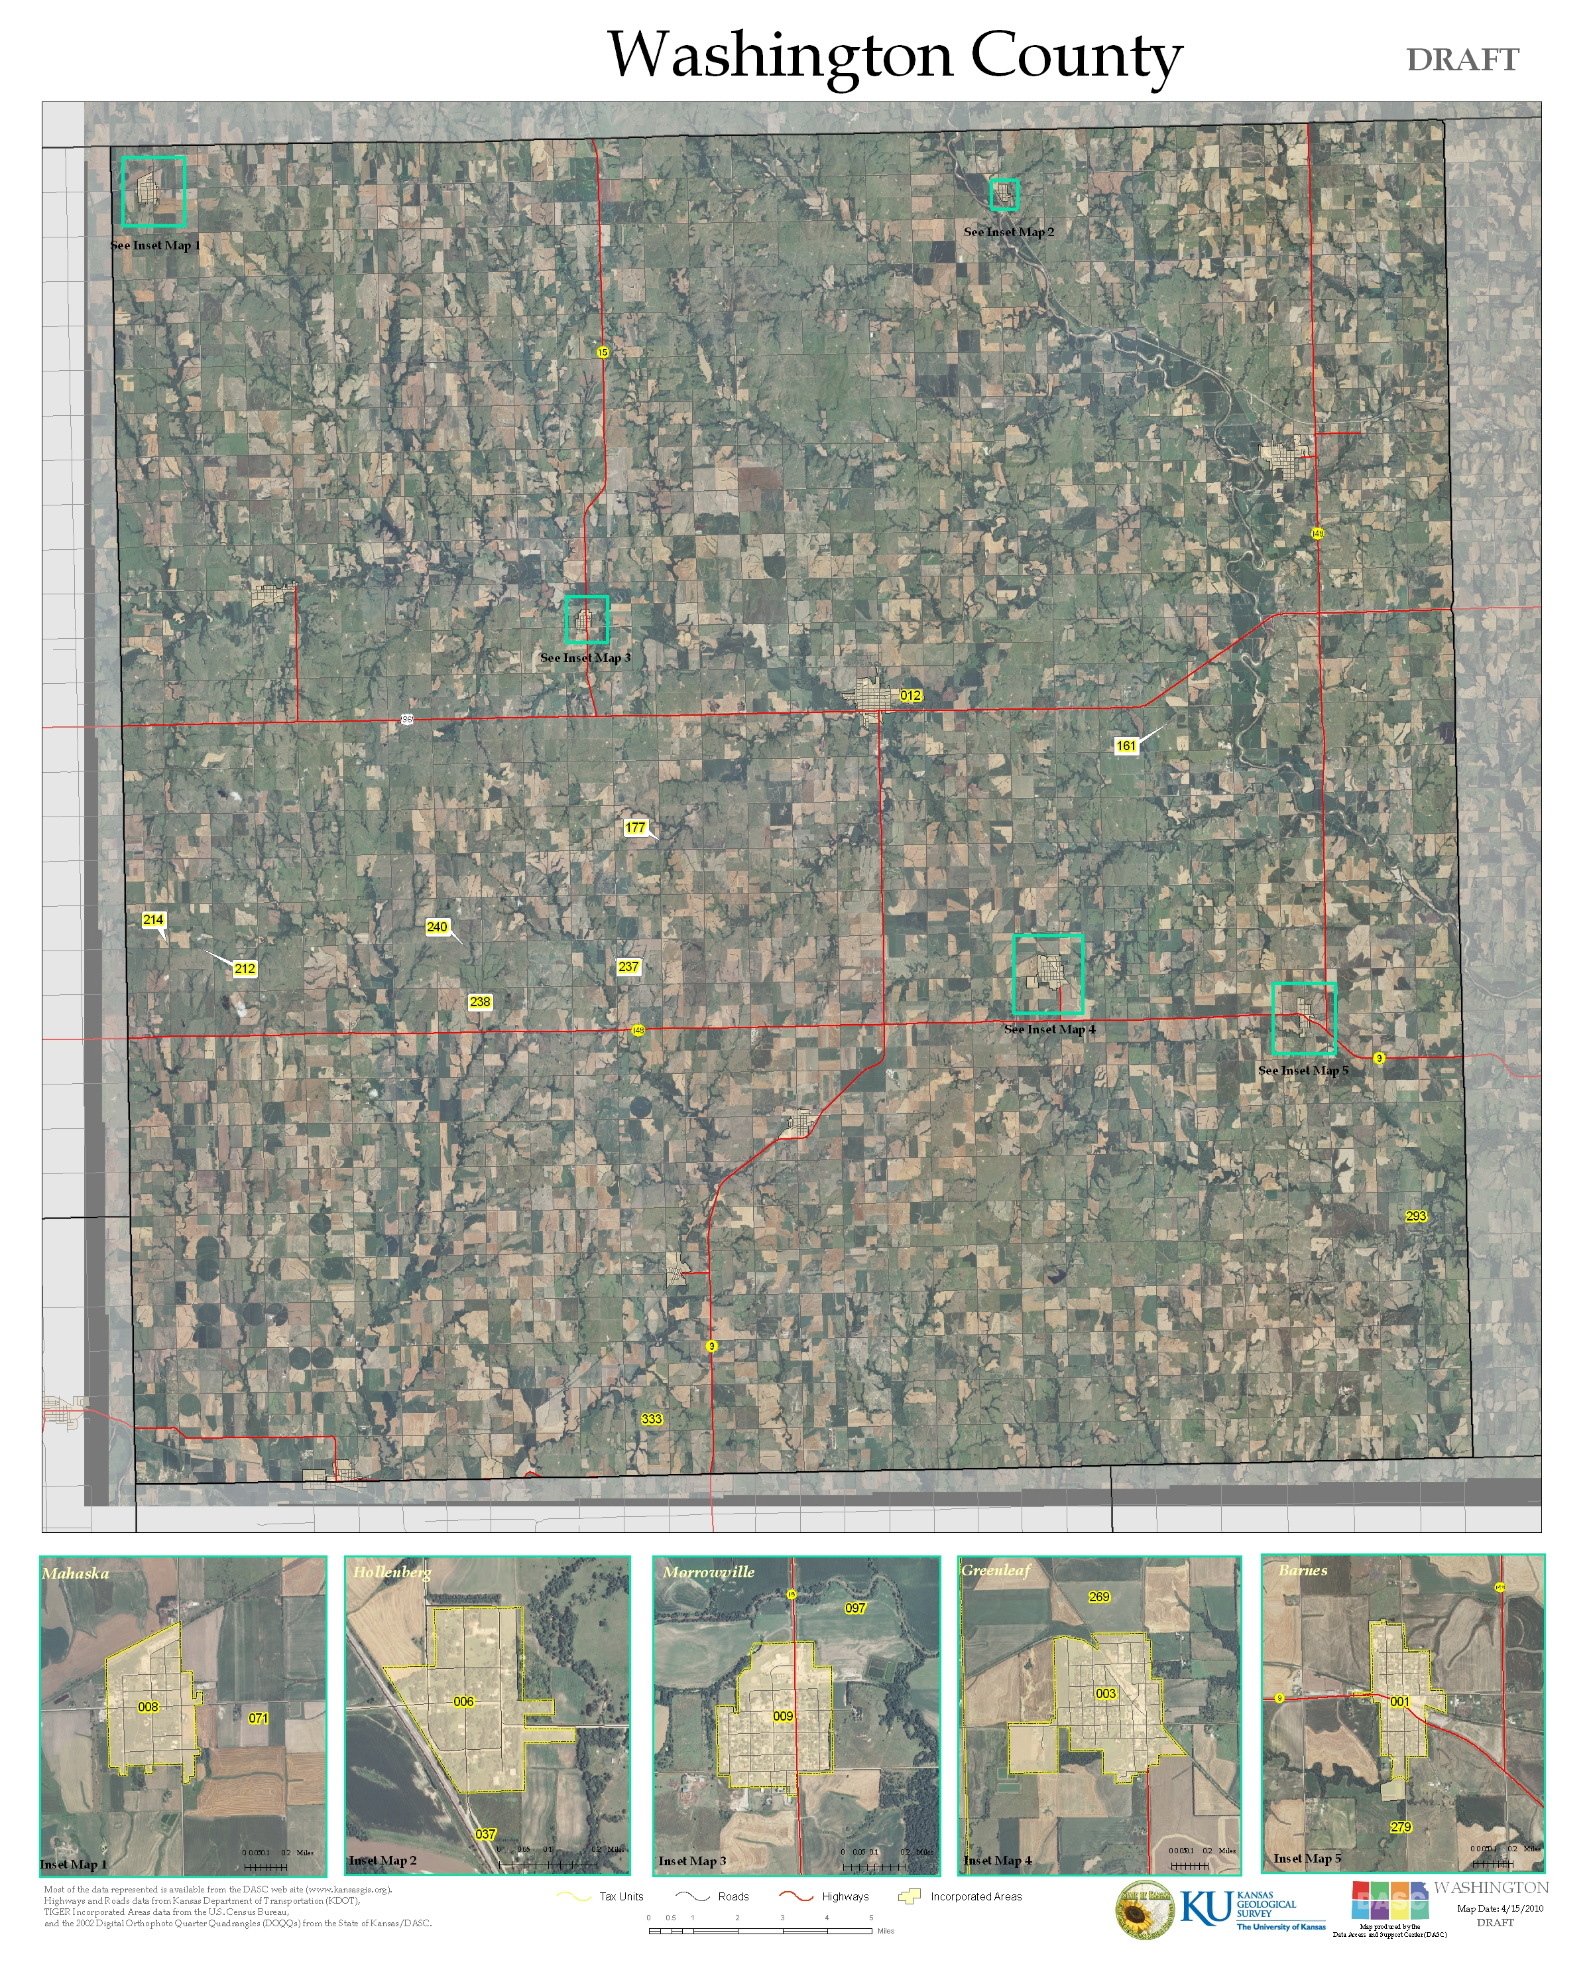
Kansas Statewide Tax Unit Boundaries
Paper Maps

Slide 12
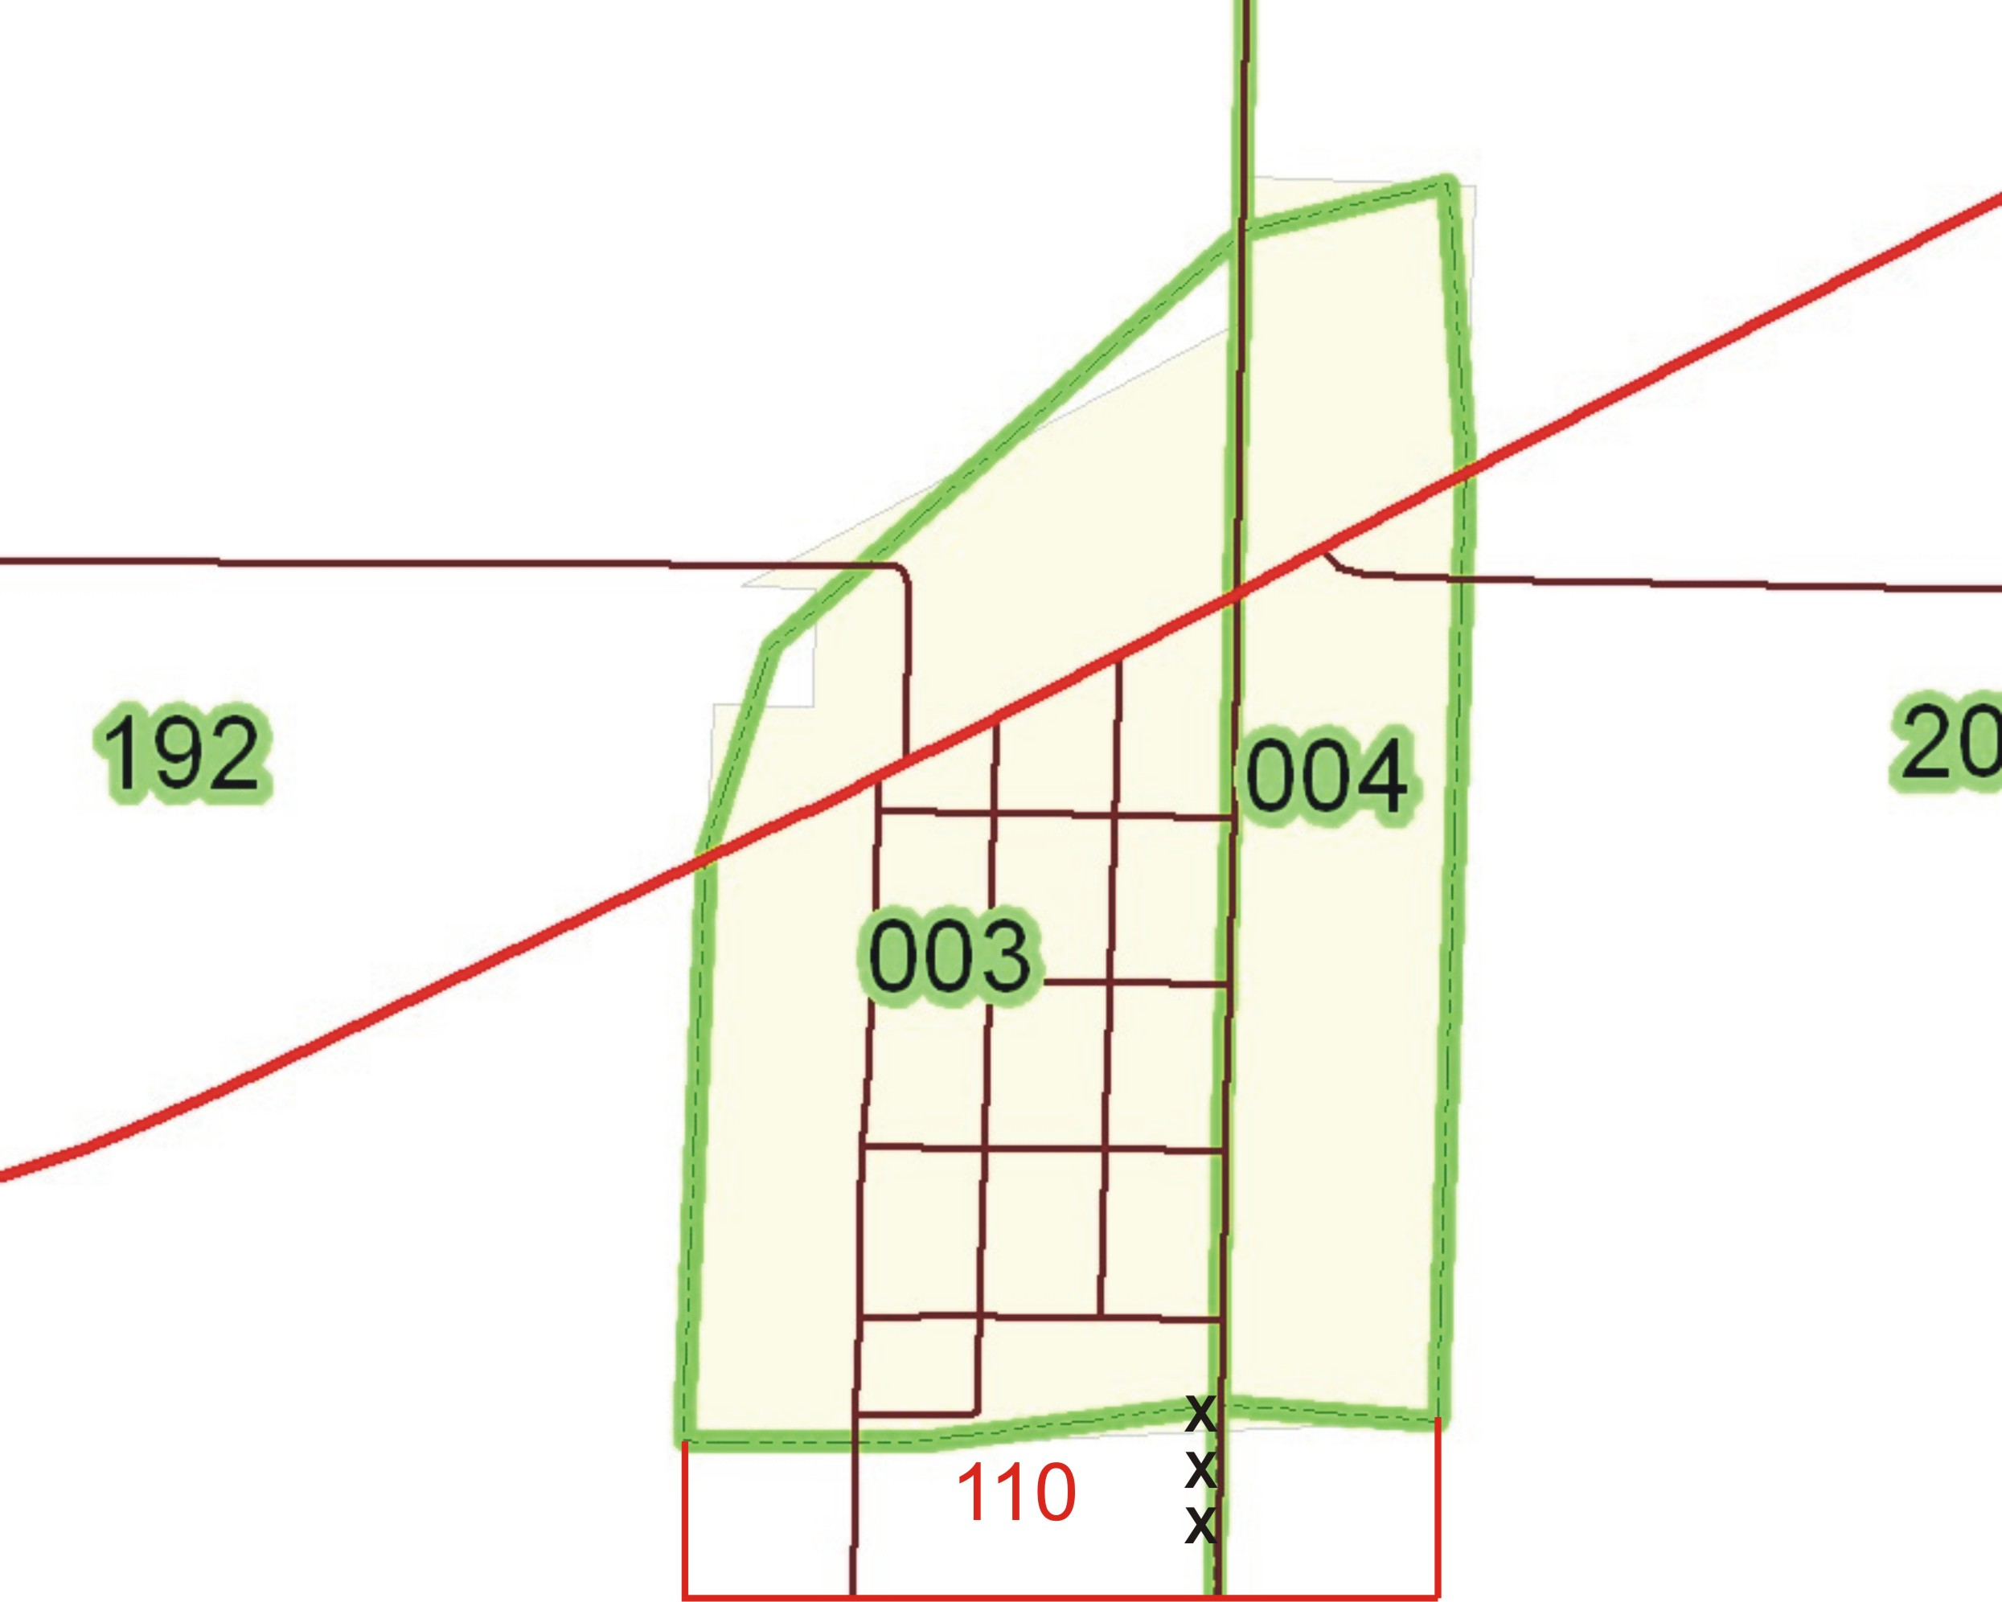
Kansas Statewide Tax Unit Boundaries
Paper Maps Edit Instructions:
Mark up the map with markers/colored pencils
Cross out incorrect boundaries and draw new boundaries in
Double check each tax unit number, correct if needed
Feel free to include additional print outs or documentation!
Tax unit 110 is new area outlined in red.

Slide 13
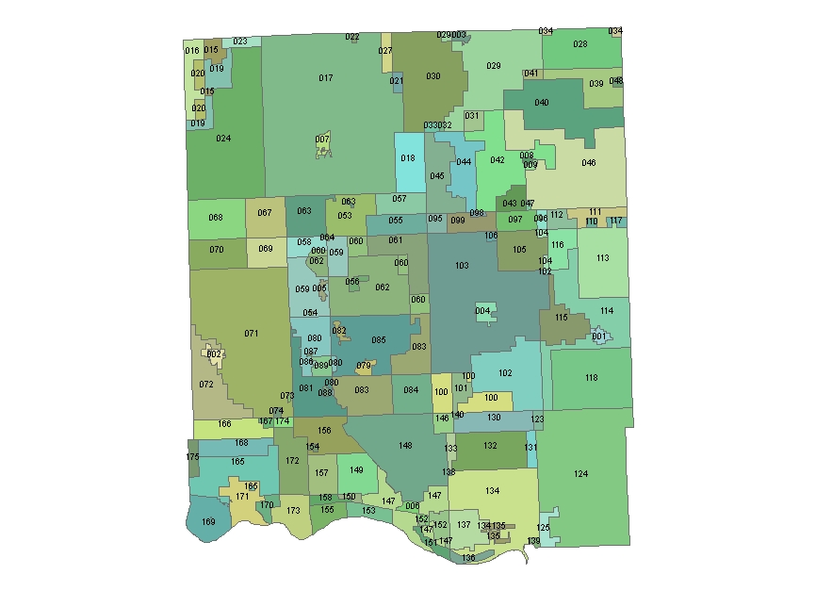
Kansas Statewide Tax Unit Boundaries
County GIS data
Submitted to DASC
DASC incorporates GIS data into statewide GIS file and makes any corrections needed along county boundaries

Slide 14
Kansas Statewide Tax Unit Boundaries
2011 – First public data release
  Updates integrated into Clerk’s annual tax unit Certification process
  Eliminate need for Clerks to submit paper map to KDOR/PVD
  KDOR/PVD Certification document contains a link to DASC website with on-line map viewer
  Clerks certify with KDOR/PVD & with DASC via on-line map viewer
  Total of 6 statewide GIS data files were released to the public on the DASC website between March - November

Slide 15
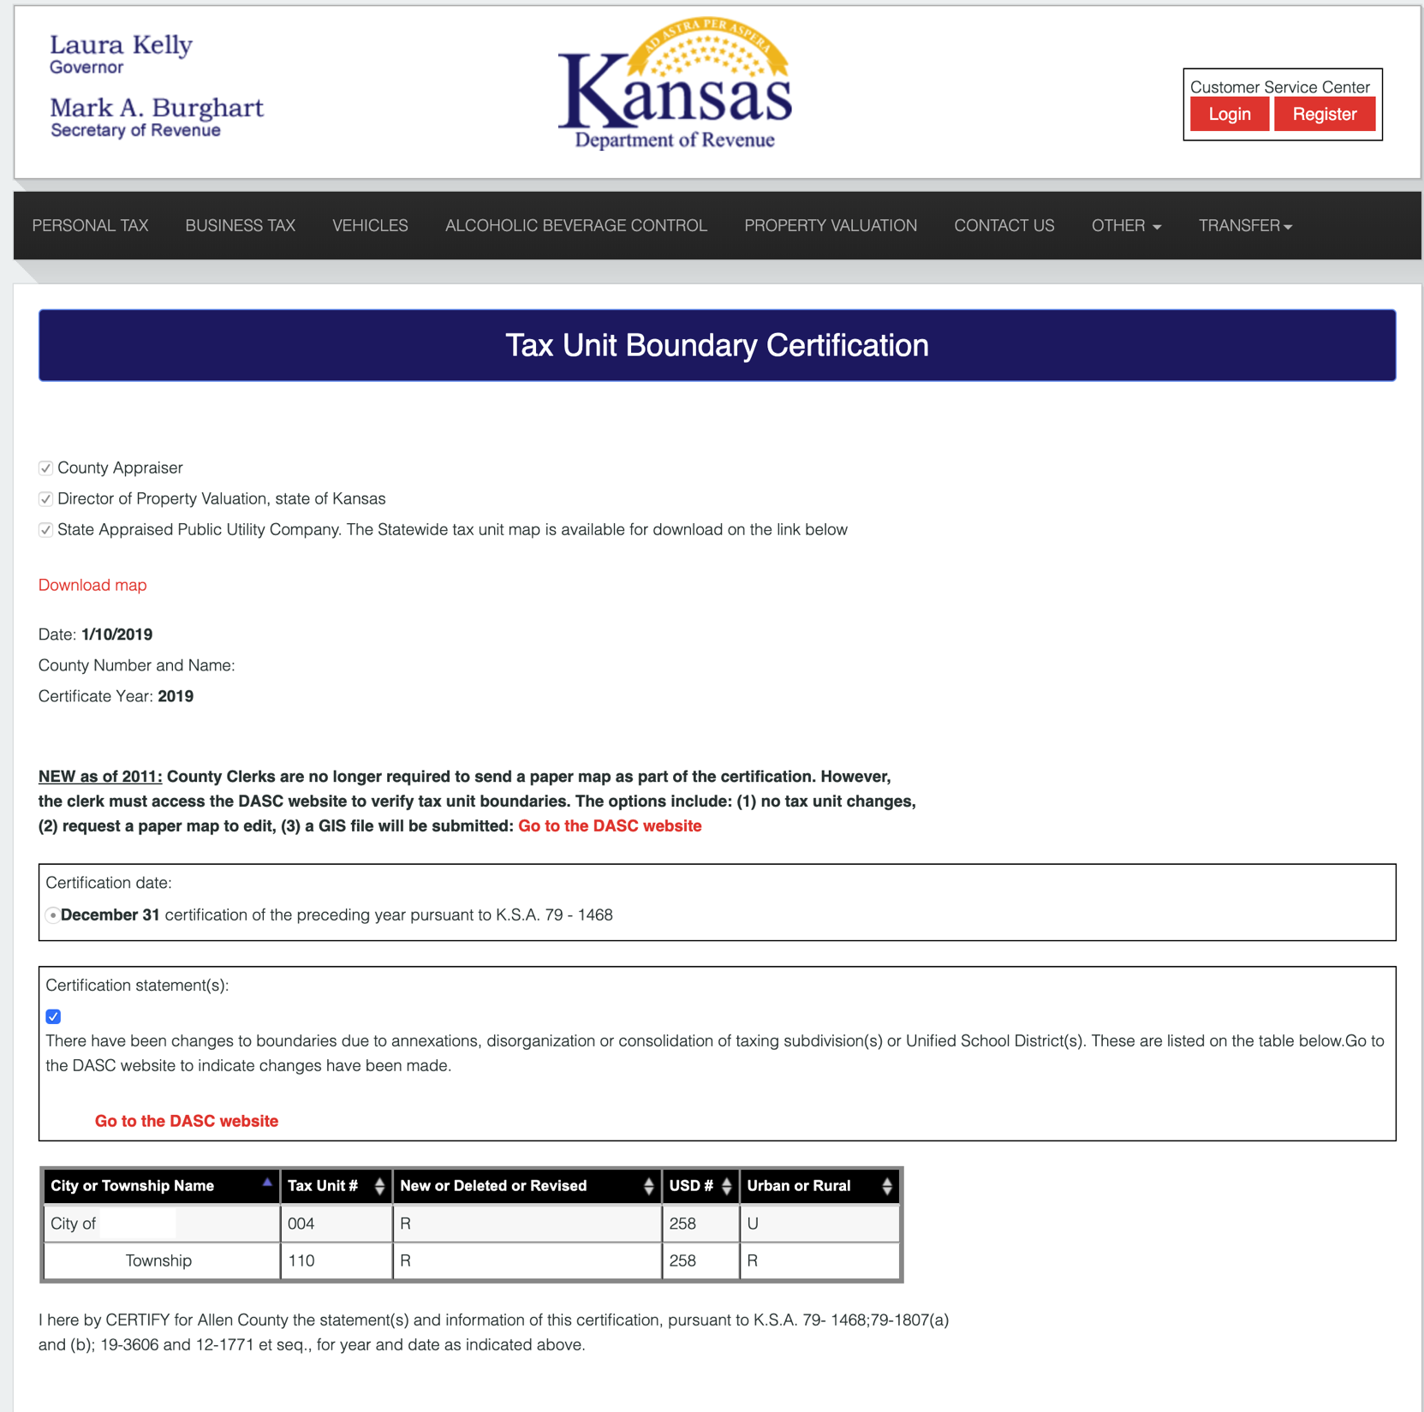
Kansas Statewide Tax Unit Boundaries
Annual Certification Process
Step 1 -
County Clerks submit Certification on KDOR website
Certification starts on Dec 1 annually

Slide 16
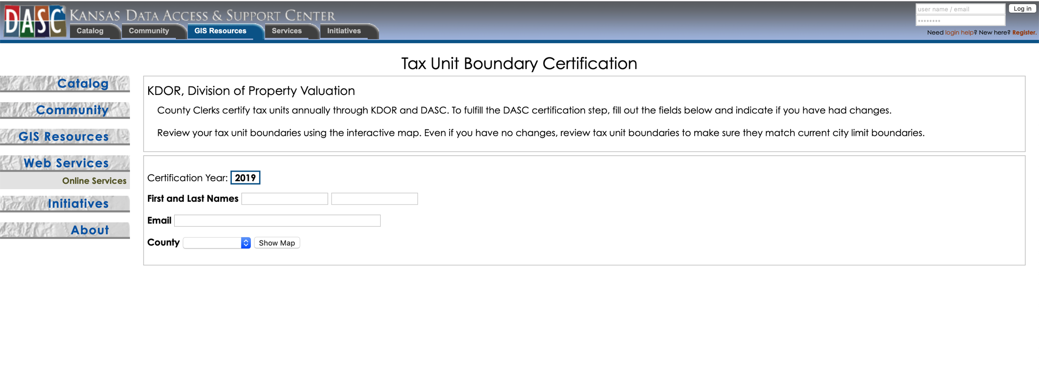
Kansas Statewide Tax Unit Boundaries
Annual Certification Process
Step 2 -
County Clerks submit Certification on DASC website

Slide 17
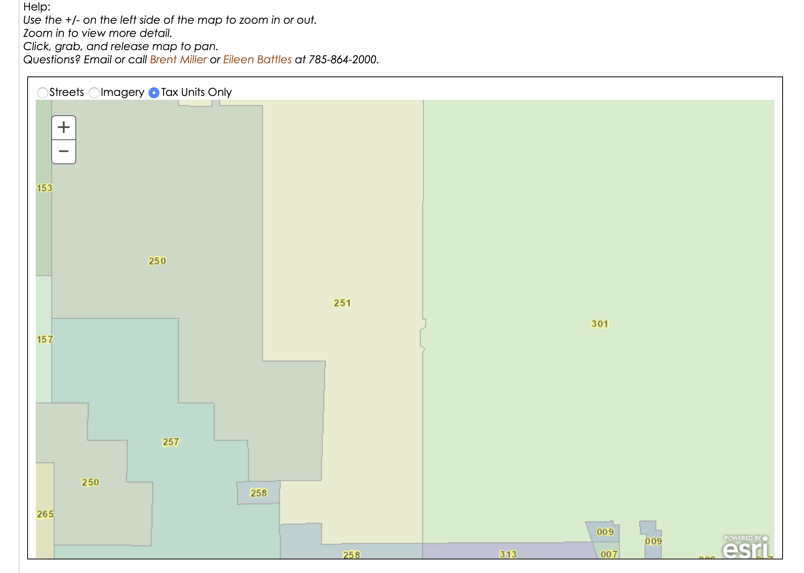
Kansas Statewide Tax Unit Boundaries
Annual Certification Process
County Clerks use DASC’s web based application to review tax unit boundaries

Slide 18
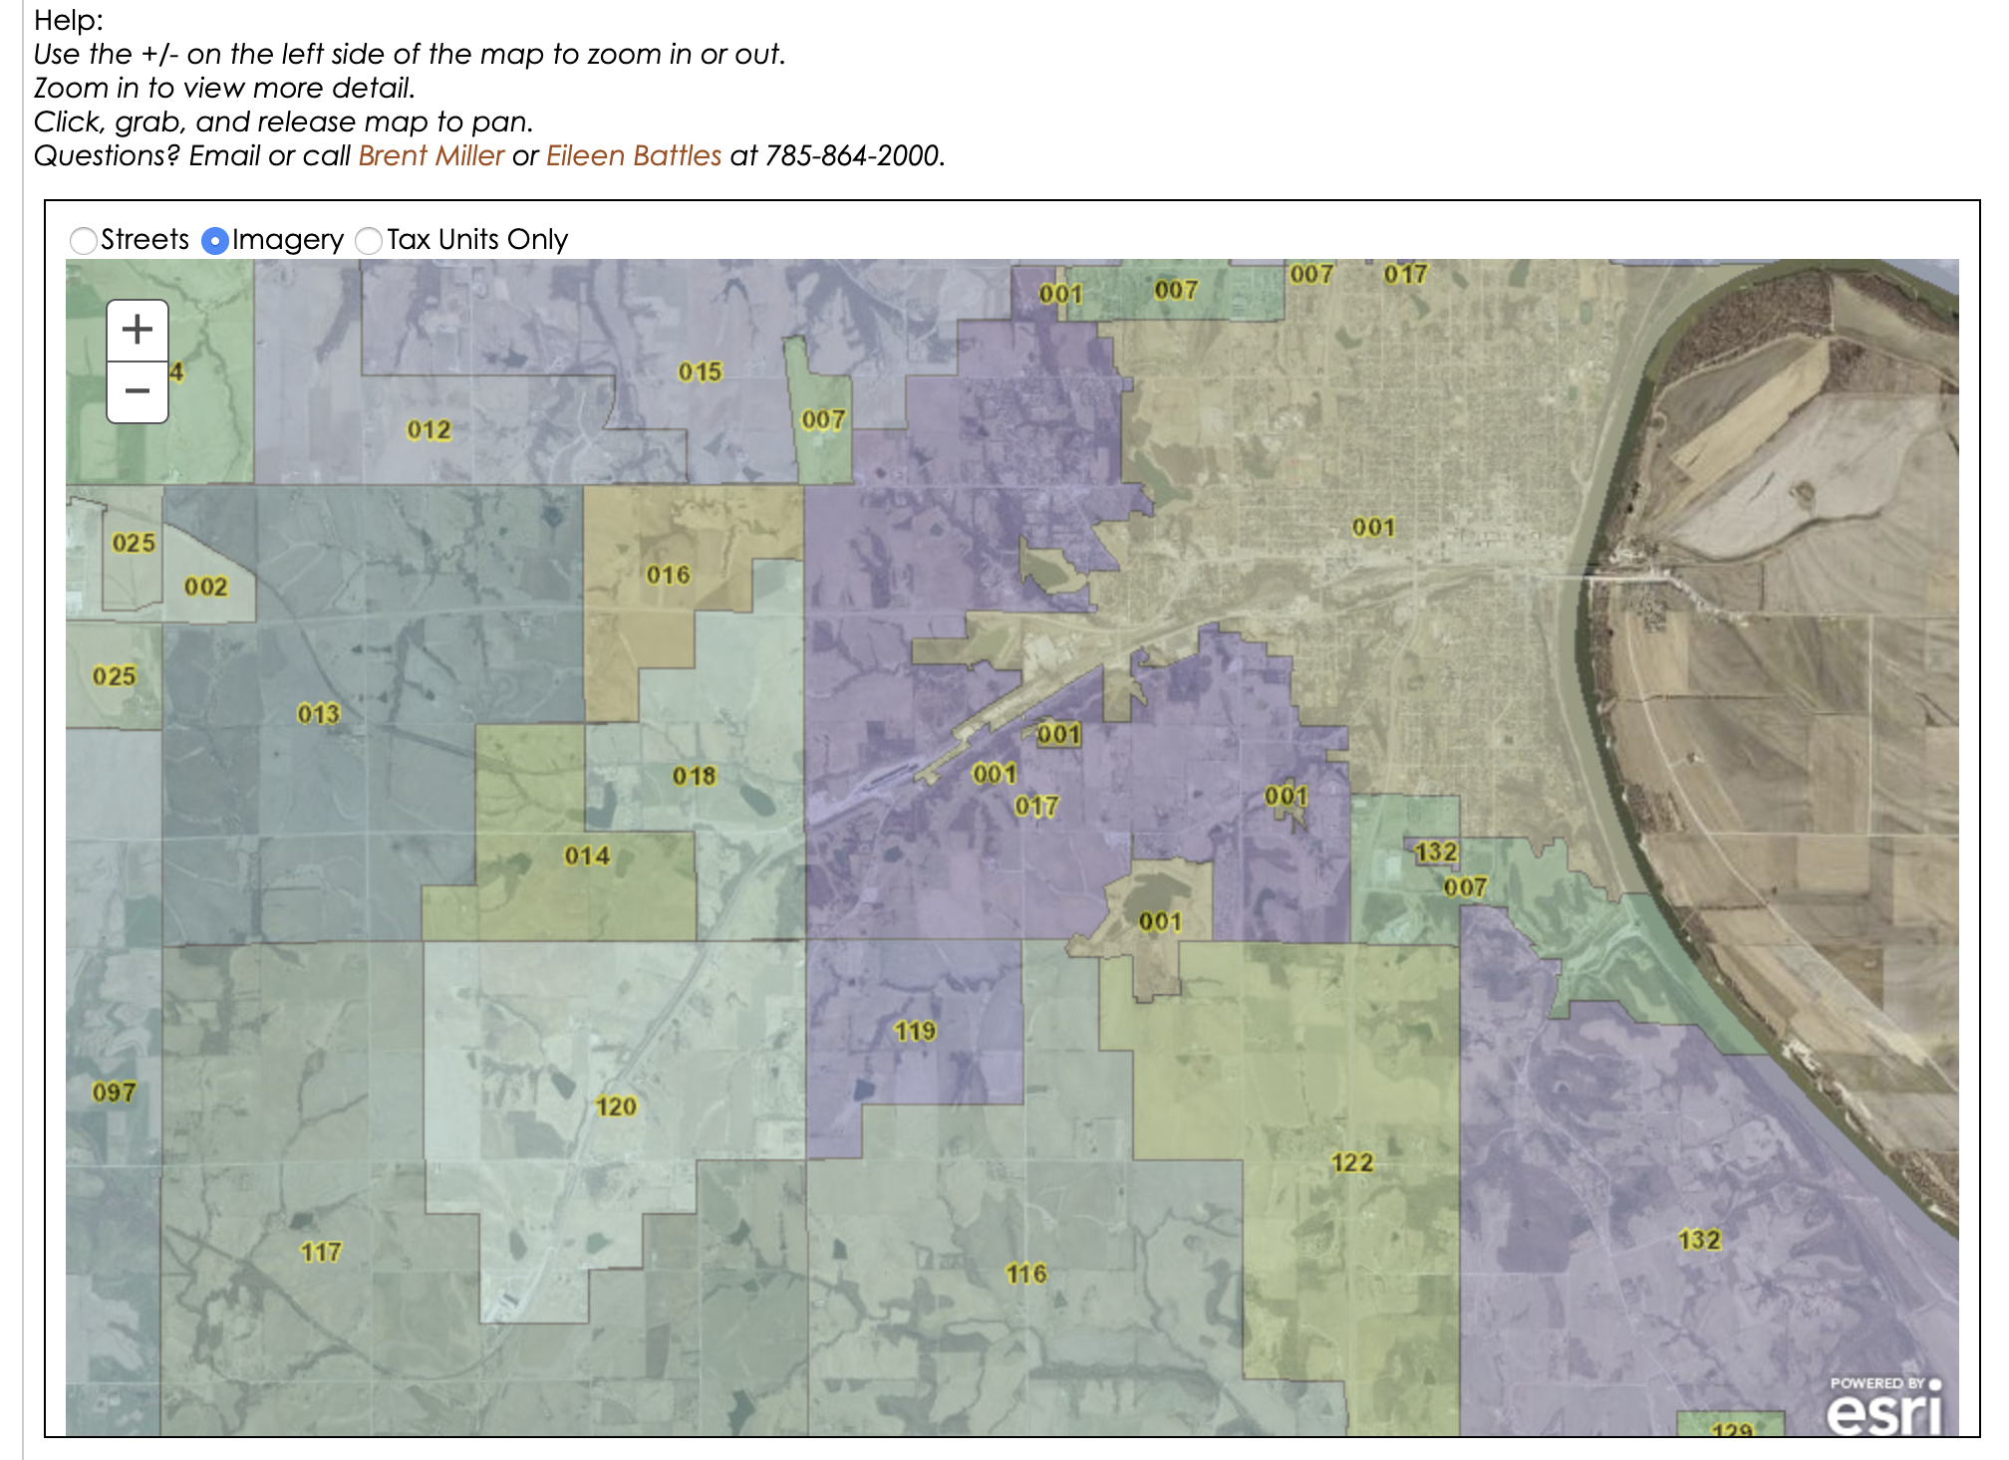
Kansas Statewide Tax Unit Boundaries
Annual Certification Process
Application includes interactive map to review tax unit boundaries
Different base map options for reference, including imagery

Slide 19
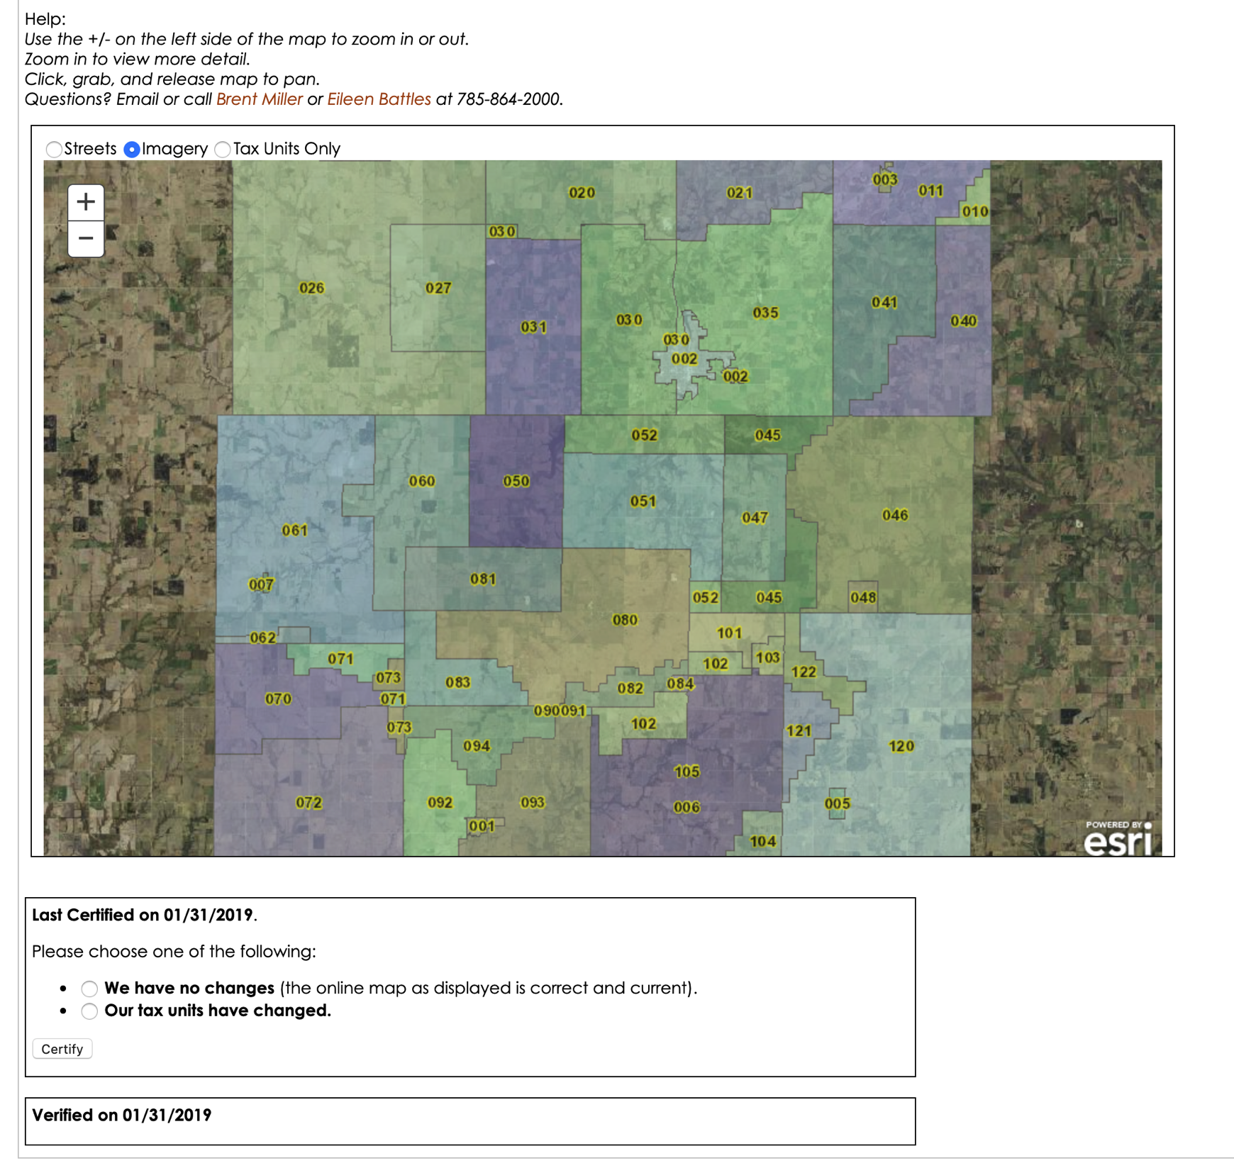
Kansas Statewide Tax Unit Boundaries
After review is complete, County Clerks select Changes or No Changes

Slide 20
Kansas Statewide Tax Unit Boundaries
After updates have been integrated into the statewide data, DASC contacts County Clerks that submitted changes to review their boundaries again to verify everything is correct.

Slide 21
Kansas Statewide Tax Unit Boundaries
DASC editing procedure
1 - Tax Unit GIS file submission
  County removed and replaced with new data
2 - Parcel GIS file submission
  Heads up digitizing, boundary comparison
3 - Paper map submission
  Heads up digitizing, PDF review
Final step, clean up topology errors and confirm no null values.

Slide 22
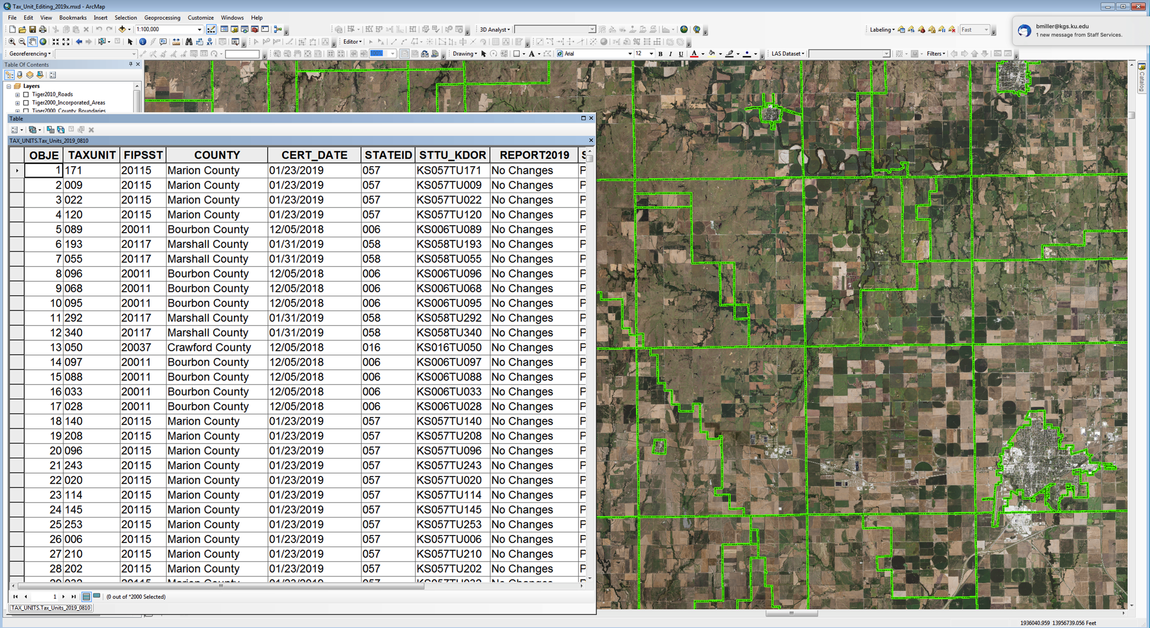
Kansas Statewide Tax Unit Boundaries

Slide 23
Kansas Statewide Tax Unit Boundaries
Statewide GIS file released annually on DASC website by March 1
There have been 6 updates released in 2019

Slide 24
Kansas Statewide Tax Unit Boundaries
2019 Statistics
All 105 counties submitted a Certification through PVD & DASC
Submitted Certifications:
  29 GIS
  5 Paper
  71 No Changes
Clerks familiar with DASC web interface
Saving county and KDOR/PVD staff time and resources
GIS data publicly available for download 24/7

Slide 25
Kansas Statewide Tax Unit Boundaries
Annual KDOR/PVD County Clerk Training Classes
September
  Classes offered in six different locations across the state
Annual KDOR/PVD and DASC Quality Assurance (QA)
November
  KDOR/PVD tax unit database
  Statewide GIS data
  Identify any inconsistencies
  Communicate with County Clerks if corrections needed

Slide 26
Kansas Statewide Tax Unit Boundaries
Lessons learned:
Partnership - GIS submissions process integrated into KDOR/PVD existing certification workflow
Communication - training, presentations, webinars, handouts, etc
Quality Control - verify tax units are valid and certified with Revenue
Heavy lift at beginning of project - compiling data and introducing new step to Clerks
Maintenance - Educating new Clerks

Slide 27
REMAINING STEPS IN THE UNIT VALUE PROCESS
Allocation: The goal of allocation is to assign a reasonable portion of the unit value to the state
Distribution: The goal of distribution is to assign a reasonable portion of the Allocated unit value to each Taxing Unit

Slide 28
Unit Value 4,500,000,000

Slide 29
Allocation
    Unit Value
    States
Unit Value 4,500,000,000

Slide 30
The Allocated $ to the State Must then be Distributed or Apportioned within the State

Slide 31
State 0.15 mi
COUNTY
County 0.33 mi

Slide 32
State 0.15 mi
TOMMY’S COUNTY
COUNTY
County 0.33 mi
School
SD #1, 2, 3,4
SD #1 - 0.66 mi
SD #2 - 0.75 mi
SD #3 - 0.48 mi
SD #4 - 0.62 mi
1
2
3
4

Slide 33
State
TOMMY’S COUNTY
COUNTY
County
A
I
B
School
SD #1, 2, 3,4
C
Fire District
FD #A, B, C, D
1
2
City
CY# I & II
II
CT #I - 0.28 mi
CT #II - 0.22 mi
D
3
4

Slide 34
State
COUNTY
County
A
I
B
School
SD #1, 2, 3,4
Fire District
FD #A, B, C, D
C
1
2
City
CY# I & II
II
Township
Library
Watershed
Sewer &
a dozen more
D
3
4

Slide 35
Distribution by Taxing Unit
02
04
05
06
01
03
08
07
09
10
11
13
12
14
15
18
16
17

Slide 36
REQUIREMENTS
Equal 100%
Data readily available
  Some sort of Cost is most common
Suitable for application to all taxing jurisdictions
Lead to a plausible conclusion

Slide 37
ALLOCATION METHODS…
Property Elements (cost, track miles) vs. Use Elements (revenue, NOI)
    Preliminary, planning data collection and analysis
Different allocations for different industries

Slide 38
ALLOCATION METHODS…
Dictated by State law or policy

Slide 39
Kansas Allocation – Original Cost shall be assigned an assessed value, in proportion to original cost thereof
2016
Unit Value $4,500,000,000
KS Investment $239,866,369
System Inv. $6,726,485,145
Allocation 0.035660
KS Value $160,470,000
2015
$3,500,000,000
$238,831,461
$4,813,545,678
0.049617
$173,660,000

Slide 40
UNIT VALUE
2016 YEAR
2015 YEAR
Director's Unit Value
1,600,000,000
1,500,000,000
ALLOCATION
Kansas Investment
4,300,000,000
3,600,000,000
System Investment
4,500,000,000
3,800,000,000
KS Allocation Factor
0.96
0.95
TAXABLE PROPERTY ALLOCATION
KS Exempt Property
925,000,000
450,000,000
KS Taxable Property
3,375,000,000
3,150,000,000
System Investment
4,500,000,000
3,800,000,000
KS Taxable Allocation Factor
0.750000
0.828947
KS Value
1,528,889,600
1,421,052,000
Taxable Property Value
1,200,000,000
1,243,420,500
Exempt Property Value
328,889,600
177,631,500
Assessment Rate
33%
33%
Kansas Taxable Assessed Value
396,000,000
410,328,765

Slide 41
POINTS TO REMEMBER
Most appraisal authorities agree that the unit value concept is the most appropriate way to value the property of a public utility company located in multiple taxing jurisdictions…
Apportionment of unit values to taxing districts are assignments of value - not valuations themselves
The market value of a fractional portion of the unit cannot be determined by allocation/distribution
Sales of segments of the unit usually bear no relationship to the value of the whole unit

Slide 42
Contact
Kansas Department of Revenue/Division of Property Valuation
Kevin Suelter Manager, Public Utility & Abstract Section 785-296-3964 kevin.suelter@ks.gov | Patrick Titsworth Property Appraiser II Public Utility Section 785-296-5109 Patrick.Titsworth@ks.gov
Kansas Data Access & Support Center (DASC)
Eileen Battles Manager 785-864-2000 battles@kgs.ku.edu | Brent Miller GIS Specialist 785-864-2000 bmiller@kgs.ku.edu

