Slide 1
2016 MAGIC GIS Clearinghouse Summit August 23 & 24 Lawrence, KS
Federal Clearinghouse Partner
USGS
Jim Langtry, National Map Liaison

Slide 2
3D Elevation Program (3DEP)
Jim Langtry, National Map Liaison
August 23, 2016

Slide 3
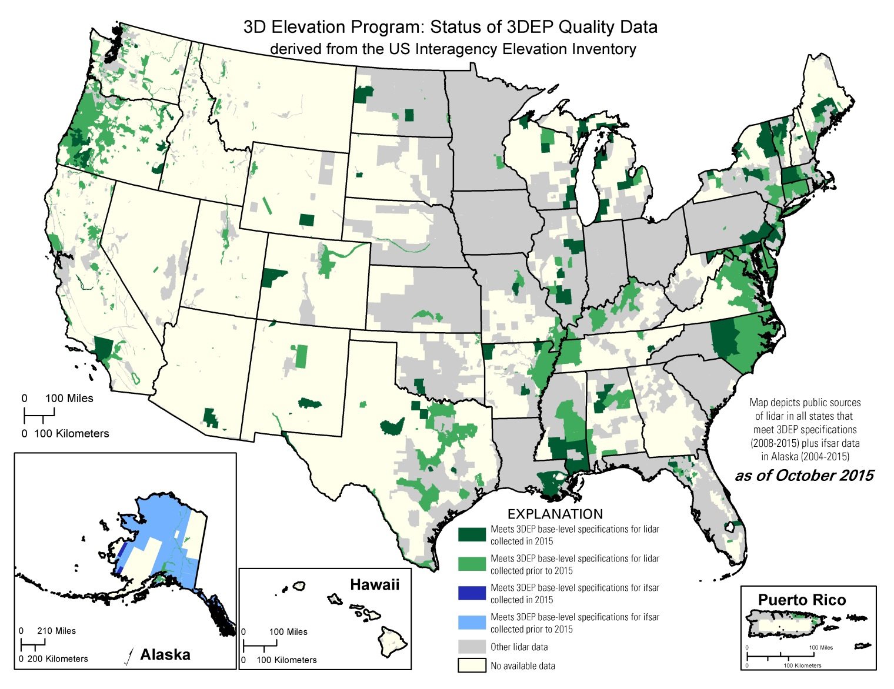
U.S. Interagency Elevation Inventory
Data Acquired through FY 2015
3.4% of entire US was acquired to 3DEP quality in FY15 - includes complete, in progress, and planned/funded
13.9% of Lower 49 Meets 3DEP quality (2008-2015 only)
63.6% of AK Meets 3DEP quality (QL5 – ifsar)
Notes:
Data Acquired as of FY15 means data that was or was planned to be collected by the sensor in FY 15. Planned projects that were to be collected by the sensor in FY16 are not included on the map or in the number.

Slide 4
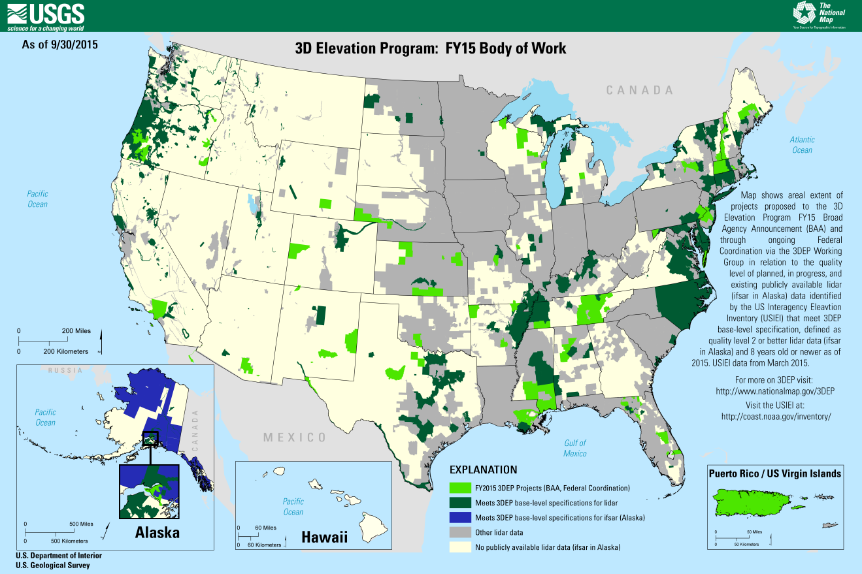
FY15 3DEP Preliminary Summary
Lidar Data Acquisition
3DEP Lidar Data Contracted in FY15
3DEP Funds $M |  |  | Partner Funds $M |  | Total $M | Sq Miles
USGS | FEMA | NRCS | Other Feds | Non-Fed | $38.6 | 151,000
$7.2 | $11.2 | $7.1 | $2.5 | $10.7
$25.5 |  |  | $13.2

Slide 5
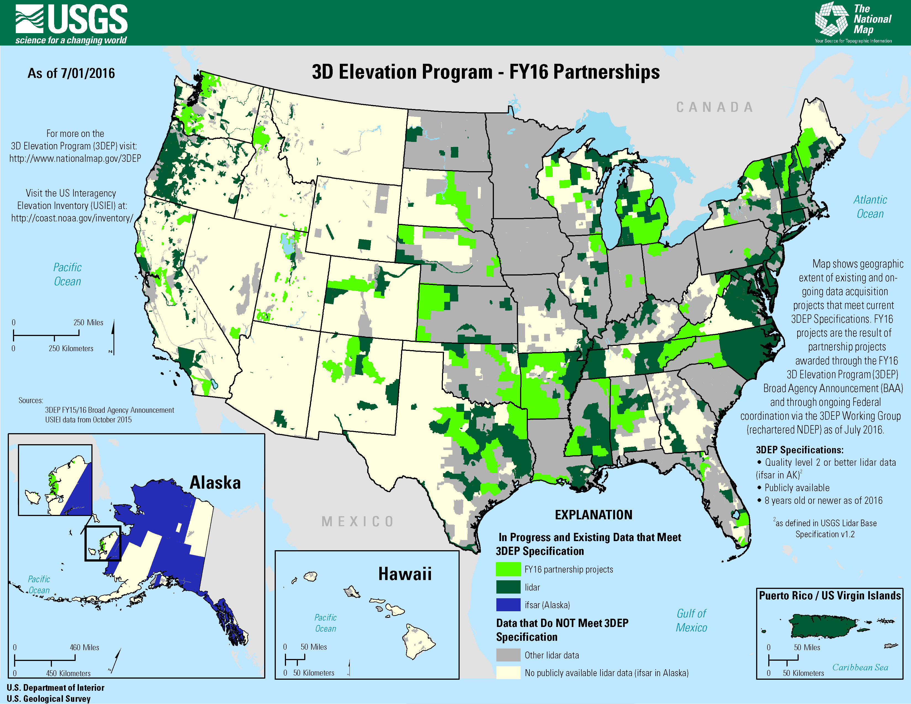
Summary of FY 2016 3DEP Partnerships BAA + Additional Federal Investments
FY16 3DEP Lidar (BAA, Federal Projects) Planned and Funded Projects (as of July 2016) *acquisition for some projects will occur in FY17
Total $M | Square Miles
58 | 245,000
BAA supported 29 projects
For BAA projects - USGS, FEMA HQ and NRCS NCGE committed $9.8M, regional federal offices, state and local agencies contributed $17M for total BAA project value of $26.8M
BAA project awards ranged from $8K to $797K, average award was $330K
Average BAA award covered 38% of the cost of the project
Average project size 4220 square miles
Results available at http://nationalmap.gov/3dep
Notes:
In FY16, our BAA numbers were very similar.
We supported 29 projects. The USGS, FEMA HQ and NRCS NCGE direct contributions to BAA projects has been consistent, however the overall federal contribution to 3DEP rose significantly. 3DEP BAA projects resulted in $26.8M of project work which will result in 123,000 square miles of new lidar data. As of July, total FY16 contributions to 3DEP projects by 3DEP stakeholders is up around $58M, supporting a total of 245,000 square miles of project work. These are preliminary figures that will be modified. Some new projects will be added prior to end of the FY; the final contracts for some of these projects will likely not be completed in FY16 but likely will be contracted before the end of the calendar year in preparation for the 2017 spring acquisition window.
The growth in federal contributions outpaced the growth in BAA submissions. Many federal acquisitions moved forward without state and local partners. For FY17 Federal agencies have worked hard to identify their high priority areas in sufficient time to include their AOIs in the BAA to advertise these partnership opportunities. We will look at those high priority areas in a few minutes.
The program was happy to see that our average project size has increased to 4220 square miles, an increase of over 1000 square miles over the FY15 average project size. The cost efficiencies gained with larger acquisitions reduce the cost of the project.

Slide 6
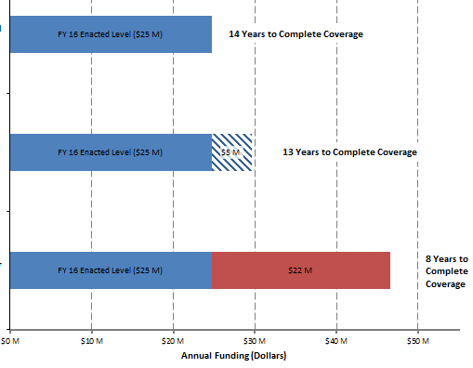
3DEP Funding
 | FY16 | FY17
USGS Base budget from prior year (includes acquisition and operations) | $20.4 M | $24.7M
Increase (FY16 enacted, FY17 proposed President’s budget) | $4.3 M | $4.9 M
Total USGS 3DEP budget | $24.7 M | $29.6 M
Preliminary Estimated USGS Program Budget
FY16 Enacted
(14 Year Scenario)
FY16 Enacted Budget
FY17 President’s Budget Increase
FY17 President’s Budget
(13 Year Scenario)
Gap in annual USGS program budget to meet 8-year program (includes operations and 1/3 of total data acquisition funding needed)
3DEP Call to
Action Goal
(8 Year Scenario)
Notes:
The chart at the top summarizes the USGS budget for 3DEP, including data acquisition and operations.
In FY16 we received an increase of $4.3M, bringing the overall budget up to about $25M
For FY17, the President’s budget includes another increase of nearly $5M, bringing the overall budget to close to $30M
The bar chart shows the funding for FY16. We have roughly estimated that this funding level will result in a program that takes 14 years to complete national coverage, assuming that partner shares remain stable.
The FY17 bar shows the prosed increase and the reduction of the years to complete the program to 13, again assuming that partner investments keep pace.
The 3DEP Call to Action bar at the bottom shows that to achieve the 8 year program goal, an addition $22M is needed in the USGS budget. Partner investments are not shown on this chart but would also need to increase to meet this target.

Slide 7
3DEP FY16 BAA / FY17 Awards
Attend National Webinars
8/11, 8/15
Timeline
Submit Proposals
8/11 – 10/10
April | May | June | July | Aug | Sept | Oct | Nov | Dec | Jan | Feb | March
BAA Released 8/11
Selections Announced
11/15 – 2/15
Enter Project Requirements in Seasketch
BAA Contract and Grant Administration
BAA Project Execution
Notes:
For those familiar with the Lidar acquisition process, you are aware that the entire project lifecycle, from formulation to product delivery is often 18 to 24 months, sometimes longer. This timeline focuses on the near term actions of gathering and reviewing requirements, submission of a BAA proposal and the selection and notification of a BAA partnership award.
The items in rose, along the bottom, are USGS actions. The items in blue across the top are your actions. The items is green apply to all stakeholders.
The BAA was posted August 11th to both FedBizOpps.gov and Grants.gov. The 3DEP team held public webinars on both August 11th and August 15th. The sessions will be recorded and the slides, the recording and the webinar and additional Q&A s will be posted on our websites. Proposals are due October 10th. While the BAA does remain open all year long, submission received by the initial deadline receive priority consideration for funding.
Initial project selections will be made beginning November 15. New this year, the USGS will be allowed to notify you as soon as your project has been recommended for award. What does this mean. It is likely that once again the federal government will be operating on a continuing resolution when our fiscal year begins on October 1st . During a CR, our ability to spend or commit funding is limited. While the evaluation team meets immediately following the initial deadline to review and prioritize projects, in the past we were not allowed to notify applicants of their status until we had the authority to spend money. This year we will be allowed to notify you that your project has been recommended for award pending the availability of funding. This will provide you early notification of our intent to fund your project so you may move forward with finalizing the details of your project and initiating the funding agreements needed to secure your funds.
Applicants choosing to make use of the Geospatial Products and Services Contracts (GPSC) will work with a 3DEP and/or GPSC POC to complete the required acquisition documents; applicants receiving cooperative agreements will work with a USGS grants specialist.

Slide 8
3D Elevation Program Activity in MAGIC States
Jim Langtry, National Map Liaison
August 23, 2016

Slide 9
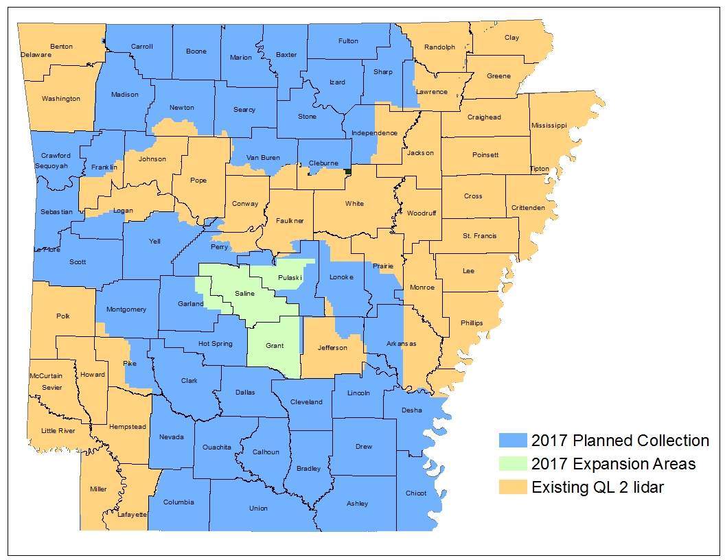
Arkansas Lidar Update
Notes:
The project we're working on is not a BAA project, but it will adhere to 3DEP specifications (QL2) and be included in the 3DEP holdings. It is a partnership of FEMA, NRCS, USACE, USFS, and AR Game and Fish Commission. The expansion areas will be collected if funding allows. If the base 2017 footprint and the expansion areas are able to be collected, Arkansas will have statewide QL2 lidar.

Slide 10
Illinois Lidar update
NEIL4 BAA – Cook Lake, Kane, and McHenry Counties
Spring 2017
One of 3 USGS Test projects acquiring 20 ppsm Geiger Mode

Slide 11
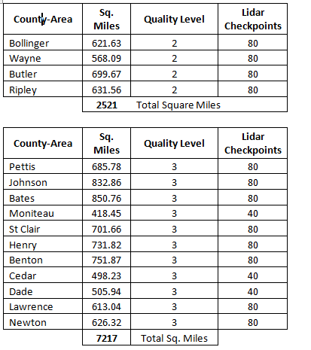
Missouri Lidar Update

Slide 12
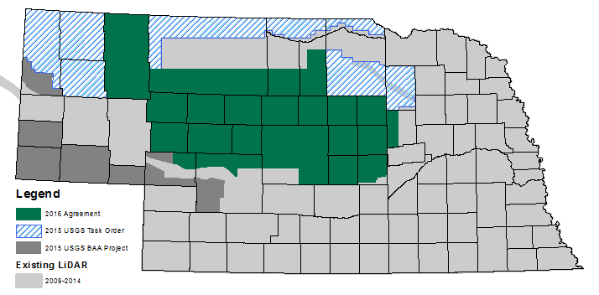
Nebraska Lidar Update

Slide 13
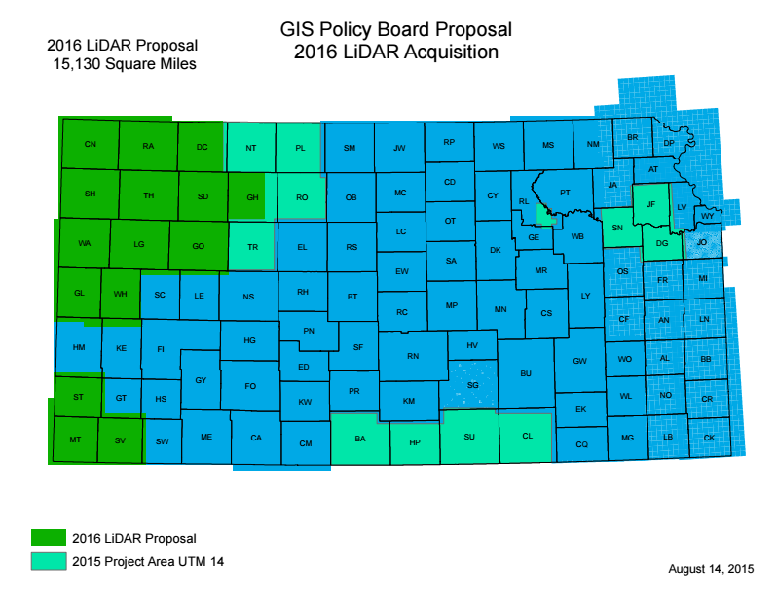
Kansas Lidar Update

Slide 14
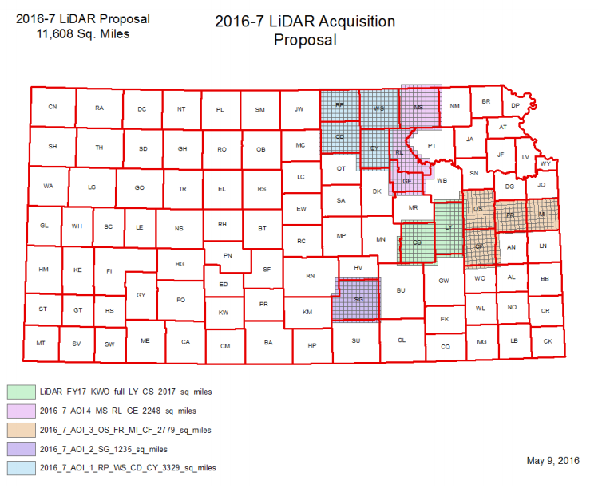
Kansas Lidar Update

Slide 15
Emerging Lidar/ E3D-WG Update

Slide 16
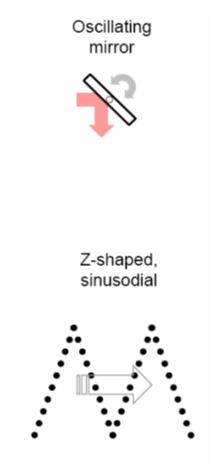
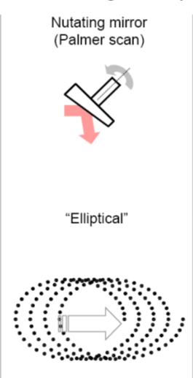
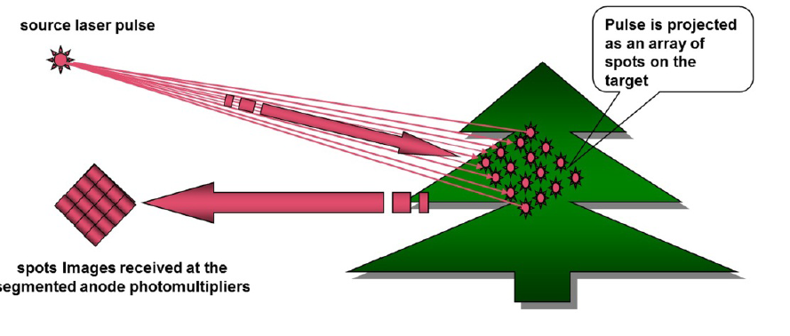
Emerging lidar platforms
Linear
Geiger Mode and Single Photon Counting (SPC) lidar are becoming more widely used and requested by 3DEP partners
Higher altitude equates to broader coverage, more efficient data acquisition
Greater point density
Assessment of data from these platforms identified initial technical challenges that impact immediate adoption by 3DEP
Non-compliance with current lidar acquisition specifications
Range walk
Foliage penetration
Absolute accuracies
Both companies say these are legacy issues that have been or will be resolved
USGS will continue to assess these technologies in an incubation period, with the goal to mature these technologies for operational use in 3DEP
Geiger
SPC
Notes:
Just a few additional notes on these technologies

Slide 17
The National Map 3DEP Product Distribution

Slide 18
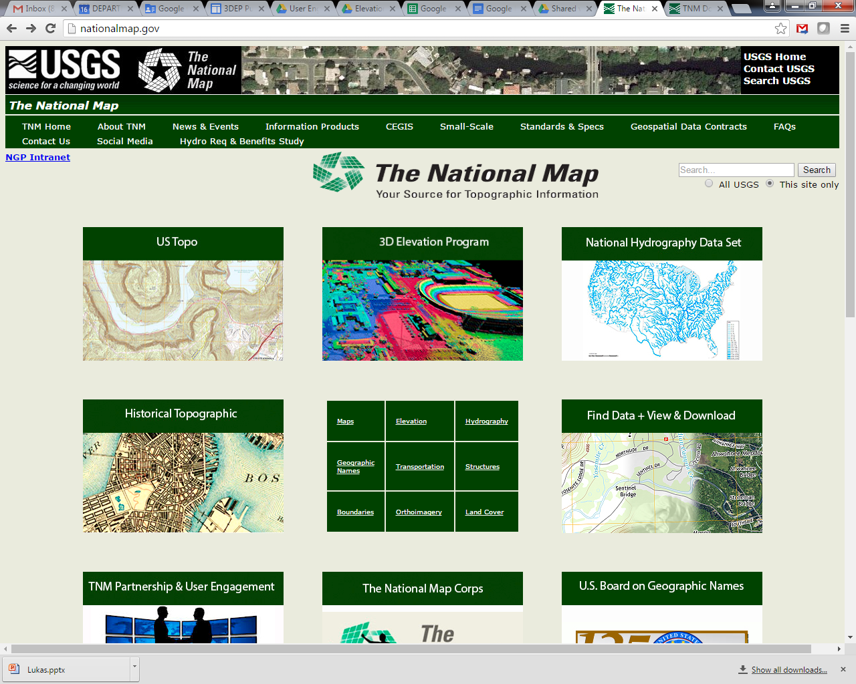

Slide 19
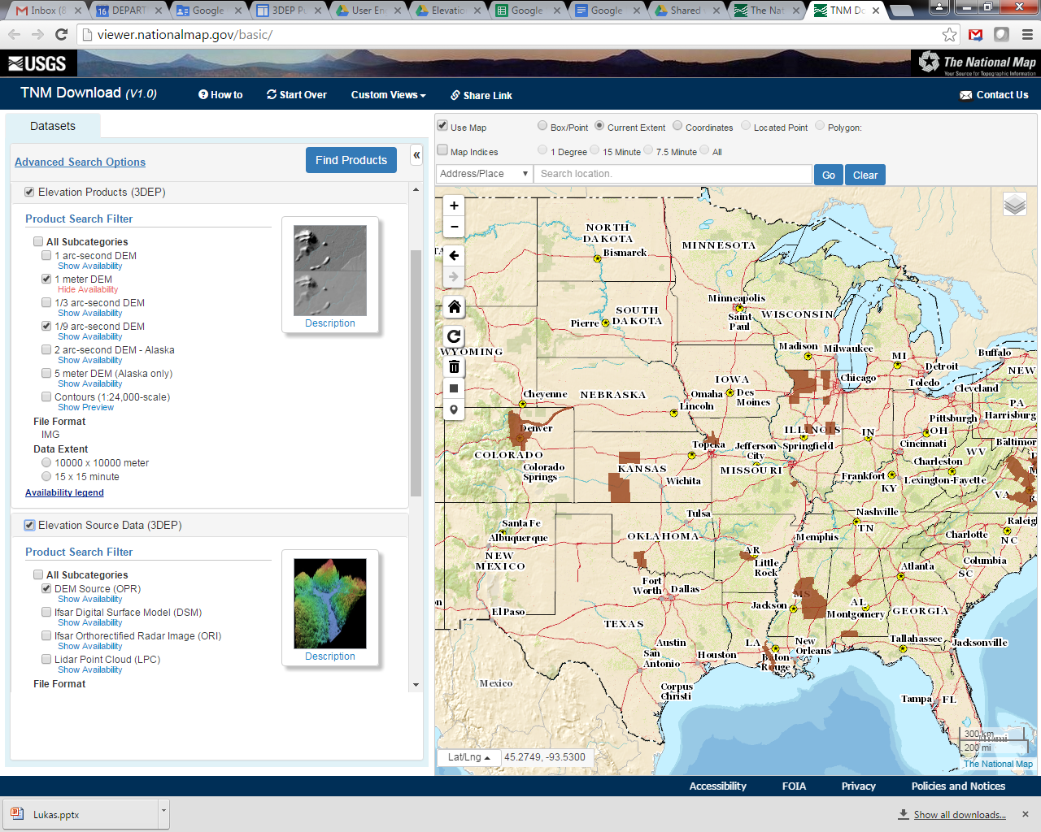

Slide 20
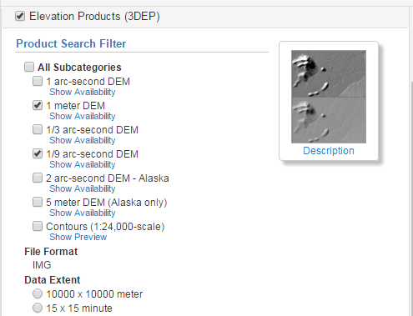
Elevation Products (3DEP)
Standard Dems
Project Based – 1-meter, 1/9 arc-second, 5-meter
Seamless - 1/3 arc-second, 1 arc-second, 2 arc-second

Slide 21
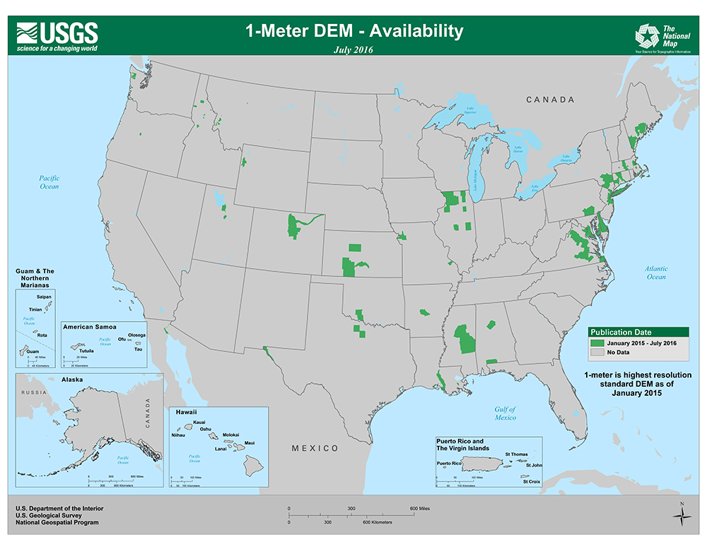

Slide 22
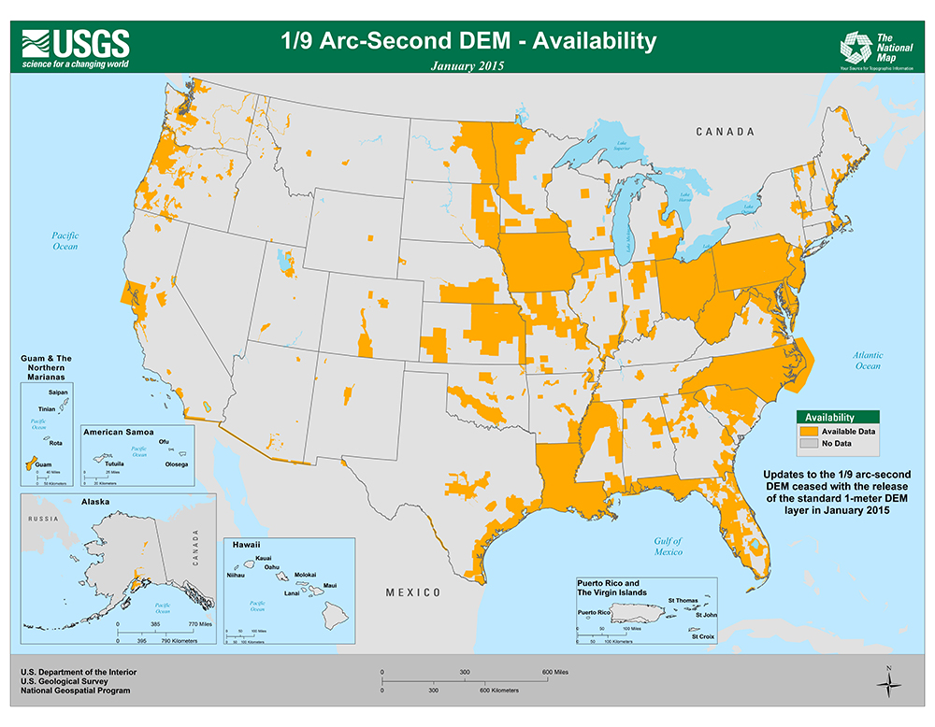

Slide 23
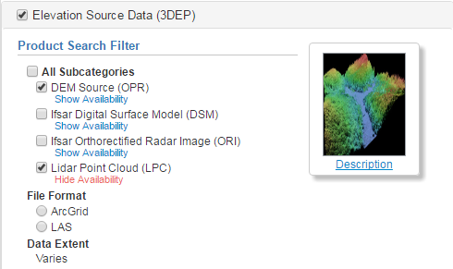
Elevation Source Data (3DEP)
Lidar point cloud
IfSAR Digital Surface Model (DSM) - Alaska
IfSAR Orthorectified Radar Intensity image (ORI) – Alaska
Source resolution DEMs

Slide 24
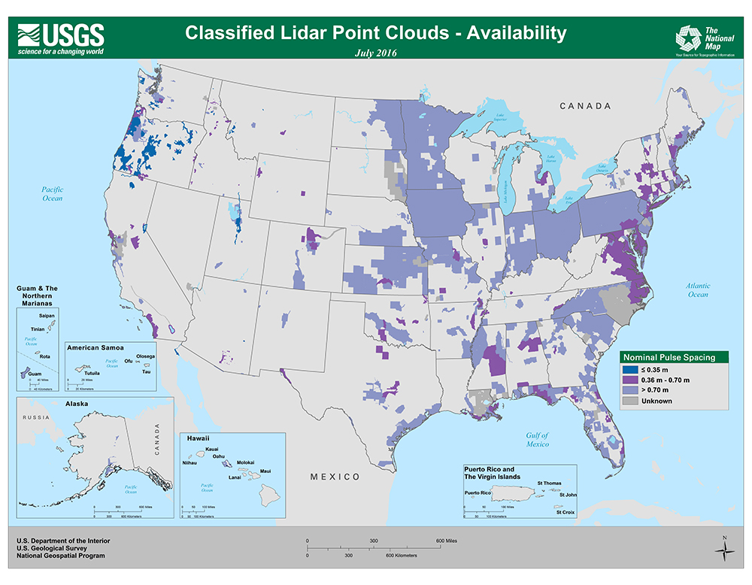

Slide 25
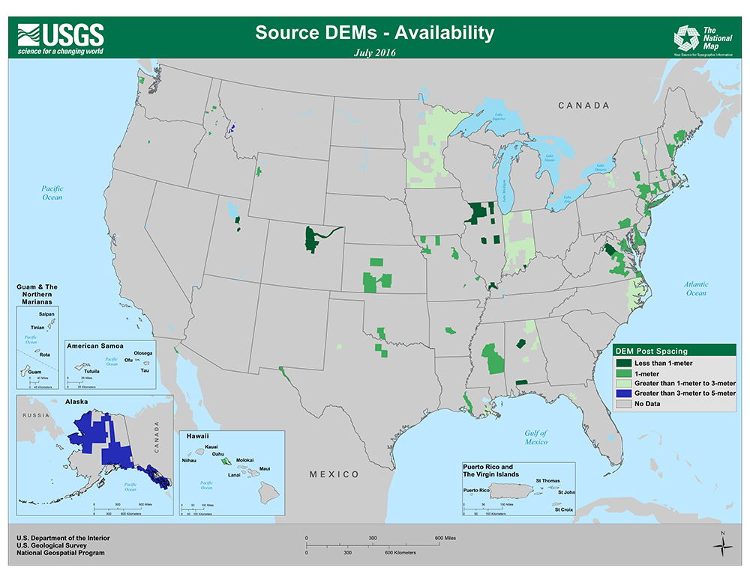

Slide 26
Thank you!

