Slide 1



State of the State Clearinghouses
Nathan Watermeier
State GIS Coordinator
Jeff Timm
IT Application Developer Sr.
Office of the CIO, State of Nebraska
2016 MAGIC GIS Clearinghouse Summit
August 23, 2016
Lawrence, Kansas

Slide 2
Topics
Geospatial / GIS Enterprise
Web Map Services with Geocortex
Managing LiDAR, Imagery, and other raster data with Apollo

Slide 3

DATA
It’s all about the Data

Slide 4
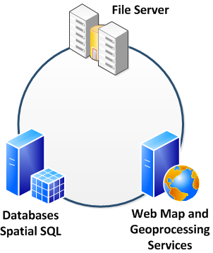
Geospatial / GIS Enterprise Platform
30+ TB
Redundant NAS and Backup
  Secure FTP
NebraskaMAP.gov
CKAN+Drupal (DKAN), Linux
APOLLO Cataloging
Maps and Apps
ArcGIS Server
APOLLO Data Portal and Imagine service processing
Geocortex Essentials
Custom - JavaScript, HTML5
  OCIO Cloud Services

Slide 5
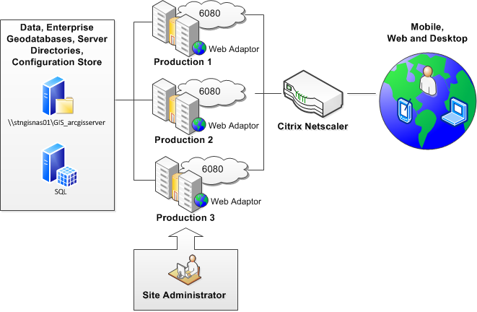
Redundancy and Performance

Slide 6
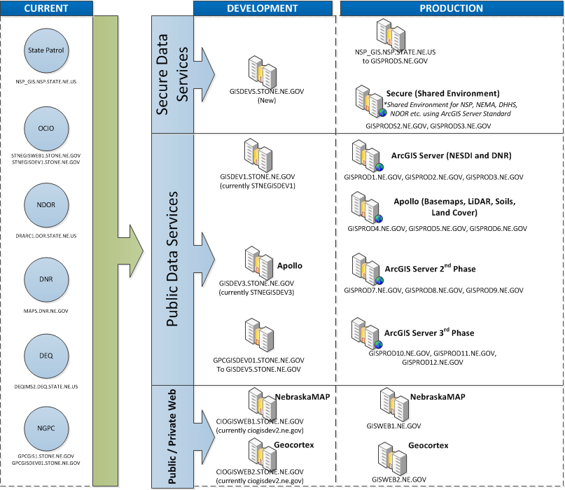

Slide 7
Monitoring and Performance Metrics

Slide 8
Monitoring and Performance Metrics

Slide 9
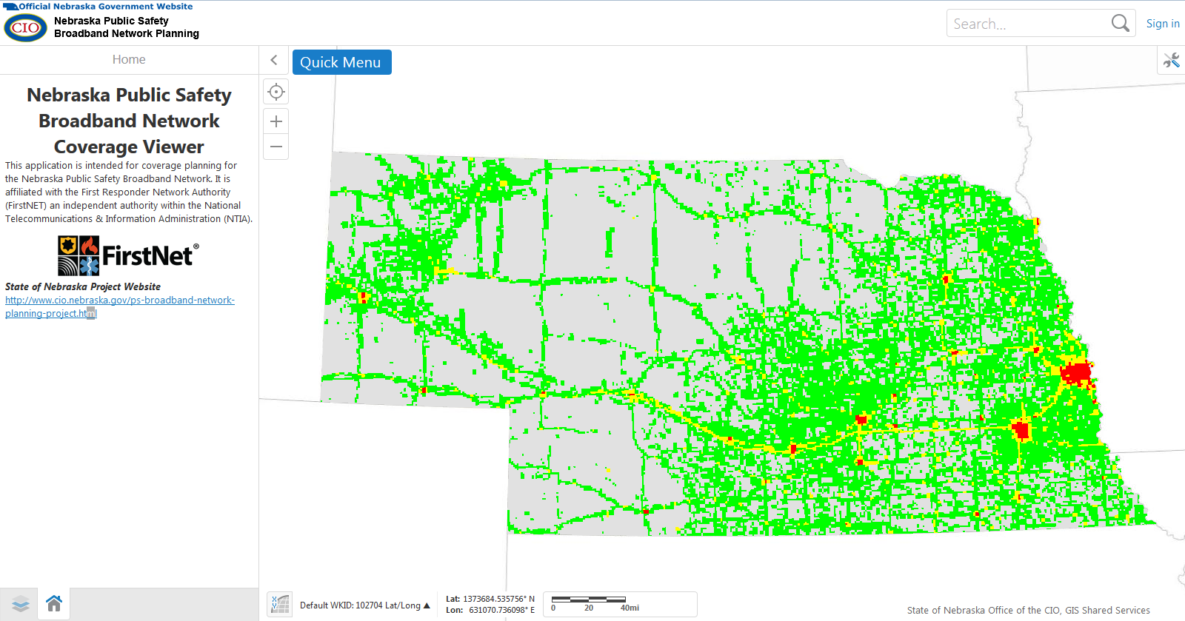
FirstNET Coverage Planning

Slide 10
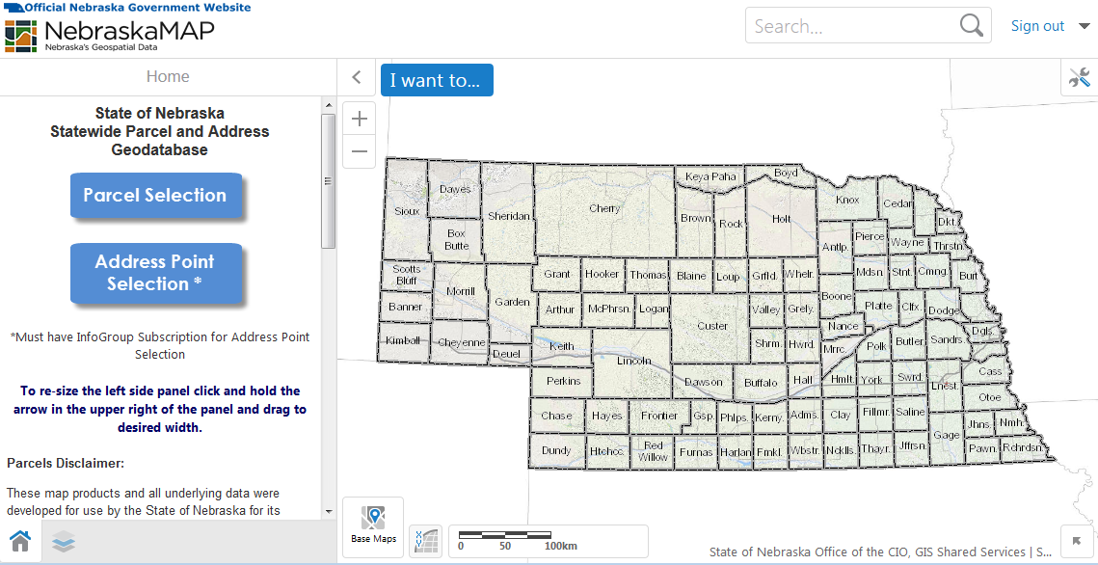
Parcel and Addresses

Slide 11
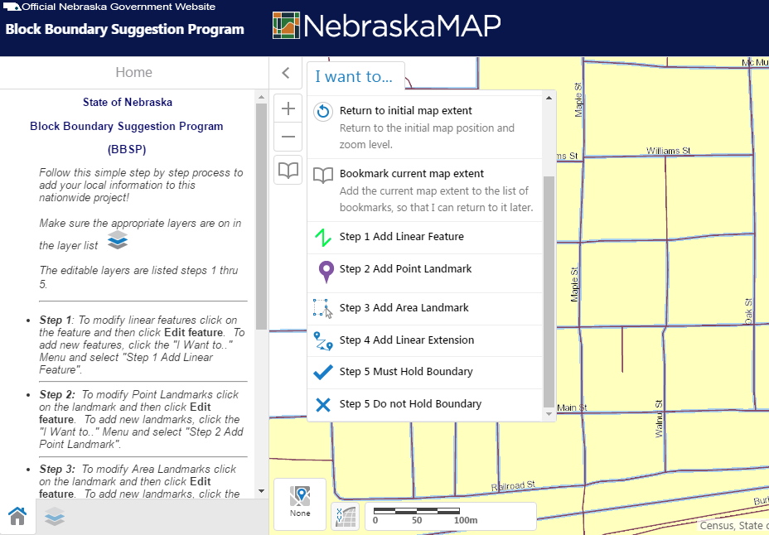
Census Block Boundary Suggestion Program

Slide 12
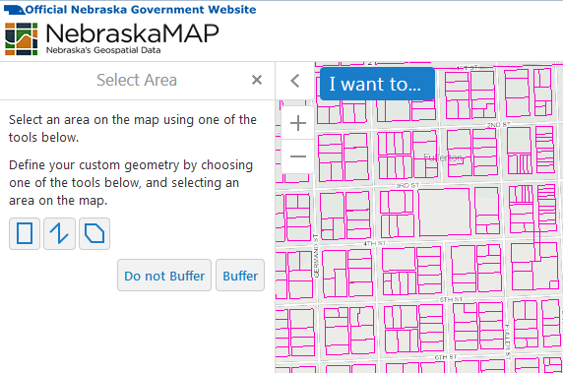
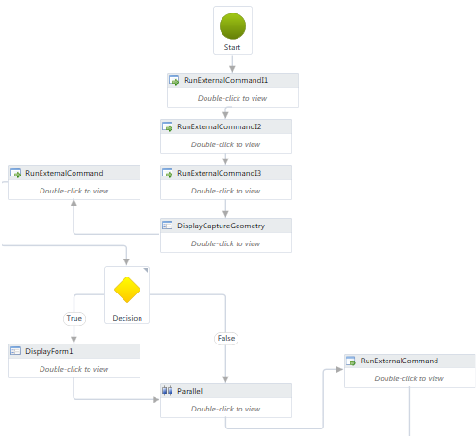
Workflows

Slide 13
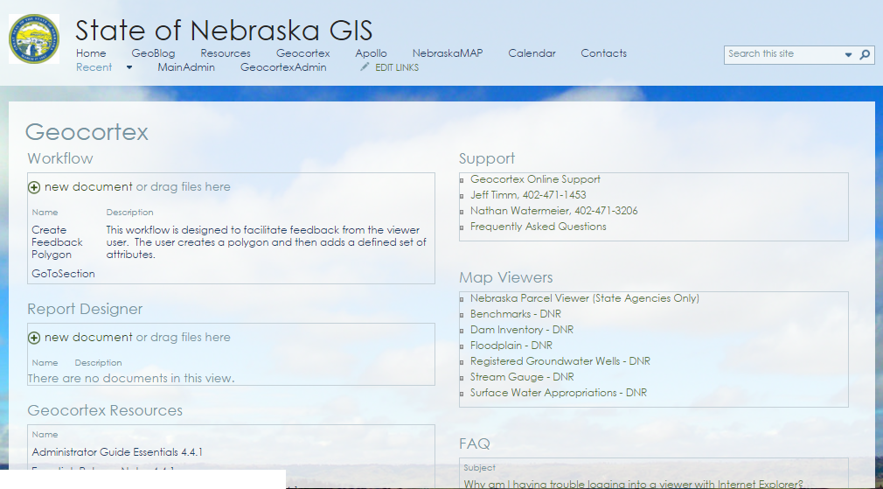
State of Nebraska Geocortex Users Group

Slide 14
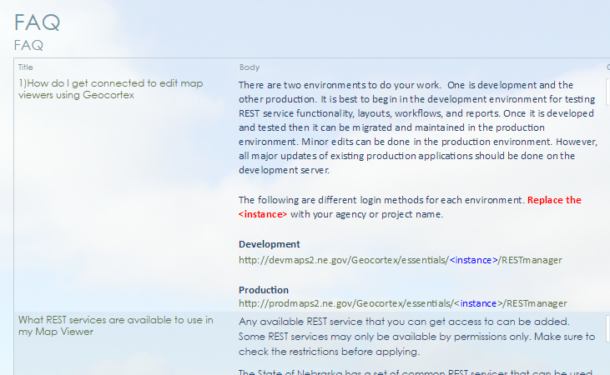
FAQs

Slide 15
Example Map Viewers
Parcel and Address Geodatabase
  Viewer Manager
Census Block Boundary Suggestion Program
  Viewer Manager
Planning Environmental Review
  Viewer Manager
Floodplain Management
  Viewer Manager
Sarpy County
  Viewer

Slide 16
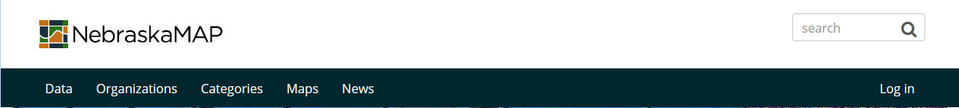
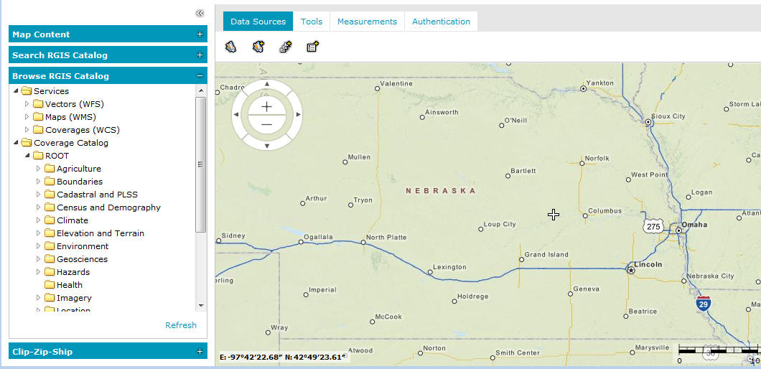

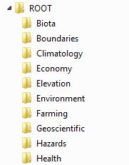
APOLLO – Big Data Analytics
Large Data Sets
Imagery
LiDAR
Soils
Parcels
Land Cover
Regional/Statewide Derivative Datasets

