Slide 1

The 2020 Census and
Geographic Partnership Opportunities
Craig Best
Jim Castagneri
U.S. Census Bureau

Slide 2
Two Areas of Discussion
Geographic Partnership Opportunities
2020 Census

Slide 3


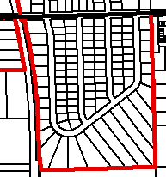



Geographic Partnership Opportunities The 2020 Census
Boundary and Annexation Survey
Geographic Support System
BQARP
Boundary Quality Assessment & Reconciliation Project
Local Update of Census Addresses
Participant Statistical Areas Program
Tools: GUPS, SWIM

Slide 4
Annual Boundary & Annexation Survey Legal Boundaries in Effect on January 1
Annual Survey to collect legal Boundaries in effect on January 1 of the BAS year
Boundaries are used to tabulate data for
Decennial Census (year ending in 0)
Economic Censuses (years ending in 2, 7)
Population Estimates Program (annually)
American Community Survey (annually)
Survey sent starting in December, Materials available
(BAS 2017 survey sent in December 2016)
4

Slide 5

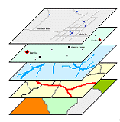

Boundary & Annexation Survey
Deadlines & Participation Options
Deadlines:
March 1 of Survey Year: updates reflected in American Community Survey (ACS) and Population Estimates Program (PEP)
May 31 of Survey Year: updates reflected in the following year’s BAS
Participation Options:
GUPS (Geographic Update Partnership Software )
Digital (Commercial GIS)
Paper Maps
5

Slide 6
Boundary & Annexation Survey Coordination with Redistricting
As part of 2020 Redistricting Data Program, State RDP
Liaisons may submit boundary updates in Phase 1 (BBSP)
& Phase 2 (VTD) new for 2020
Census BAS staff coordinates any RDP-submitted updates with local BAS official for the jurisdiction
More info on 2020 Redistricting Data Program:
https://www.census.gov/rdo/

Slide 7
BAS Consolidation by the State or a County Government
State-Level BAS consolidation:
Appropriate where state law dictates that all governments within the state must provide legal changes to a state office
County-Level BAS Consolidation:
County responds to BAS for governments within the county (entities must agree)
Consolidation can eliminate duplication of effort, save $$, ensure boundary changes are being reported, contributes to the NSDI
(Census Bureau is boundary steward under OMB Circular A-16)
Good Opportunity to Update Boundaries before LUCA!
7

Slide 8
Boundary Validation Program January 2020
Highest Elected Officials and Tribal Chairs provided maps of jurisdictional boundaries for review and update
Boundaries as of January 1, 2020 that will be used for 2020 Census data tabulation
8

Slide 9
Geographic Support System GSS: Opportunity to submit addresses and spatial data to Census Bureau on a continual basis
Goal: Add new addresses to the Master Address File (MAF), new streets to TIGER, and resolve address and spatial inconsistencies
Must meet minimum Address Guidelines
After acquiring partner data, Census performs content verification to determine usability
Crosswalk, standardize, match, and geocode partner addresses and structure points using Master Address File
Match street centerline data to ID differences, calculate spatial accuracy (CE95 method) of partner data using GPS control points
Data Content Guidelines
9

Slide 10
10

Slide 11
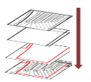
Boundary Quality Assessment and Reconciliation Project BQARP
Goal: Improve legal and administrative spatial boundary
quality in MAF/TIGER System
Compare locally sourced data (we acquire whole data sets,
not transaction polygons) to adjust Census boundaries
Align to parcel and PLSS boundaries, where applicable
Coordinate efforts with State partners
Lock boundaries in place to prevent changes without
legal documentation
Independent of BAS
BQARP Map Example 1
BQARP Map Example 2

Slide 12
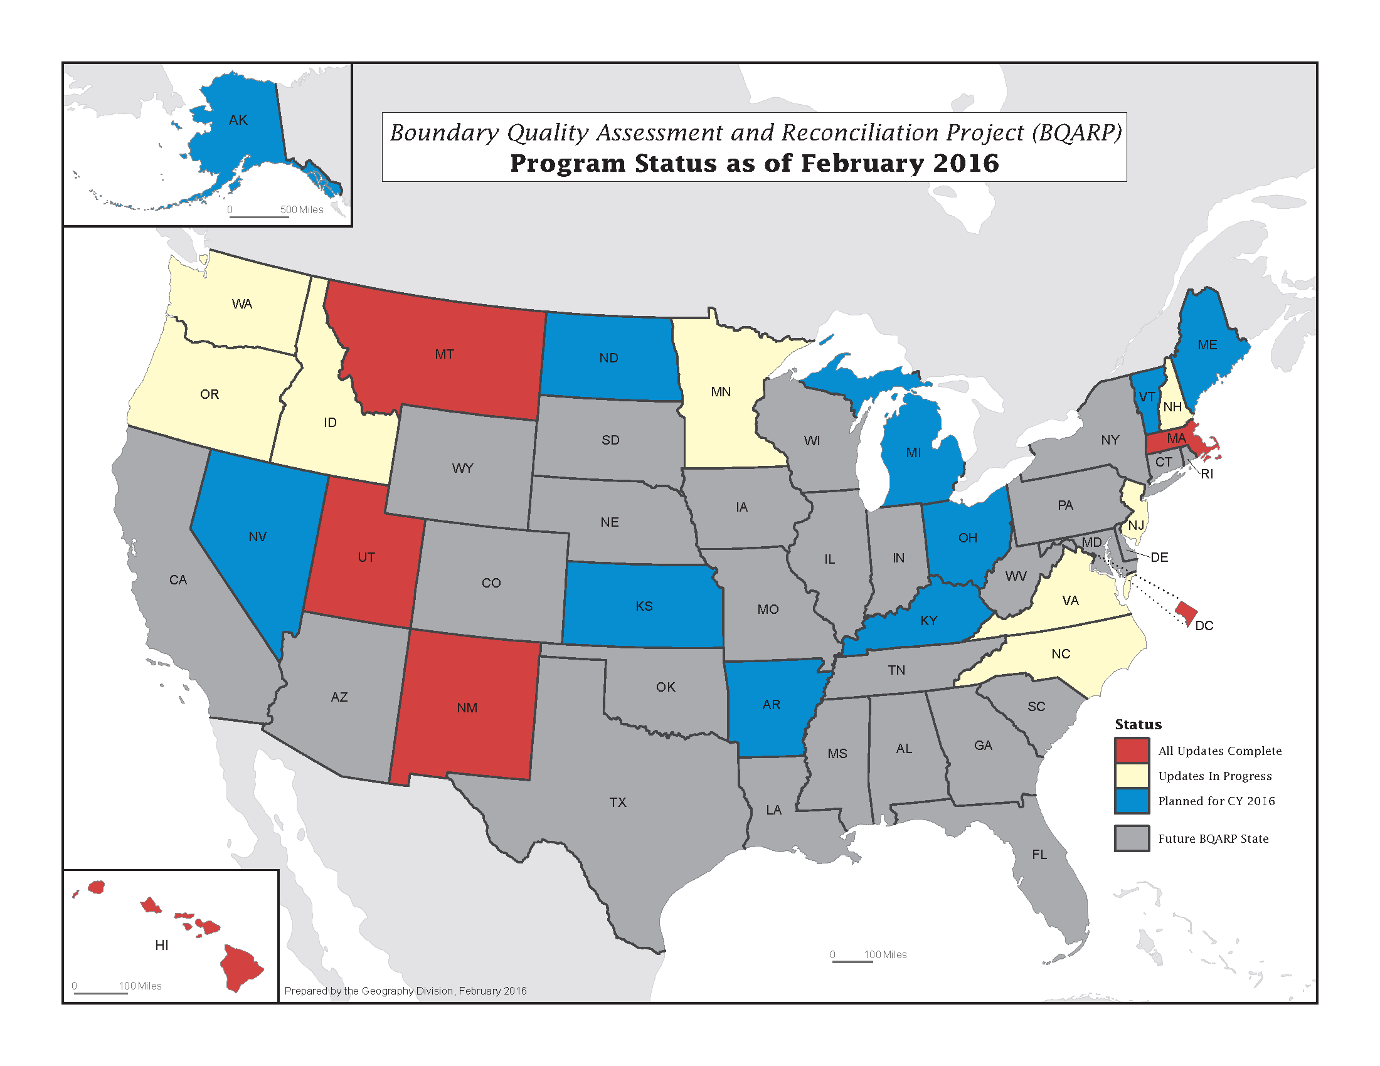
12

Slide 13
2020 Local Update of Census Addresses Program A once-a-decade-opportunity for designated representatives to review the addresses that will be used to conduct the Decennial Census
Single, Simplified Option:
Title 13, Full Address List Review
Reduce the number of deleted LUCA records in field verification activities
Reduce the burden and the complexity of LUCA
Continuous feedback throughout the decade through the GSS program
No Boundary & Annexation Survey as LUCA component for 2020

Slide 14
2020 LUCA Program New for 2020
Include census structure coordinates in the census address list and allow partners to return their structure coordinates as part of their submission
Provide ungeocoded (no geographic coordinates) U.S. Postal Service Delivery Sequence File addresses to State and County partners
Provide address list in more standard formats (.xlsx & .csv)
We’ll provide address counts in early 2017 and a public geocoding tool so you can geocode your address list to assess whether you’d like to participate

Slide 15

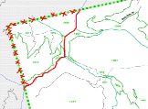
2020 LUCA Program Participation Options & Schedule
Participation Options:
Tentative Schedule:
Program invitation: July 2017
Materials Available for Review: February 2018
LUCA Feedback Provided: August 2019
LUCA Appeals: October 2019
GUPS (Geographic Update Partnership Software )
Digital (Commercial GIS/Spreadsheet/Database software)
Paper Address List and Maps
(Available only to governments with < 6000 addresses)
Background imagery on paper maps?

Slide 16
2020 Participant Statistical Areas Program Opportunity for designated representatives to review and update statistical geographies for 2020 Census data tabulation
Possible renaming of program
Enables coordinating agencies to review, identify, propose changes and delineate new census tracts, block groups, census designated places (CDPs), and census county divisions (CCDs).
TSAP folded into PSAP: ONE program on one schedule
2 Phases: Delineation (120-day review)
Verification
Standard & Tribal Stat Areas

Slide 17
2020 PSAP “Plan” New for 2020
Census Bureau intends to create a 2020 statistical areas “plan” for both the standard and tribal statistical geographies, which our partners can review and update
Lessens burden on our partners
Ensures that ALL statistical geographies are reviewed/updated consistently
More extensive review than just criteria thresholds
Partners can update the 2020 “plan” OR
they have option to update from 2010 statistical
geography base
GOAL: Clean, Consistent Statistical Geography Nationwide

Slide 18



2020 PSAP Participation Options & Schedule
GUPS
Geographic Update Partnership Software
Tentative Schedule:
Program invitation: Spring 2017
Materials Available: Winter 2018
PSAP Verification: Fall/Winter 2019
Standard Statistical Geographies:
Tribal Statistical Geographies:
GUPS
or
Paper Maps
18

Slide 19
Census Bureau Geographic Partnership Tools GUPS: Geographic Update Partnership Software
Self-contained GIS software package that allows partners with or without GIS software to digitally participate in Census geographic programs, including address updates
Replaces the MAF/TIGER Partnership Software (MTPS)
Includes built-in tools and verification checks to ensure your data output adheres to program criteria and is formatted correctly so it can be accepted and processed by Census
Supports all Geographic Partnership Programs:
RDP Redistricting Data Program
LUCA Local Update of Census Addresses
PSAP Participant Statistical Areas Program
SDRP School District Review Program
BAS Boundary & Annexation Survey
PUMA Public Use Microdata Areas
TAZ/TAD Traffic Analysis Zones/Traffic
Analysis Districts
CQR Count Question Resolution

Slide 20
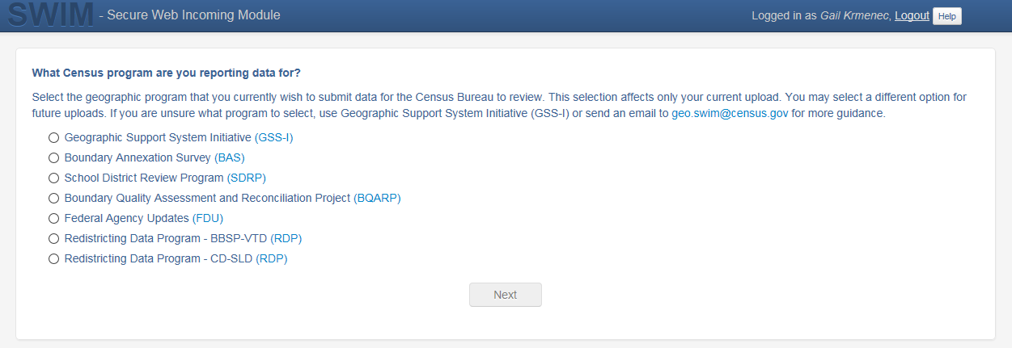
SWIM: Secure Web Incoming Module
Official web portal for uploading partnership materials to the Census Bureau
https://respond.census.gov/swim/
User

Slide 21












The 2020 Census
Key Geographic Partnership Activities
BAS 2016 deadline to be included in ACS, PEP - March 1
BAS 2016 deadline for updates to be included in next year’s BAS - April 31:
BAS 2017 - annual invitation to update legal boundaries - December
LUCA Advance Notice sent to Highest Elected Officials – January
BAS 2017 deadline to be included in ACS, PEP - March 1
BAS 2017 deadline for updates to be included in next year’s BAS - April 31:
LUCA Invitation to review Master Address File –July 2017
BAS 2018 – annual invitation to update legal boundaries - December
LUCA materials available for review- February (120 days)
PSAP materials available for review -December 120 days
BAS schedule repeated as above
LUCA Feedback provided to participants - August
LUCA Appeals Process - October
PSAP Verification materials available for review- Fall/Winter
BAS schedule repeated as above
Boundary Validation Program maps sent to HEO/Tribal Chair -January
Census Day – April 1, 2020
Apportionment Counts to the President- by December 31, 2020
BAS schedule repeated as above
Redistricting Counts to the State- by March 31, 2021
BAS schedule repeated as above

Slide 22
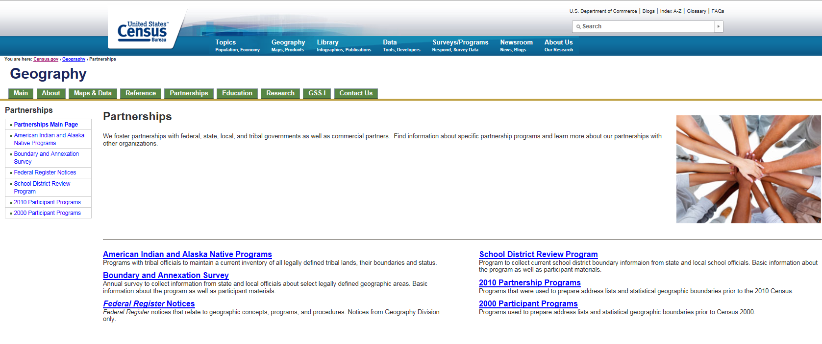
Visit Our Census Geographic Partnerships Page
http://www.census.gov/geo/partnerships/index.html

Slide 23
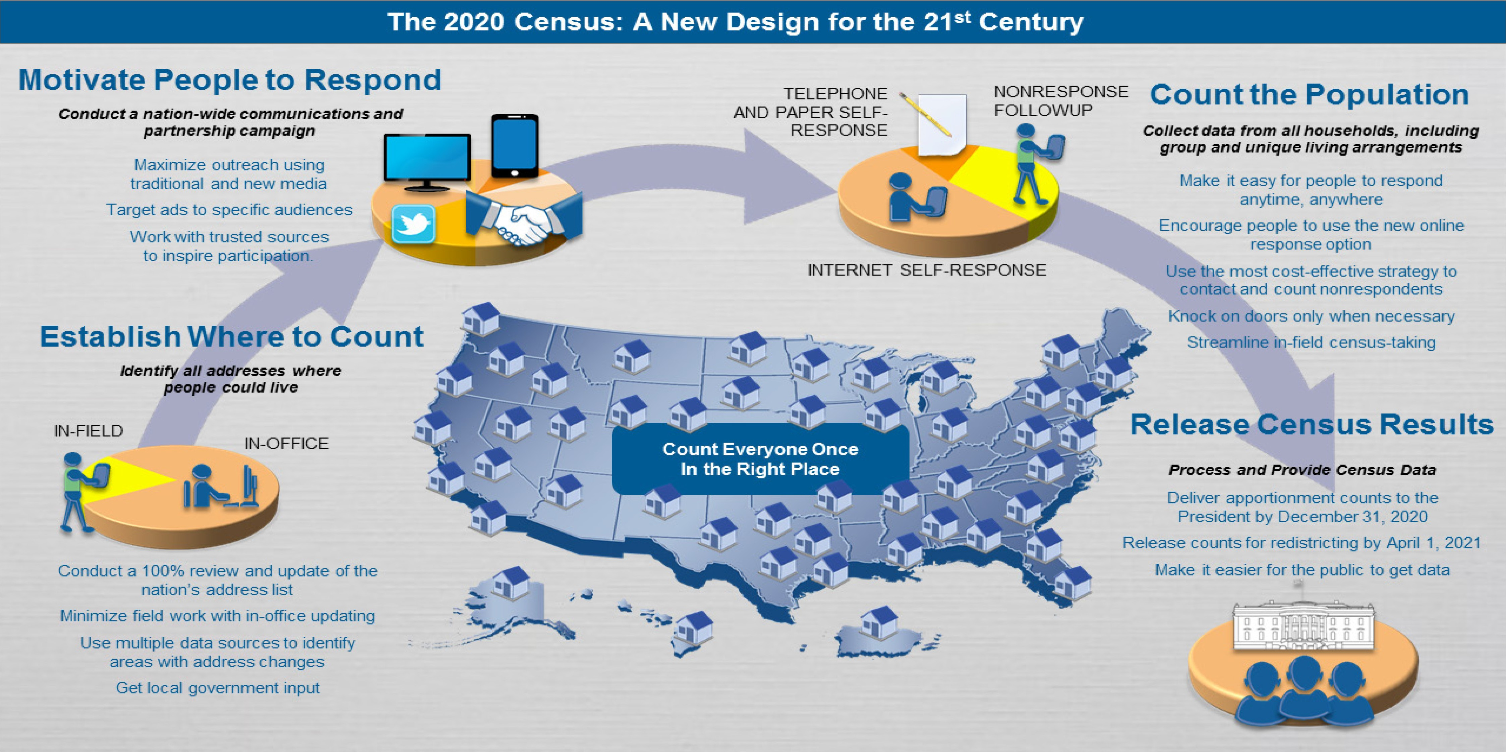
The 2020 Census
A New Design for the 21st Century
23

Slide 24

2020 Activities
Area Census Office (ACO) Delineation
Defining office boundaries and office locations
About half as many offices as in 2010
2016 Address Canvassing Test in St. Louis, MO and Buncombe County, NC
Test new in-office and in-field address canvassing methods.
Analyze the use of a listing and mapping application on a mobile device during in-field address canvassing.
Test updates to the MAF/TIGER system with address and spatial data.
Study reengineered methods for quality assurance.
2018 End-to-End Test in Pierce County, WA;Providence County, RI;Bluefield-Beckley-Oak Hill, WV
To test and validate 2020 Census operations, procedures, systems and field infrastructure to ensure proper integration and conformance with functional and non-functional requirements.
To produce a prototype of geographic and data products.
To validate the 2020 Census design and cost estimate.

Slide 25
Craig.Duane.Best@census.gov
816-304-7342
Thank you
Questions?
James.D.Castagneri@census.gov
720-962-3882

