Slide 1

Iowa
State Project Presentations
2016 MAGIC GIS Clearinghouse Summit
August 23 & 24
Lawrence, KS

Slide 2
Iowa DNR Initiatives
What LiDAR has done for us
First products were all elevation products
DEMs
Contours
Hillshade
Slopes
Now working on derivatives of these dirivitives

Slide 3
Floodplain Mapping Workflow Stages:
Stage One:
Initial Mapping Complete
Hydrology and Hydraulics Done
Redelineations Incorporated (if any)
Stage Two:
Draft FPM Products Delivered
(Public Official Ready)
Phone Kick-off Meeting with officials/stakeholders
Deliver data on www.Iowafloodmaps.org website
Stage Three:
Incorporate Changes to FPM Products
(Public Ready After Complete)
Incorporate new development since LiDAR
Stage Four:
DFIRM
Basemap preparation (roads, panels, general structures, subbasins) – IFC GIS Staff
New Studies Incorporated (if any)
FPM Manual Cleanup/Review
DFHP Meeting with officials/stakeholders
Distribute Products (Shapefiles, Depth Grids, Models, CSLF) to stakeholders
Elicit Feedback from officials/stakeholders
Incorporate new information from community
Review to assess impact of new information
Follow up with officials regarding results
Incorporate changes into other products (Depth Grids, CSLF)
Preliminary Map Preparation before preliminary submittal to FEMA – DNR Subcontractor
Meetings (Engineering Review/CCO) – DNR/FEMA/Sub
Post Preliminary Map Production – DNR Sub
Incorporate last minute changes
Letter of Final Determination – DNR/FEMA/Sub
COMPLETE!!!
Incorporate changes into FPM/Hydraulic Submittals if warranted

Slide 4
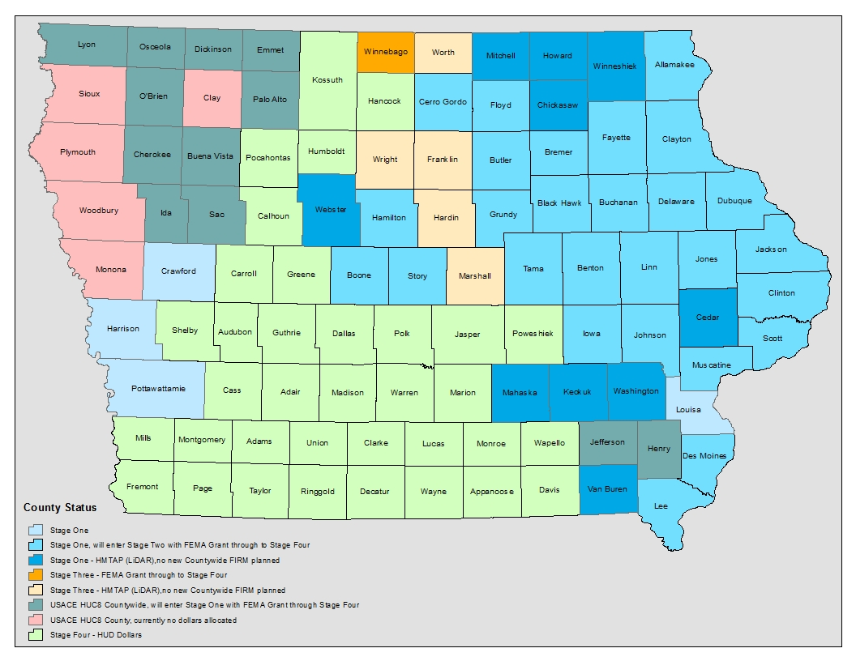
Stages of County FPM Development Protocol: to reach Stage 3 and become “public ready” data must be presented to public officials/stakeholders in order to garner feedback and ensure agreement of findings. After incorporation of any new data we are more confident in sharing with the public. For those counties with no countywide FIRM planned we will still have meetings with officials in order to be able to release our information for others to use for research and mitigation efforts.

Slide 5
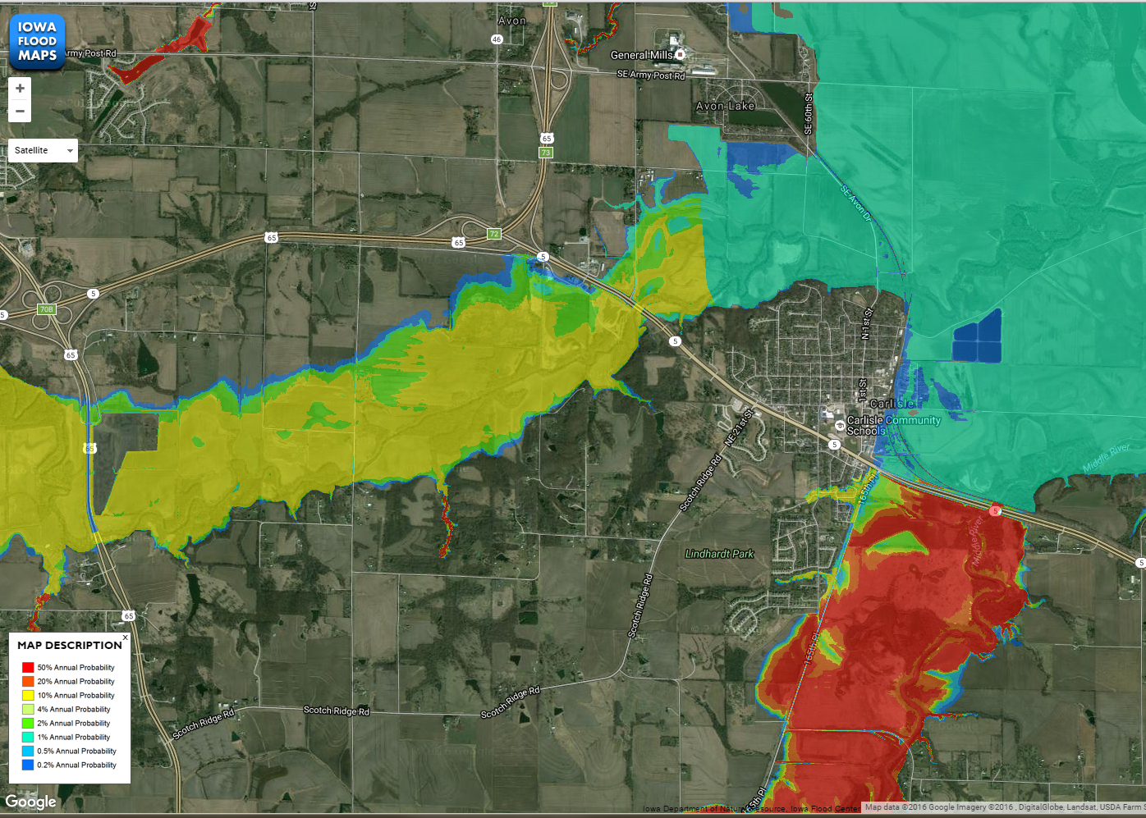
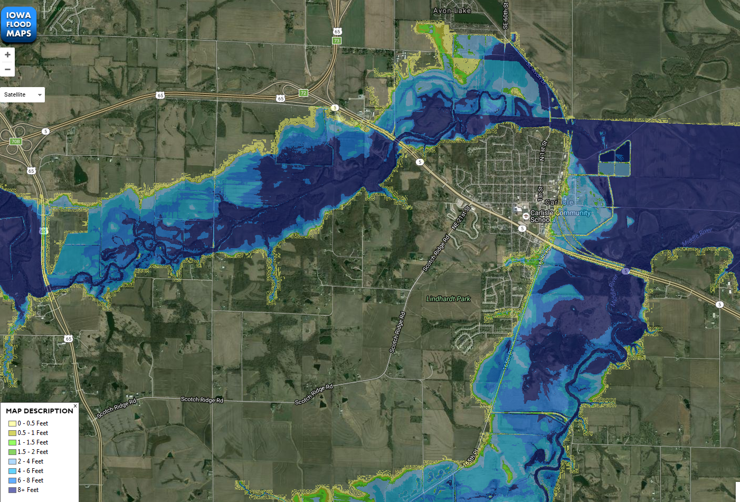
Flood Risk and Flood Depth

Slide 6
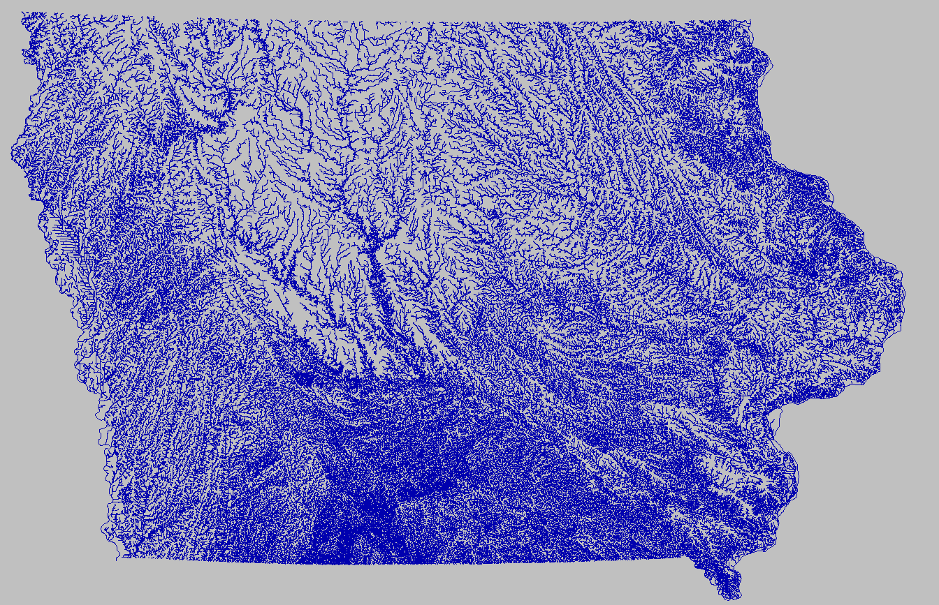
Stream Centerlines
Hydrologically Enforced Network
Integrating into the NHD through a conflation process
Edge of Water and Top of Bank
Stream Order

Slide 7



Iowa Geospatial Data Clearinghouse

Slide 8



Clarity in licensing
Open Data Commons
Database License (ODbL)
Public Domain Dedication and License (PDDL)

